Slide 1
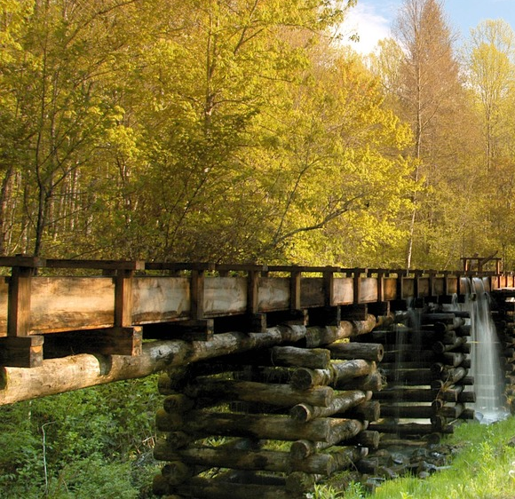
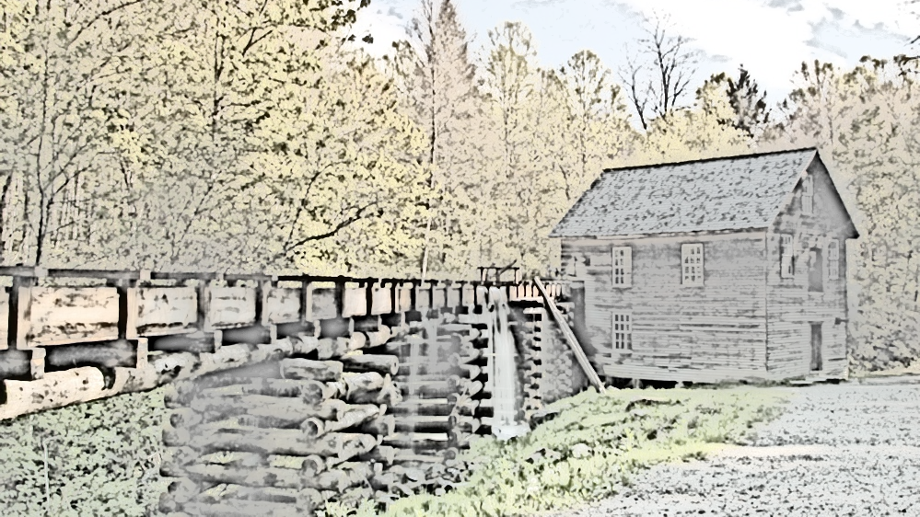
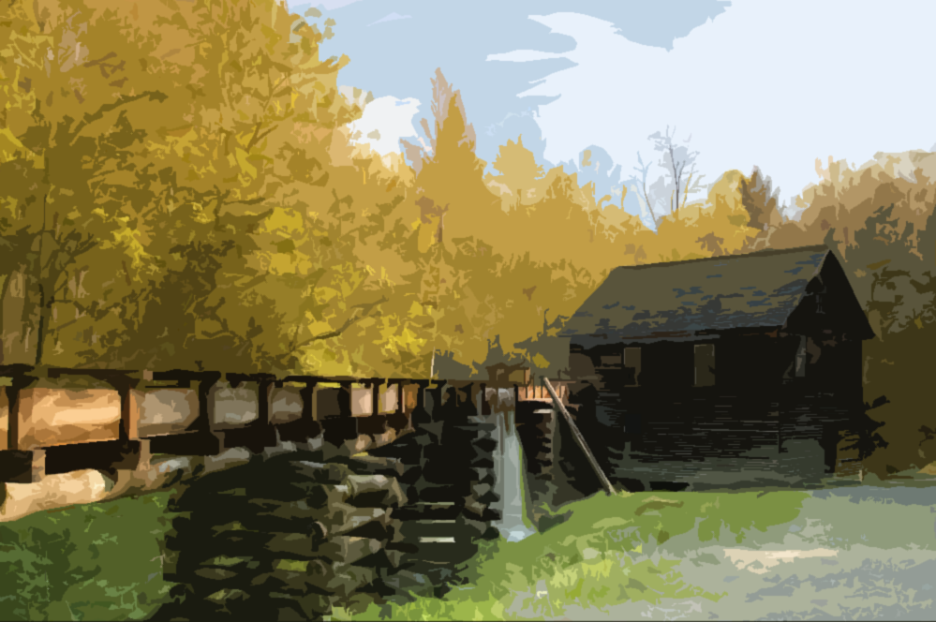
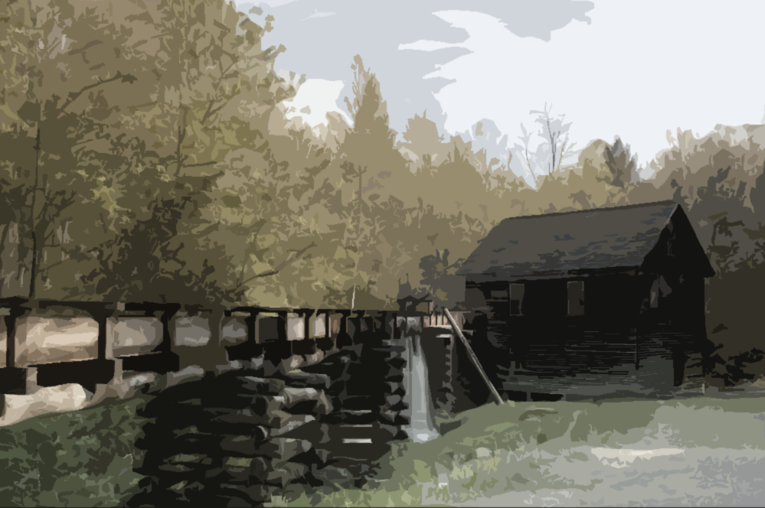


Trek Through Time
Journey through the Smokies’ past
Notes:
Photo of Mingus Mill in Great Smoky Mountain National Park by Robert Crootof, NPS usage.

Slide 2
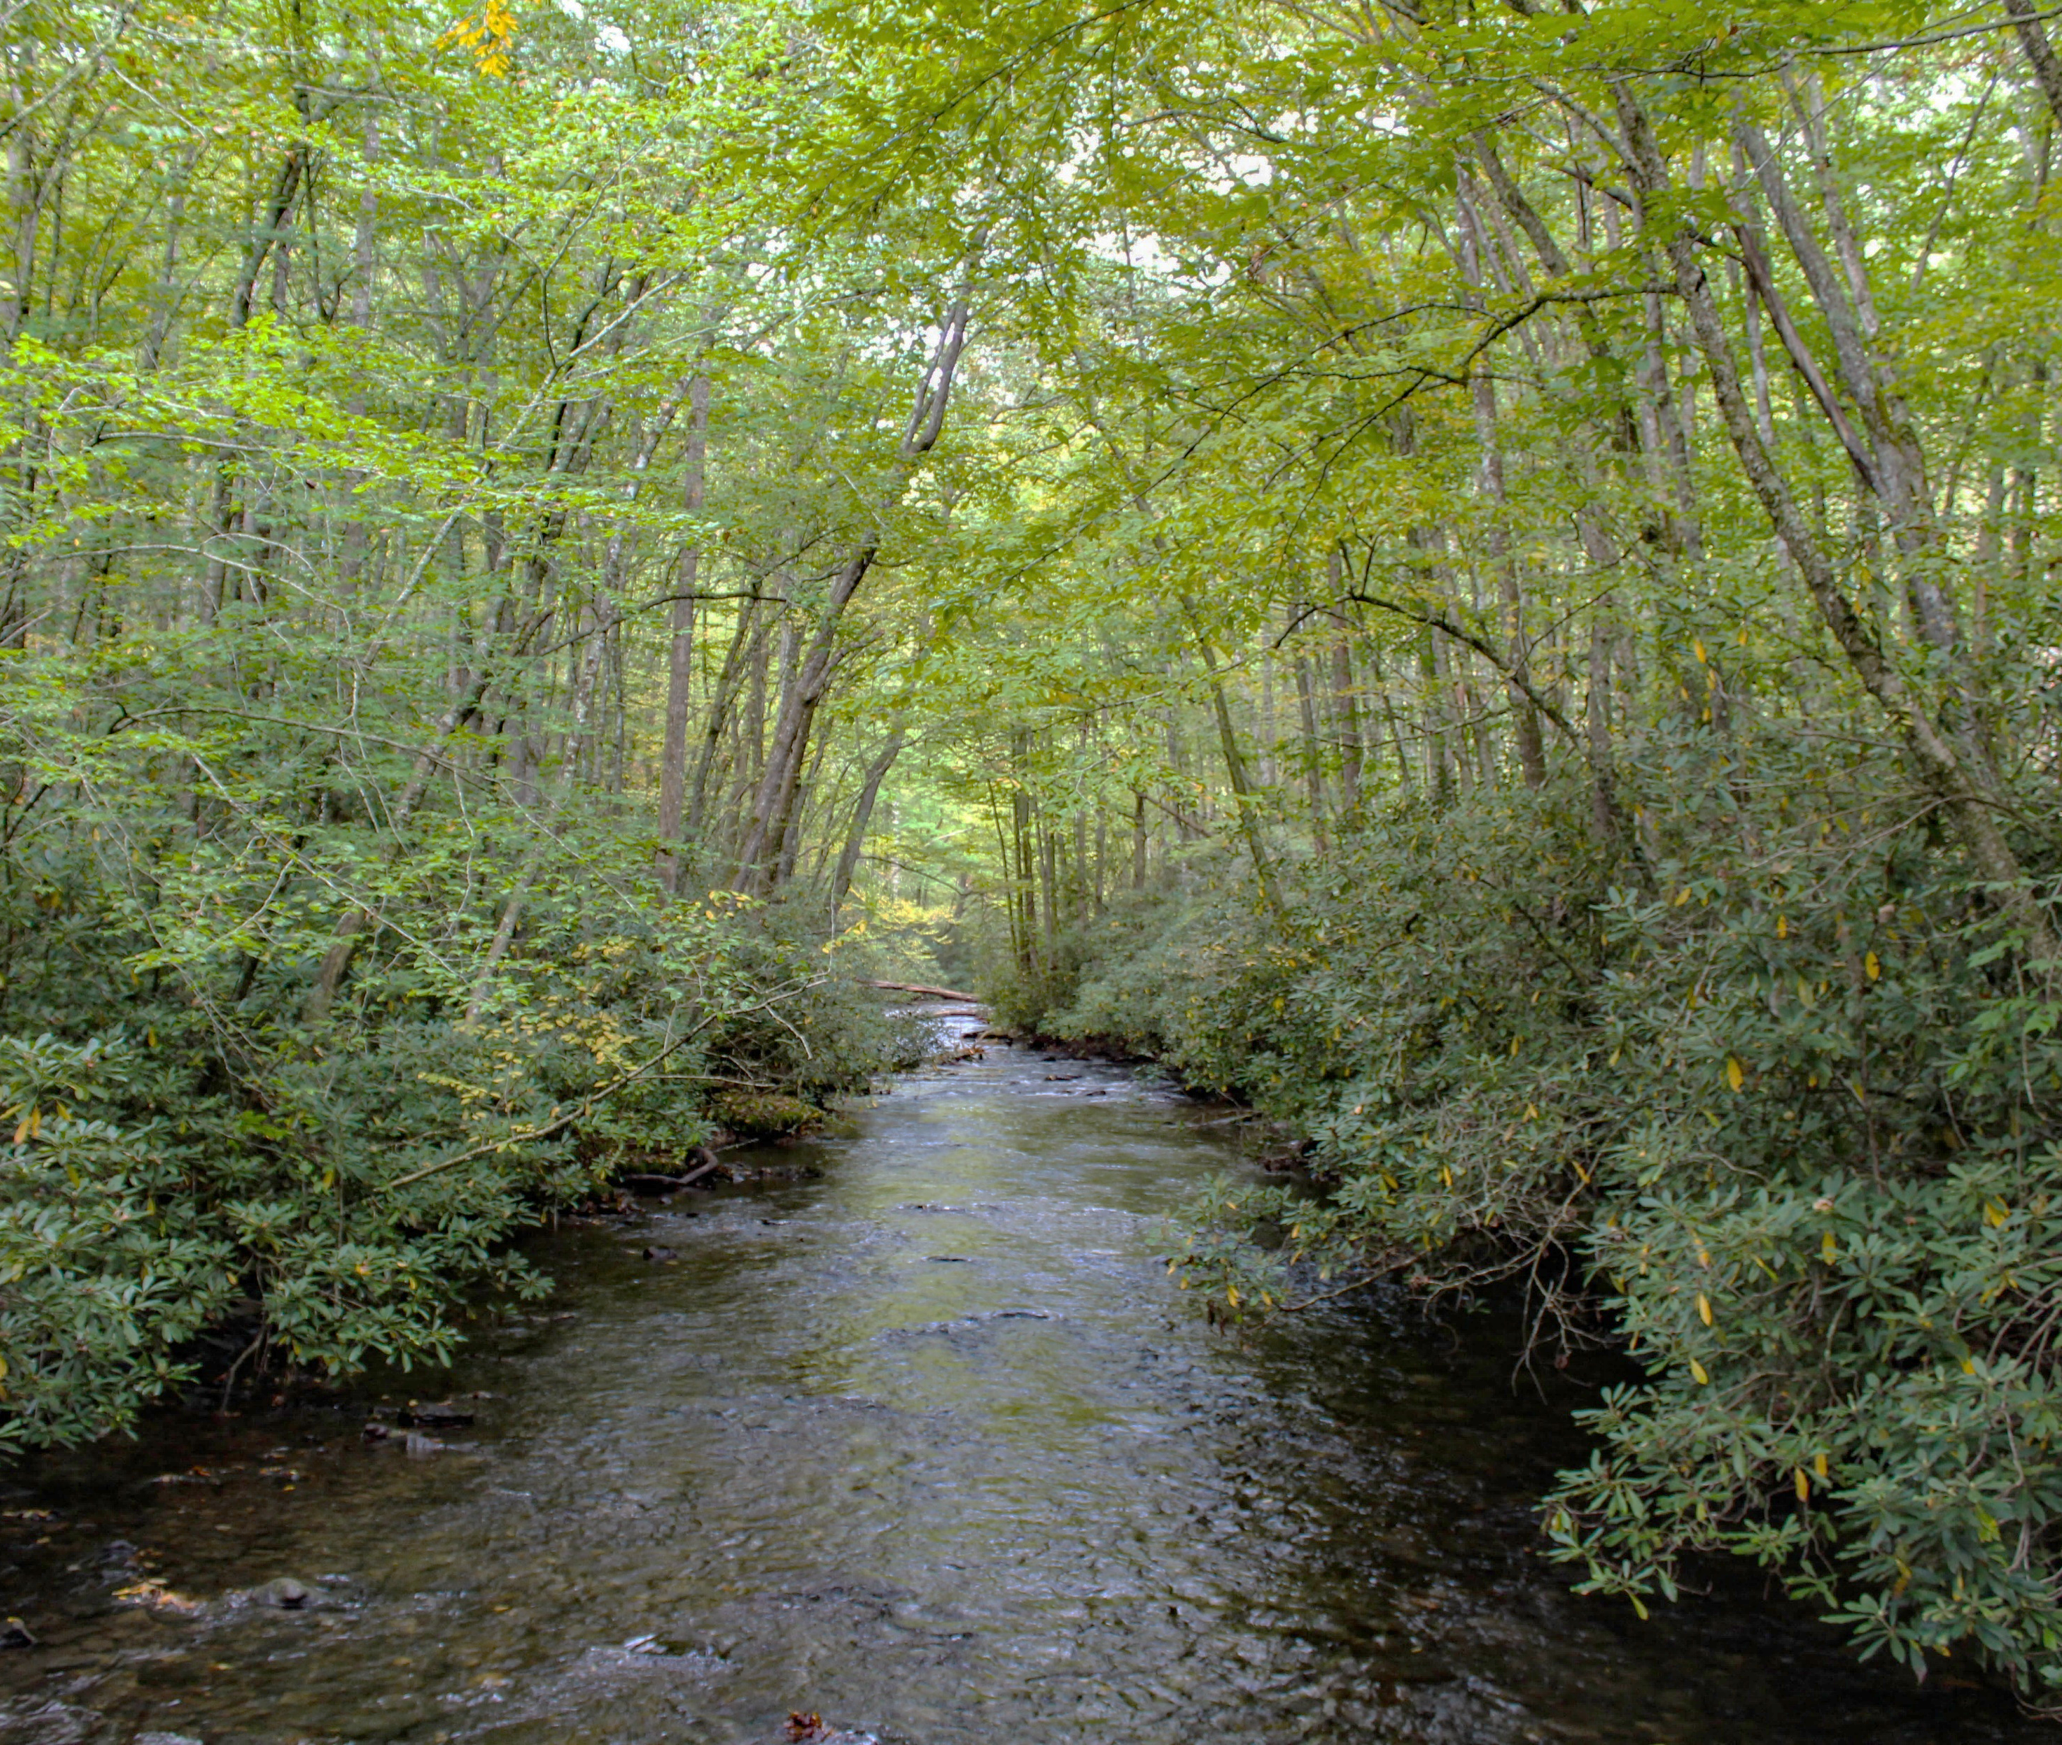
What do you think?
We don’t really know how long exactly, a recent archeological study in Cherokee suggested people have been here… (drumroll)
Let’s find out!
​
How long have people lived in the Great Smoky Mountains region?
Notes:
Pre-Activity Discussion:
How long have people lived in the Great Smoky Mountains Region?
(Answers will likely revolve around Columbus, European Settlement).
We know people have been here a LONG TIME, so let’s find out…

Slide 3
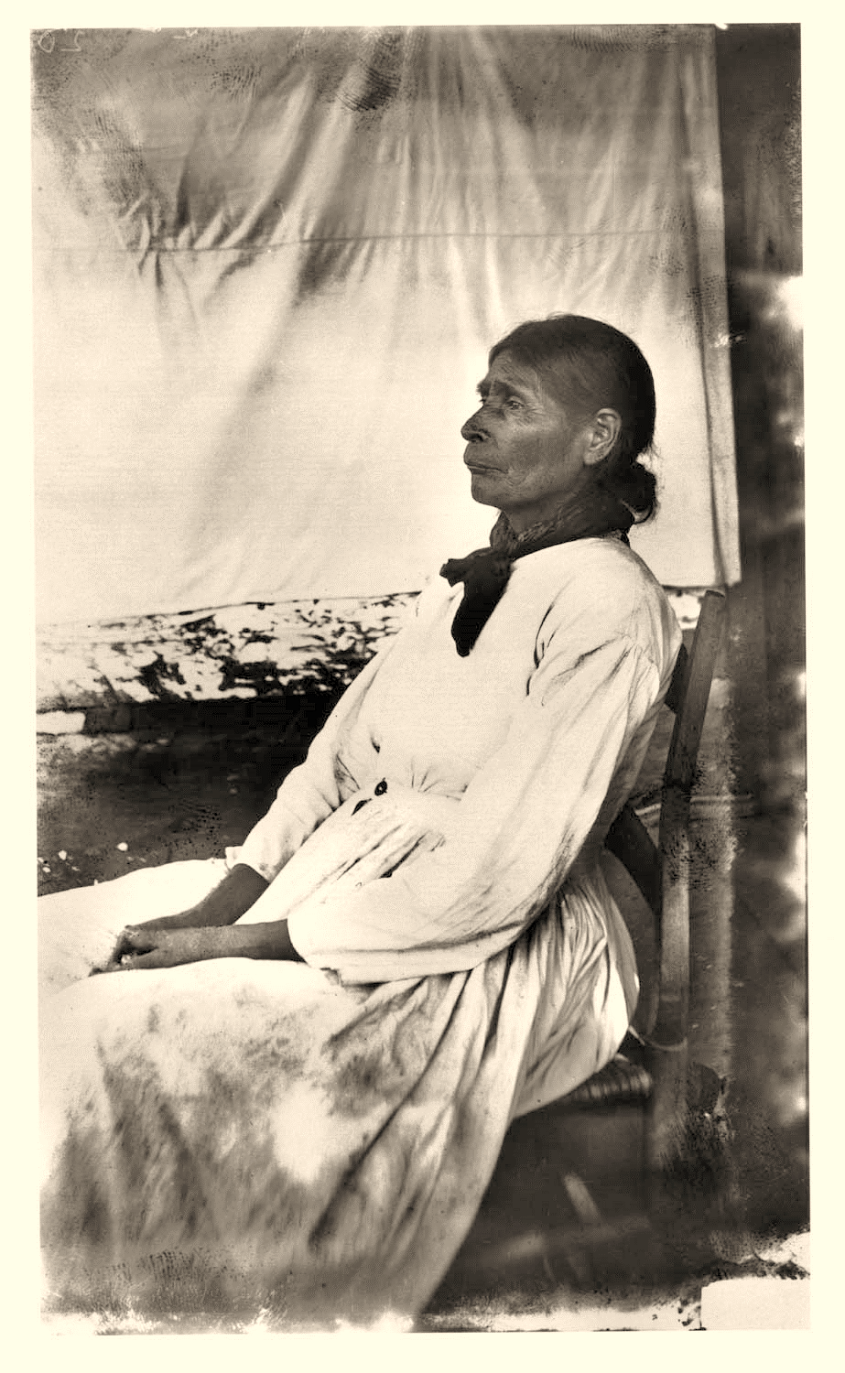
We’re going on…
A Trek through Time!
Notes:
To demonstrate how long people have been in the area and compare it with what we might have learned in our history classes, let’s go on “A Trek Through Time!”
We’re going to use this “timeline rope” activity to demonstrate how long people have been here, how Cherokee history relates to United States and World history, and how their history was impacted by technologies invented.
NPS Photo

Slide 4
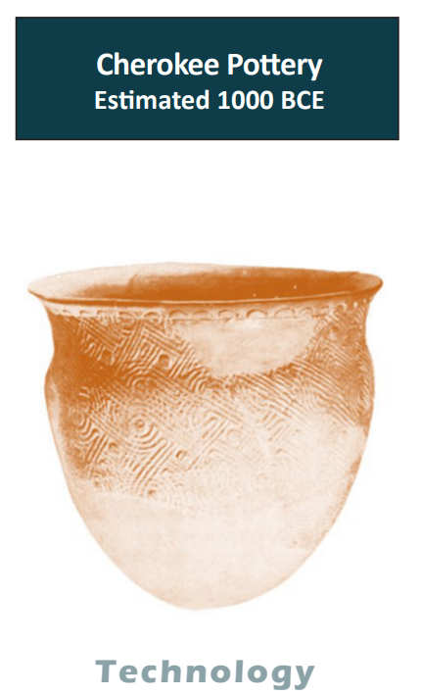

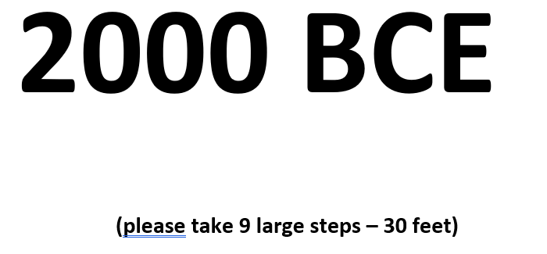
Trek Through Time Instructions:
  You will receive a card
  It might be an era or period of time.
  Discuss the terms CE and BCE
  It might be a technology
  It might be an event or person(s)
Notes:
Instructions
We’ll tie the knotted rope (with ten knots spaced about a foot apart) between two trees or other large objects.
We’ll then pass out the numerical “centuries” Eras/Years hang tags. Some are events, people, technologies, or periods of time.
Discuss what CE (Common Era) and BCE (before Common Era) mean.

Slide 5
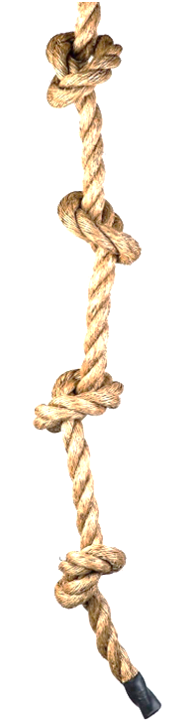




Trek Through Time Instructions:
  Line up by the date on your card.
  On the rope, we’ll put our dates in order for the last 1,000 years…
  Each Knot or Foot Represents 100 years!
Notes:
Students can then arrange themselves from most recent to most ancient according to their card.
Each student with a smaller “century” card from 1000 to 2000 should hang it at a knot on the rope, in order, going left to right.
It should begin at 1000 on the left, and end with 2000 on the right.

Slide 6
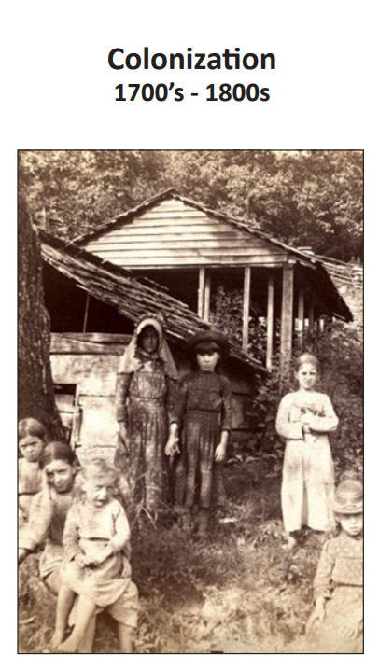


Trek Through Time Instructions:
  Once the rope is filled with dates, we’ll start adding the events and technology cards ONE AT A TIME.
  Raise your hand
  Read your card aloud
  Place it on the rope between the centuries most fitting
  Discuss your event or technology
Notes:
When the rope is filled with dates, we’ll add the events and technology cards one at a time.
After calling out each century (ex: 1700s) – each student with an event card that corresponds to the date range should raise their hand, read their card aloud, and place it on the rope where they think the date would fall in time.
Ex: if the card is “1863” it would go between 1800 and 1900.
Students whose time periods fall before the time of the rope will wait. (Pre-1000)

Slide 7
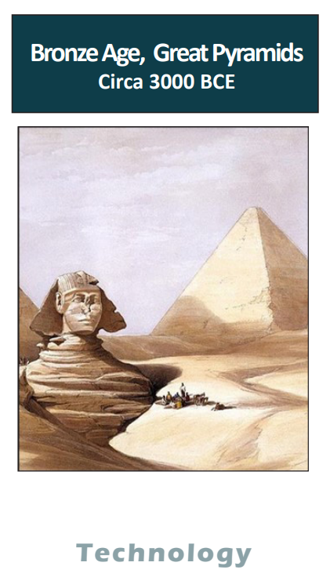
Trek Through Time Instructions:
  You will notice that the timeline is not long enough to show events before 1000 CE.
  If your card is before the year 1000 or before Common Era (BCE), you must trek through time!
Notes:
Once the rope is filled (from 1,000 – 2,000 CE), there will be students with remaining cards that pre-date this time period.
We will now “Trek Through Time” going backwards.

Slide 8
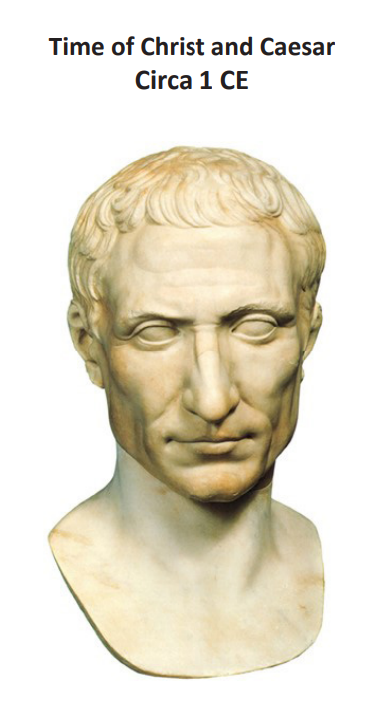
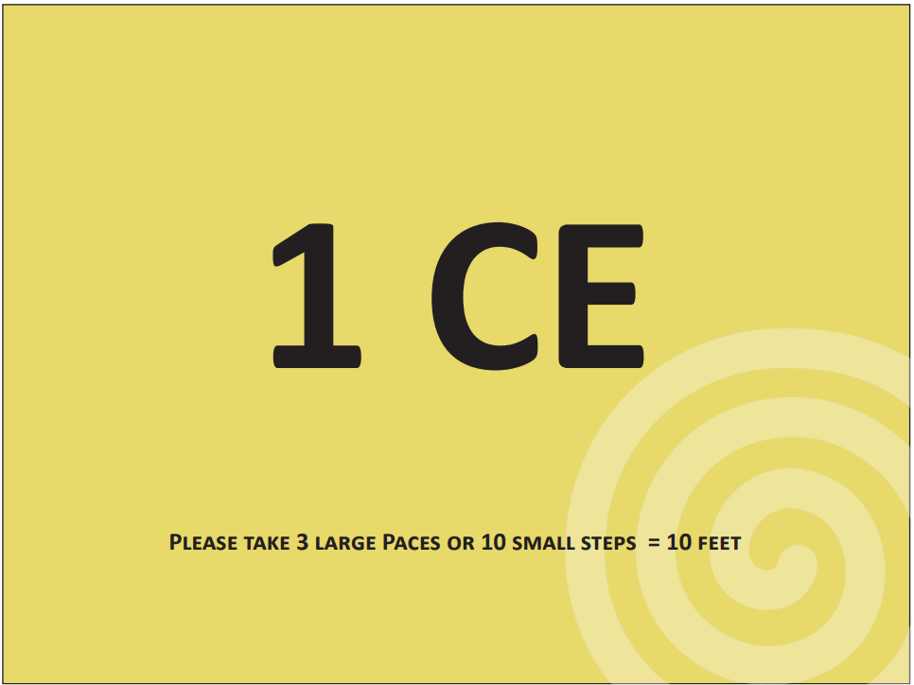
Trek Through Time Instructions:
We will now “Trek Through Time” going back in time!
The student with “1 CE” will take 10 small steps (or 3 very large paces) away from the rope (towards whatever space you will be trekking through).
This represents 10 feet, or 1,000 years.
The student with a card closest to this era will read their card aloud.
Notes:
The student with “1 CE” will now take 10 small steps (or 3 large paces) away from the rope (towards whatever space you will be trekking through). This represents 10 feet, or 1,000 years.
If another student has an event or technology card close to this period of time, they can read their card, otherwise continue trekking to 1,000 BCE, then 2,000 BCE, etc… stopping along the way to discuss the cards, until 10,000 BCE is reached.
The student with indigenous cultures can then go past this card, where they think that 12,000 BCE would be.

Slide 9
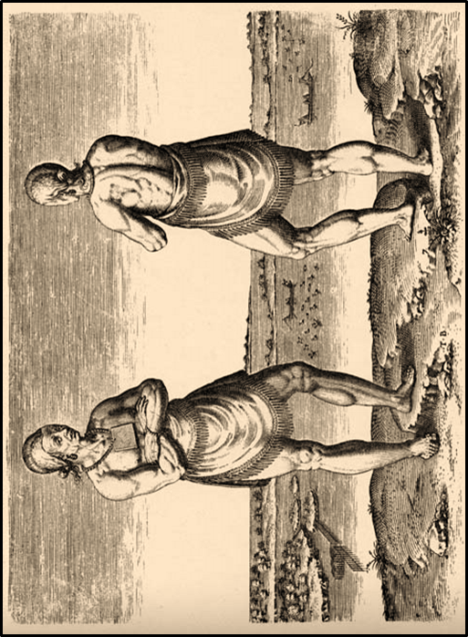
Trek Through Time:
1 foot = 100 years
1 foot= about 1 step
How many steps do you need to take to represent how long Indigenous peoples have lived in the area of present day Great Smoky Mountains National Park?
Notes:
With one foot equaling 100 years, how many steps will we take to represent how long Indigenous peoples have lived in this area?
Let’s go do the activity and return to this slide.

Slide 10
Now - what do you think?
At LEAST 14,000 years!
Probably much more…
​
How long have people lived in the Great Smoky Mountains region?
​
Notes:
Post-Activity Discussion:
How long have people lived in the Great Smoky Mountains Region?
What about the people that were already here, did they already “settle” the area? Because of disease, war, destruction of entire villages in the revolutionary era, and the enslavement of indigenous people in the 1600-1700s, much of the area appeared to be uninhabited in the early 1800s when the European “settlers” arrived. After Cherokee removal in the 1830s, only a fraction remained.
(CLICK) We know through linguistics and artifacts that Cherokee culture was here for a long time. Recent archeological studies suggest that people have been here at least 14,000 years!

Slide 11
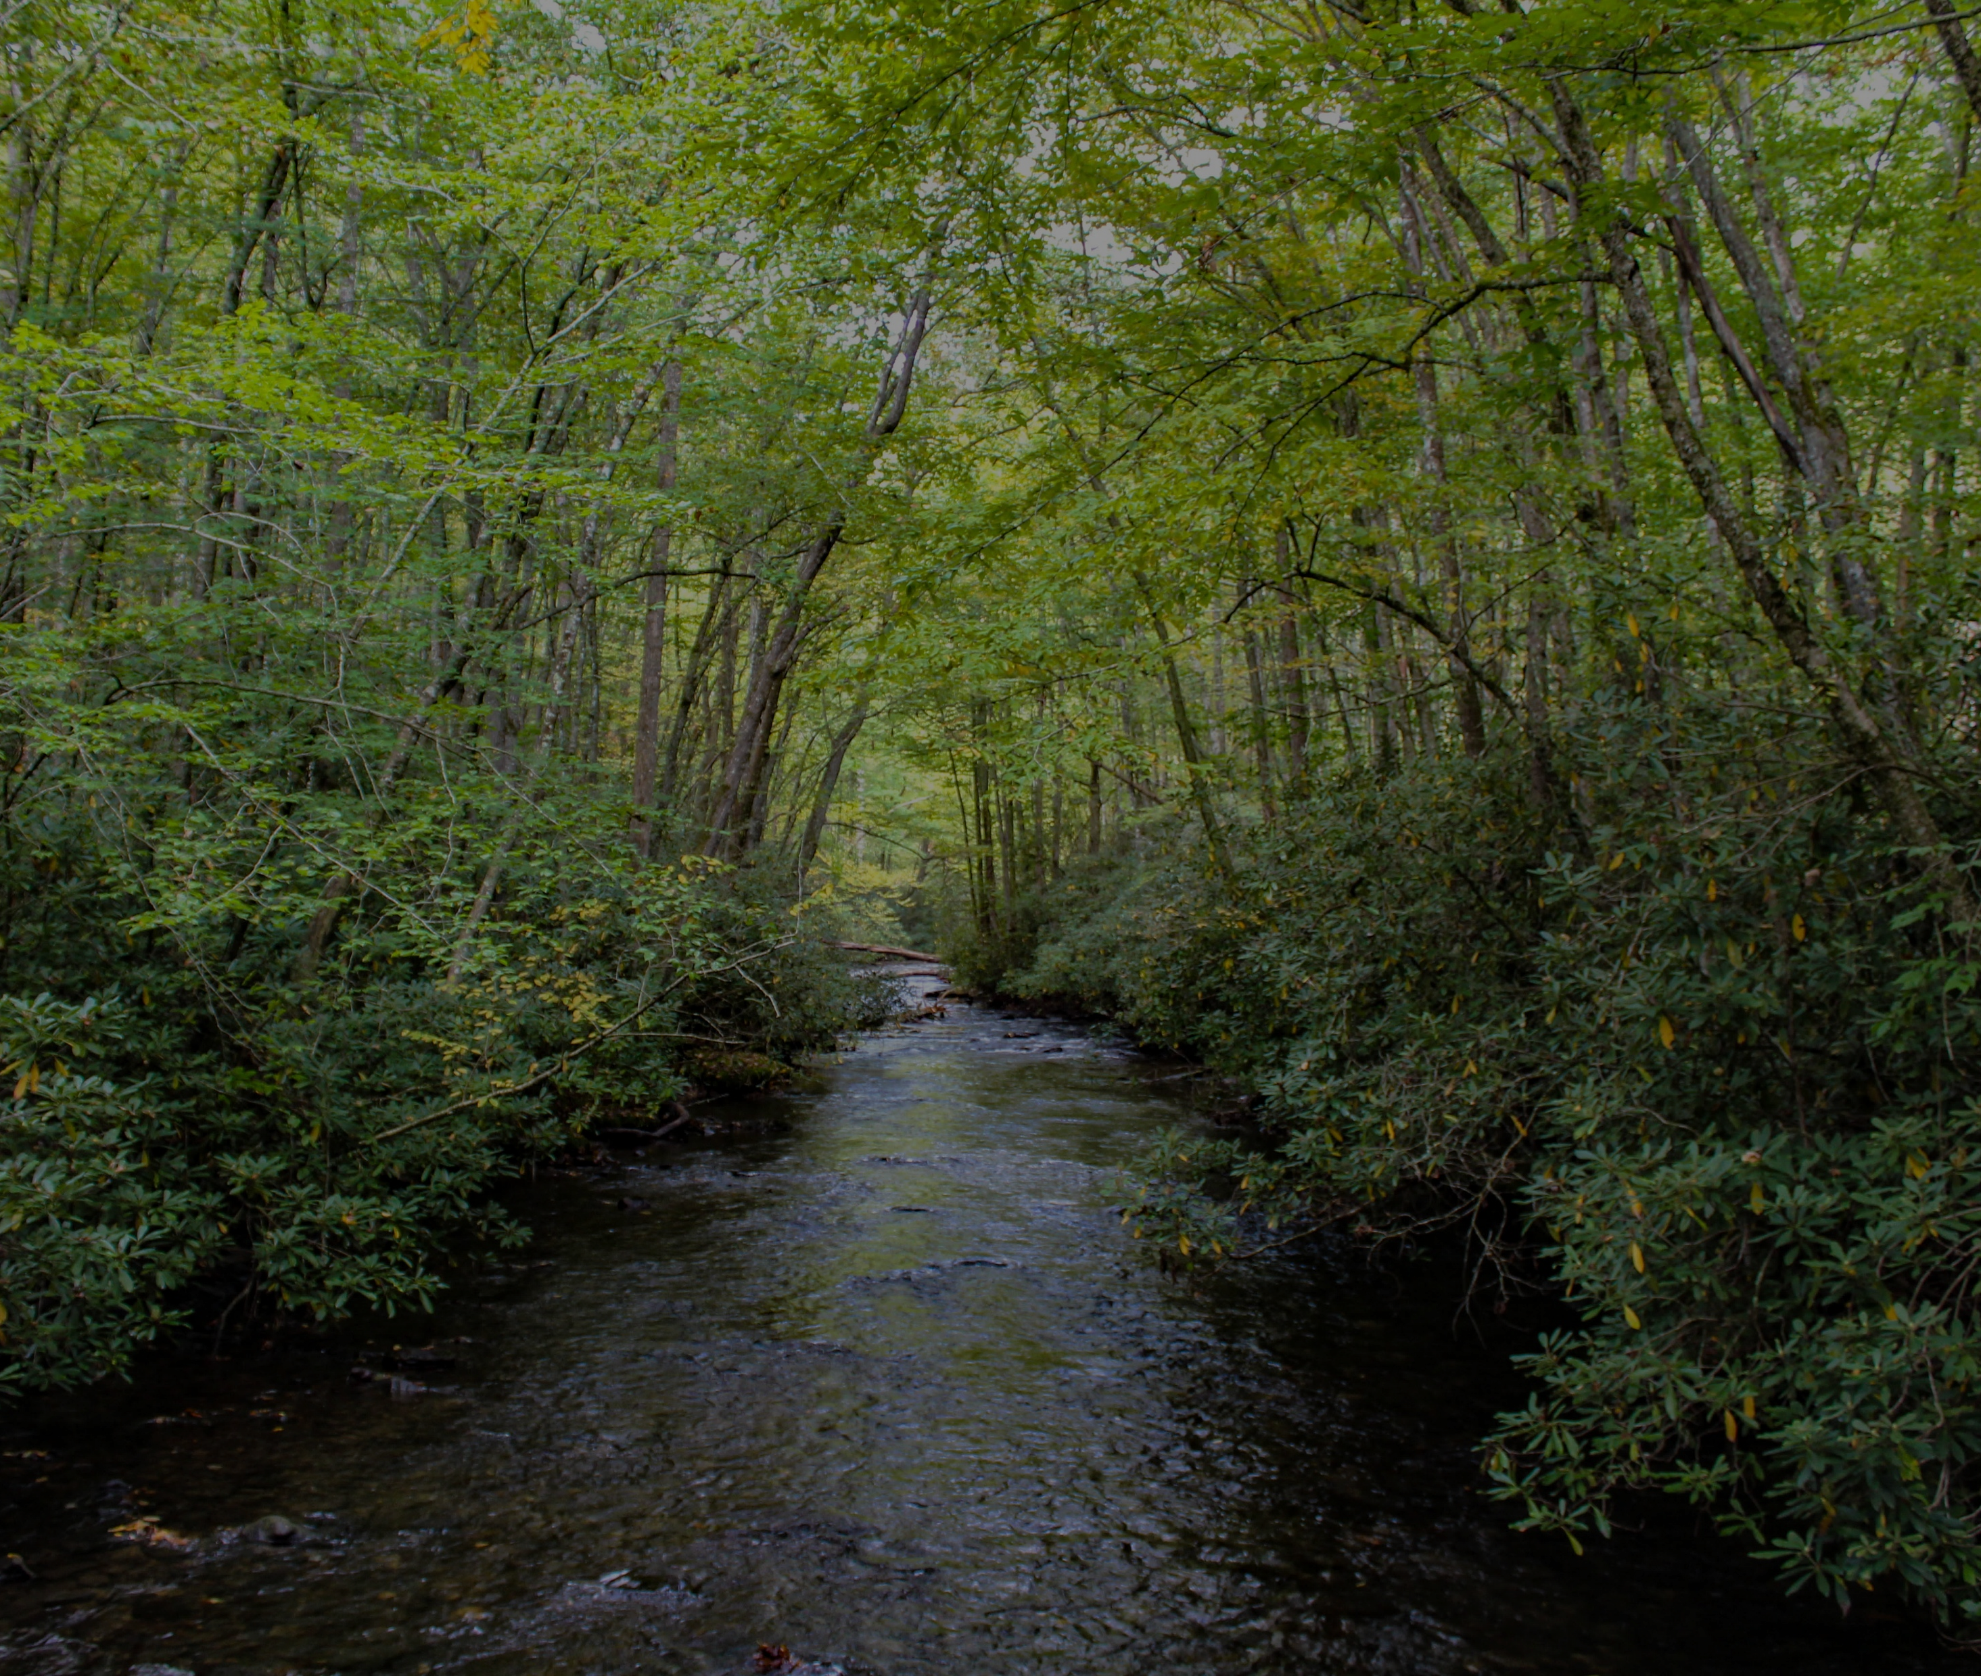
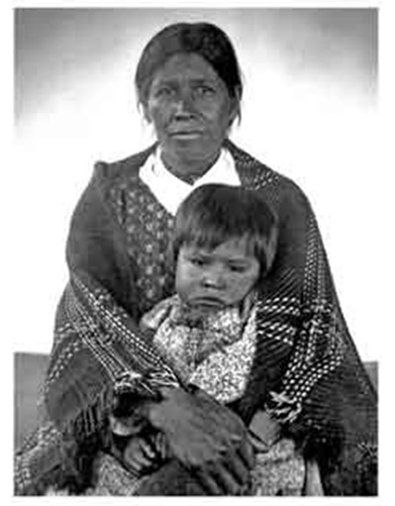
How long have people been here?
Cherokee: We have always been here, and we are still here.
Notes:
Science might tell us that people have been here at least 14,000 years, but all cultures each have their own beliefs with different timelines and origin stories.
Cherokee call themselves Ani-yu-wiya, “the principal people”, or “first people”. Their stories tell us that they have “always been here”.
While other cultures and people may come and go, they were originally here, and are still here.
NPS photo

Slide 12
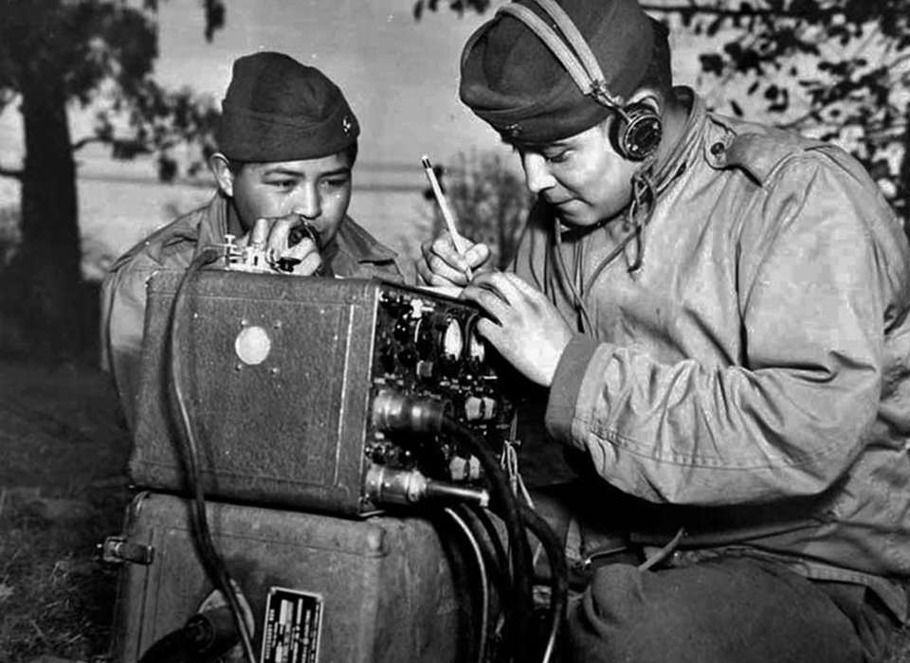
Activity Discussion:
  Why does the timeline look the way it does? Why are there more cards concentrated at certain points? (Think about “recorded history” or written history.)
  How long have Cherokee and their ancestors lived in this area?
  Did anything you saw in this activity surprise you?
Image: WWII Code-talkers, US Archives.
Notes:
Why does the timeline look the way it does? Why are there more cards concentrated at certain points?
Did anything you saw in this activity surprise you?
What are some of the important innovations you learned about in the timeline? How do you think these developments changed the course of history?

Slide 13
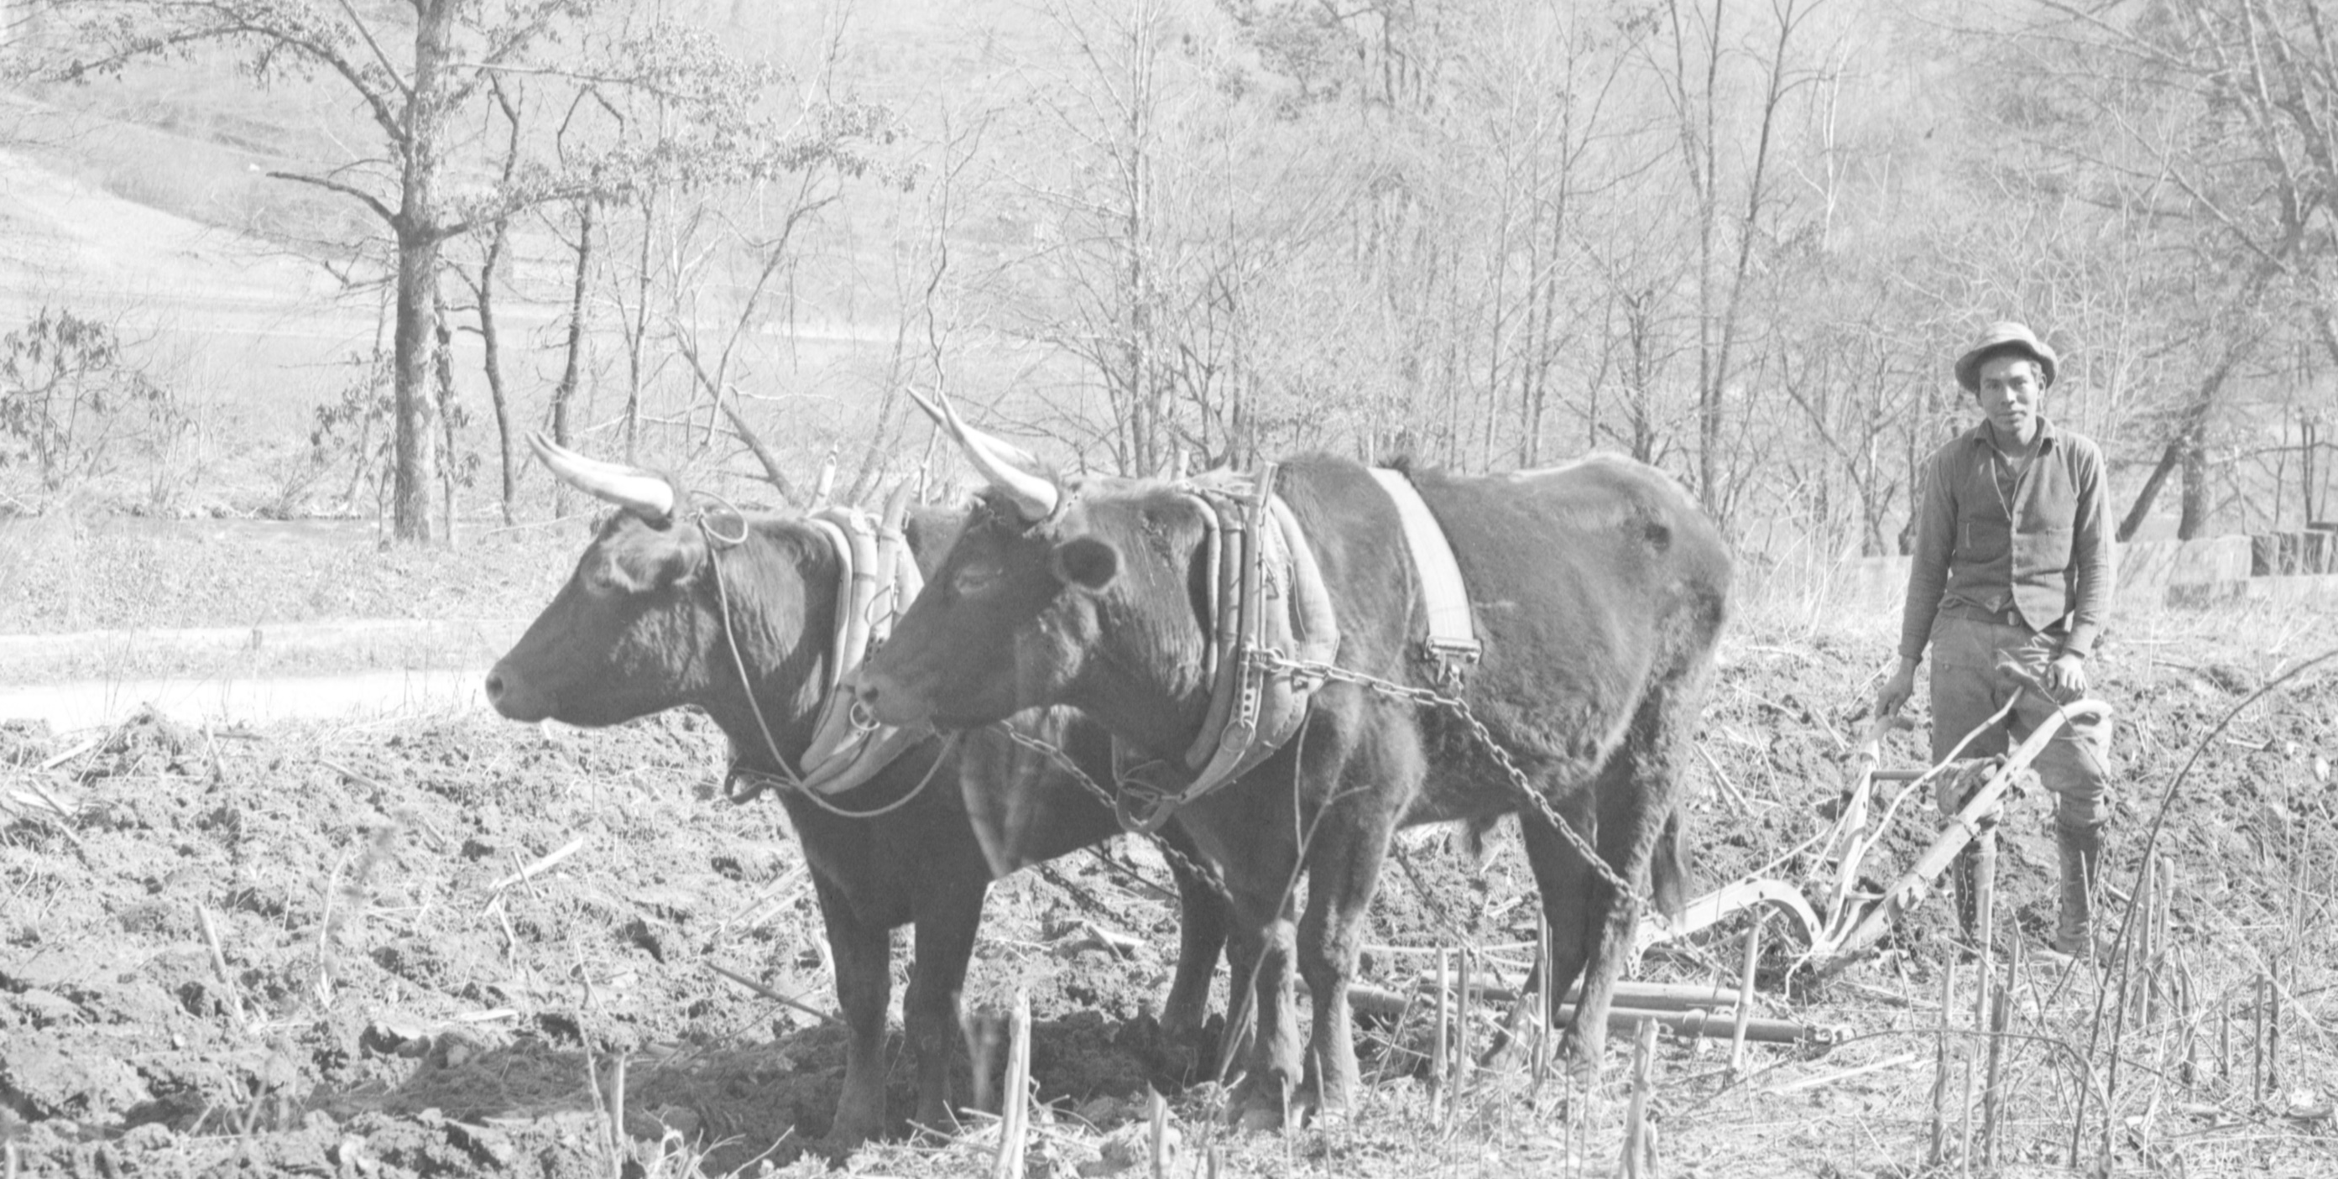
Activity Discussion:
  What are some of the important innovations you learned about in the timeline? How do you think these developments changed the course of history? Are there others you can think of?
  What events would you put on your own timeline? Your ancestors? Your community? •
  Is there a technology you use daily? Do you know its history?
Image: 1936 Cherokee farmer plowing. NPS.
Notes:
What are some of the important innovations you learned about in the timeline? How do you think these developments changed the course of history? Are there others you can think of?
What events would you put on your own timeline? Your ancestors? Your community? •
Is there a technology you use daily? Do you know its history?

Slide 14
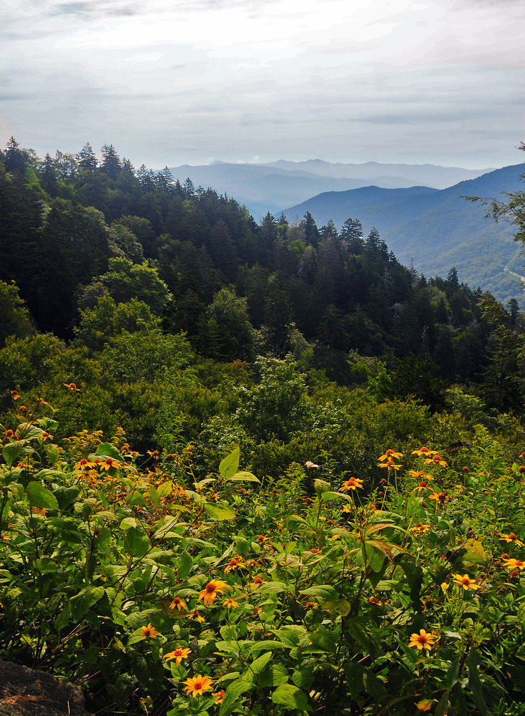
What does history
tell us?
History can be very different depending on the perspective from which it is told.
Why do you think this is the case? Can you think of examples?
Notes:
What does history tell us?
History can be very different depending on the perspective from which it is told.
Why do you think this is the case? Can you think of examples? (Example: revolutionary war story – perspectives are different for United States, Britain, and the Cherokee. Some benefitted and others didn’t. Our history books favor the US revolutionary story, with “victories” likely different from those for the Cherokee or British.)
Photo: Sochan

Slide 15
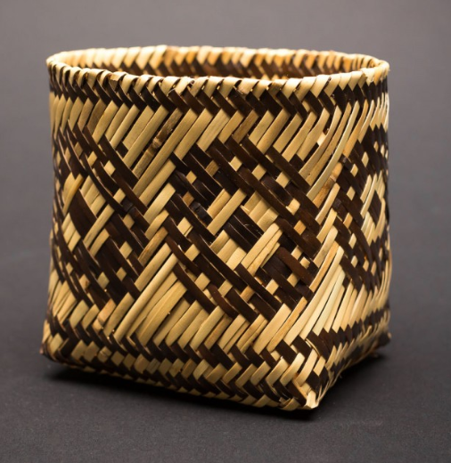
What do you think?
Why is it important that park anthropologists, archaeologists, and historians preserve and protect historical and cultural resources within the park?
Can you think of clues they use to understand people of the past?
Photo credit: Basket – Rivercane, by B., Cherokee. BIA. PD
Historians, archeologists, and anthropologists often use artifacts to weave stories of the past together.
Notes:
We often think of history as events recorded or written down. However, in many cultures, stories of the past are passed down orally from one generation to the next. Historians, archeologists, and anthropologists are not always present at the time periods they are studying, so how do they piece together history?
What clues help us to understand people and events in the past?
Photo credit: Basket – Rivercane, by B., Cherokee. BIA. PD

Slide 16
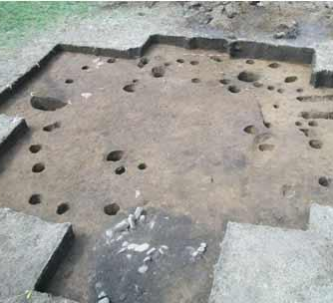
Archeology in the Park
One Example:
In 2010, Cherokee students helped to excavate a site
Dated to the Mississippian period (CE 1000-1350)
Items found included tools, ceramic vessels, plant grinding materials, and even a gaming stone (chunkey)
Notes:
In 2010, Cherokee students from the Snowbird community helped to excavate an ancestral house in the Park.
Dated to the Mississippean period (CE 1000-1350), it allowed first-hand observation of the community lifestyle, with a structure carbon-dated to CE 970. It appeared to be a small village, away from the larger “mound” towns.
Items found included tools, ceramic vessels, plant grinding materials, and even a gaming stone (chunkey).

Slide 17
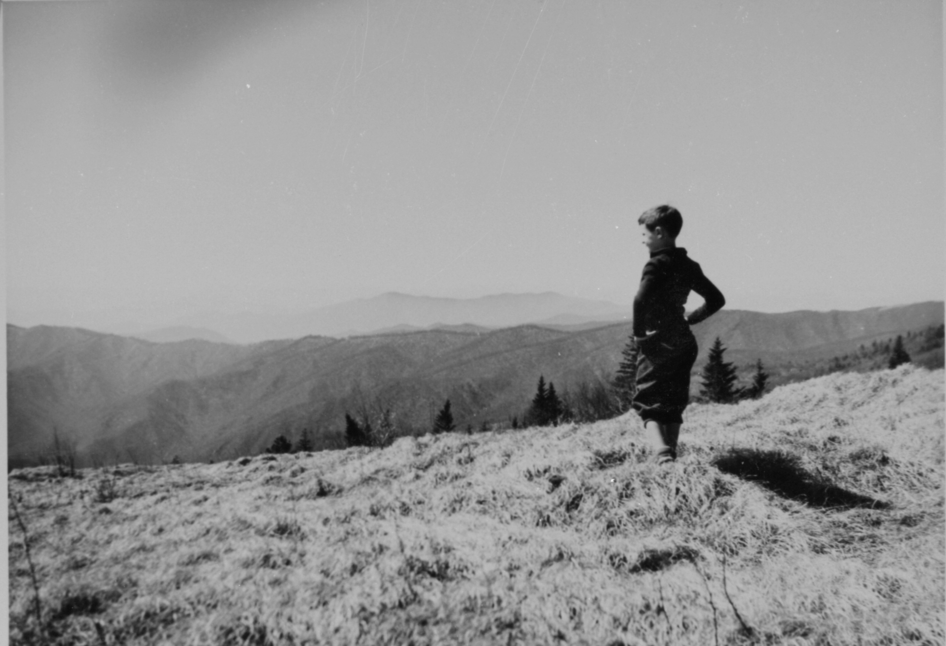
Extension Activities:
  Research what the Cherokee “Mother town”, known as Kituwah, would have been like in the past.
  Create a timeline of your family’s history.
  Research the cultural resources that you can visit at the Great Smoky Mountains National Park.
Notes:
What do you think the Cherokee “Mother town” known as Kituwah would have been like in the past? Research early Cherokee villages and draw a model of what you may see there if you could go back in time.
Create a timeline of your family’s history. What are the important events? How far back in time could you place known people or events?
Research the cultural resources that you can visit at the Great Smoky Mountains National Park. What time period on the timeline would those structures or artifacts be placed?

Slide 18

Thanks to:
Museum of the Cherokee Indian
NC DNCR
EBCI Tribal Historic Preservation Office
NC Archaeological Society
Intrigue of the Past: UNC Chapel Hill
Western Carolina University Anthropology Department
Notes:
Thanks to:
Museum of Cherokee Indian
NC DNCR
EBCI Tribal Historic Preservation Office
NC Archaeological Society
Intrigue of the Past: North Carolina’s First Peoples: UNC Chapel Hill
Photo of Mingus Mill in Great Smoky Mountain National Park by Robert Crootof, NPS usage.

