Slide 1
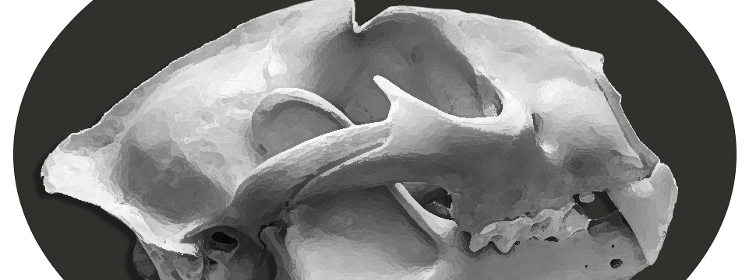


Skull Detectives
Identifying and understanding skulls and morphology
Notes:
Animals and their adaptations have been observed by Cherokee and their ancestors for millennium. Their attributes and behaviors have influenced stories, names of people and families, places, dances, art, music, foodways... The list goes on. The adaptations that animals use to survive have evolved along with the indigenous connections, creatures large and small respected and revered for their important part in the ecosystem. Those connections continue today.
The Eastern Band of Cherokee Indians, (or Ani-yu-wi-ya) continue their stewardship of the land by continuing many old practices, and by managing the resources wisely today. Along with the Great Smoky Mountains National Park, both strive to protect the places that plants and animals use as habitat today. Scientists gather information, not only data from ongoing studies, but also by digging into clues found within cultural practices, oral histories and story traditions.

Slide 2
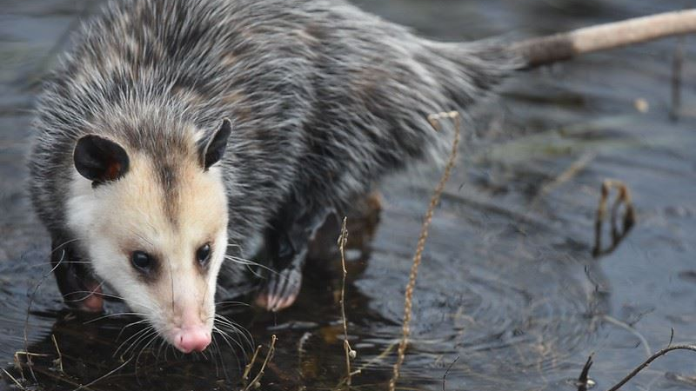
How the Possum Lost his tail
A Cherokee “teaching” story highlighting animal adaptations
Notes:
Many Cherokee stories were teaching stories, often involving life lessons and outcomes for the community good.
This old story of How Possum Lost his Tail is told to teach about the possible outcomes of bragging and boasting.
(Edited and adapted from the story as told by Freeman Owle.)
(Image: TXWC.gov)
From: Living Stories of the Cherokee, ed. Barbara R. Duncan (Chapel Hill: University of North Carolina Press, 1998. Pp. 212–215.)

Slide 3
Opossum
U-tse-tsdi
Notes:
Many years ago…..
“The possum (U-tse-tsdi – literally “smiling pig”) was a beautiful creature… one day he was walking out beside the waters and looked into the very very still waters, saw a reflection of himself, and realized that his tail was big and fluffy and beautiful….
So he began to admire himself, and he walked by that water all day … and began to boast and brag to the other animals in the forest…. and they began to get tired of it….
(image: TXWC.gov)

Slide 4
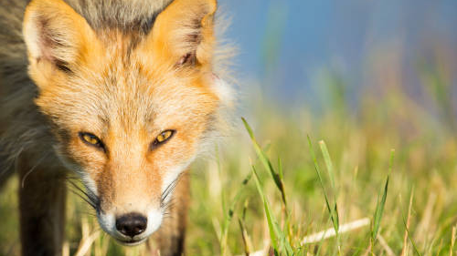
Fox
Tsula
Notes:
“…. the fox (Tsuhla) and the cricket (Taladu) got so tired of it that they made a plan to put an end to it.
They had a contest set up in the square-grounds of the Cherokee the next day and invited Mr. Possum to come down and participate, because it was a contest to see who had the most beautiful tail. And sure, he would do that, he knew he would win, and that would be fine.
But they coaxed him into going with them that night to comb and brush his tail. And when he went into the cave of the fox, they began to brush his tail and groom it, and he began to get a little sleepy….
(Image: USFWS.gov)

Slide 5
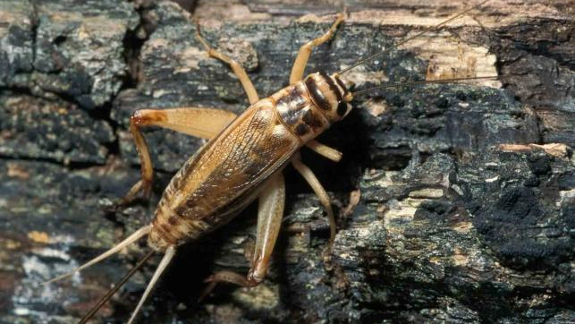
Cricket
Taladu
Notes:
“The cricket (Taladu), being the creature that he is, began to chew. And he chewed every hair off the possum’s tail… and they tied it up with a piece of deerskin and tied a beautiful bow on the end of it.
And early next morning when the possum awakened, he said, “What did you do to my tail?” being very upset. And they said, “Oh we combed and brushed it so beautifully…. (and) wrapped it up so it would not get messed up.” And so…. he bounced on off to the square-grounds.”
(Image: Missouri Dept. Conservation.gov)

Slide 6
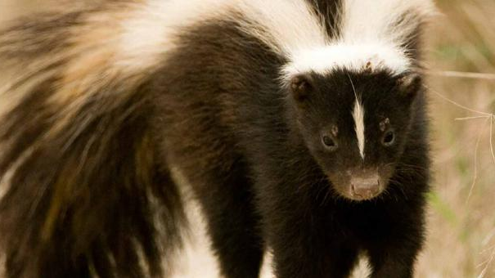
Skunk
Dili
Notes:
“And the animals began to go across the stage. … you had the skunk (Dili) with his beautiful black tail with a white streak down the middle. And of course he didn’t smell very good, but all the people were pleased, at a distance.
(Image: MO Dept. Conservation.gov)

Slide 7
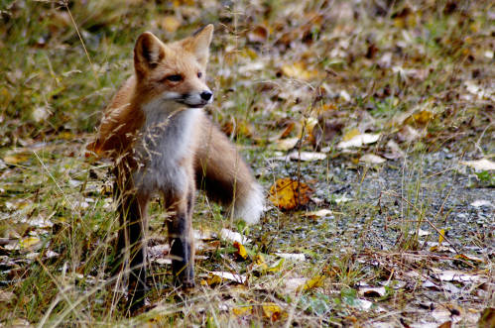
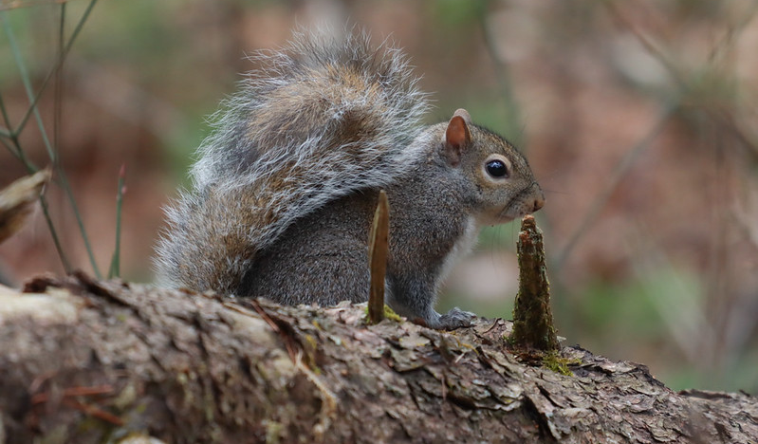
Tsuhla
Saloli
Notes:
“And the other animals crossed the stage, the squirrel (Sa-lo-li), and the red fox with his big beautiful orange tail with the black spot on the end.
The possum couldn’t wait any longer, and he began to get antsy. So he jumped up on the stage and he said, “It’s my time, we need to get this thing settled.” So he said, “Take the thing off my tail!”

Slide 8
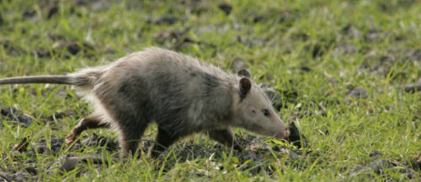
Image1
Notes:
“And when they take the ribbon off, all the animals, and all the people in the audience began to roll and laugh and giggle. And he looks back at his tail, and he sees what they’re laughing about. He has the most ugly, rat-looking tail that he’s ever seen in his life.”
(Image: USFWS)

Slide 9
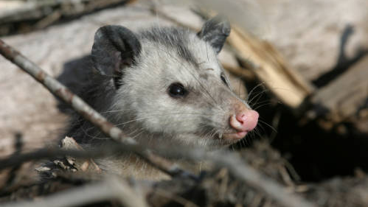
Image 2
Notes:
“And first he begins to snarl and spit and become very angry. But after a little while they laugh again, and he can’t stand it anymore, and he rolls over on his back, and he plays dead. The old possum boasted too much. And if you go out today and find him in your trash cans, you will see that …. he’ll roll over onto his back with all four feet sticking into the air.”
(Image: USFWS)
Adapted from: Living Stories of the Cherokee, as told by Freeman Owle, ed. Barbara R. Duncan (Chapel Hill: University of North Carolina Press, 1998. Pp. 212–215.)

Slide 10
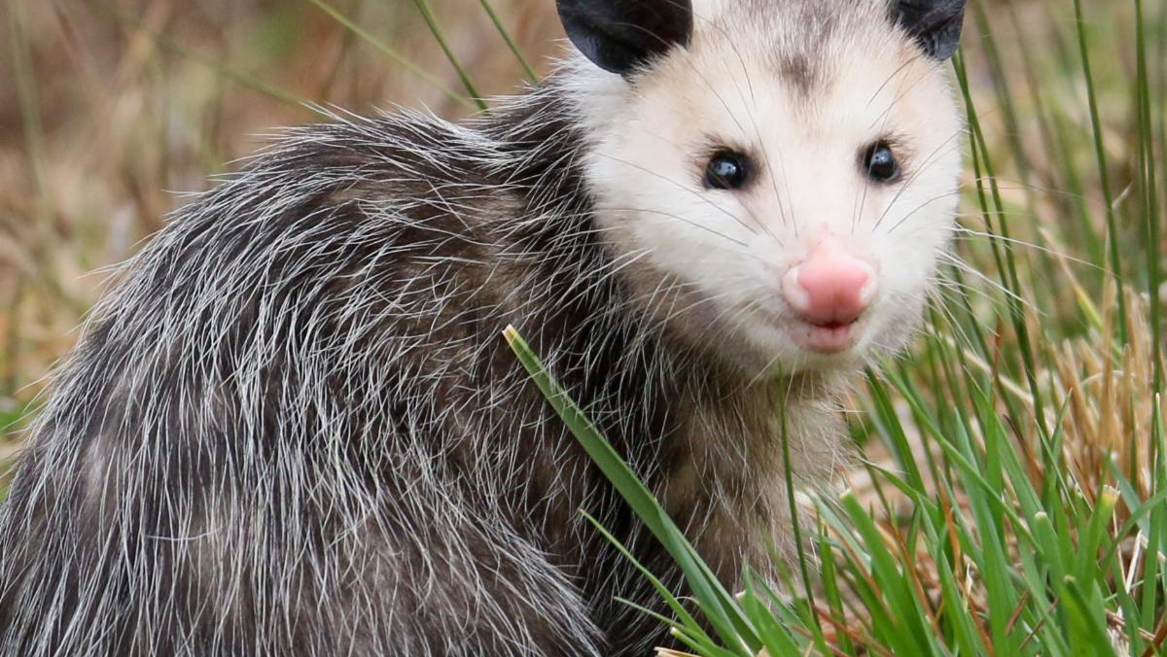
What information is being shared in this story?
Notes:
DISCUSSION:
Stories have been used throughout history to help pass along information and traditional ecological knowledge from one generation to the next.
What information do you think was being shared through this story?
(Ex: opossums have prehensile bare tails and play dead as survival behavior. Foxes are cunning, crickets chew and clip things, and skunks are odorous!) These adaptations are unique to the opossum and have helped it to survive over time.
For over 14,000 years, people have been a part of the Southern Appalachian ecosystem. From observations and experimentations, indigenous science and knowledge developed in order to know how to utilize plants and animals wisely and understand their relationships with one another. Utilizing animals for the skin (clothing, shelter and tools), their meat (food), tendons and bones (tools) historically gave Cherokee and their ancestors a level of knowledge beyond what most people are familiar with today.
By studying animals’ physical attributes, we can discover some of their adaptations and relationships too.
(Image: USFWS)

Slide 11
Game of Bones
Identifying and learning about relationships
Notes:
By studying animal attributes and adaptations, we can learn about animals, people, and their relationships.
Imagine that you work in the cultural or wildlife resources division with the National Park Service, or with the State, or the Tribe.
If you are a biologist, some of your work involves protecting live animals and studying their habitats. But there may be times where investigating the remains of an animal is a part of your work. Looking at bones and skulls of mammals may offer clues on an animal’s health and/or reason for death. This is called a necropsy, in which remains are analyzed, and various tests are performed for identifying parasites, toxins, viruses, human involvement and other issues. But first, you need to be able to identify which skull belongs to which animal. In this activity, you will be biologists studying the skulls of mammals found in this region.
If you are an archaeologist, you may be investigating a site where people lived hundreds or thousands of years ago. Often, in fire pits, you may find animal remains, such as bones. Or you may find carved tools, weapons or jewelry items. Knowing the species of animal used will help your investigation. For example, deer make up the bulk of skeletal material at cultural sites, during all historic periods analyzed. Think about ways deer specifically may have been used. (Flesh used for meat, cord, drum heads, leather, shelter. Hooves rendered into glue, used as scrapers. Other bones, antlers used as weapons and tools, carved into jewelry.) Prior to European contact, deer were the single most important mammal species. Unfortunately, over-harvesting for trading decimated their numbers and changed the culture forever.

Slide 12
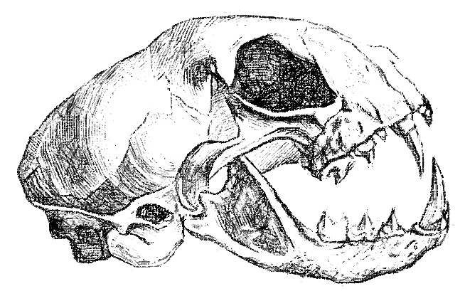
Skull CSI
  EYES
  TEETH
  JAW
  NASAL CAVITIES
  SAGITTAL CREST
  AUDITORY BULLA
Notes:
Skulls can tell us a lot of information about an animal, its diet, its defense, and where it might fall in the food web.
QUESTION: Which type of eyesight would be best for a predator species to have? For a prey species to have? (binocular – forward facing / monocular – on sides). We’ll solve and define this in the next activity, but take your best guess.
Think for a moment about your own skull, where your eyes sit, forward or side facing.
What teeth do you have to help process the food you eat?
How would your nasal cavity compare to that of a bear?
The sagittal crest, or prominent ridge bone along the top, is pronounced in animals with a high intelligence.
By making observations and comparing the structures, we can determine which skulls might belong to various animals and how they interact in the food chain.
One thing we may notice right away is that once muscles, fat, fur and feathers are removed, skulls can be smaller than what we would imagine.

Slide 13
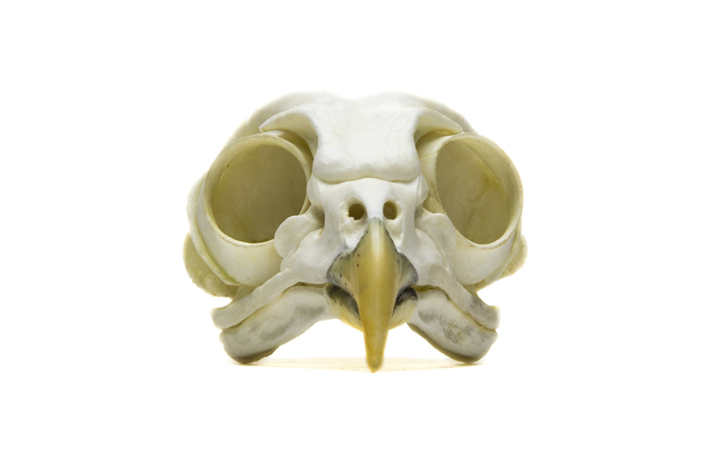
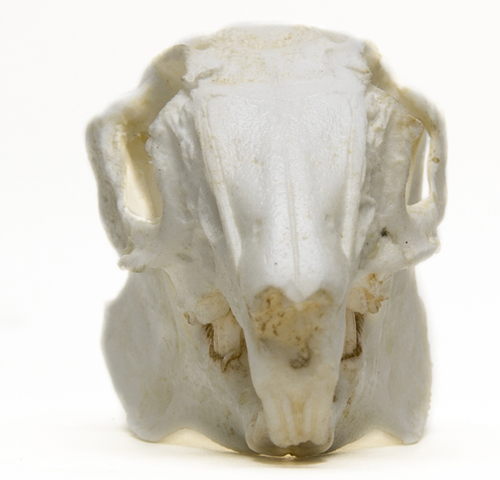
Eye Socket (Orbit) Placement
Monocular - Side facing
Binocular - Front facing
Notes:
Let’s start with the eyes and their positioning in most mammals and birds.
Position
Side-orientated – greater monocular vision (greater peripheral vision around sides, advantageous for prey species looking for movement of predators)
Forward-positioned – greater binocular vision (allows predators to focus on exact position of prey)
“Eyes in front, I hunt. Eyes on side, I hide.”
(These two skulls are that of a rabbit on the left, and a barred owl, on the right. What else do you notice?)
Image: Acorn Naturalists

Slide 14
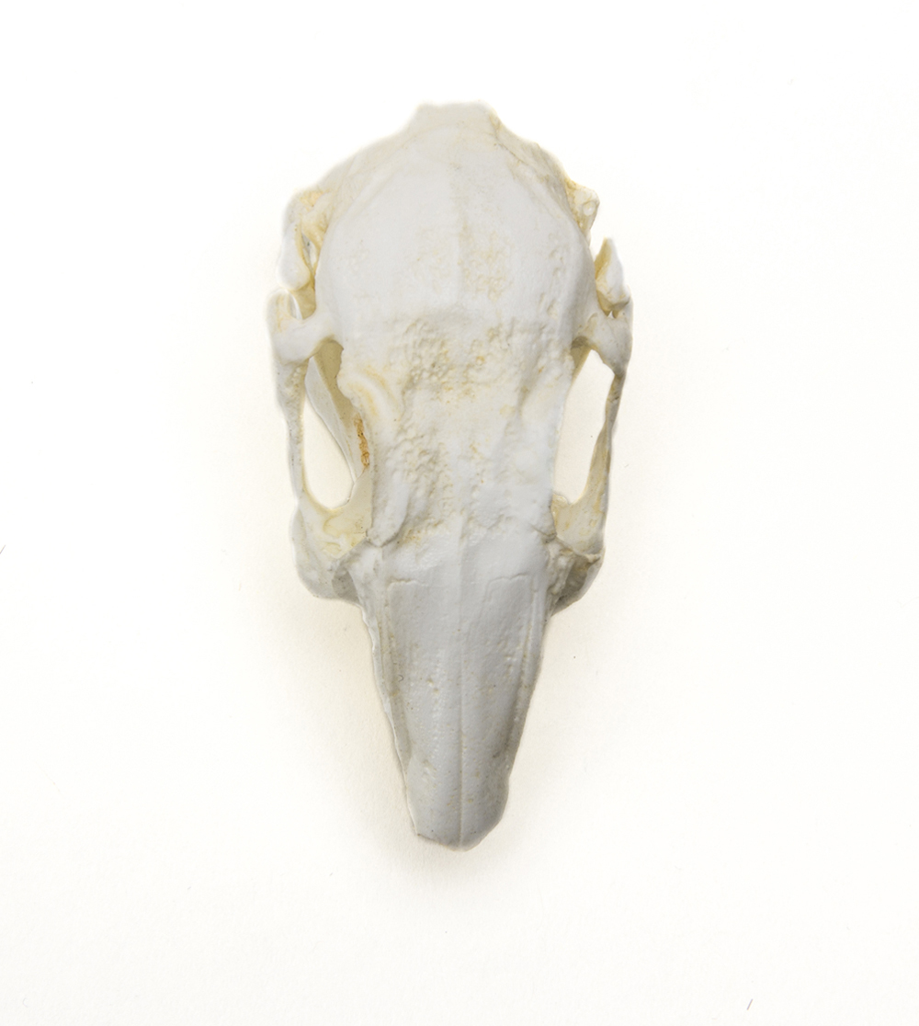
Range of vision Activity
Seen by both eyes
Prey Species
Monocular - Side facing:
only one eye is used to see an object; good for seeing objects all around without having to move the head – peripheral vision.
Seen by left eye
Seen by right eye
Notes:
Let’s examine exactly what the two vision types in mammals might mean.
(Monocular Vs. Binocular Activity)
Peripheral Vision “Predator/Prey” Demonstration
Demo One (Prey Peripheral Vision)
1. 3 student volunteers can come to front to demonstrate for class; or, have students get into groups of three so all can try.
2. Two students can stand back-to-back in one place without moving. One of the students in the pair should cover their left eye and the other student their right eye.
3. These two students are playing the role of an “prey animal” that has side-orientated eye sockets. Have them raise the hand not covering their eye. They will lower that arm when the third student enters into their vision.
4. The third student can now slowly start walking around the pair making a complete circle. This student is the “predator” animal.
5. As the third student makes the circle, they should pause frequently and question the pair about whether they can still see them. There will be a small area of the circle in which each “prey animal” will not be able to see the third student.
(Next: Stay in groups: predator binocular vision)

Slide 15
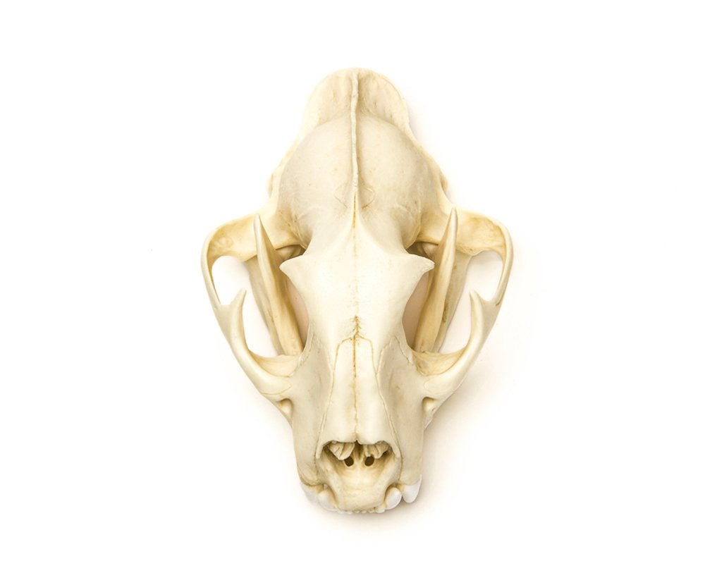
Range of vision Activity
Seen by both eyes
Predator Species
Binocular - Front facing:
both eyes are used to focus on an object; this is good for judging distance.
Seen by left eye
Seen by right eye
Notes:
Let’s continue to examine range of vision, now with the predator species.
(Monocular Vs. Binocular Activity)
Demo Two (Predator Binocular - Peripheral Vision)
1. The 3rd student (the predator) can stand in one place facing forward without moving. They are an animal with binocular vision (which is true of humans) and they will have one arm raised when they are able to see the other student.
2. One of the “prey” students (from the pair making the monocular animal) can walk in a circle around the “predator”. Like before, the student walking the circle should pause several times and ask the binocular “predator” animal if they can still see the “prey” student. (The binocular animal’s peripheral vision should be much less than the monocular animal.)
3. Discuss the vision difference with the entire class.
Demo Three (Predator Judging Distance and Location)
The binocular (predator) animal can remain where they are standing.
Have the prey animals crumble up a piece of paper.
The predator will try to catch the piece of paper using one hand, first covering up one eye (to simulate an animal with monocular vision) and then again with both eyes. Students can take turns.
What was the difference? (Students can also practice focusing on an object in the room, with one eye closed, and then the other, noticing how the object “moves” between the positions.) These two viewpoints allow for three-dimensional vision.
Predators are adapted for binocular vision because it allows them to target their prey for when they strike. Think of how predators like cats stalk their prey to judge distance and location before they strike.

Slide 16
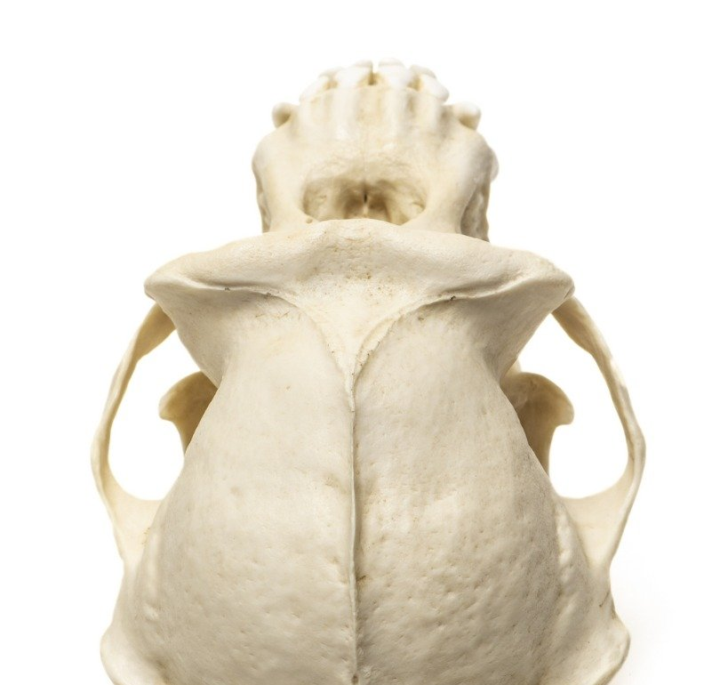
Human Peripheral vision test
Seen by both eyes
What about you??
Seen by left eye
Seen by right eye
Notes:
Okay, now let’s see where we fall in this spectrum. What do you think, are humans, as primates, predators, prey or both?
Test your theory:
Hold both your arms out front, putting both thumbs in a “thumbs up” position. Yeah, good job! Look straight forward.
Slowly move your arms apart, each moving away from the other. Keep looking straight ahead.
As your arms approach the sides of your body (you look like a “T” pose), notice when you cannot see your thumbs anymore in your peripheral or side vision.
You have found the edge of your vision.
Do you think you are adapted as a predator? A prey? Both?
(Image: Primate skull, Acorn Naturalists)

Slide 17
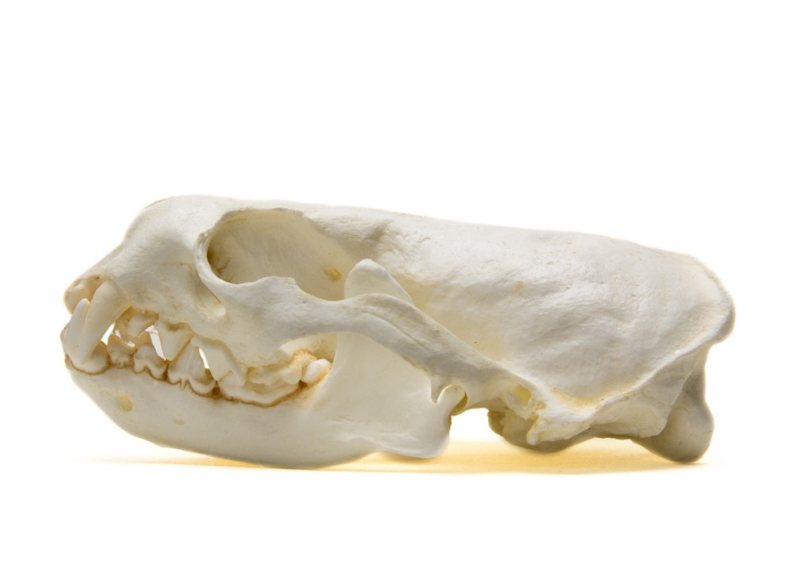
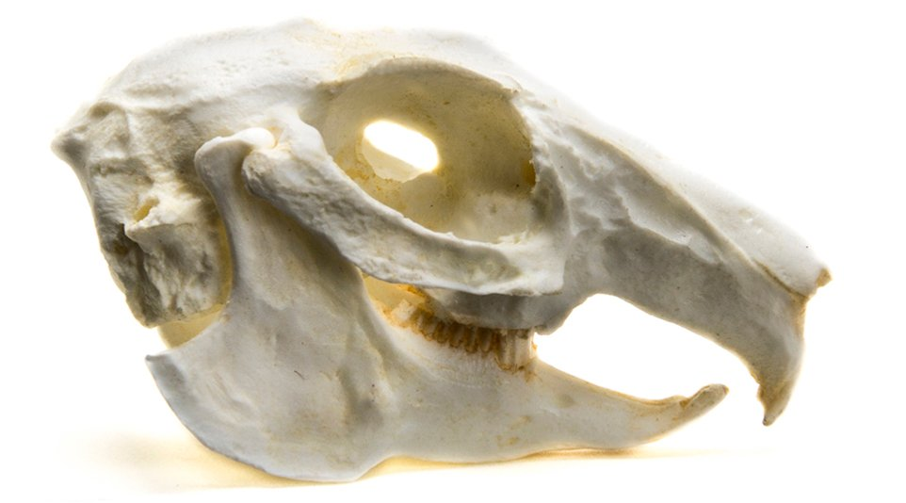
Eye Socket / Orbit Size
Notes:
Eye Socket or Orbit Size
The larger the eye socket as compared to the overall skull size indicates excellent vision. This can be handy for both predators and prey, but depending on the animal and its adaptations, it can help you narrow down species. Some animals rely on vision more than others.
(CLICK) If you look in the circular “orbit” of the skull, the round opening where the eye would sit, follow the arched cheekbones (Zygomatic arch) along the bottom of the orbit, and the upper “post-orbital process”, a bony projection that dips behind where the eye would be. The orange circles here will help you to visualize how the eyeballs may sit and how large they would be.
What would you guess about these two animals? Which one relies more on vision for survival?
The animal on the left relies more on vision, with large eyes on the sides (monocular) that allows it to see if predators might be sneaking up on it. The animal on the right has smaller eyes forward-facing at the front of the skull (binocular), most likely so that it can catch prey.
Image: Acorn Naturalists

Slide 18
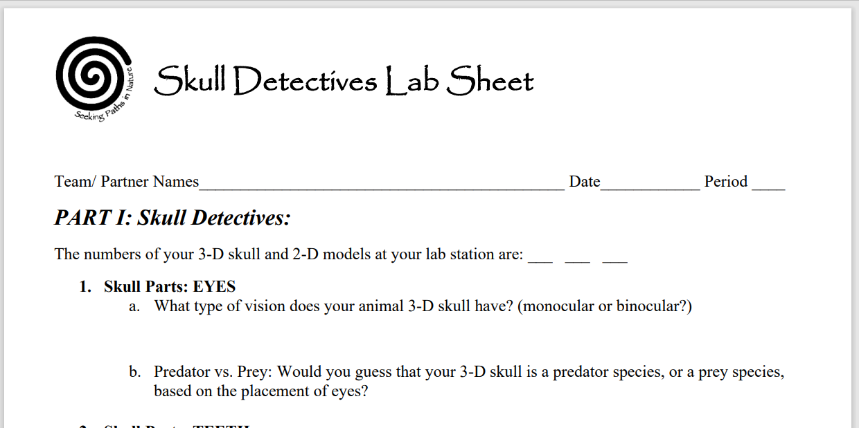
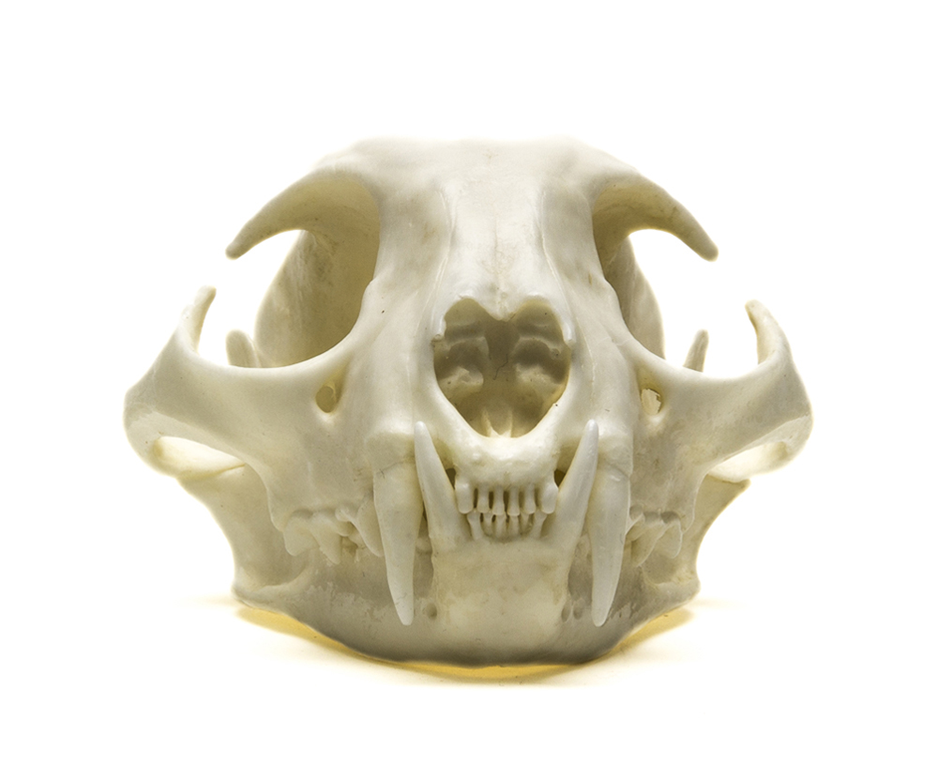
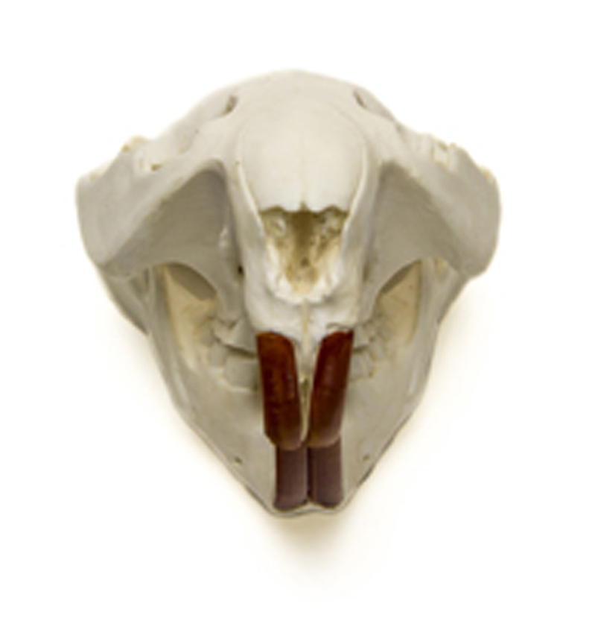
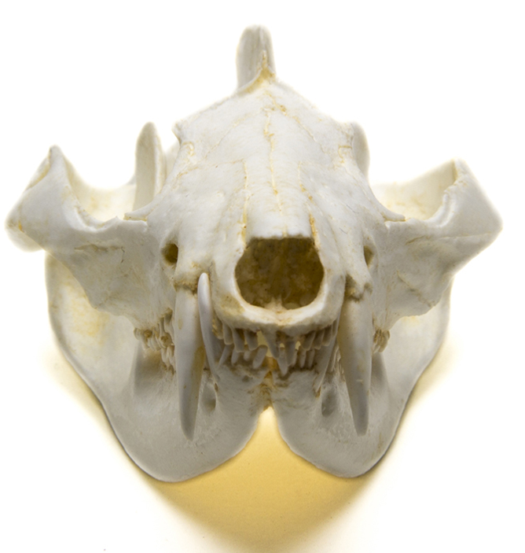
Worksheet Part I
Predator or Prey???
Look at the EYES on the skull at your station.
Monocular or Binocular vision?
2) Based on what you just learned do you think that your skull is from a predator or prey?
Notes:
Skull Detectives Lab Sheet: Part 1: Question 1: Eyes
Students should get into three groups. Pass out the 3D skulls, one to each group.
Have student take a few minutes to determine:
What type of vision the animal has? (monocular or binocular?) Do the eyes seem to be facing to the sides or the front?
Can you determine yet whether the 3-D skull at their lab station is a predator or prey? Make a first guess.
Discuss and record answers on the lab sheets.

Slide 19
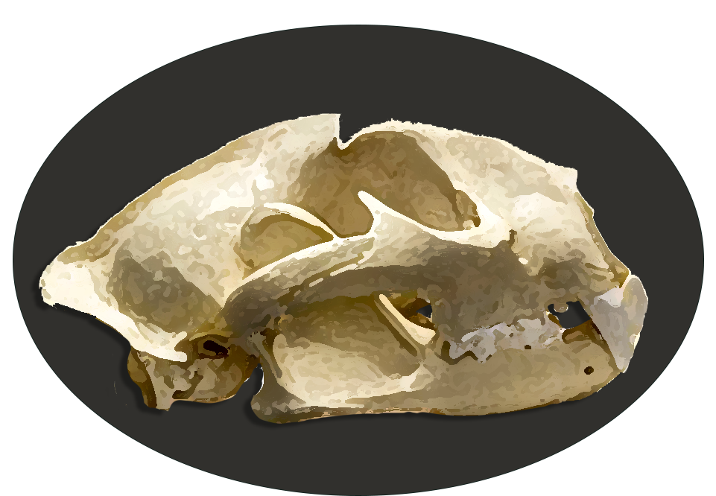
Skull Parts: Teeth
Four Types:
  Incisors
  Canines
  Pre-molars
  Molars
  *Pre-molars & molars are often referred together as cheek teeth*
Notes:
Now we’re going to examine the teeth.
There are four types of teeth we will look at:
Incisors
Canines
Pre-molars
Molars
(Pre-molars and molars are sometimes referred together as cheek teeth)

Slide 20
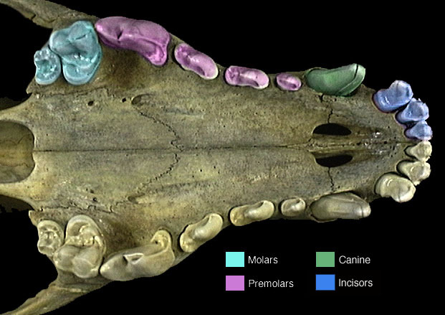
Skull Teeth: Incisors
They are:
sharp-edged
used for grasping, clipping, scraping and picking.
Notes:
Let’s start with the INCISORS in the front. They are the dark blue teeth on the far-right side of this image. (CLICK)
They are sharp-edged, used for grasping, clipping, and picking items up.
Raise your hands if your skull has incisors.
----------------------------------
Photo of Gray Wolf Canis lupus found at: https://animaldiversity.org/collections/contributors/anatomical_images/teeth_types/
Retrieved 2/26/2019
Copyright Info:
Contributors
Phil Myers (photographer; copyright holder), Museum of Zoology, University of Michigan-Ann Arbor
Animal Diversity Web Staff (photographer)
Conditions of Use
This work is licensed under a Creative Commons Attribution-Noncommercial-Share Alike 3.0 Unported License.

Slide 21
Skull Teeth: Canines
  They are:
  beside incisors if present
  long, pointed & cone-shaped
  used for piercing and holding prey
Notes:
Next are the CANINES. (The green tooth)
They are next to the incisors, long, pointed, cone-shaped and are used for piercing or holding prey. They are sometimes referred to as “fangs” in pop culture. (Think Dracula!)
Raise your hands if your skull has pronounced canines.
----------------------------------
Photo of Gray Wolf Canis lupus found at: https://animaldiversity.org/collections/contributors/anatomical_images/teeth_types/
Retrieved 2/26/2019
Copyright Info:
Contributors
Phil Myers (photographer; copyright holder), Museum of Zoology, University of Michigan-Ann Arbor
Animal Diversity Web Staff (photographer)
Conditions of Use
This work is licensed under a Creative Commons Attribution-Noncommercial-Share Alike 3.0 Unported License.

Slide 22
Skull Teeth: Pre-molars
  They are:
  along the side
  vary in shape
  used for tearing, knowing and grinding food
Notes:
Further back are the PRE-MOLARS. (The pink teeth)
They are side teeth, vary in shape, used for tearing, knawing, and grinding food.
Raise your hands if your skull has pre-molars.
----------------------------------
Photo of Gray Wolf Canis lupus found at: https://animaldiversity.org/collections/contributors/anatomical_images/teeth_types/
Retrieved 2/26/2019
Copyright Info:
Contributors
Phil Myers (photographer; copyright holder), Museum of Zoology, University of Michigan-Ann Arbor
Animal Diversity Web Staff (photographer)
Conditions of Use
This work is licensed under a Creative Commons Attribution-Noncommercial-Share Alike 3.0 Unported License.

Slide 23
Skull Teeth: MOLARS
  They are:
  in the very back of the mouth
  varied in shape, but flat in comparison
  used for grinding
Notes:
Finally, we have the MOLARS. (The aqua teeth)
They are in the very back of the mouth along the side. They can have different shapes but are usually flat-topped (in comparison to canines) and used for grinding food.
Raise your hands if your skull has molars.
----------------------------------
Photo of Gray Wolf Canis lupus found at: https://animaldiversity.org/collections/contributors/anatomical_images/teeth_types/
Retrieved 2/26/2019
Copyright Info:
Contributors
Phil Myers (photographer; copyright holder), Museum of Zoology, University of Michigan-Ann Arbor
Animal Diversity Web Staff (photographer)
Conditions of Use
This work is licensed under a Creative Commons Attribution-Noncommercial-Share Alike 3.0 Unported License.

Slide 24
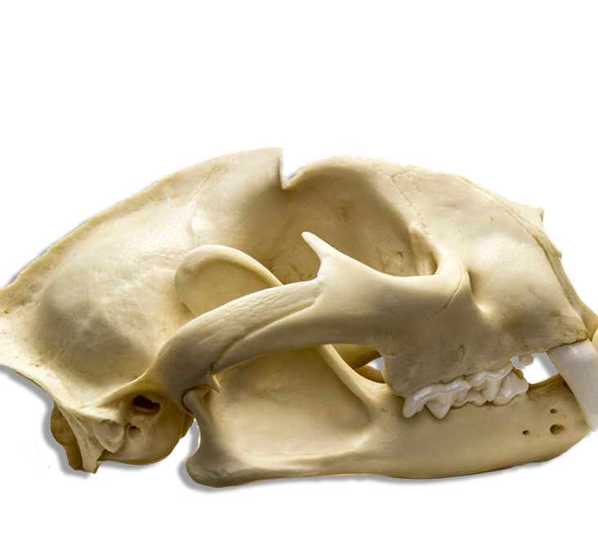
Skull Parts: Teeth
Teeth in an animal skull can tell scientist what type of consumer the skull belongs to:
Primary Consumers
Secondary Consumers
Notes:
By looking at these teeth, scientists can determine if an animal is a primary consumer (herbivore) or a secondary consumer (carnivore or omnivore).
Let’s review and define these three terms?
(Allow students to answer…. click for answer)

Slide 25
Primary and Secondary Consumers
Teeth in an animal skull can tell scientist whether the skull belongs to a carnivore, herbivore, or omnivore
    Herbivore – plant-eater (primary consumer)
    Carnivore – meat-eater (secondary consumer)
    Omnivore – animal that eat both (secondary consumer)
Notes:
Herbivore – plant-eaters (primary consumer)
Carnivore – meat-eaters (secondary consumer)
Omnivores – animals that eat both (secondary consumer

Slide 26
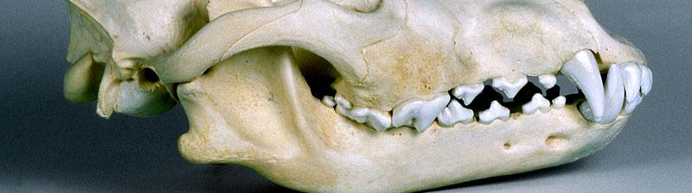
Carnivore: Teeth
Predators that bite, tear, and gulp their food without chewing.
Teeth tend to be clean and white instead of stained by plant material like herbivore teeth would be.
Notes:
Let’s check out the carnivore’s teeth:
They capture, pin, bite, tear and gulp their food without a lot of chewing.
Eating fewer plants, their teeth tend to be whiter and less stained by plant materials.
Image of Wolf from: http://www.skullsite.co.uk/Wolf/wolf_lat.htm
Retrieved 2/26/2019

Slide 27
Carnivore teeth: INCISORS
Incisors can be smaller and less developed than herbivores.
Notes:
The incisors in the front are smaller and less developed.
Image of Wolf from: http://www.skullsite.co.uk/Wolf/wolf_lat.htm
Retrieved 2/26/2019

Slide 28
Carnivore Teeth: Canines
Canines are large, long, prominent, and pointed for piercing and holding prey
Look like “fangs”
Notes:
Canines are large, long, prominent, and pointed for piercing and holding prey.
Image of Wolf from: http://www.skullsite.co.uk/Wolf/wolf_lat.htm
Retrieved 2/26/2019

Slide 29
Carnivore Teeth: cheek teeth
Pre-molars and molars can still be sharp and pointed
Overlap when jaws are closed for scissor-like cutting
Used for grasping, tearing, grinding and crushing
Notes:
The pre-molars and molars, or cheek teeth on carnivores are:
flatter, but can be sharp & pointed, and
the upper jaw teeth can overlap lower jaw teeth when mouth is closed creating a scissor-like cutting ability
The pre-molars are for cutting, grasping and tearing.
The rear molars are for grinding, and the wide surface allows for crushing bones.
Image of Wolf from: http://www.skullsite.co.uk/Wolf/wolf_lat.htm
Retrieved 2/26/2019

Slide 30
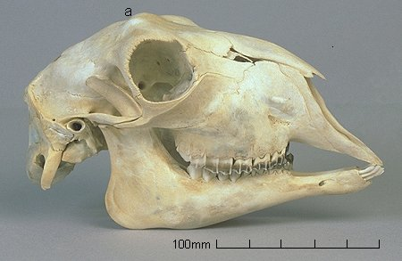
Herbivore: Teeth
Herbivores are prey species that eat only plants.
Teeth are used for grinding and chewing
Their teeth may appear stained due to their plant-based diet
Notes:
Let’s contrast teeth of the carnivore with the herbivore.
Herbivores eat mostly plants, and teeth are used for clipping, chewing and grinding. They often appear stained due to their plant-based diet.
Image of Goat from: http://www.skullsite.co.uk/Goat/goat.htm
Retrieved 2/26/2019

Slide 31
Herbivore Teeth: Incisors
The incisors are at the very front of the skull. They are:
large, and well-developed,
some may be missing upper incisors
Notes:
Incisors are at the front of the skull and are:
Large & well-developed
In rodents, they can have a curved or cupped shape
Wide, for stripping vegetation
Some animals, like deer, may be missing upper incisors. They press the lower incisors against the hard upper palate to rip twigs and branches from trees. Others, like horses, have both sets of incisors, so that they can clip grasses and vegetation cleanly (like fingernail clippers).
Image of Goat from: http://www.skullsite.co.uk/Goat/goat.htm
Retrieved 2/26/2019

Slide 32
Herbivore Teeth: Canines
Diastema – gap in teeth
Canines are often not present in herbivores. If present they are:
flat and non-pointed
instead herbivores will have a flattened palate that act like a cutting board for the lower incisors to cut plant material against
Notes:
Canines are often absent or small in North American herbivores.
If they are present, they are usually flat and not pointy like carnivores.
Elk, for example, have two small shiny canine teeth in the upper jaw that are referred to as “ivories”, “buglers” or “whistlers”.
Instead, many herbivores have a large gap between the incisors and molars called the DIASTEMA. (CLICK) This is used to clamp onto branches and strip the vegetation off.
Image of Goat from: http://www.skullsite.co.uk/Goat/goat.htm
Retrieved 2/26/2019

Slide 33
Herbivore Teeth: Molars
The “cheek teeth” (molars and pre-molars) are:
large, broad, and flat
upper and lower cheek teeth usually match or slightly overlap when jaw is closed to maximize grinding ability
Notes:
Molars in herbivores tend to be large, broad and flattened.
In deer, they are somewhat sharped in a “cusp” shape, while rodents are more likely to have very flat molars.
Image of Goat from: http://www.skullsite.co.uk/Goat/goat.htm
Retrieved 2/26/2019

Slide 34
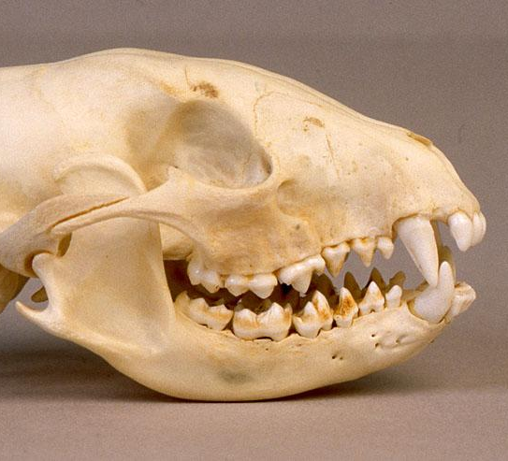
Omnivore: Teeth
Omnivores
eat both plants and animals.
have all four types of
teeth characteristics are a mix between carnivore and herbivore
Notes:
Finally, let’s look at the teeth of omnivores. They are usually of a mix-and-match variety, as they eat both plants and meat. They will generally have all four types of teeth.
Image of Racoon from: http://www.skullsite.co.uk/Racoon/raccoon_lat.htm
Retrieved 2/26/2019

Slide 35
Omnivore Teeth: Incisors
Incisors
Well-developed
Used for both clipping plants and grasping prey
Notes:
The incisors in the front are usually well developed. They are used for both clipping plants and grasping prey.
Image of Racoon from: http://www.skullsite.co.uk/Racoon/raccoon_lat.htm
Retrieved 2/26/2019

Slide 36
Omnivore Teeth: Canines
Canine teeth are:
Long and pointed
Used for capturing prey and tearing
Notes:
The canines of omnivores can be confusing too. They can seem just as pronounced as those in some predators. They are long and pointed and are used for capturing prey and tearing meat.
Image of Racoon from: http://www.skullsite.co.uk/Racoon/raccoon_lat.htm
Retrieved 2/26/2019

Slide 37
Omnivore Teeth: Cheek Teeth
Pre-molars and molars:
Long and pointed
Used for capturing prey and tearing
Notes:
The pre-molars & molars may be slightly pointed but are still broad enough to have significant contact between upper and lower cheek teeth when jaws are closed; used for shearing and crushing. Some may overlap slightly for a scissor effect. They tend to be more pronounced than those in carnivores.
Image of Racoon from: http://www.skullsite.co.uk/Racoon/raccoon_lat.htm
Retrieved 2/26/2019

Slide 38
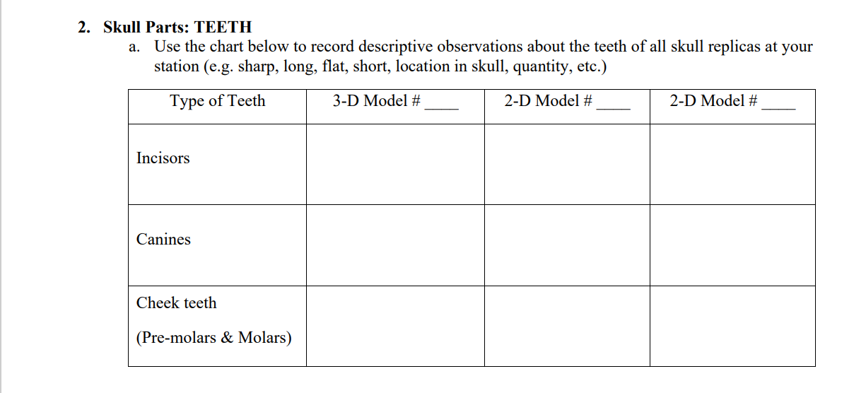
Teeth: Note your observations
Look at the TEETH on the skulls at your station.
Record descriptive observations of each type of teeth:
Incisors, Canines, Pre-molars and Molars
Notes:
Skull Detectives Lab Sheet: Part 1: Question 2: TEETH
2a. Now, back to your worksheet. Use the chart in question 2 to record observations about the teeth of all the skull replicas at your station. There should be one 3D model and two 2D paper models. Complete your observations for the incisors, canines and cheek teeth (pre-molars and molars).
Example: incisors are long, flat, absent, short… location in the skull, quantity, etc.

Slide 39
What Type of Consumer is each skull?
 | Carnivore | Herbivore | Omnivore
Incisors | Small and less developed | Large, well-developed, may be missing top jaw incisors | Large & well-developed
Canines | Large, long, prominent, & pointed for piercing & holding prey | If present flat & non-pointed; often not present & instead herbivores will have a flatten palate that act like a cutting board for the lower incisors to cut plant material against | Long & pointed
Cheek Teeth | Sharp & pointed, upper jaw teeth overlap lower jaw teeth when mouth is closed creating a scissor-like cutting ability | Large, broad, & flat; upper & lower cheek teeth match when jaw is closed to maximize grinding ability | Pre-molars & molars may be slightly pointed but still broad enough to have significant contact between upper & lower cheek teeth when jaws are closed; used for shearing and crushing
Is each likely to be an:
Herbivore
Carnivore
Omnivore
Notes:
Skull Detectives Lab Sheet: Part 1: Question 2b: What type of consumer?
2a. Based on your observation about the teeth of your skulls, what type of consumer (primary or secondary) are each of your skulls? Please write “primary” or “secondary” beside each model # on your sheet and explain your answer. (Ex: 3-D Model # 1: Secondary; 2-D Model # 5: Secondary; 2-D Model # 9: Secondary)
Would you guess that they are likely to be an:
Herbivore
Carnivore
Omnivore
2b. Circle your answer for each skull.
(CLICK for next screen: reminder chart of attributes)

Slide 40
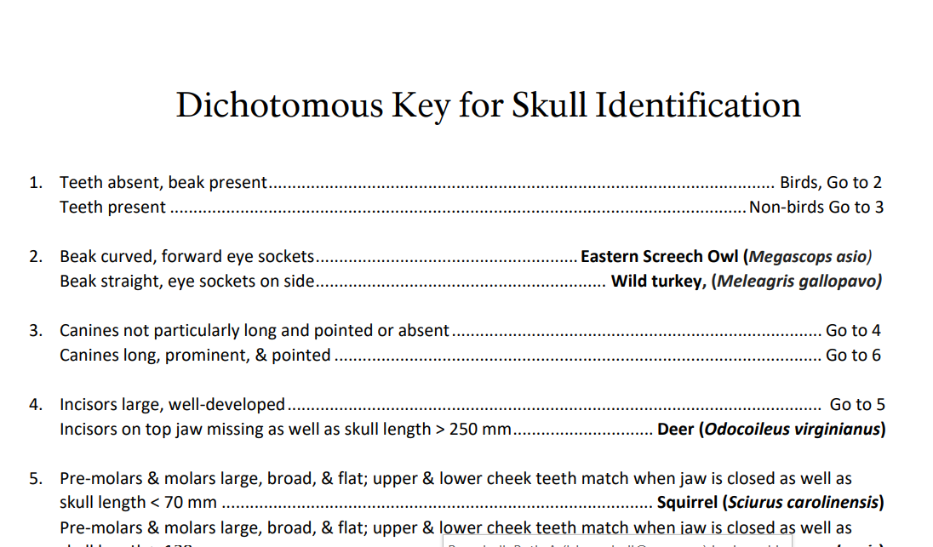
Worksheet Part II:
Time to solve the mystery
Notes:
Worksheet Part II
Once you have figured out what type of consumers you have, we’ll use the “Dichotomous Key for Skull Identification” laminated sheet to narrow down what animal we might be looking at. (Pass out the sheets)
Dichotomous comes from (from the word: dichotomy: a contrast between two things. It comes from the Greek “dikho” meaning “in two” + “temnein” meaning “to cut”.)
If you’ve ever had “dichotomy popcorn”, it is sweet and salty!)
To use the key, answer each question, and move to the number on the list according to your answer.
“Part II: Skull Identification”, question 1., write your guesses. Put the skull number in, and then your guess for the species.
Now, find the card for your animal species guess, and set out the matching cards to your skulls. See if you can pronounce the Cherokee translation of your animal’s name.
Please write your answers in PART II of your worksheet and answer
Who would like to “report” to the rest of the class what animals they think they have for the 3D skull, and what brought you to that conclusion? For the 2D skull?
(Or just reveal the answers on the next slide.)

Slide 41
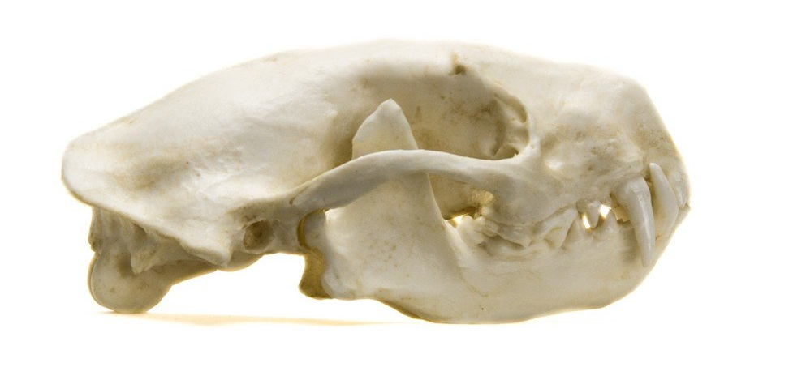
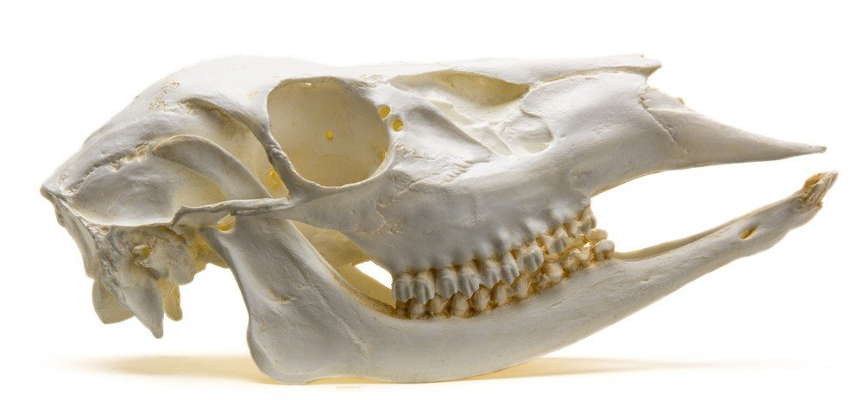
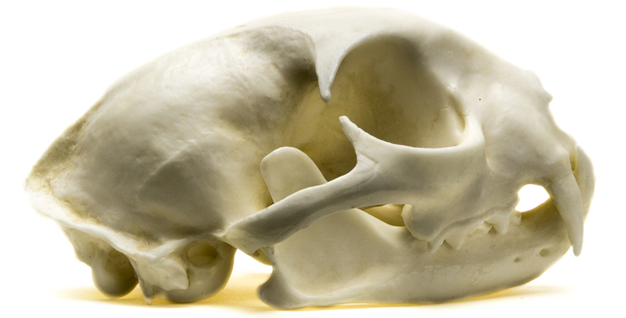
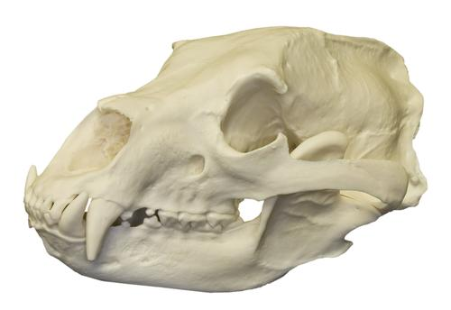
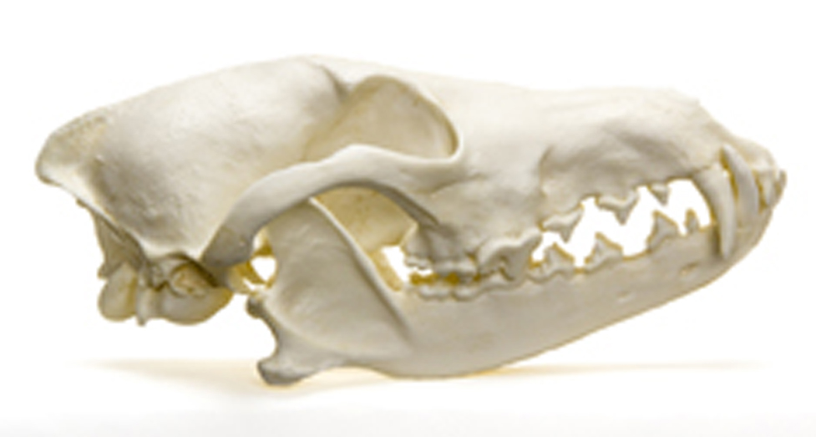
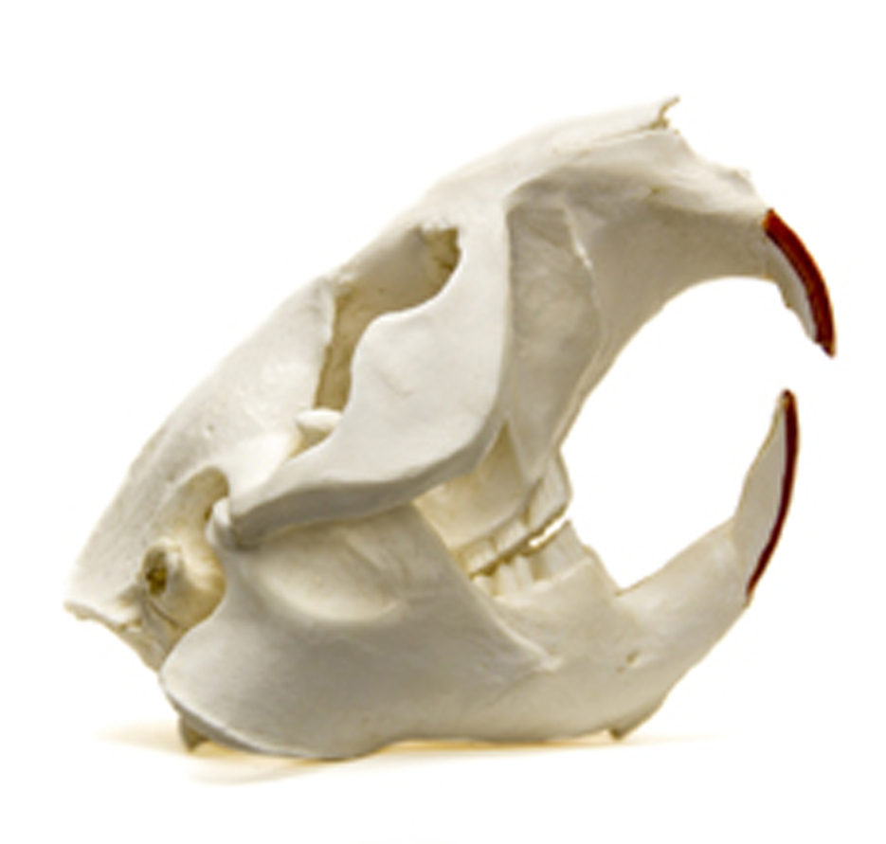
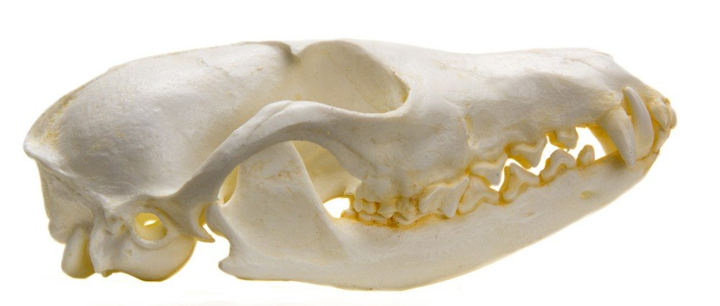
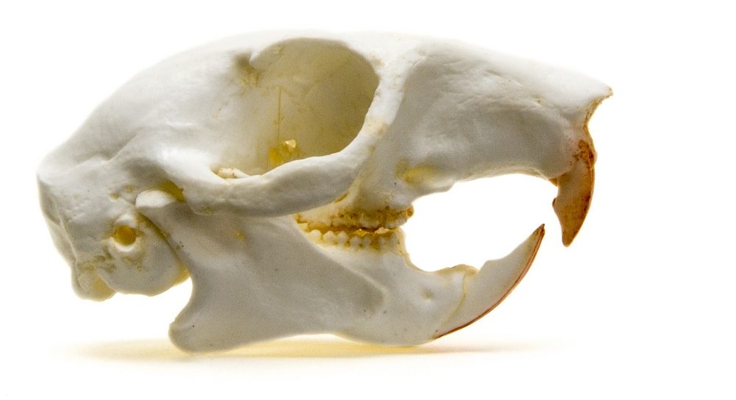
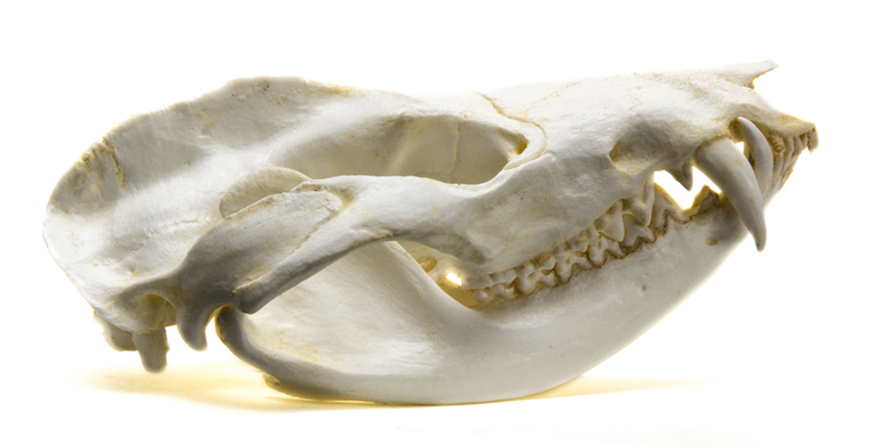
Worksheet Part II
The Moment of truth!
#1 = Bobcat (3D)
Carnivore
#2 = Skunk (2D)
Omnivore
#3 = Deer (2D)
Herbivore
#4 = Beaver (3D)
Herbivore
#5 = Black Bear (2D)
Omnivore
#6 = Coyote (2D)
Carnivore/Omnivore
#7 = Opossum (3D)
Omnivore
#8 = Red Fox (2D)
Carnivore
#9 = Squirrel (2D)
Herbivore
Notes:
Compare your answer to the answers on the screen.
Were your 3D skull guesses correct? Your 2D? Were you correct in the observation of the type of consumers at your station?
Why was one easier to solve than the other? What do you now realize, knowing the identity of your skulls?
Skull Identification Key (adaptation notes)
#1 – Bobcat (3-D) - Carnivore - notice the very large eye sockets and canine teeth. It is built to catch prey and see in the dark!
#2 – Skunk (2-D) – Omnivore - notice the variety of teeth that make it the perfect “garbage man” of the night, scavenging whatever it can find.
#3 – Deer (2-D) – Herbivore - notice the lack of canines, the flat “cheek teeth” for grinding plants, and the eye sockets on the side for defense.
#4 – Beaver (3-D) – Herbivore - notice the very flat “cheek teeth” for grinding wood and especially the darkened and pronounced incisors, coated with iron for strength, allowing it to cut down trees. The eye sockets are almost on the top of the head, to see above the water!
#5 – Bear (2-D) – Omnivore - with a huge nasal cavity, bears rely on smell to find food, and their varied teeth help them eat both meat, berries, nuts and plants. Most of their diet is from nuts, berries, plants and insects.
#6 – Coyote (2-D) – Omnivore/Carnivore - coyotes hunt, using both a keen sense of smell and their strong sense of hearing.
#7 – Opossum (3-D) – Omnivore - Opossums are the only marsupials in N. America, and have a pronounced snout (larger than their braincase) for smelling food. They have the most teeth of any mammal, with 50 sharp teeth, and open their mouths to scare away predators. If that doesn’t work, they play dead, and if that doesn’t work, they go to the bathroom on themselves! They’re harmless, resist rabies, and are great because they can eat up to 5,000 ticks a season!
#8 – Fox (2-D) – Carnivore – fox are also carnivores, with a keen sense of hearing, sharp canines for catching prey, and a long snout for reaching into holes after rodents.
#9 – Squirrel (2-D) – Herbivore - squirrels have pronounced incisors and strong jaws used almost like a nutcracker. Their large eyes on the side of their heads detects movement from possible predators.

Slide 42
Worksheet Part III:
World of your skulls:
Answer questions 1-6
Notes:
Part III: The World of Your Skulls
1. Is your 3-D skull animal a primary consumer or a secondary consumer? What do you think it mostly eats?
2. Please create a food chain that includes the animal of your 3D skull.
3. Please create a food web that includes all 3 of the animals at your lab station and record your answer below. (No fewer than 6 organisms.) Collaborate with a neighboring group for their initial food chain for ideas!
4. What would happen to your 3-D skull animal’s population if there was a historic drought in the habitat where it lives?
5. A city developer has decided to build a large housing development in the habitat of the food web you created in question #2. How might this impact the population of your 3-D skull animal? Which animal population of the models at your lab station would be impacted the greatest and why?
6. Once you have completed the section above, pick 2 questions from below to discuss as a group. Please record some of the group’s thoughts in the space provided below.
How do my actions impact the food web around my home?
What profession would use the skills of skull identification as a part of their job?
How does the human skull compare to these other animal skulls?
How might animal skulls in groups such as reptiles, birds, or amphibians differ from the skulls of mammals?
(image: TXWC.gov)

Slide 43
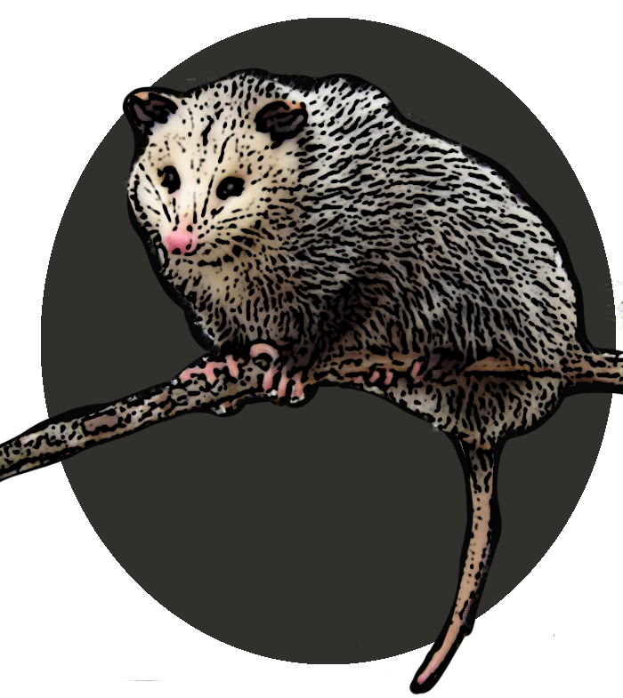
Inspiring stories
Inspiring research
What would you want to learn about these animals?
How do animals inspire you?
U-tse-tsdi
Notes:
Adaptations allow animals to survive in their ever-changing habitats. We are all a part of that world, and one of the missions of the National Park Service is to protect the many ecosystems for these animals. Given the pressures of development and human encroachment on the natural world, it is important to have lands set aside where animals can “do their thing”.
Animals provide inspiration, serving as characters in our stories and movies, inspiration for songs and sayings, subjects of art and science, and even give us ideas for inventions. They connect us to our cultures in so many ways. How do you connect with animals in your world?
(Art: NPS/bbramhall)

