Slide 1
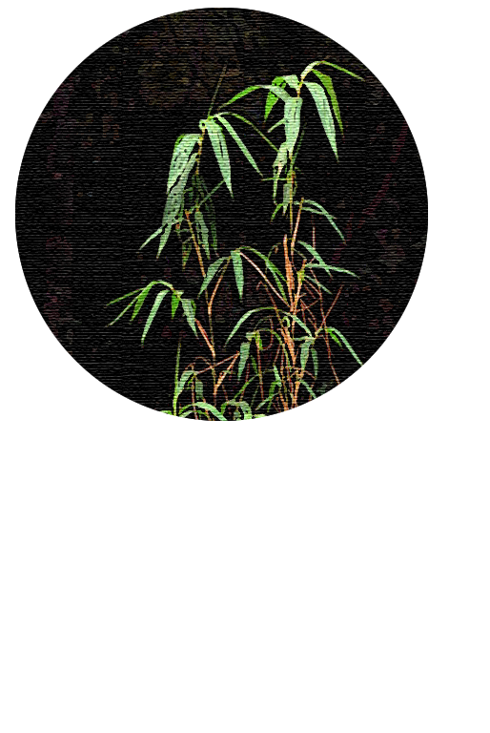

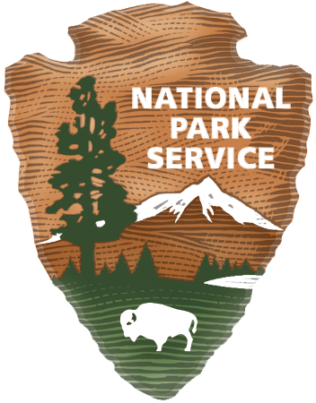
Rivercane Mapping - Introduction
Raising Cane: Restoration of “Cherokee Plastic”
Notes:
Is it possible for a plant to be a “super plant?”
Rivercane is a source of Cherokee cultural identity and is also important ecologically. It preserves riverbanks and improves water quality. However, it is now considered a threatened ecosystem. Is it worth our protection?

Slide 2
Why is Rivercane Important?
What’s the big deal?
Notes:
So, why do we care?
Do any of you have any knowledge about rivercane and its importance?

Slide 3
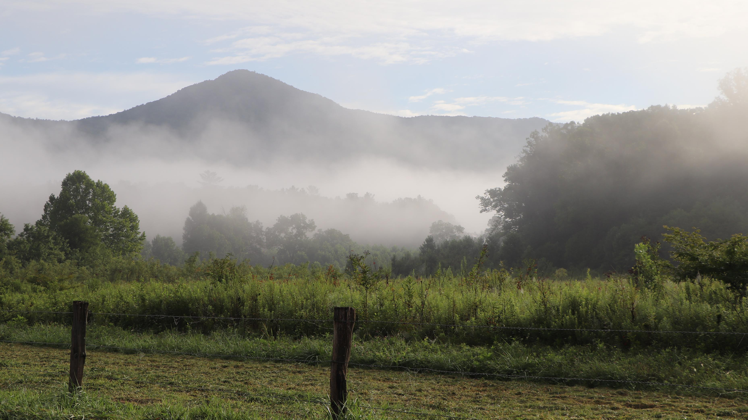
Rivercane in the National Park
Why do we care?
Notes:
The Great Smoky Mountains National Park works to preserve and protect both natural and cultural resources in this diverse area. With so many different ecosystems, rivercane can be found in several areas around the park and within the surrounding communities. The Smokies are within the ancestral lands of the Cherokee people and share the mountains with the Qualla Boundary, the modern home of the Eastern Band of Cherokee Indians.
The Park is working with the tribe to manage resources important to the tribe. For example, sochan, or cutleaf coneflower, can be selectively harvested for traditional uses through a lottery system.
Image: NPS

Slide 4
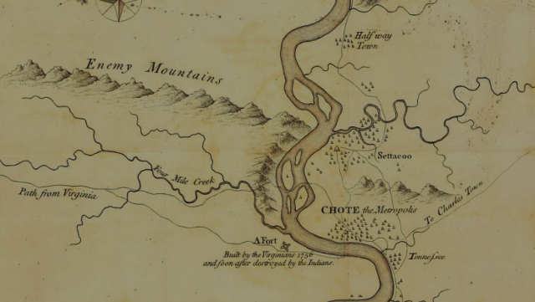
Historic Significance
Notes:
Let’s first examine some things we know about rivercane’s history here.
Imagine walking through forests of rivercane, stalking wildlife, fishing, gathering food. Several Cherokee stories point to rivercane’s use and early written accounts of European explorers mention its use as well.
(If time)
In 1540, Hernando DeSoto wrote of the reliance on rivercane for baskets and homebuilding.
Botanist Mark Catesby described rivers “covered with spacious tracts of cane” in 1724, as he documented local flora and fauna, as did William Byrd in 1728, describing “a Forest of Tall canes”.
William Bartram’s 1775 exploration and documentation of the southern Appalachians described “perhaps the most extensive Canebreak (sic) that is to be seen on the face of the whole earth”.
When Henry Timberlake visited the Cherokees in 1754, he described vast canebrakes dominating the lowlands and the hunting of small game by children using cane blowguns. Other accounts describe dense stands, as well as local usage.
Image: Timberlake map 1754, PD.

Slide 5
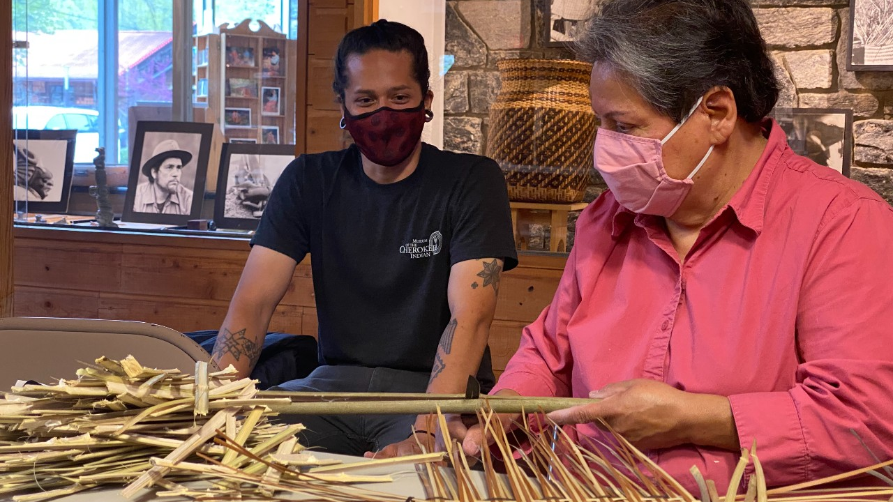
Cultural Importance
Referred to as “the plastic of the Southeastern Indian”
Image: Conserving Carolina / RoseJenkinsLane
Artisans: Dylan Morgan and Lucille Lossiah
Notes:
What is something that you use every day? What is it made of? Now imagine that resource gone, how would you adapt without it?
The Eastern Band of Cherokee and their ancestors have used native rivercane, a North American relative of bamboo, for centuries (at least 500-1500 years) and many continue those traditions today. Archeologist Dr. Charles Hudson referred to it as “the plastic of the Southeastern Indian”, and many have called it “Cherokee plastic” because of its versatility.
Rivercane was abundant, versatile, strong, waterproof and valuable in its many uses. It could be straightened, bent, split, woven, and drilled. (ᎢᏯ - “ihya” – pronounced “ee-hee-yah”) (Arundinaria gigantea)
Image: Conserving Carolina / RoseJenkinsLane
Artisans: Dylan Morgan and Lucille Lossiah

Slide 6
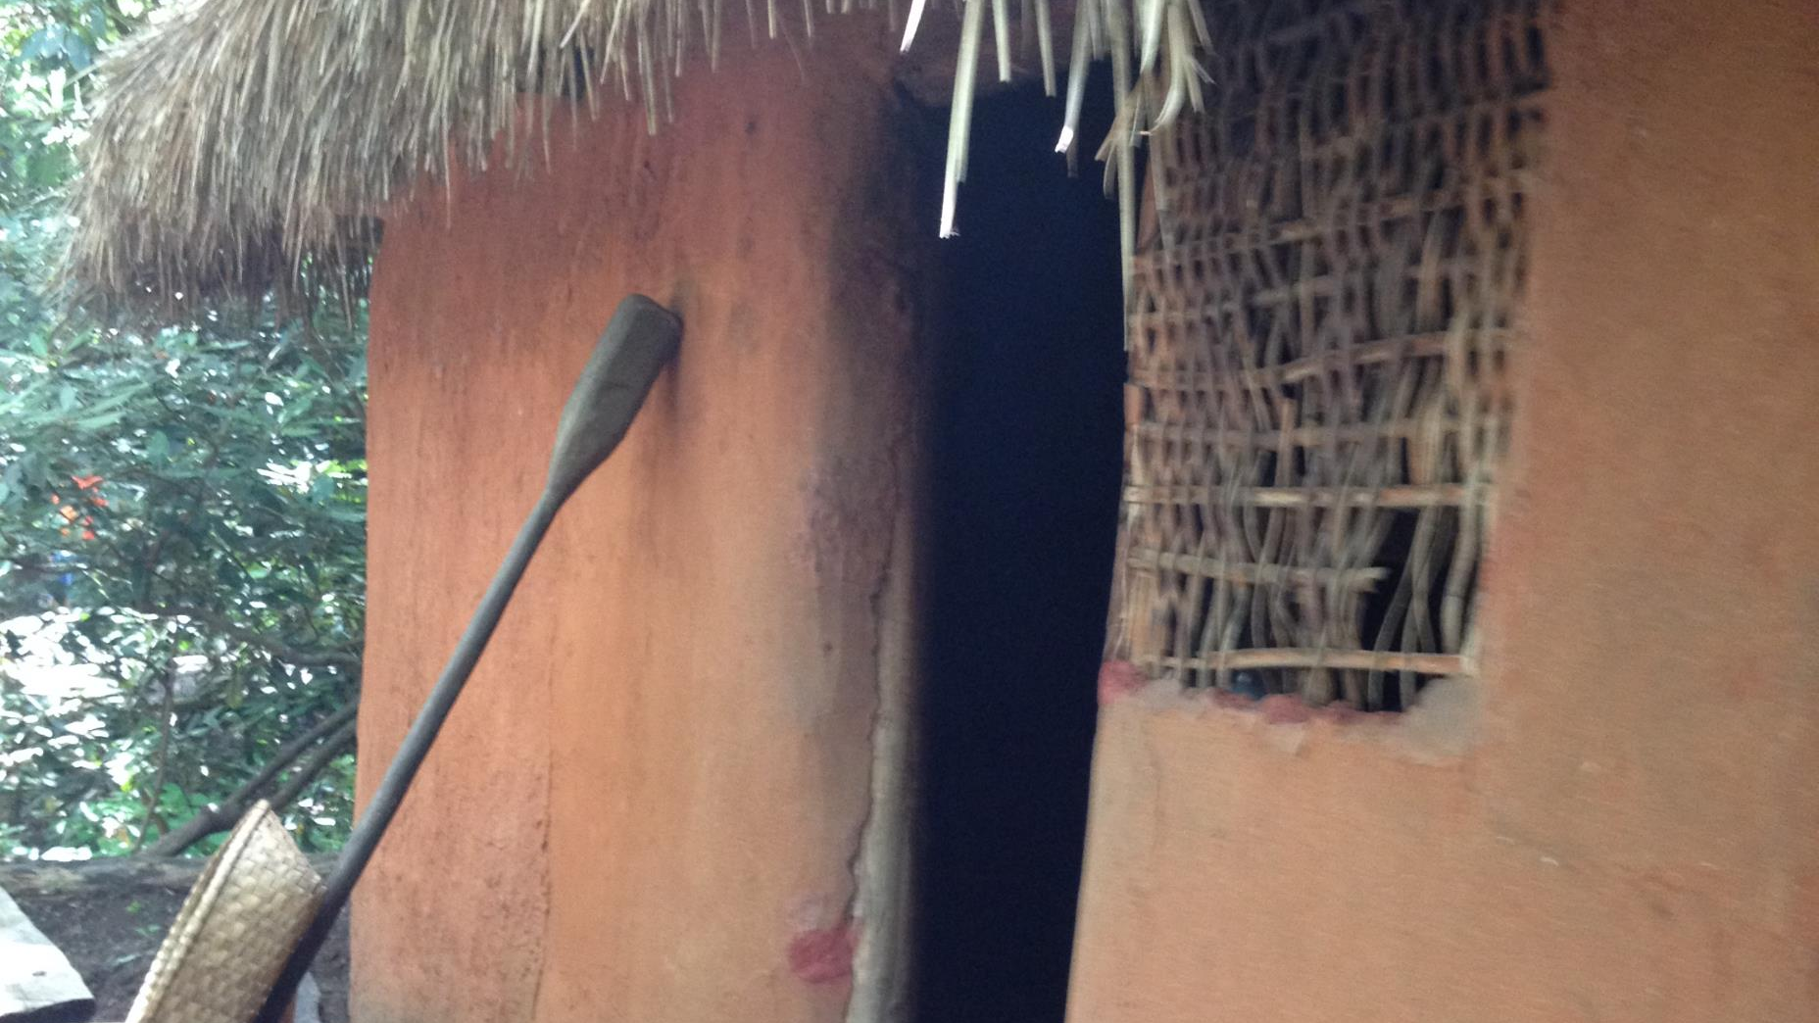
Homes
Image: Courtesy of Oconaluftee Indian Village
Notes:
Being lightweight with the strength compared to steel or modern materials, rivercane could be used to build houses. Cane was woven into walls, and then covered with mud and clay compounds to create an adobe like structure. Furniture could also be built, and mats woven for rugs and sleeping.
NPS (B.Bramhall) – Oconaluftee Indian Village

Slide 7
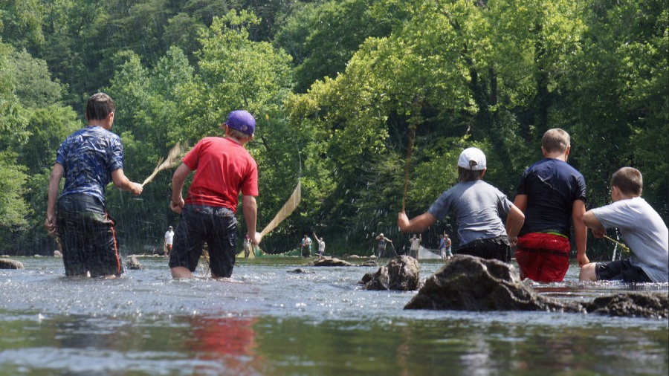
Fishing Weirs
Image: Courtesy of USFW & WATR
Notes:
Fish could be funneled by creating weirs to corral them downstream. Low rock walls would be built in the riverbed, extending from the shores and shaped like a “V”. A line of women and children would form a chain and smack the water with rivercane poles, driving the fish into the rock funnel, and eventually a basket-like trap made of rivercane.
Reference
USFW - image
Watershed Association of Tuckasegee River (WATR)

Slide 8
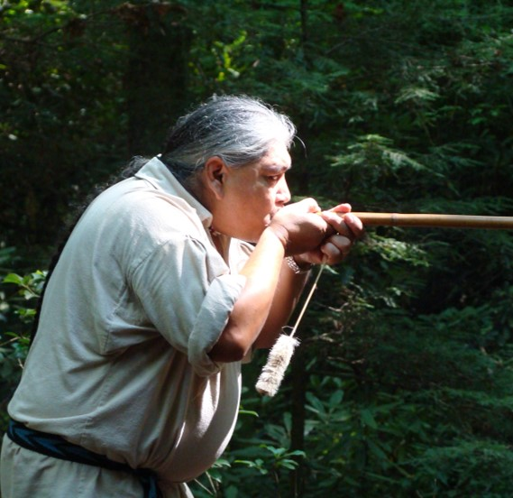
Weapons
Image: courtesy of Oconaluftee Indian Village and the Museum of the Cherokee
Notes:
Rivercane could be hollowed out by dropping hot embers inside to burn through the joints. The rod could then be straightened by applying heat. The result would be an effective blowgun, used to hunt small animals using darts made from wood and thistle. (See Blowguns Program for more info.)
Reference
Oconaluftee Indian Village - image
Museum of Cherokee Indian

Slide 9
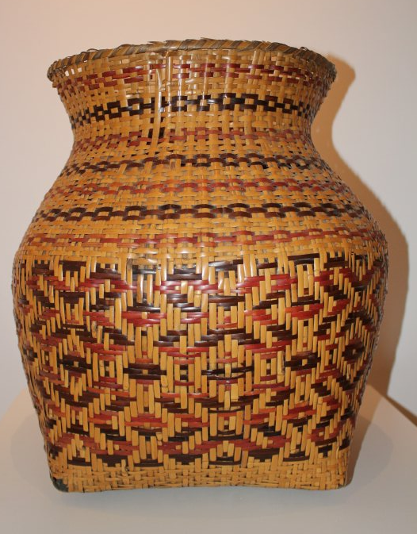
Baskets
Notes:
Rivercane could also be stripped and split into very narrow sections. The cane could be dyed with various trees and plants, soaked, and woven into intricate baskets. Intricate double-walled baskets can mystify, with one pattern on the inside and another on the outside. They can be woven tightly enough to haul water. Very few artisans today are able to make these amazing basket.
Images:
NPS (B. Bramhall)

Slide 10
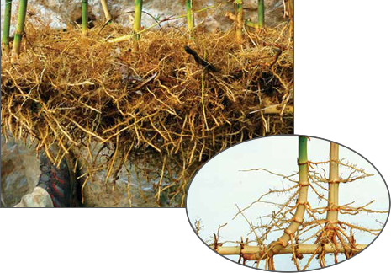
A Natural Water Filter
Image: South River Waterhed Alliance
Notes:
Rivercane is an important buffer for streams. The woven rhizomes (roots) of rivercane provide structure for stream banks, lessening erosion. This is especially important with the increase in flood events due to climate change.
Ecologically important, it also filters contaminants and sediment from riparian (wetland) areas. Imagine the stalks as a huge teabag for water to filter through, the finely knitted roots removing toxins such as nitrates in agricultural areas. It is also important in its role in stabilizing and protecting eroding riverbanks, especially in flooding events. Soil can wash away from runoff without the Velcro-like structure provided by plants such as rivercane.
Image: South River Watershed Alliance

Slide 11
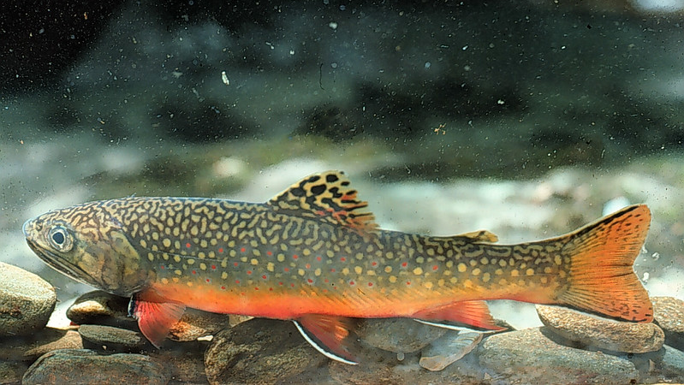
Important Wildlife Habitat
Image: South River Waterhed Alliance
Notes:
Found from Maryland to Florida, and as far west as Texas, rivercane serves as important habitat for over 60 species of wildlife including mammals, birds, amphibians, fish, insects and reptiles. Birds build their nests in canebrakes, bears find refuge, snakes live and hunt there, and white-tailed deer graze on tender shoots in spring. Several butterfly species also rely on canebrakes for habitat.
If streams get murky, fish cannot find food, see prey or predators. The woven rhizomes (roots) of rivercane also provide structure for stream banks, lessening erosion. This is especially important with the increase in flood events due to climate change.
Image: NPS

Slide 12
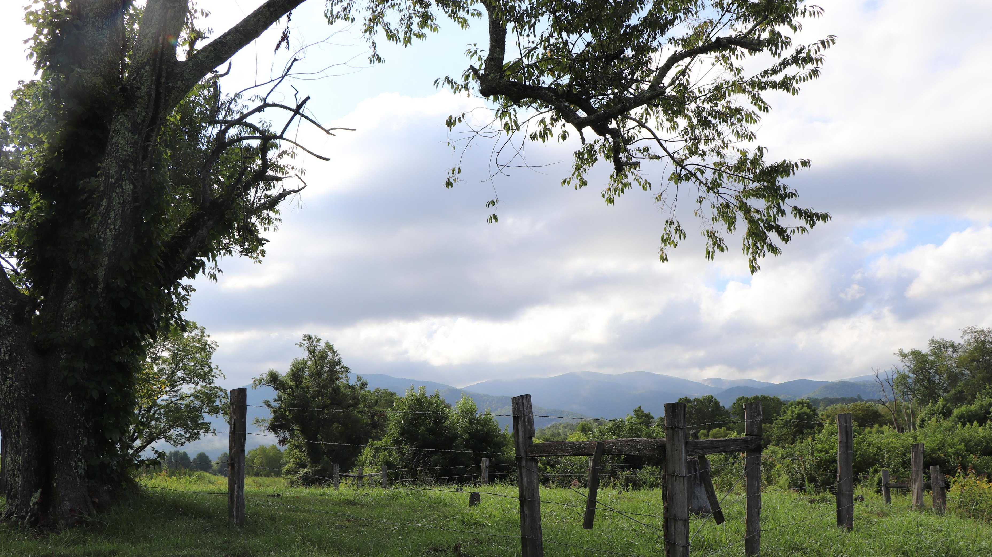
Disappearing Range
Less than 2% of original range
Notes:
Unfortunately, canebrakes have disappeared over time due to years of colonization, cattle-grazing, land prospecting, development, farming, logging and competition from exotic bamboo. It now only occupies 2% of its historic range, making canebrakes a technically endangered ecosystem. Efforts are underway to restore and increase knowledge about this amazing plant.
With the arrival of European colonists, the demand for land resulted in an aggressive eradication of rivercane. Just as bison were important to western cultures, rivercane in the East was vital to tribes in many ways. By destroying canebrakes, those wanting the land could put further pressure on Cherokee and other tribes by diminishing their resource needs. Generations of cutting, burning, using grazing cattle to destroy the giant stands, and hogs to root up the rhizomes, resulted in a dramatic landscape change. In the recent years, development and invasive plants have further strained the rivercane population.

Slide 13
What is Rivercane?
Arundinaria Gigantea
Notes:
“Arundinaria gigantea” is the scientific name of rivercane and refers to the native “Giant Rivercane” that grows in North America.
What do YOU know about rivercane?
There are three different Arundainaria species found in the US:
Arundinaria Gigantea (rivercane)
Arundinaria Appalachiana (hill cane)
Arundinaria tecta (switch cane – in swamps)
Rivercane is found from southern New York to central Florida, and as far west as Texas. It is classified as a “native, perennial, evergreen grass that grows to a height of 6.6’ to 32.8’. The stems are round and hollow, 0.7” to 3” thick.” (USDA). It reproduces mostly from rhizomes, as seed production is rare. Seedlings grow painfully slowly, with 3-year-old seedlings usually less than a foot tall!
Image: Artwork (BB via USDA Image)

Slide 14
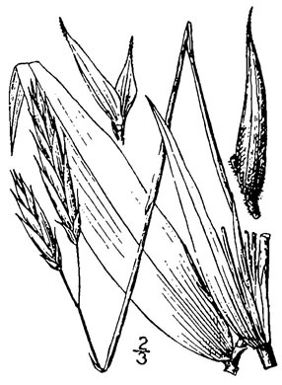
Yes, but What IS Rivercane?
North American Bamboo
Spreads via underground rhizomes
Leaves for photosynthesis
Nodes: segments
Image: 1913 Illustration by Britton/Barown (USDA/NCRS)
Notes:
Rivercane is a type of bamboo, and like other grasses, spreads underground with rhizomes (like “roots”), sends up shoots that produce culms (a protective layer, like tree trunks), and branches with leaves, for photosynthesis.
Along the culm, or “trunk” of the cane, branches grow from the solid “nodes”, where you see a segment line. Between these nodes are hollow internodes.
It only flowers every 30-40 years, but has been observed 3-50 years, and the blossoms continue for about a year. The length of time for a seed to germinate, grow and die is suggested to be 20 years or more. There is still a lot to learn about the life cycle of rivercane.
Image: 1913 Illustration by Britton and Barown (USDA/NCRS)

Slide 15
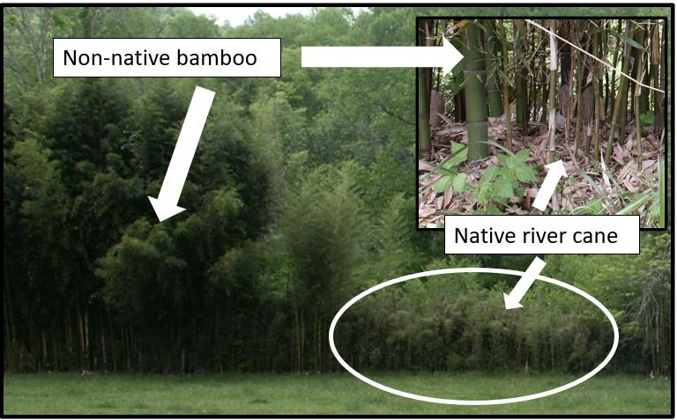
Rivercane vs.
Invasive Bamboo
Thinner (1” in diameter)
Shorter (usually 15’ or less)
Image: Adam Griffith, EBCI RTCAR
Notes:
While both are members of the grass family, rivercane is native to the United States and is different from much of the exotic bamboo we see in our region.
So, how can we identify which is which?
The exotic bamboo found here is often Chinese Golden Bamboo and is highly invasive and difficult to remove once started. It is larger than rivercane, often over 3” in diameter, and much taller, often over 30 feet. When seen together, the bamboo dwarfs the rivercane, as seen in this image. It usually crowds out native rivercane along streams.
Golden Bamboo generally has thicker nodes or joints.
Rivercane generally grows about 1” in diameter at most, and usually to 15 feet tall. Some grow taller but are generally decades old.
Rivercane leaves are more leathery than exotic bamboo.
Image: Adam Griffith, EBCI RTCAR

Slide 16
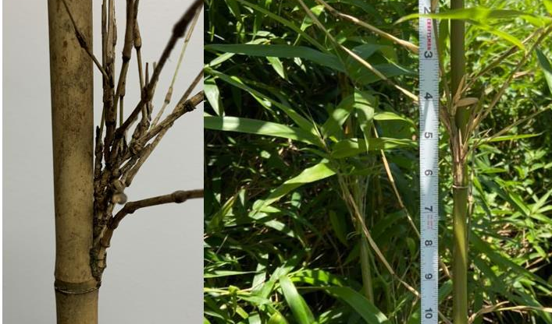
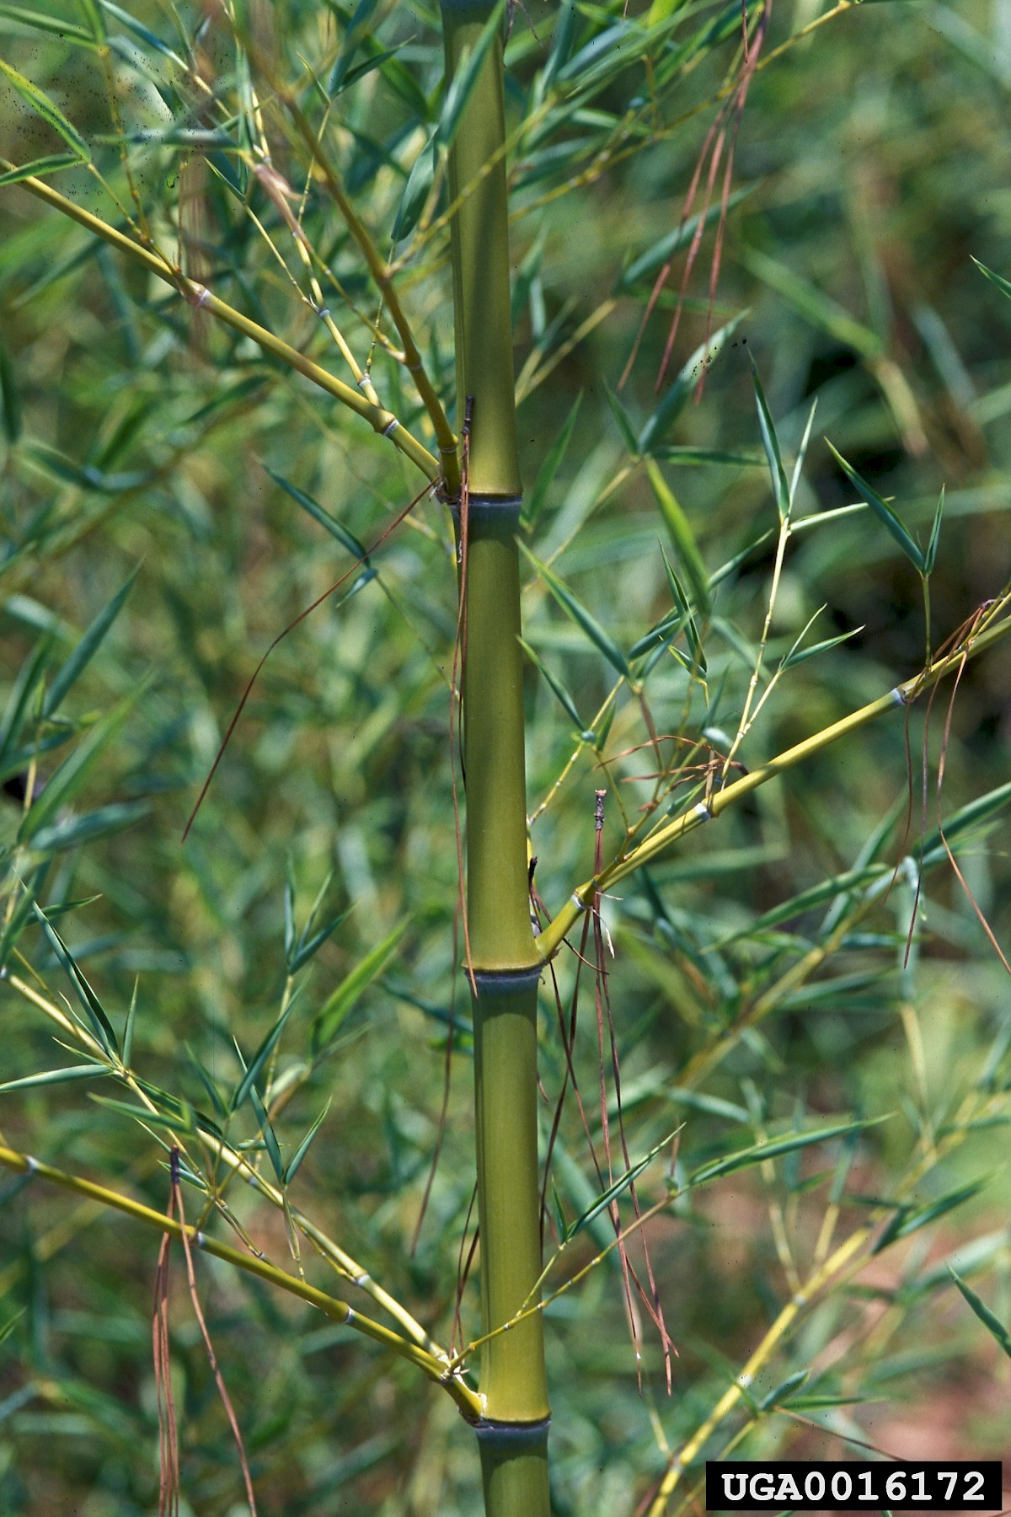
How is it Different from Bamboo?
Branches parallel to stem
Single branch or clump at each joint
No groove along main stem
Image: Adam Griffith, EBCI RTCAR
Notes:
Branches forming at the joints can help with identifying rivercane versus bamboo.
Angle of branches: rivercane branches often try to grow parallel with the main stem, angling sharply upwards. Exotic bamboo generally grow at a 45-degree angle or perpendicular at 90 degrees.
Rivercane usually has single branch or clump of branches at each internode, or joint. Non-native bamboo often has two branches at each joint.
Non-native bamboo usually has a groove, called a sulcus, along one side of the stem between nodes.
Image: Adam Griffith, EBCI RTCAR

Slide 17
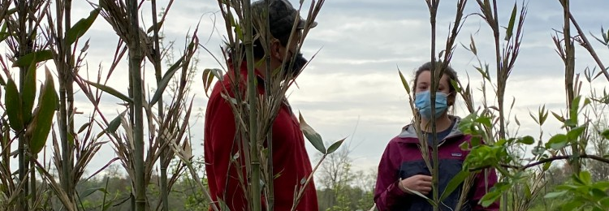
Where does it live?
Along river banks
Slopes, floodplains & woodlands
Light tree cover or open areas
Sandy to clay soils
Neutral to acidic soils
Image: Bo Taylor and Laura Anderson / Conserving Carolina
Notes:
Cane inhabits lower elevation moist sites, mostly along river and stream banks, but also on slopes, floodplains and woodlands. It can tolerate floods but doesn’t like to have consistently “wet feet”. It thrives in well-drained silty loams but can grow in soil types from clay to sand. It can be shade tolerant and thrives in areas with light tree cover. It usually grows in neutral to acidic soils.
Canebrakes are considered “fire-dependent ecosystems” and grow well in areas that are disturbed by fire every 2 to 8 years. While fire kills many other aboveground plant parts, it helps cane in the stimulation of new sprouts and elimination of competition.
………………………………
Image: Bo Taylor and Laura Anderson / Conserving Carolina

Slide 18
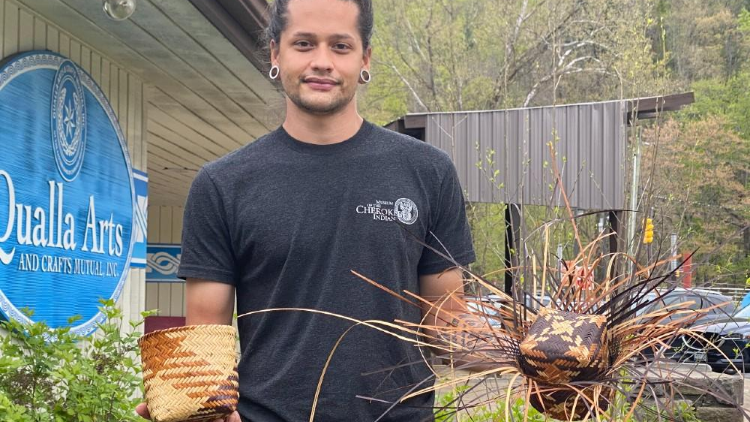
New Interest in Rivercane
Younger generations learning to use rivercane
Image: Dylan Morgan / Conserving Carolina
Notes:
Artisans young and old are interested in using rivercane to continue the traditions of the community. This is Dylan Morgan, a member of the Eastern Band of Cherokee Indians. He is working to learn more about the culture and science of rivercane.
Image: Dylan Morgan / Conserving Carolina

Slide 19
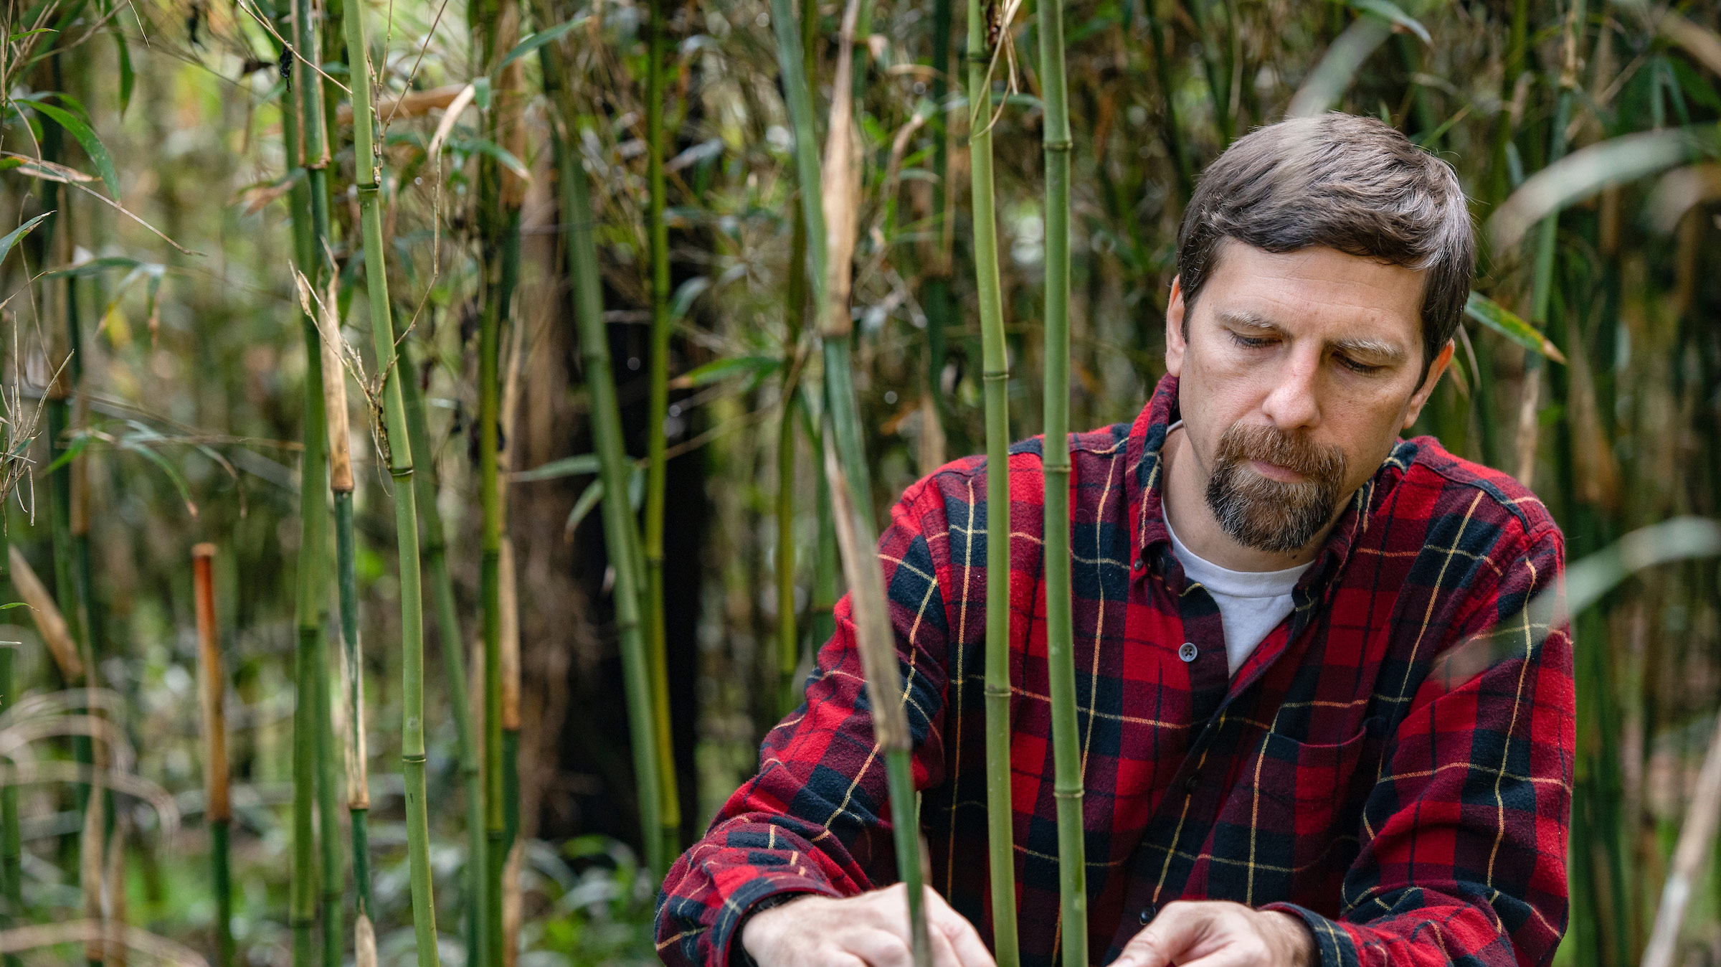
Studying Rivercane
Image: Adam Griffith, EBCI RTCAR
Notes:
Scientists and artisans are working together to study where rivercane is found and how to propagate more healthy stands. This is Adam Griffith, who with others, has studied rivercane for years. He works with the tribe and other agencies and community members to help identify and expand existing rivercane habitat.
Image: Adam Griffith EBCI/RTCAR

Slide 20
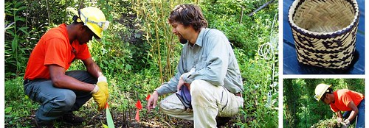
Studying Rivercane
Where is rivercane found?
What is the best way to propagate it?
What is the best way to manage it?
Image: Adam Griffith, EBCI RTCAR
Notes:
Some of the questions that Adam and his crew are trying to answer are:
Where is rivercane found?
What is the best way to propagate it?
What is the best way to manage it?
How can we help keep traditions alive?
Image: Adam Griffith EBCI/RTCAR

Slide 21
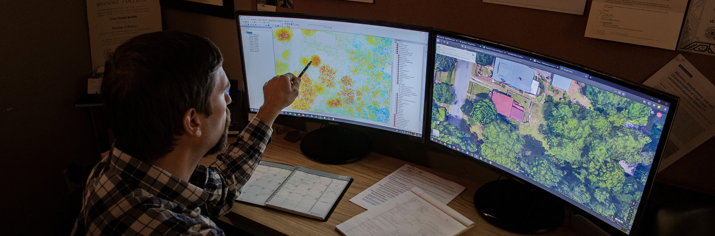
Rivercane Mapping
Where might rivercane be found?
  Soil Type
  Water Sources
  Elevation
Image: Adam Griffith, EBCI RTCAR
Notes:
Mapping and modeling are methods that scientists can use to find where rivercane might grow, and where it might be best planted and managed.
Scientists look at data about elevation, soil type, water sources and other information, and determine which areas might be targeted for rivercane habitat.
Today, you will get a chance to try your hand at mapping where you think the best habitat for rivercane might be.
Image: Adam Griffith EBCI/RTCAR

Slide 22
What Does Rivercane Need?
Elevation – prefers areas below 760-m in elevation (2,493.4 ft.)
Close to Water – prefers floodplains
Flooding tolerance – it is unable to withstand long periods of being under water
Solar Energy – prefers thin or no canopy cover
Soil Type – prefers soils with high sand content
Notes:
To find where rivercane grows, we need to know where it thrives.
Elevation – prefers areas below 760-m in elevation (2,493.4 ft.)
Close to Water – prefers floodplains
Flooding tolerance – it is unable to withstand long periods of being under water
Solar Energy – prefers thin or no canopy cover
Soil Type – prefers soils with high sand content

Slide 23
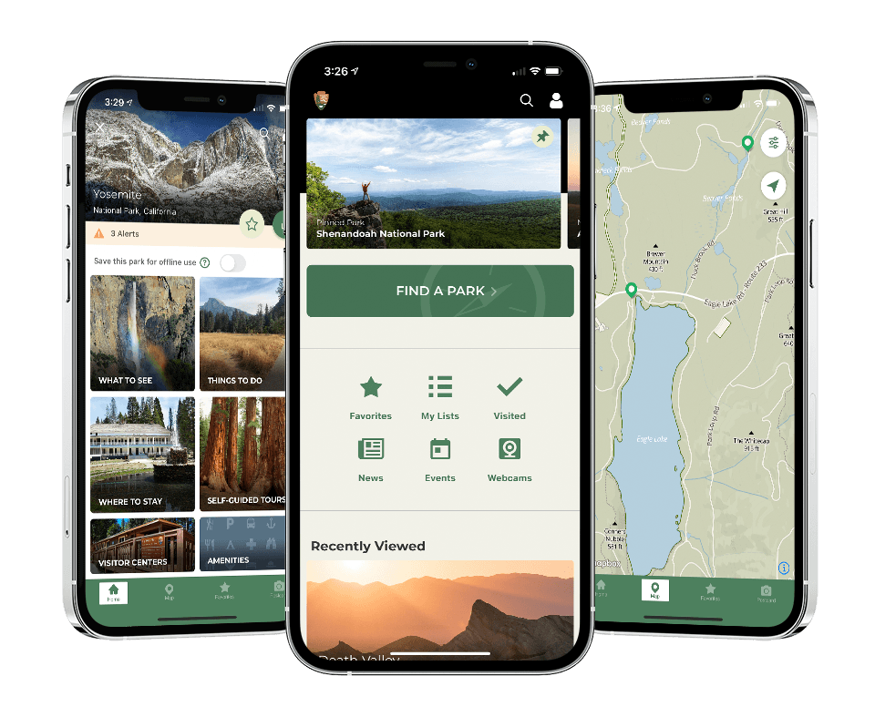
How Does Mapping Work?
Notes:
Have you ever used mapping technology on your phone to find something? (Have students share examples). You can ask the map to show locations of restaurants, stores, parks and other destinations.
Technology has assisted our lives in so many ways. But have you ever stopped to think about how certain things work? Specifically, have you ever used any map app that gives you directions from Point A to Point B with any other stops along the way?
Image: NPS

Slide 24
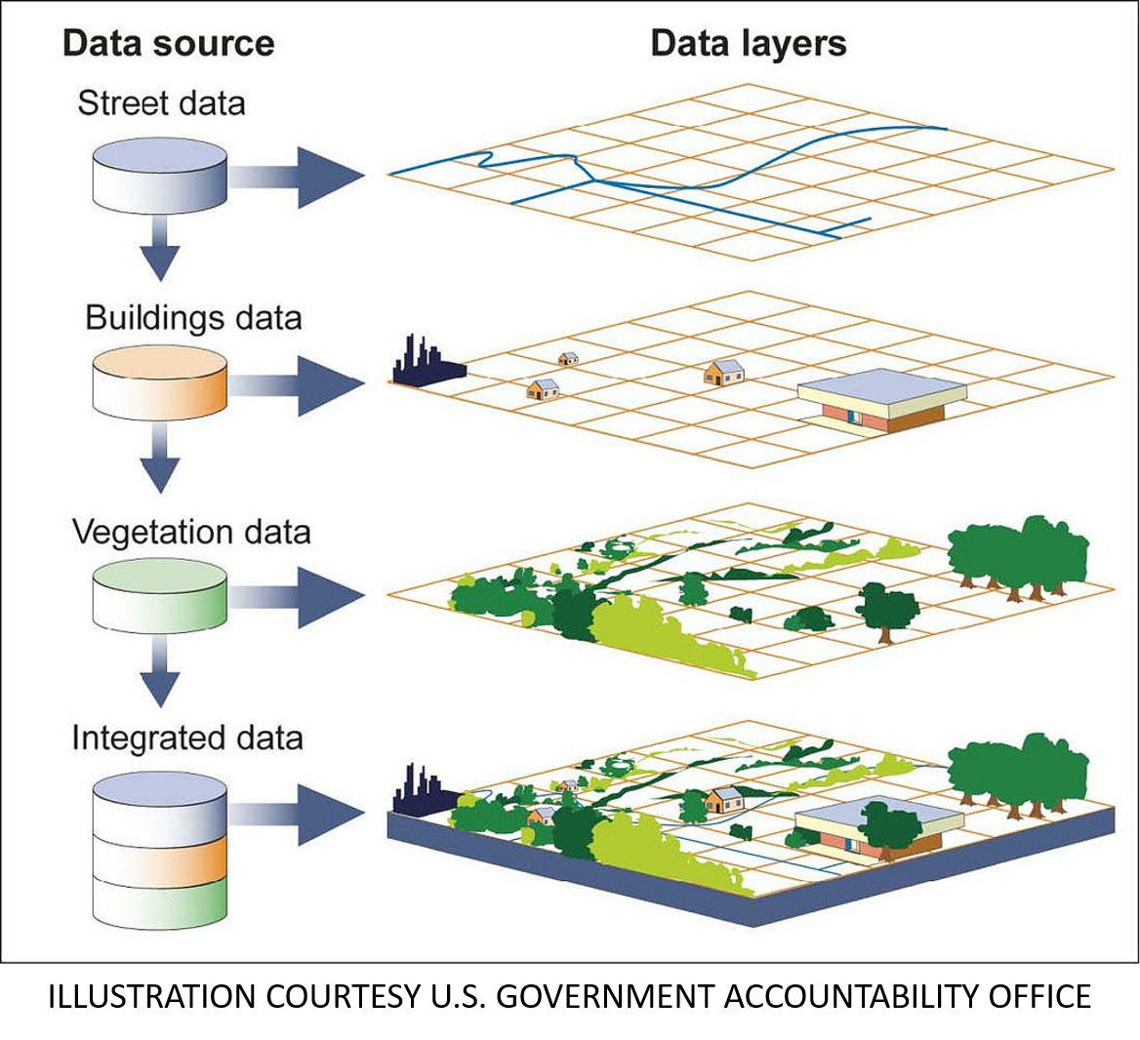
It’s all about layers
GIS: Geographic Information Systems
  Data set variables
  Layer on one another
Notes:
This is possible thanks to something called GIS or Geographic Information Systems.
It allows us to discover new restaurants, but can also help us discover which pieces of land would be best for the restoration of native plants or where to dedicate resources to protecting prime habitats for endangered animals. Plus, so much more!
It does this by taking known data set variables and layering them on one another as in the illustration. Depending on what layers of data are added or removed allow for many different conclusions to be drawn from the same data sets.
Today we’re going to learn how you can help Great Smoky Mountains National Park find the best places to restore a native grass called rivercane (Arundinaria gigantea.)
Image: Adam Griffith EBCI/RTCAR

Slide 25
How Can you Help?
Help find rivercane in your community!
Notes:
You can also help efforts by helping to build the data sets. Community science efforts are collecting data about where rivercane is located and pooling the results using phone apps. You can add data using your smartphone!
Reference – B. Bramhall

Slide 26
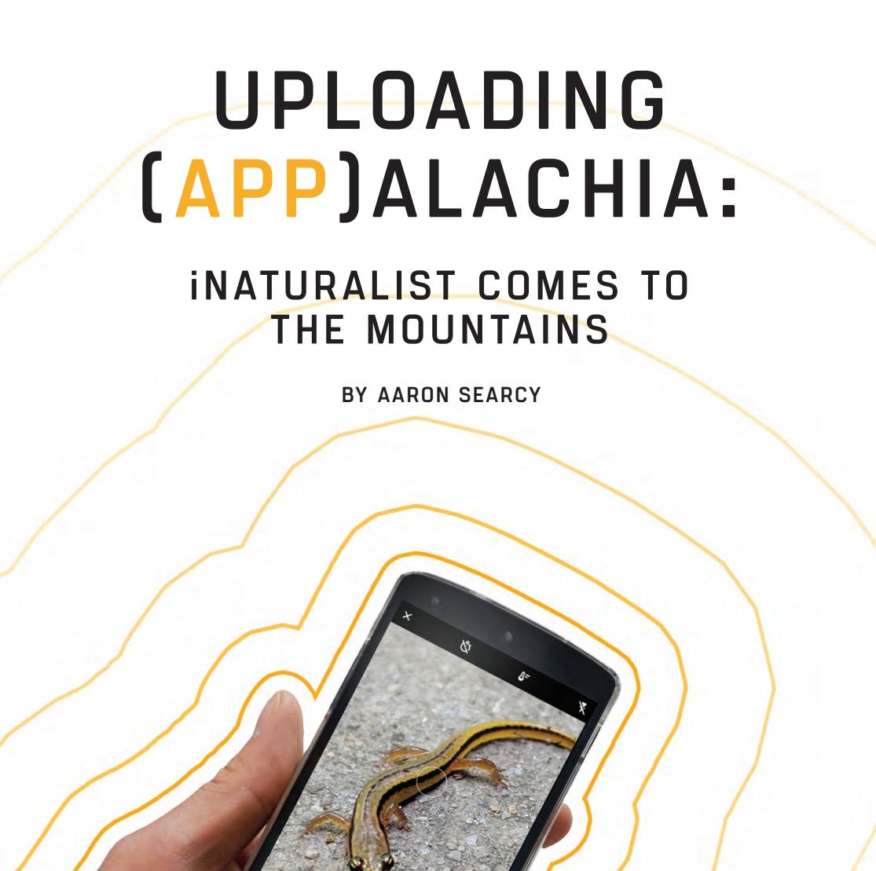


Crowdsourcing Data through iNaturalist & Seek
Notes:
Crowd-sourcing apps, like iNaturalist and Seek, provide much needed data about where people are seeing rivercane. Learn about the species in the Smokies and earn badges in Seek. Scientists refer to the data in iNaturalist to fill out their own studies.
Join efforts such as the “Rivercane Mapping in the Southeast” program - Rivercane Mapping in the Southeast · iNaturalist
Image: iNaturalist

Slide 27
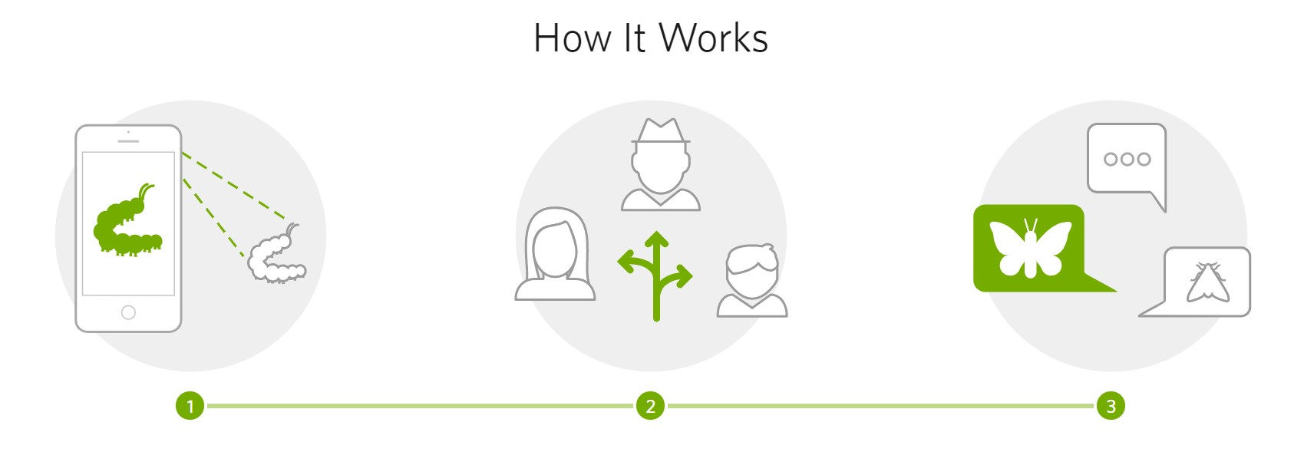
Using iNaturalist & Seek
Notes:
Download iNaturalist app, take photos and share location data to assist Park and other scientists in locating healthy canebrakes. This effort can help in creating regional maps!
It’s as easy as snapping a picture, posting and waiting for others to help identify what you’ve found. Besides rivercane, you can learn about all the other organisms living in our area!
……………………………………..
Image: iNaturalist

Slide 28
Rivercane Mapping Activity
Next, we'll do an activity that shows us where we might find rivercane by learning its habitat needs and where it might be found!
We’ll move to the next presentation to begin our activity.
Notes:
Next presentation labeled:
Rivercane Mapping PPT ACTIVITY

Slide 29
What Questions Do You Have?
Thanks to:
RTCAR.org (Revitalization of Traditional Cherokee Artisan Resources)
Conserving Carolina
EBCI Natural Resources and Speakers Council
iNaturalist.org
Museum of the Cherokee Indian
WCU
USDA / NCRS
Notes:
What questions or comments do you have?
………………………………..
References
RTCAR.org (Revitalization of Traditional Cherokee Artisan Resources)
Conserving Carolina
iNaturalist.org
Museum of the Cherokee Indian
Great Smoky Mountains National Park
USDA / NRCS - Giant cane (Arundinaria gigantea) Plant Guide (usda.gov) Mapping rivercane in the Southeast through community science partnership with the United Keetoowah Band of Cherokee Indians | SRS Research Highlights 2019 (usda.gov)
WCU
Native Plants of the Carolinas and Georgias
Chinquapin: Newsletter of Southern Appalachian Botanical Society Chinquapin_24-1_Spring_2016.pdf (namethatplant.net)

