Slide 1

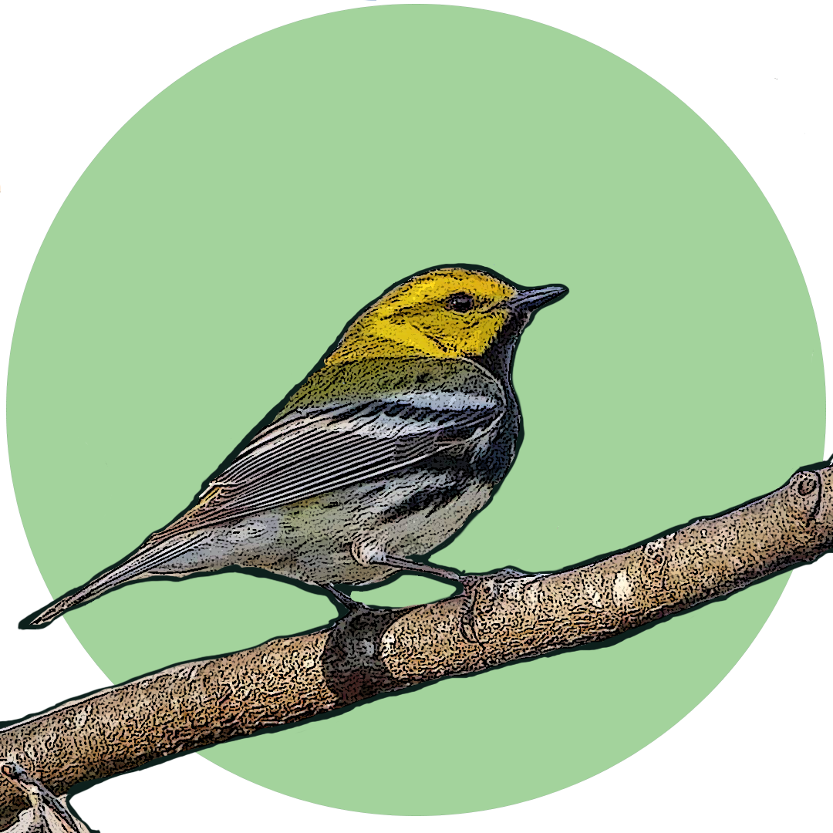


Nature’s Calendar
OBSERVING BIOLOGICAL PATTERNS
Notes:
Think about the seasons of the year and what it means for you and your routine. You likely have certain patterns in your life. Do certain seasons mean different clothes, foods, holidays, sports, or travel? In nature, seasonal changes bring about different BIOLOGICAL EVENTS, and the study of these events is called PHENOLOGY. You can think of it as Nature’s Calendar.
Scientists study these biological events and monitor them from year to year to look at changes and what it might mean for certain species.
Great Smoky Mountains National Park and Great Smoky Mountains Institute at Tremont have been recording phenological, or seasonal, events and weather data since the 1980s. This data collection is an ongoing project. These projects include observing, inventorying and monitoring many different organisms, from birds and flowers to trees and air pollution.
(artwork: B. Bramhall 2021, NPS)

Slide 2
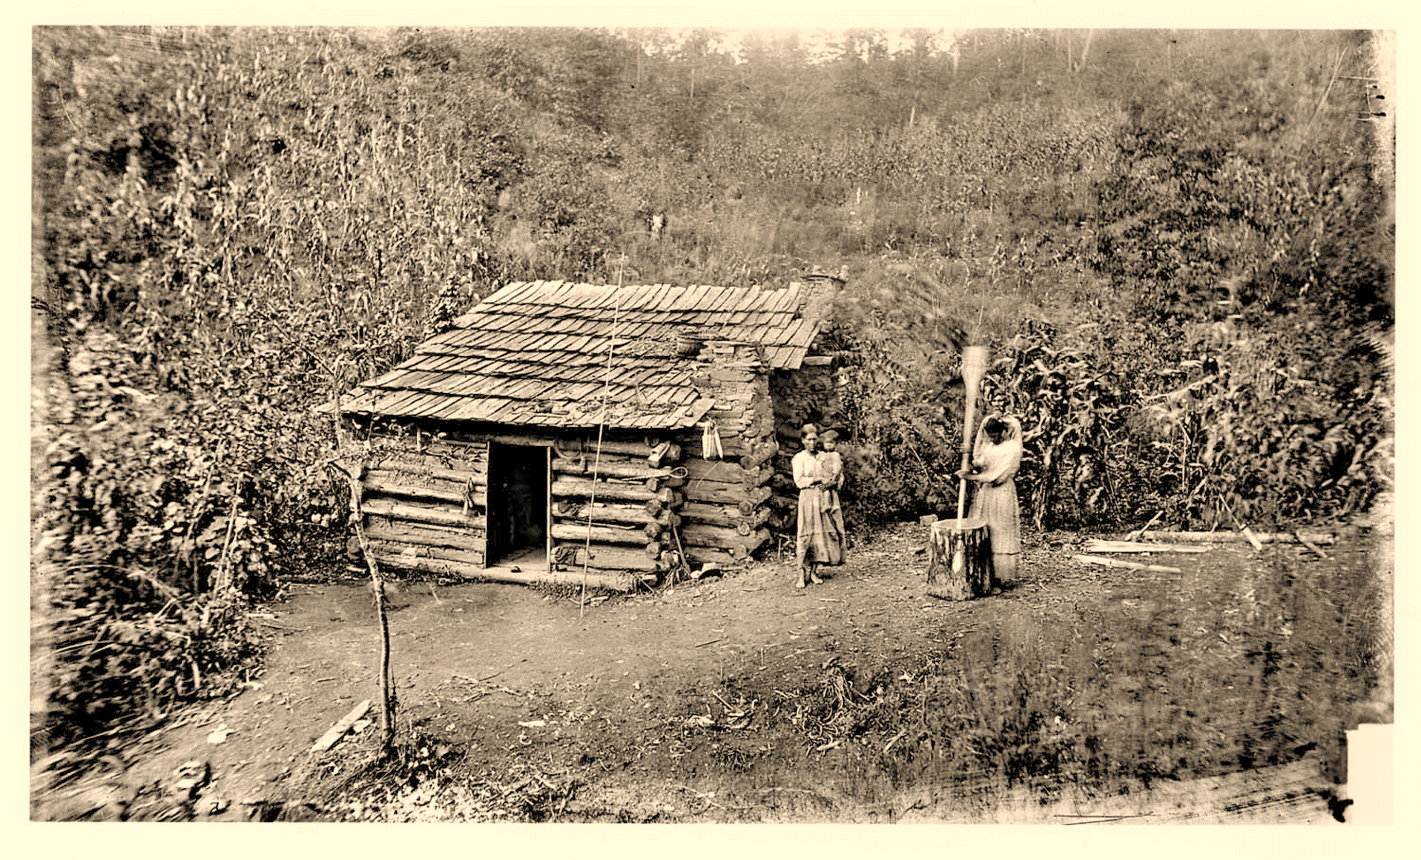
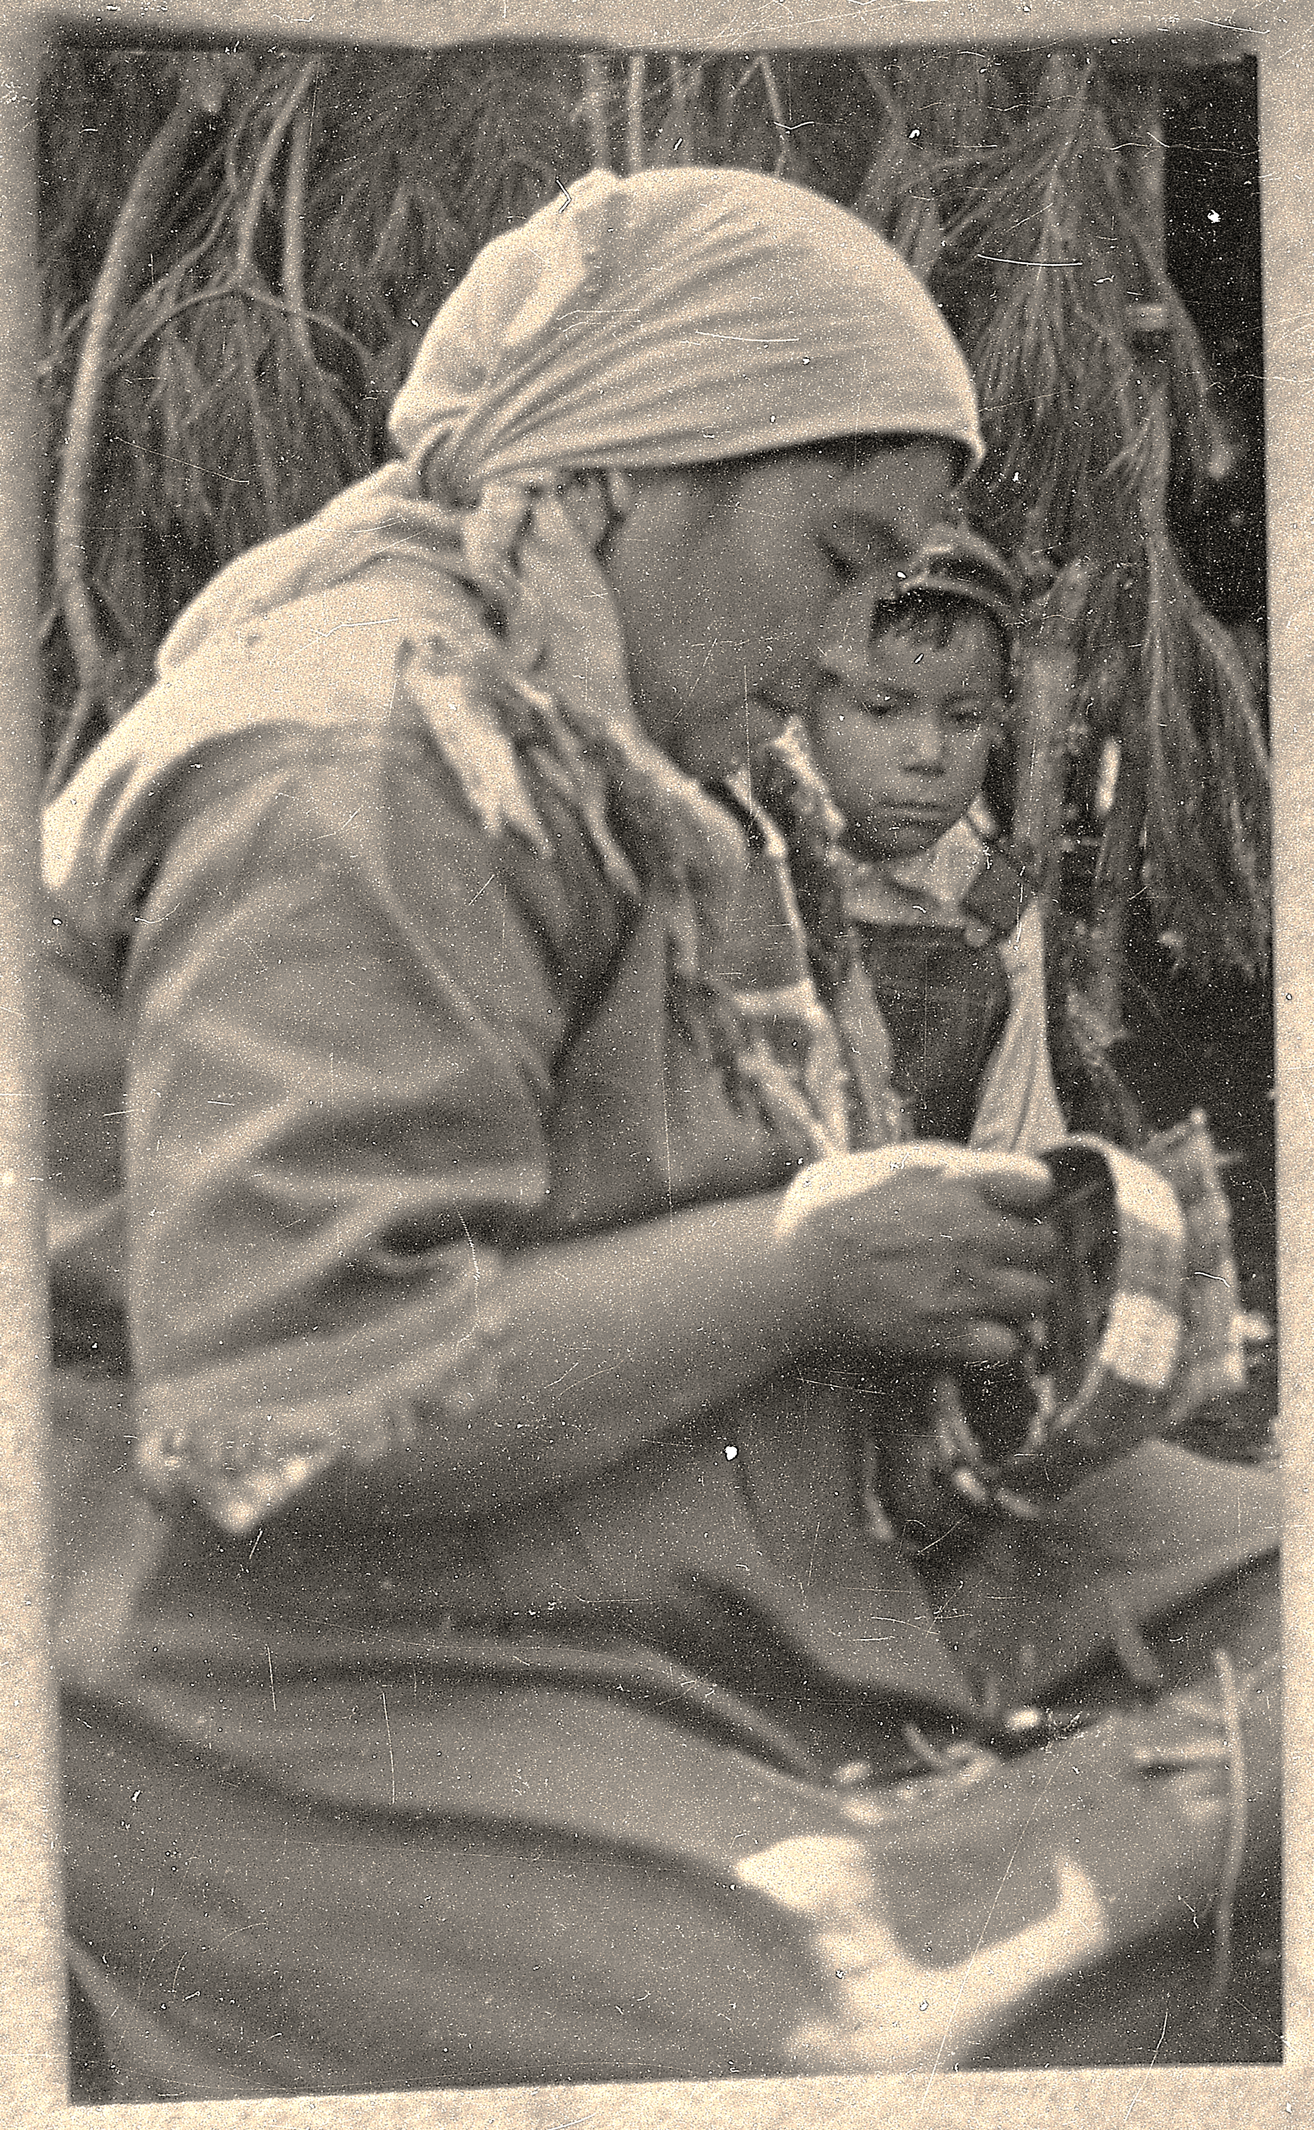
Cherokee: the original stewards
Notes:
Stewardship of the land and observing seasonal patterns is not a new idea and was well in place long before the formation of the National Park in the 1930s.
The land we are on today in Great Smoky Mountains is the ancestral home of the Ani-gaduwa-gi (Anikituwahgi) or the Cherokee, and we share our borders with the Eastern Band of Cherokee today. We recognize them and their ancestors as the original and continuing stewards of this land, going back over 14,000 years in this area.
Their intimate knowledge of the land, and the seasonal availability of plants and animals, has influenced other cultures’ stories, medicinal remedies and uses of the mountain resources.

Slide 3
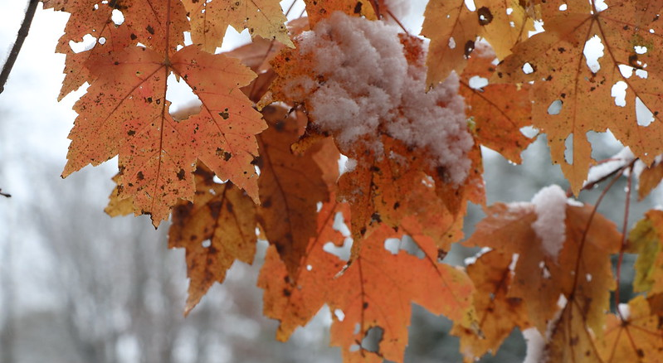




Cherokee: the original stewards
Notes:
Seasonal changes would trigger the gathering of certain plants for medicines. Several traditional medicines are being proven to have health benefits in modern scientific studies. Science is really all about observations.
And here’s one example:
Cherokee recognized red maple, or tsunwagi, in combination with other plants, as a treatment for certain cancers, infections and other ailments.
Recently, researchers in Japan and Rhode Island have studied the cancer-preventing compounds in maple syrup, leaves, and flowers and are finding some positive results.
So, seasonal patterns in nature might signal availability for gathering and harvesting resources, but they have also inspired stories in many cultures.

Slide 4
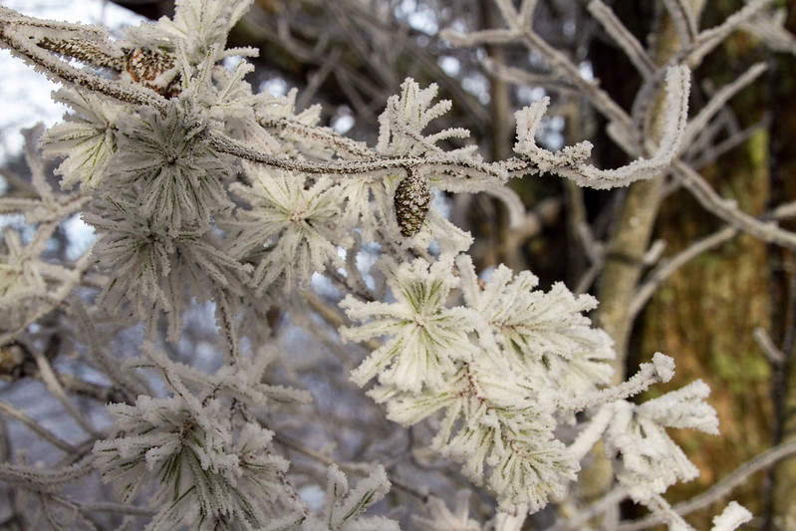
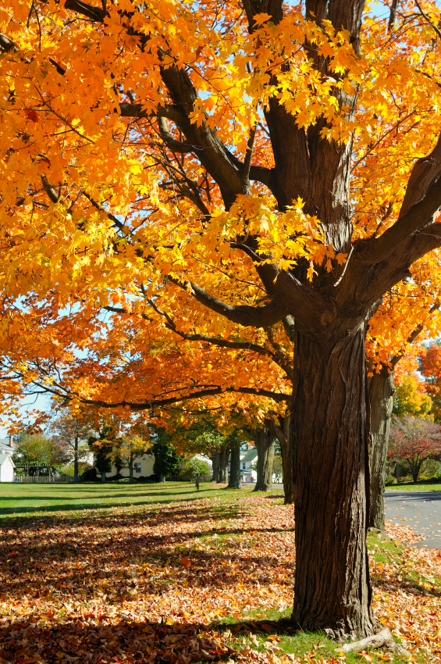
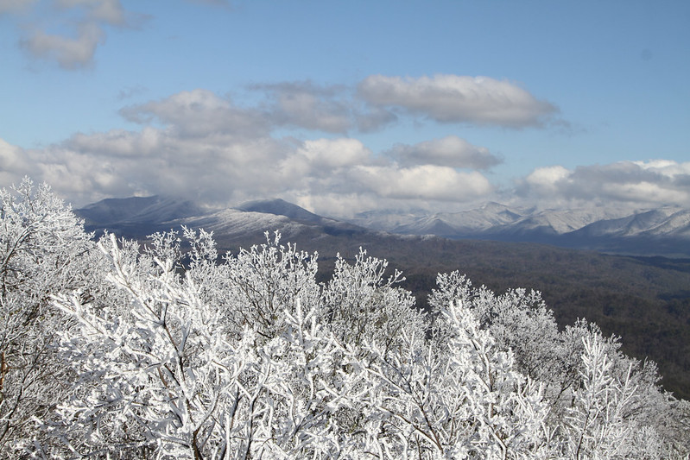
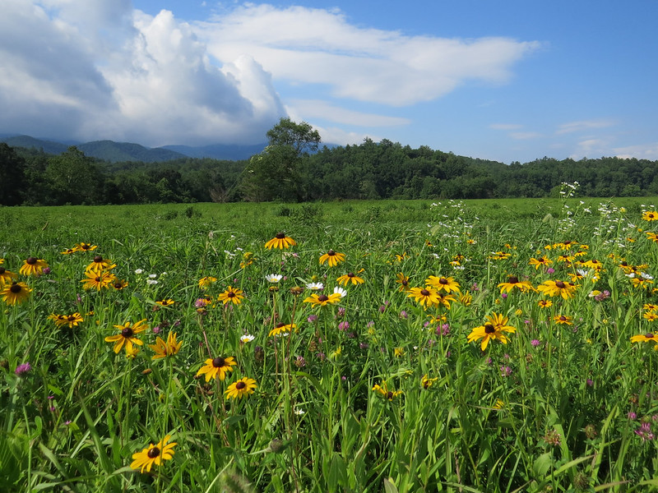
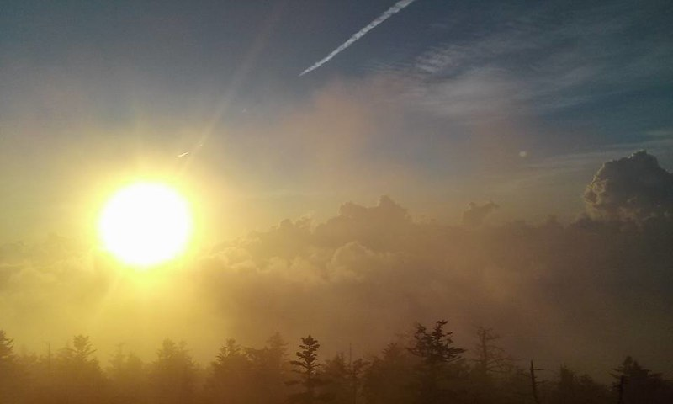
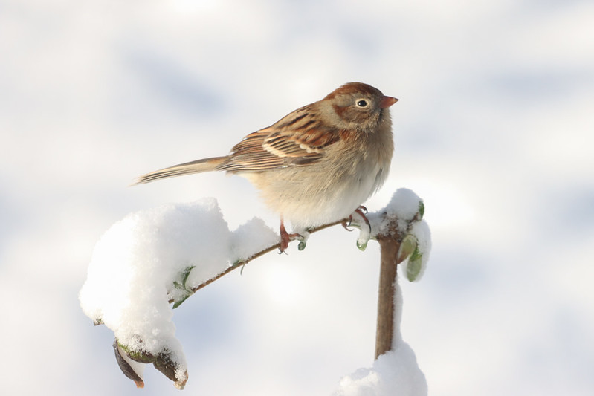
Traditional Stories: Guides to the Seasons
Notes:
Bride from the South (click for animated pictures) –
1) The North went traveling and after going far and meeting many people, he met and fell in love with the daughter of the South and asked her to marry him.
(2) She was willing, but her parents objected and said “ever since you came around, the weather has been cold, and if you stay, we may all freeze to death”.
(3) The North pleaded and said he would take the daughter back to his region (which is opposite of usual Cherokee matriarchal tradition of the groom joining the bride’s family). So, they were married and he took her back north, where the people all lived in ice houses.
(4) The next day, when the sun rose, the houses began to leak, and as it climbed higher, they began to melt and it grew warmer and warmer.
(5) The people went to the husband and told him he must send his wife back home or the weather would get so warm that the whole settlement would be melted. He loved her and tried to hold out, but as the sun grew hotter the people became more desperate, he had to send her home.
(6) The people said that because she had been born in the South, and had nourished on food from that climate, her nature was warm and unfit for the North.
(Flowers slide) Discussion:
(Ask students to think about this and what it means? Is there any connection between this story and changes in seasonal patterns today? Might some climate event have inspired this story? Have they noticed “climate mis-matches?”)
(Story attributed to Eastern Band of Cherokee, J. Mooney)

Slide 5
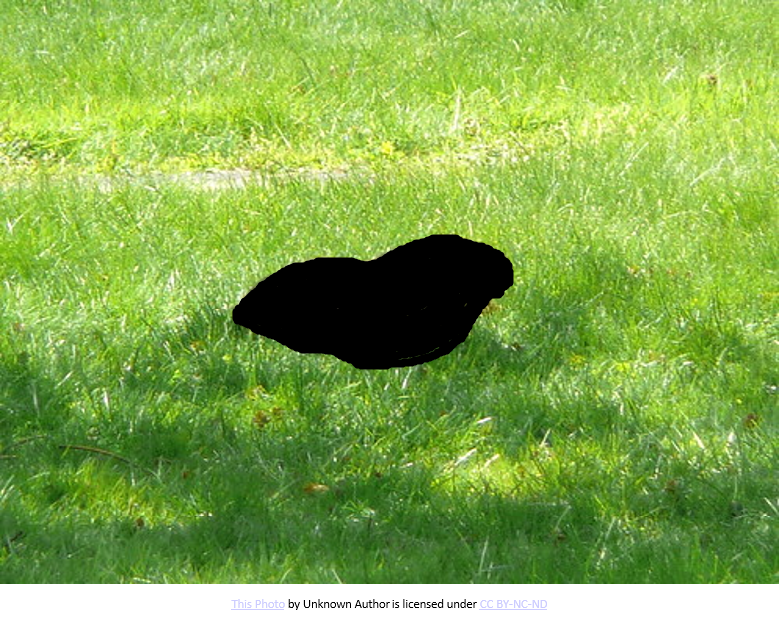
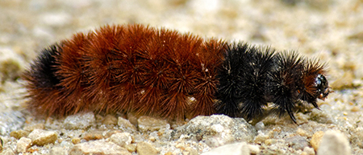
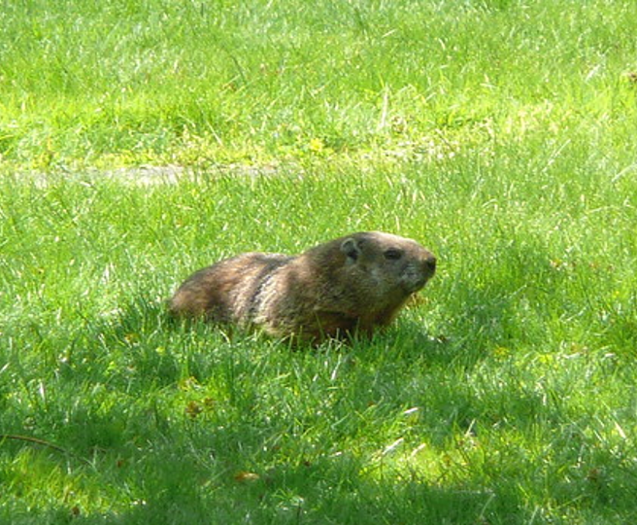
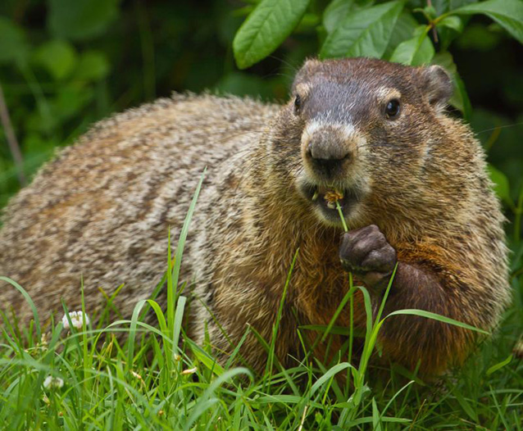
Question Time!
Climate and Weather in Stories:
Can you think of any stories or traditions that are believed to predict the seasons/weather?
Notes:
Time for a question:
Climate and weather often come up in stories – can you think of any cultural stories or traditions that revolve around seasonal predictions or changes?
A hint about one: There is an animal associated with February and it just predicted that we’re going to have 6 more weeks of winter…. (Groundhog / whistle pig!)
Answers: Click for each. (Groundhog day, and woolybears/woolyworms, others: red sky at night…)
Photo: Shenandoah NPS

Slide 6
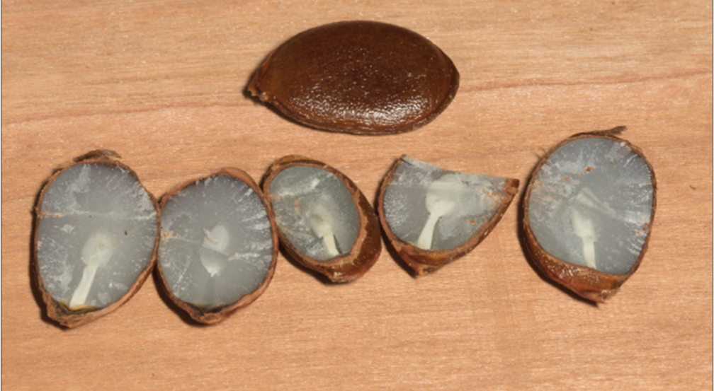
Climate & Weather Folklore
Photo of Persimmon courtesy of Mike Dunn
Notes:
Another Appalachian bit of folklore tied to the seasons:
Persimmon seeds were used to predict the type of winter to expect by cutting into them and looking at the inner kernel, or cotyledon (cahduh-leedin):
a knife signifies the winter will be bitterly cold, with winter winds cutting through you like a knife;
a fork means a winter with milder conditions, and snow will likely be light and fluffy;
a spoon means cold, wet and heavy snow that requires shoveling. This photo shows spoon, spoon, knife, spoon, knife. So a very wet snowy winter with bitter winds.
While we can observe changes in many ways, and try to make predictions, park scientists are paying attention to climate and its effect on the various resources in the park and in our communities and seeking hard data.

Slide 7
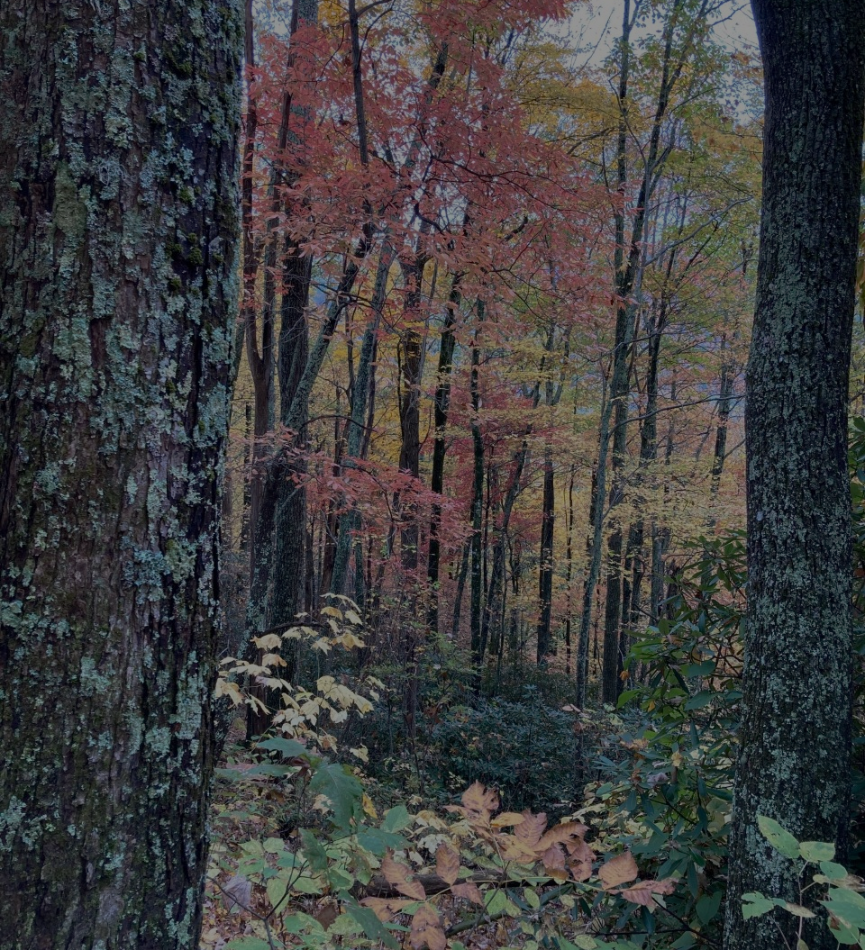
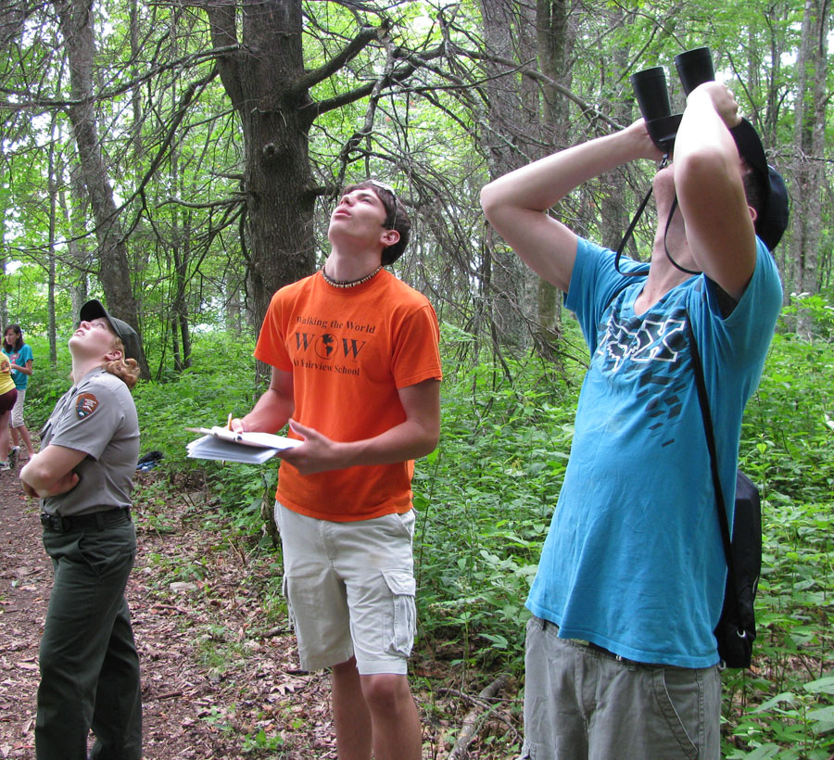
Phenology or “Fun-o-logy?”
Notes:
We’ve been observing climate for millennium, but what is phenology?
Or, is it Fun-o-logy?
We like to think that it’s both…
Studying phenology, or seasonal events, is monitoring (checking up on) and recording “phenophases”, or the changes the species makes throughout the year. Phenophases include the arrival of birds in the spring, leafing out of trees, wildflower blooms, or changes in the colors of trees.

Slide 8
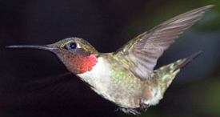
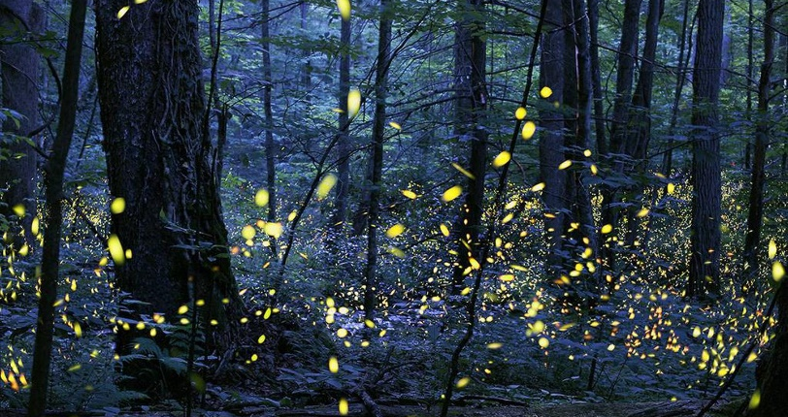
Phenology: the study of biological events
Notes:
So…. what is Phenology?
Phenology is the study of biological events for a species. Think of it as “Nature’s Calendar”. The word Phenology comes from the greek “Phenos” meaning change. The study of annual or cyclical change or the study of change in Nature's Calendar.
Monitoring phenology is one way the park is tracking the impacts of a changing climate on park resources.
For example, hummingbirds are photoperiod migrators, meaning they rely on the relative length of day and night to determine when to migrate. When they migrate each year from Mexico to the United States and Canada, the timing of each stage of migration is phenology, but it’s sometimes not in sync with the nectar available in their destinations. You might study the timing of its arrival in different areas and whether food sources are available, such as flowering plants.
Another example of phenology is the emergence of Synchronous Fireflies (Photolinus Carolinus). Temperature and moisture play a role in the timing of their display, with peak usually falling from late-May to mid-June. Predicting their arrival can help the park and outlying communities in managing the many visitors that come to see them.
But what causes a bird to know when to migrate or an insect to emerge? It’s often based on food availability ---which can be tied to temperature, moisture, or on the length of day or photoperiod.
Tracking phenological events, or phenophases, helps us in understanding the park’s resources and what effect climate change is having on our many ecosystems. Are flowers blooming earlier? Are trees dropping leaves later? Are pollinators in sync with their food sources? We have a lot of questions.
Photo credits:
www.allaboutbirds.org/guide/ruby-throated_hummingbird/id
www.recreation.gov

Slide 9
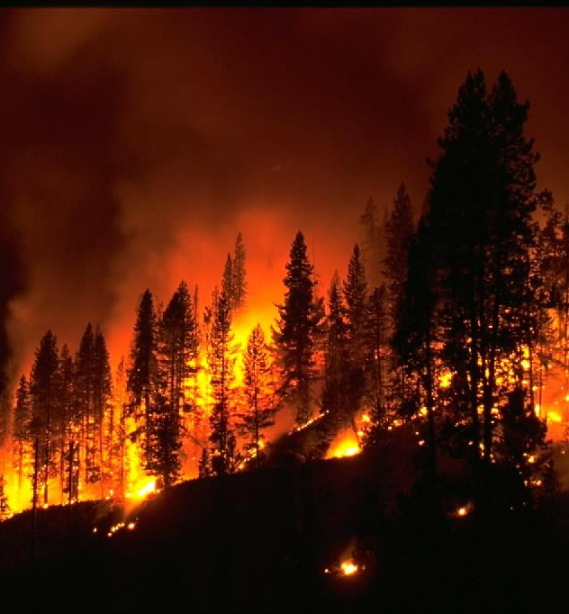
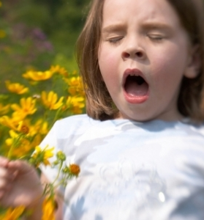
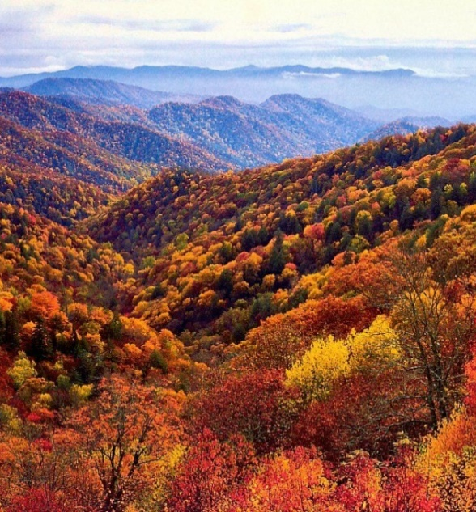
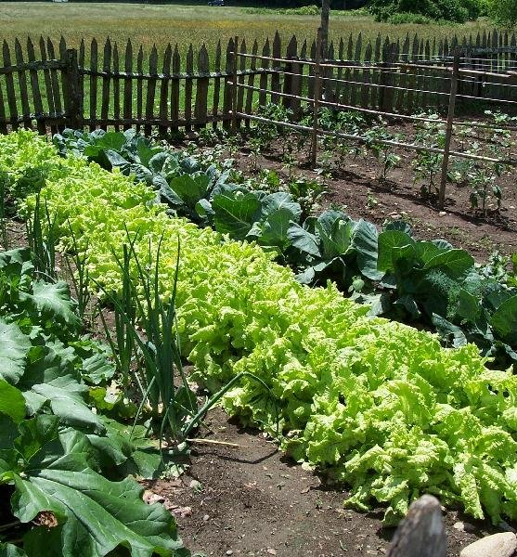
Why Do We Care About Phenology?
Notes:
So, why do we care?
Many people travel to the mountains to see fall colors and spring wildflowers and this can have an impact on local economies.
If any of you are allergy sufferers, you know that understanding the timing of pollen release might help you plan ahead.
Farmers care about phenology because it impacts their planting schedule and their reliance on pollinators.
It helps in our understanding of hazards by monitoring and studying the effects of drought, severe weather events and fire risks. This helps us in the park and in the community.

Slide 10
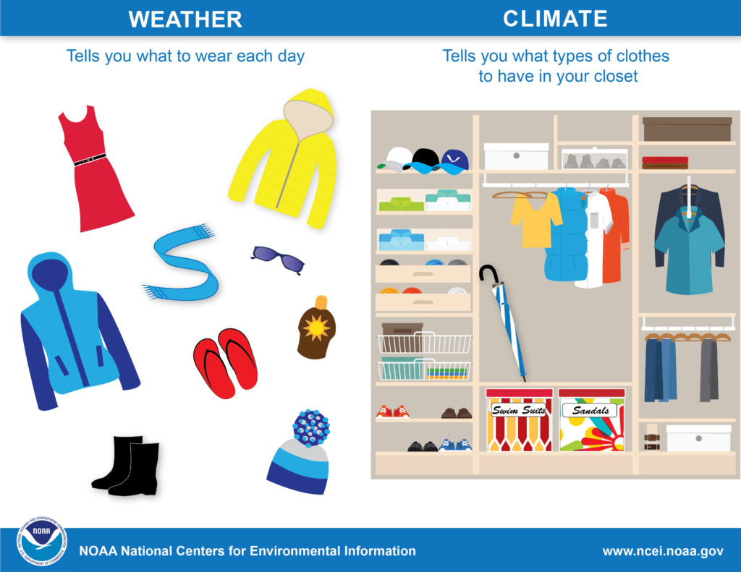
Weather vs. Climate
Notes:
What is the difference between weather and climate?
As an analogy, weather is what you’re wearing today. Climate is your whole wardrobe.
Each year, phenology is tied to weather. Is it a warm spring or a cold one? Weather is what we see out our door on any given day, climate is the long-term analysis of weather over at least 25-30 years. Any one year that seems wacky doesn’t prove climate change but when looking at patterns of spring over the past 25-30 years, we can see if there is a trend towards warmer or cooler springs.
Slide 10:
To understand and be able to analyze the impacts of climate change on phenology we must first understand the fundamental differences between climate and weather.
What is the difference between weather and climate?
The most notable difference between weather and climate is a measure of time. Weather is what conditions of the atmosphere are over a short period of time, and climate is how the atmosphere “behaves” over relatively long periods of time.
Just because we have an extra hot summer or an extra cold winter does not mean that the climate is changing. Such extremes may even out over time
(From MSPhenology pdf).
Image: NOAA.gov
Video link: NASA: What's the Difference Between Weather and Climate? | NASA Climate Kids

Slide 11
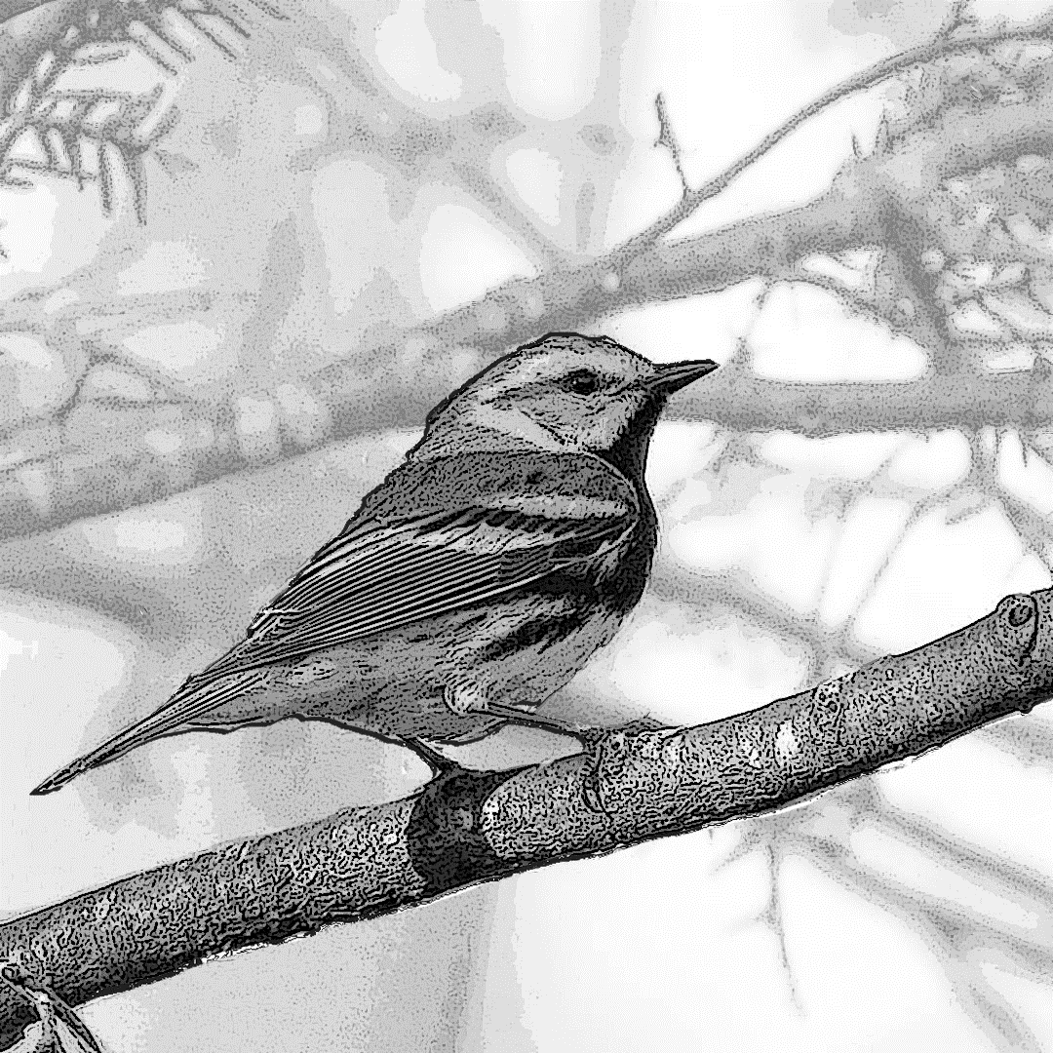
Weather, Climate, or Both…
Pop Quiz!
It snowed 5 inches last night.
Notes:
Time for another quiz!
Phenology is affected by a lot of things, including climate and weather. But, what’s the difference between Climate and Weather?
Climate is the average of daily weather in a region for an extended period of time.
Think about climate as your entire wardrobe. Living in this region, you have a variety of items from shorts to winter coats.
Weather is the short-term atmospheric conditions in an area, changing day by day, hour-by-hour.
Weather might be similar to what you would wear on a single day or what you plan to wear tomorrow?
Here’s a quick quiz about the difference between weather and climate. The answer could be one or the other or both. (Answers can be given now or at end of program).
Weather
Climate – typical conditions (based on averages)
Climate – typical conditions (based on averages)
Weather
Both, weather (10 degrees) and climate (normal for that time of year based on averages).

Slide 12
ANSWER!
Weather, Climate, or Both…
Pop Quiz!
It snowed 5 inches last night. Weather
Notes:
(This can be inserted earlier in the slideshow too…)
Here’s the answer to the earlier Quiz (to make sure we understand the difference between weather and climate).
Weather
Climate – typical conditions
Climate – typical conditions
Weather
Both, weather (10 degrees) and climate (normal for that time of year).

Slide 13
Weather, Climate, or Both…
Pop Quiz!
2. Travel guides recommend bringing layers when traveling to Alaska in October.
Notes:
Time for another quiz!
Phenology is affected by a lot of things, including climate and weather. But, what’s the difference between Climate and Weather?
Climate is the average of daily weather in a region for an extended period of time.
Think about climate as your entire wardrobe. Living in this region, you have a variety of items from shorts to winter coats.
Weather is the short-term atmospheric conditions in an area, changing day by day, hour-by-hour.
Weather might be similar to what you would wear on a single day or what you plan to wear tomorrow?
Here’s a quick quiz about the difference between weather and climate. The answer could be one or the other or both. Feel free to put your answers in the chat. (Answers can be given now or at end of program).
Weather
Climate – typical conditions (based on averages)
Climate – typical conditions (based on averages)
Weather
Both, weather (10 degrees) and climate (normal for that time of year based on averages).

Slide 14
ANSWER!
Weather, Climate, or Both…
Pop Quiz!
2. Travel guides recommend bringing layers when traveling to Alaska in October. Climate—typical conditions
Notes:
(This can be inserted earlier in the slideshow too…)
Here’s the answer to the earlier Quiz (to make sure we understand the difference between weather and climate).
Weather
Climate – typical conditions
Climate – typical conditions
Weather
Both, weather (10 degrees) and climate (normal for that time of year).

Slide 15
Weather, Climate, or Both…
Pop Quiz!
3. Typically in the Smokies, rainfall in June is under 1 inch.
Notes:
Time for another quiz!
Phenology is affected by a lot of things, including climate and weather. But, what’s the difference between Climate and Weather?
Climate is the average of daily weather in a region for an extended period of time.
Think about climate as your entire wardrobe. Living in this region, you have a variety of items from shorts to winter coats.
Weather is the short-term atmospheric conditions in an area, changing day by day, hour-by-hour.
Weather might be similar to what you would wear on a single day or what you plan to wear tomorrow?
Here’s a quick quiz about the difference between weather and climate. The answer could be one or the other or both. Feel free to put your answers in the chat. (Answers can be given now or at end of program).
Weather
Climate – typical conditions (based on averages)
Climate – typical conditions (based on averages)
Weather
Both, weather (10 degrees) and climate (normal for that time of year based on averages).

Slide 16
ANSWER!
Weather, Climate, or Both…
Pop Quiz!
3. Typically rainfall in June is under 1 inch. Climate—typical conditions
Notes:
(This can be inserted earlier in the slideshow too…)
Here’s the answer to the earlier Quiz (to make sure we understand the difference between weather and climate).
Weather
Climate – typical conditions
Climate – typical conditions
Weather
Both, weather (10 degrees) and climate (normal for that time of year).

Slide 17
Weather, Climate, or Both…
Pop Quiz!
4. Based on today’s forecast I’m going to wear shorts.
Notes:
Time for another quiz!
Phenology is affected by a lot of things, including climate and weather. But, what’s the difference between Climate and Weather?
Climate is the average of daily weather in a region for an extended period of time.
Think about climate as your entire wardrobe. Living in this region, you have a variety of items from shorts to winter coats.
Weather is the short-term atmospheric conditions in an area, changing day by day, hour-by-hour.
Weather might be similar to what you would wear on a single day or what you plan to wear tomorrow?
Here’s a quick quiz about the difference between weather and climate. The answer could be one or the other or both. Feel free to put your answers in the chat. (Answers can be given now or at end of program).
Weather
Climate – typical conditions (based on averages)
Climate – typical conditions (based on averages)
Weather
Both, weather (10 degrees) and climate (normal for that time of year based on averages).

Slide 18
ANSWER!
Weather, Climate, or Both…
Pop Quiz!
4. Based on today’s forecast I’m going to wear shorts. Weather
Notes:
(This can be inserted earlier in the slideshow too…)
Here’s the answer to the earlier Quiz (to make sure we understand the difference between weather and climate).
Weather
Climate – typical conditions
Climate – typical conditions
Weather
Both, weather (10 degrees) and climate (normal for that time of year).

Slide 19
Weather, Climate, or Both…
Pop Quiz!
5. The low temperature last night was 10 degrees above normal.
Notes:
Time for another quiz!
Phenology is affected by a lot of things, including climate and weather. But, what’s the difference between Climate and Weather?
Climate is the average of daily weather in a region for an extended period of time.
Think about climate as your entire wardrobe. Living in this region, you have a variety of items from shorts to winter coats.
Weather is the short-term atmospheric conditions in an area, changing day by day, hour-by-hour.
Weather might be similar to what you would wear on a single day or what you plan to wear tomorrow?
Here’s a quick quiz about the difference between weather and climate. The answer could be one or the other or both. Feel free to put your answers in the chat. (Answers can be given now or at end of program).
Weather
Climate – typical conditions (based on averages)
Climate – typical conditions (based on averages)
Weather
Both, weather (10 degrees) and climate (normal for that time of year based on averages).

Slide 20
ANSWER!
Weather, Climate, or Both…
Pop Quiz!
5. The low temperature last night was 10 degrees above normal. Both, weather (10 degrees) and climate (normal for that time of year)
Notes:
(This can be inserted earlier in the slideshow too…)
Here’s the answer to the earlier Quiz (to make sure we understand the difference between weather and climate).
Weather
Climate – typical conditions
Climate – typical conditions
Weather
Both, weather (10 degrees) and climate (normal for that time of year).

Slide 21
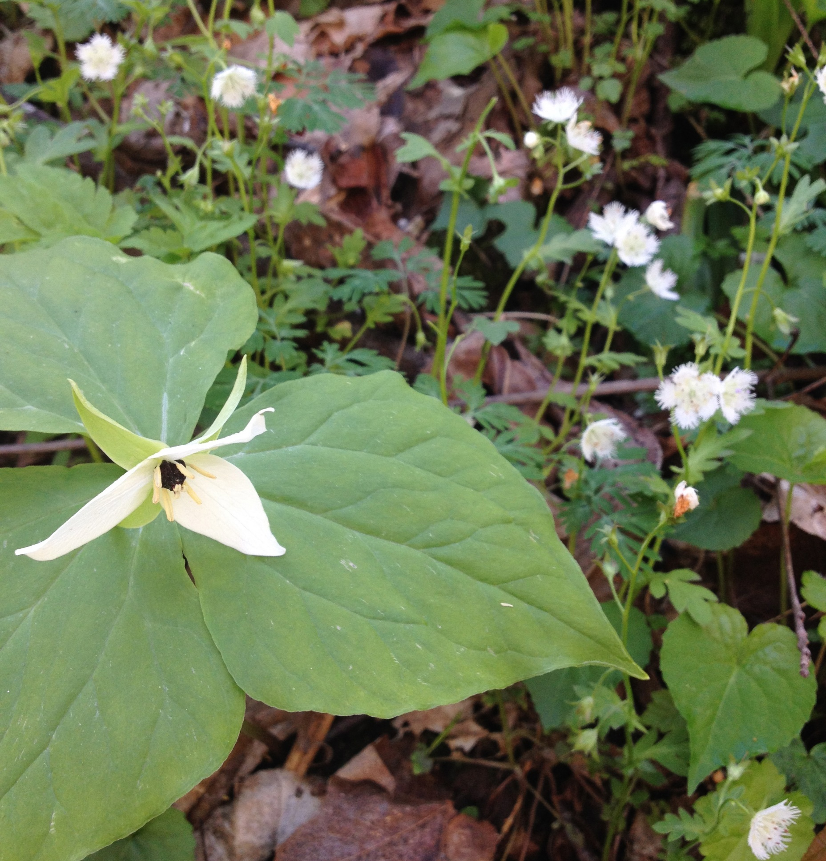
Weird climate: Mismatches in timing
  Can you think of examples you’ve witnessed that demonstrate seasonal mixed messages?
Notes:
Have you personally noticed an increase in seasonal weather oddities or timing mismatches? (if time, share the story below, ask for their thoughts of things they’ve seen)
In the Greenbrier section of the Great Smoky Mountains, there is a special area known for wildflowers. The fringed phaecelia (fuh-seal-yah) grows so thick that it looks like snow. It’s an amazing thing to see… and hear! Visiting each year, part of the experience is not only the sea of white tiny flowers (the smaller flower in the picture), but also the humming sound. The humming is from thousands of bees.
One year, the phaecelias arrived a few weeks early. Visitors were enjoying them as usual, but many realized that it was silent. There were no bees. They wondered why they weren’t there? Can you think of reasons the bees may not have been a part of the experience? (Maybe because the flowers were early and they hadn’t become active yet?) Situations like this create many questions.
By studying phenology, we might track what this type of event would mean, and how the timing of the blooming of plants affects the animals that rely on them. This timing can also affect the pollination of the plants.

Slide 22
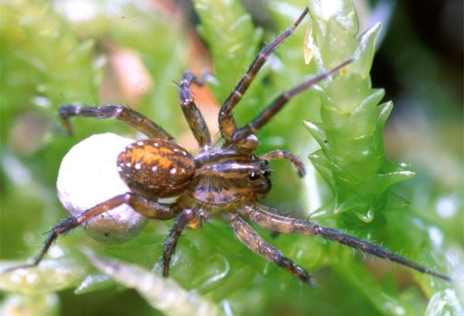
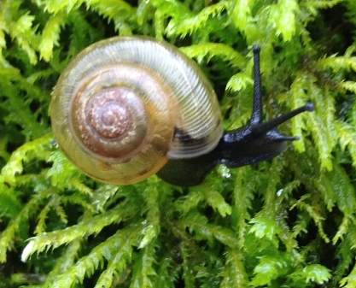
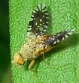
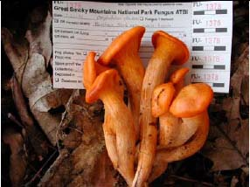
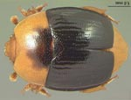
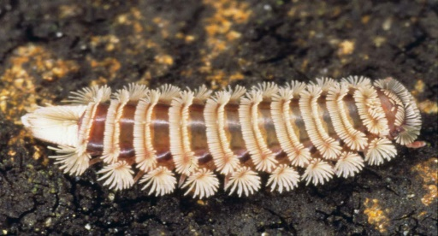
Biodiversity in the Smokies
over 20,000 species inventoried
Spiders
41 new to science
Snails
2 new to science
Flies
65 new to science
Mushrooms
68 new to science
Millipedes
3 new to science
Beetles
74 new to science
Notes:
To know what to monitor and how to protect various species and habitats, first, we need to understand what is here.
The All Taxa Biodiversity Inventory or ATBI is an effort to identify every form of life in the park.
Since 1998, we have added over 10,000 species to park records, bringing the number known to 20,000! That includes over 1,000 new to science!

Slide 23
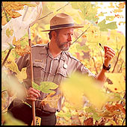
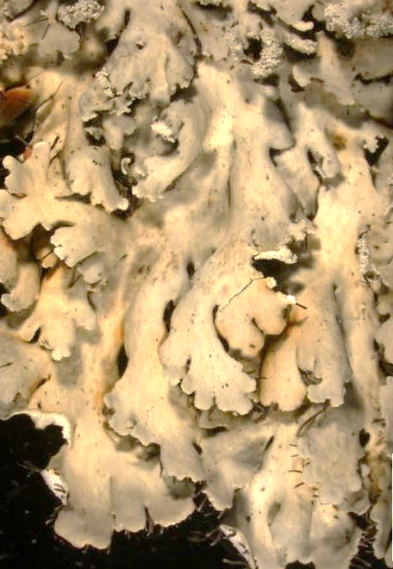
New to Science = New Names
Lichens: 900 species
  Newly discovered = new names
    Heterodermia Langdoniana – Langdon’s Whiskers!
See the resemblance?
Notes:
One fun thing about discovering new species is that they need new names. Scientists James Lendemer and Erin Tripp have been studying lichens in the park for over 10 years and have cataloged more than were known to exist! One of their jobs was to come up with new names --- Appalachian Dust Bunnies, Cupless Cups, & Hot Dots!
Several lichens have been given names honoring staff members and others taking care of the park. The Heterodermia Langdoniana was named for retired park ranger Keith Langdon and his famous whiskers.

Slide 24
Inventorying and Monitoring
OBSERVING BIOLOGICAL PATTERNS
Notes:
So let’s review inventorying and monitoring.
If we are inventorying, what are we doing? (making a list of species, understanding interactions with other species…).
What is MONITORING? (periodically checking on the status of a species found in prior inventories – like going to the doctor for checkups.)

Slide 25
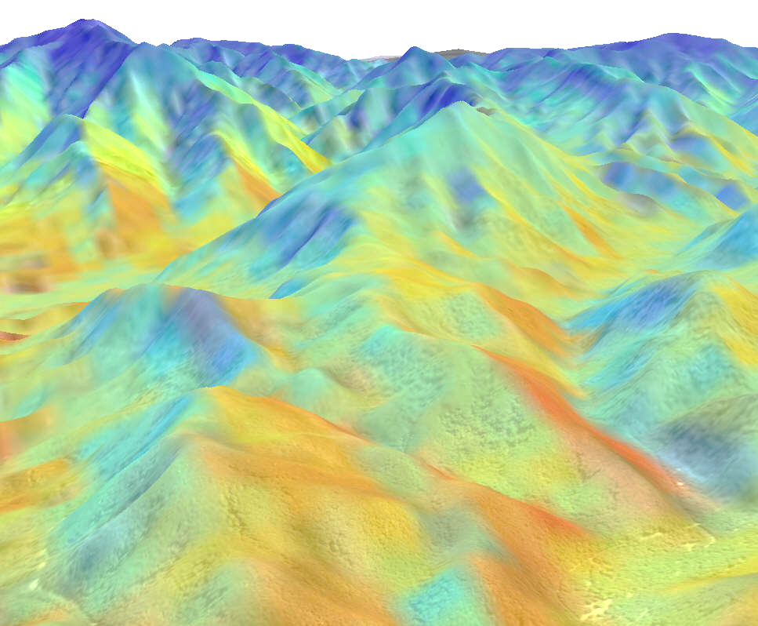
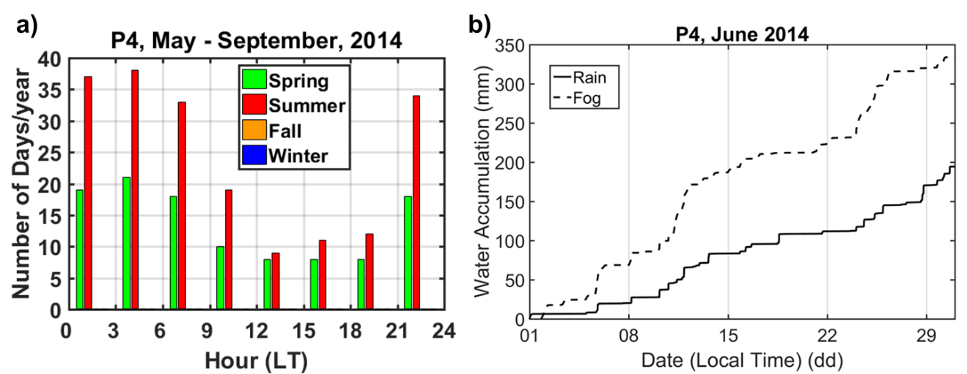
High Elevation Dynamics
Notes:
Monitoring over time allows us to understand how species respond to a changing climate. Over time, we may see species numbers increasing or declining, or see them move to other areas for better habitat conditions.
For example: If sensitive species are forced to migrate from mid-slope to upper slopes, seeking cooler and wetter conditions, there is far less area available, think of it like a triangle of space, moving towards the top. Smaller populations are more vulnerable to extirpation, or local extinction, on individual peaks.
One prediction is that species may shift around a mountain to cooler areas on north-facing slopes and along stream channels instead of to higher elevations. We need to test this theory through inventory and monitoring of biotic and abiotic factors.
---------------------------------
(More info: )
Smokies elevations range from ~300 meters elevation to slightly over 2000 m.
If the Smokies elevations are placed in 400 m. elevational bands, there is a decrease in area of 84% going from the second highest elevational band (1200 m to 1600m.) and the highest band (1600 to 2000m.)
Highest elevations may remain relatively stable IF precipitation and cloud cover increase of remain steady. In spruce-fir forests, almost half of precipitation comes from condensation of fog, not rain or snow. Many high elevation trees are very good at pulling moisture out of the fog for their root systems or directly absorbing through their leaves.

Slide 26
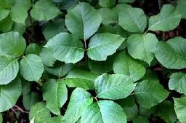
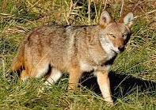
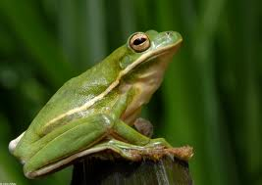
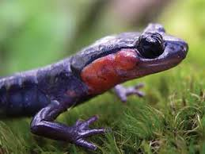
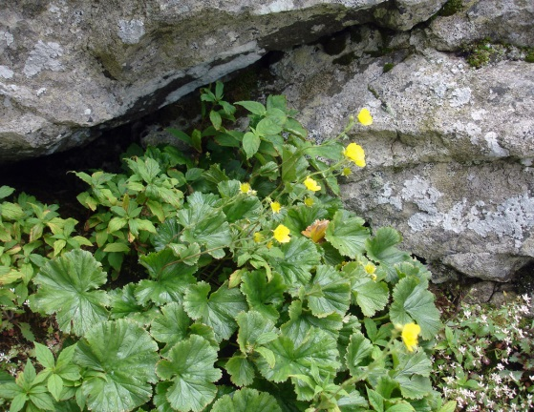
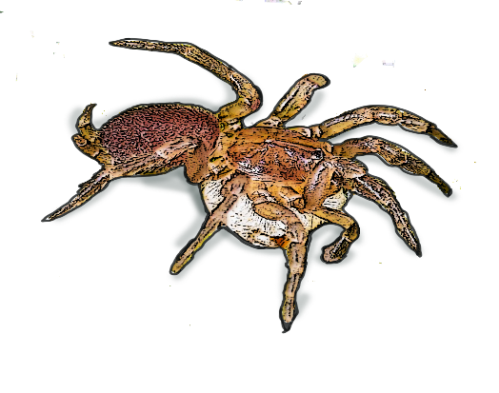
The Smokies: Winners and Losers
Adapt (?)
Migrate (?)
Perish (?)
Notes:
Smokies species have three main choices in the face of climate change:
Adapt: poison ivy thrives in high CO2 conditions and coyotes are very adaptable and are expanding their territory
Migrate: green tree frogs and nine-banded armadillos have started being seen in the park this past decade, presumably hitching rides from park visitors and finding suitable conditions here; red-cheeked salamanders, as a species, may be able to retreat into cooler pockets of spruce-fir habitat on northern facing slopes or in deeper gullies.
Some may perish: if high elevations lose fog and dry out, species such as the federally endangered Spreading Avens and Spruce-fir moss spider may go extinct. (The spruce fir moss spider is one of the smallest tarantulas in the world, only a ¼” in size! It relies on moss in high elevations.)
Phenological changes are causing mismatches in timing that can also have an effect.

Slide 27
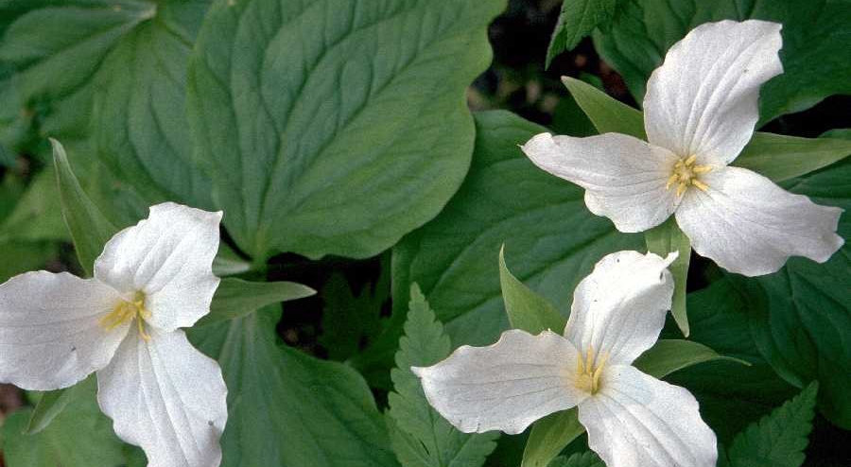
Graphing Activity
White Trillium, Trillium grandiflorum
Notes:
To understand the timing of things, we can look at dates of arrivals over time. Let’s start by using an example of a flower called the White Trillium. Have any of you seen this flower before? It is a white flower that is mostly found here in the Smoky Mountains and blooms in the spring time. We are going to look at the date in which it first blooms each year from 1985 all the way to 2005. (20 years) This means we are going to be plotting the dates for which researchers first saw it blooming each year.
Image: White Trillium (USDA.gov) http://plants.usda.gov/java/largeImage?imageID=trgr4_003_ahp.tif

Slide 28

White Trillium First Bloom 1985-2005
Notes:
We will have two axes— with two variables.
A VARIABLE is an object, time period or any other type of category we are trying to measure.
The year is the independent variable, meaning it is not changed by the other variables, so it goes on the x-axis along the bottom.
The timing of first blooms would be dependent variables, because they change and depend on other factors. We would plot those bloom dates on the y-axis along the left side.
Image: White Trillium (USDA.gov) http://plants.usda.gov/java/largeImage?imageID=trgr4_003_ahp.tif

Slide 29
Data- White Trillium First Bloom
Year | Trillium first bloom
1985 | 3-Apr
1986 | 1-Apr
1987
1988
1989 | 29-Mar
1990
1991 | 2-Mar
1992 | 29-Mar
1993 | 6-Apr
1994 | 2-Apr
1995 | 25-Mar
1996 | 14-Apr
1997
1998 | 27-Mar
1999 | 20-Mar
2000 | 19-Mar
2001 | 26-Mar
2002 | 22-Mar
2003
2004 | 30-Mar
2005 | 2-Apr
2006
2007
2008 | 30-Mar

Slide 30
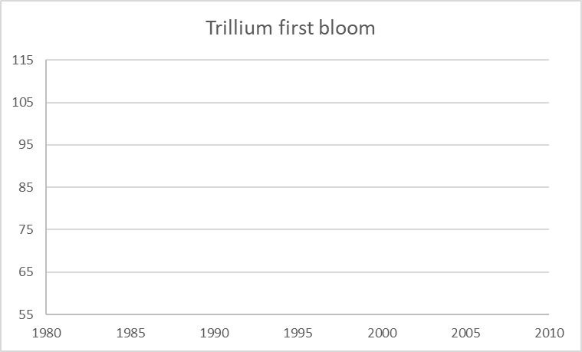
Data- White Trillium First Bloom
The Julian calendar- introduced by Julius Caesar in 45 BCE, served as the main calendar in the Western world for over 1600 years. Based on 365-day solar year.
Year | Trillium first bloom (Julian Calendar) | Trillium first bloom (Gregorian Calendar)
1985 | 93 | 3-Apr
1986 | 91 | 1-Apr
1987
1988
1989 | 88 | 29-Mar
1990
1991 | 61 | 2-Mar
1992 | 89 | 29-Mar
1993 | 96 | 6-Apr
1994 | 92 | 2-Apr
1995 | 84 | 25-Mar
1996 | 105 | 14-Apr
1997
1998 | 86 | 27-Mar
1999 | 79 | 20-Mar
2000 | 79 | 19-Mar
2001 | 85 | 26-Mar
2002 | 81 | 22-Mar
2003
2004 | 90 | 30-Mar
2005 | 92 | 2-Apr
2006
2007
2008 | 90 | 30-Mar
Notes:
In the Science community once you have all your data collected, you must find a good way to share your findings. Graphs help scientists to share their data in a visual way. Using the Julian calendar is a great way to show data over a length of time (years).

Slide 31
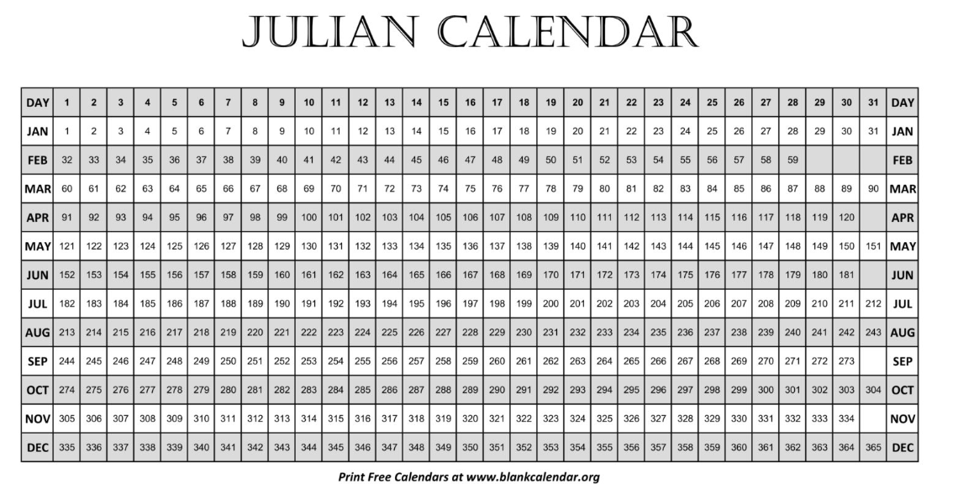
Julian Calendar- 45 BCE
Based on a 365-day solar year, additional day added every four years to account for the extra 0.25 days in the solar year.
Solar year, which is the length of time it takes for the Earth to orbit the sun.
This calendar was very accurate in its calculations, great way to visually show representation of data.
Good for Graphing

Slide 32
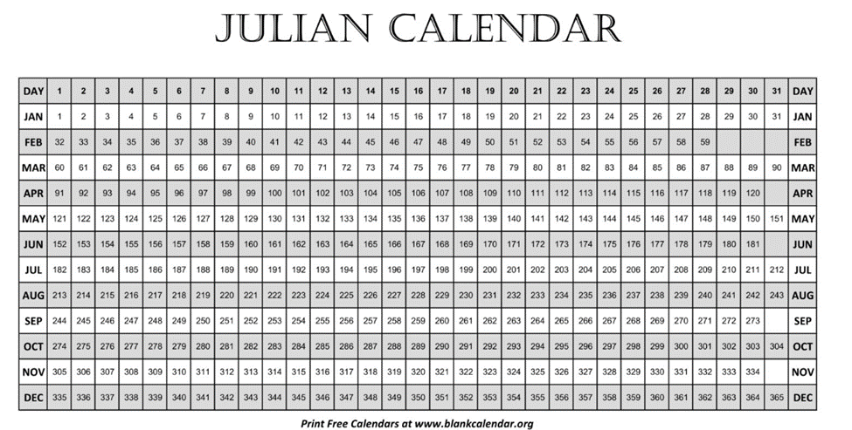
Activity- Find your Birthday in the Julian Calendar-
Maybe it’ll be your new lucky number
Notes:
The Julian calendar was introduced by Julius Caesar in 45 BCE and served as the predominant calendar in the Western world for over 1600 years. It was based on a 365-day solar year, with an additional day added every four years to account for the extra 0.25 days in the solar year. Solar year, which is the length of time it takes for the Earth to orbit the sun. This calendar was very accurate in its calculations, great way to visually show representation of data.
Key Features of the Julian Calendar
1. 365-day year: The Julian calendar is based on a 365-day year, divided into 12 months.
Key Points to Remember
• Julian calendar introduced by Julius Caesar in 45 BCE
• 365-day year with a leap year every 4 years
• Replaced by the Gregorian calendar in 1582
• Important for historical and astronomical studies
Have the students find the Julian calendar number that matches up to their birthday in the Gregorian calendar.

Slide 33
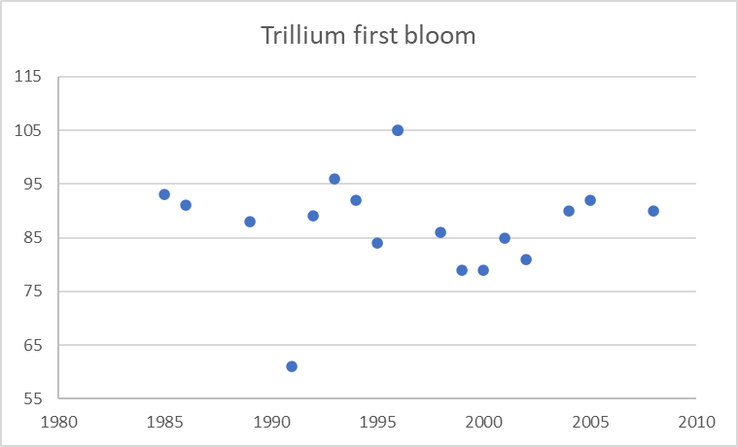
Trillium First Bloom
Notes:
Data is recorded onto the graph with dots.
Let’ translate what we see.
In 1992, approximately when did the trillium first bloom? (about March 30- 89 day of Julian Calendar)
What year was the earliest first bloom recorded? (1991, February 29- 61st day of the Julian Calendar)
Looking at the 20 years represented, would you say that on average the earliest date blooming is coming earlier, later or staying the same? Can you tell?

Slide 34
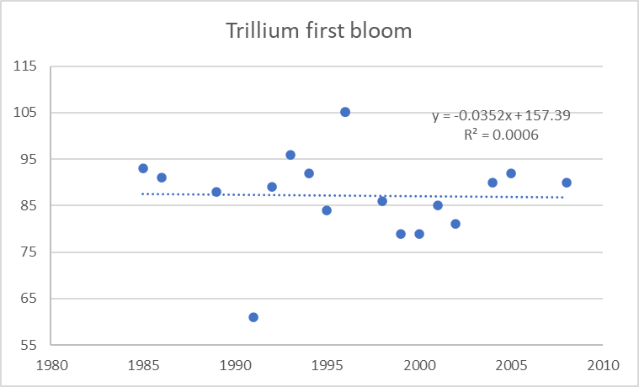
Trillium first bloom 2
Notes:
With such variable data, we need to interpret the data so that it’s easier to understand. We can create a TREND LINE.
The trend line is the line showing the general pattern of the data, based on averages of highs and lows. This trend line is sloping slightly downwards which is showing a “negative relationship”. This doesn’t mean it is “bad” but means that there is a downward trend relationship; blooms are happening earlier in the year, on average, over time. They are going downward.
The trend line would slope upward if the relationship was positive; the later the year, the later the time of year for blooming.
There could also be no relationship with no change seen.
In the grey box towards the top, you will see what is called the R-Value.
The R-value is the relationship of reliability between the x and y axis values. An R values closer to 1 indicate an excellent linear reliability. This R value is .0045 which is not close to 1.0 so it doesn’t have good reliability. This means the data has a lot of variability, but it doesn’t mean the data is not reliable. We just need more data.
This study was only 20 years. By increasing the number of years studied, or numbers of plants, we might improve the R-value.

Slide 35
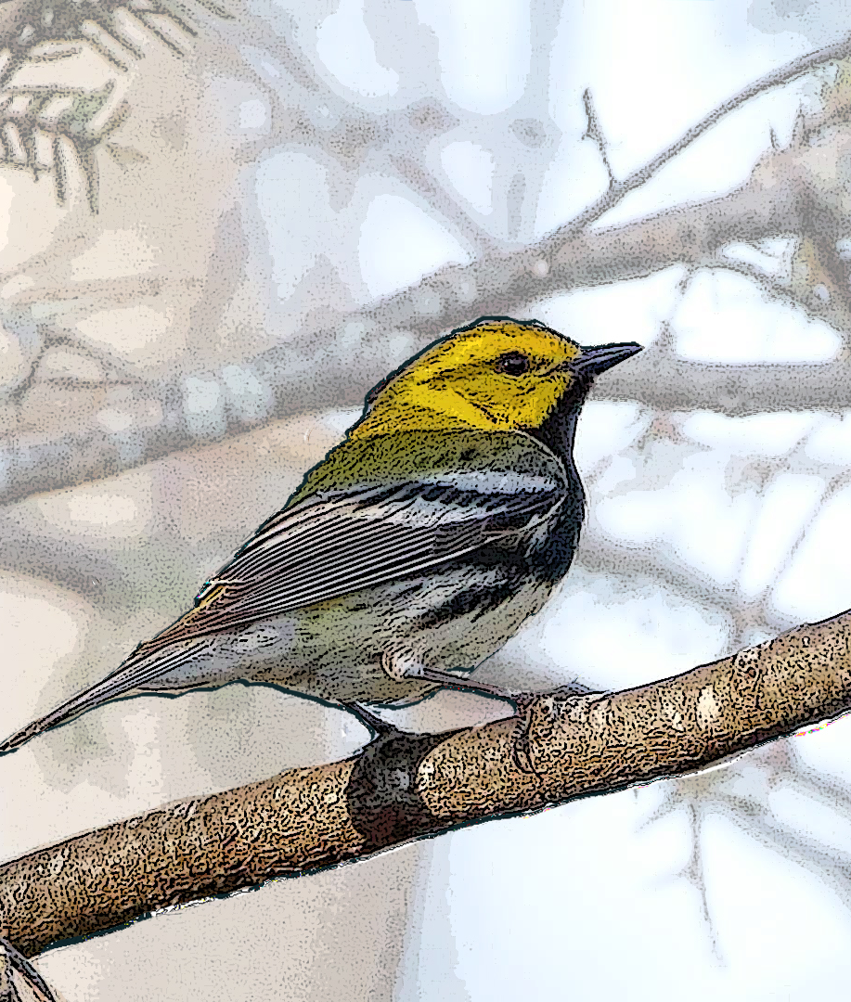
Black-Throated Green Warbler
Notes:
One species that is affected by climate and the budding and blooming of plants is the Black Throated Green Warbler. They eat almost exclusively insects during the breeding season, especially caterpillars, which they glean from small branches on both coniferous and deciduous trees. They also take berries in migration and feed on the buds of cecropia trees while wintering in the tropics.
While some birds, like the hummingbird, depend on photoperiods for migration timing, this bird migrates with weather.

Slide 36
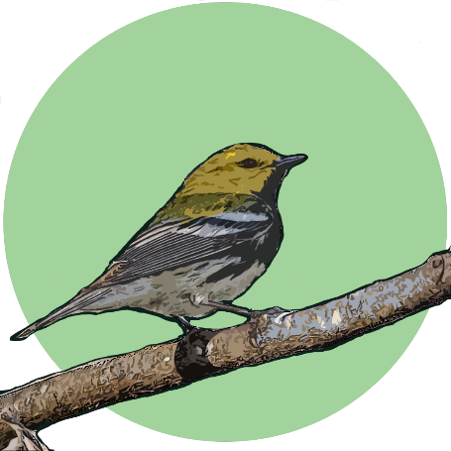
Some Phenology Data from Tremont
Notes:
We can study a changing climate and its impact on the Smokies through the study of phenology.
Are plants blooming earlier than normal? How does that impact pollinators? How does it impact birds, like the Black Throated Green Warbler.
The Great Smoky Mountains Institute at Tremont, our residential environmental center in Tennessee, has been recording first appearance of birds, amphibians and flowers for over 35 years. We are seeing trends of early arrivals for some bird species and some flowering plants.

Slide 37

10 years of Data
Julian Day First Heard
Year
Notes:
Once we add a trend line, can you see a POSITIVE or NEGATIVE trend over time?
When we average the results, this is showing a positive trend with a trend of the bird being seen later in the year over time.
From the information on this graph, we can summarize our conclusions: there is a trend that spring came later in the Smokies between 2009 - 2019. (If looking at the last date, it was two weeks earlier, but the average was more like 5 days).
Is ten years enough time to draw a conclusion? What is the R-value? (In the grey box). (It’s only .0464) We like to see an R-value close to 1.0 for reliability of data.

Slide 38

Let’s Graph!
Notes:
Now it is time to create your own graph! (Hand out the data and the graph sheet template.)
You will be creating your graphs using a blank grid.
We will supply you with data about the arrival of Black Throated Green Warblers, or other species, and you can plot the data on the chart by date of their arrival.
Looking over your graph, you can determine if the birds are arriving earlier or later, by looking at the Trend Line.
Some tips: Don’t forget your labels and a tip – use a similar spacing for you dependent variable graphing. Don’t just put down the dates in the random way they show up on your data sheet. Would it be best to do 5, 10, 15 day intervals? This is up to you but think about your viewer being able to see distinctions in the data.

Slide 39

34 years of data = Better reliability?
Notes:
What will happen if we add more data? Instead of 10 years, let’s graph 34 years together.
(Pass out student graphing activity sheets).

Slide 40

Now You Try….
Black-Throated Green Warbler First Heard
Year | Julian Day | Arrival Date
1985 | 98 | 8-Apr
1986 | 91 | 1-Apr
1987
1988
1989 | 111 | 21-Apr
1990
1991
1992 | 97 | 6-Apr
1993 | 102 | 12-Apr
1994
1995 | 86 | 27-Mar
1996
1997
1998 | 90 | 31-Mar
1999 | 94 | 4-Apr
2000 | 84 | 24-Mar
2001 | 93 | 3-Apr
2002 | 88 | 29-Mar
2003 |  | 23-Mar
2004 | 86 | 26-Mar
2005 | 88 | 29-Mar
2006 | 88 | 29-Mar
2007 | 81 | 22-Mar
2008 | 88 | 28-Mar
2009
2010
2011 | 83 | 24-Mar
2012 | 79 | 19-Mar
2013 | 89 | 30-Mar
2014 | 61 | 2-Mar
2015 | 67 | 8-Mar
2016 | 83 | 23-Mar
2017 | 86 | 27-Mar
2018 | 86 | 27-Mar
2019 | 85 | 26-Mar
On graphing activity printout, enter dots on the graph above the year of the x-axis, corresponding to the y-axis dates. 1985 is input as an example: April 8th.
Notes:
You will be entering data from a table to a graph. Some groups will be working with Black Throated Green Warblers, some will be working with Spring Peepers.
For this example, we’ll look at the Black throated green warblers but the process is exactly the same.
Look at the first year that data is listed, and the calendar date that they first arrived.
What year? (1985)
What was the date? (April 8th)
Above 1985 on the x-axis, enter a dot closest to April 8. (See example on screen).
Go ahead and fill out the rest of the graph with your data.
(When groups are done, have them report what they found.)

Slide 41

34 years of data = Better reliability
Notes:
You should have something that looks similar to this.
Can you tell if the trend is positive or negative? (going up, or going down?)
Would you say the warblers coming earlier or later? Can you tell?

Slide 42

34 years of data = Better reliability
Notes:
Now let’s add the trend line from your results.
Is the trend line positive or negative? (Negative)
What is happening? (The trend is that warblers are arriving on average, about 3 weeks earlier).
How reliable is this chart compared to the 10 year chart? (The R-value moved from .046 to .45 which is closer to 1.0 and therefor more reliable). It also moved from a positive trend line, showing the birds arriving later in the year to a negative trend line showing the birds arriving earlier in the year over time.
More data means that we have a clearer trend line. Scientists sometimes hesitate to announce that something is due to climate change, because some studies need more time for data collection.
1985-2019- 34 years
With more data, the story from the data has changed dramatically going from positive to negative. It is important to make conclusions based off a reliable amount of data. More data will give you a stronger, more reliable conclusion. With year-to-year variations, overall, the slope is negative meaning this bird is continually arriving earlier in the Smokies. The big question: Is the arrival of the bird in sync with the food it needs to feed its young?
If we continue this study, we will have more data, and the R value should become more reliable.

Slide 43

34 years of data = Better reliability
Notes:
Let’s look at the Spring Peeper data.
You should have something that looks similar to this.
Can you tell if the trend is positive or negative? (going up, or going down?)
Would you say the spring peepers are being heard earlier or later? Can you tell?
Okay Spring Peeper group, let’s add the trend line from your results.

Slide 44

What does the Trendline mean?
Notes:
Now that we’ve added the Trendline to our graph- what does it mean?
Is the trend line positive or negative? (Negative)
What is happening, what does the trend mean? (The trend is that the peepers are being heard on average about 2-3 weeks earlier).

Slide 45
What is the Trend for Spring?
Notes:
Okay, don’t worry. We can figure this one out. It is demonstrating the averages of minimum temperatures from April through June from 1970 to 2019. Each color is a different month.
What is the range of years that we are looking at? (X-axis along the bottom: 1970-2019).
What are the four months that we’re comparing with the lines? (Each color of line graph: March, April, May & June).
What is being compared over time? (Y-axis along the left side: we’re comparing temperature in degrees Fahrenheit).
What does this data tell you? (without trend lines). The lines represent temperatures going up and down, month by month, year by year. But can you see a trend over time? Let’s add some trend lines and see if that helps. We’ll average all these ups and downs.

Slide 46
What is the Trend for Spring?
Notes:
Can you see the trend-lines? By comparing the various colors and lines, what is your first impression on what is happening with temperatures? While there are dips and valleys, the line shows the tendency moving upwards.
This graph shows data from 1970 – 2019 (almost 50 years) for the months of March, April, May and June, and the 3-month average minimum temperatures. You see a pattern of variability but with each month showing an overall warming trend.
This has implications for the bloom times for flowers and trees, the emergence for insects, amphibians and other animals.
It could also affect migratory birds and other insects important to either pollination or population control.
Take a look at the two lowest lines, March and April. What do you notice in the shapes of the lines? There are a lot of extreme shifts in minimum temperature.
While we’re seeing a warming spring – but the critters, plants and things are getting mixed messages. While the overall trend is going upwards, there are spikes and drops in temperature, and they can make young animals and plants vulnerable.
Plants and animals might be adapted to the cold in January February, but once they have started “doing their spring thing”, (reproducing, blooming, laying eggs) huge changes in temperature makes them more vulnerable.

Slide 47



Climate Change Symptoms
Rainier rains
Droughtier droughts
Floodier floods!
More frequent flooding events
More extreme rain events
More frequent landslides
Precipitation
22% wetter in past 115 years
Notes:
What are some other symptoms of a changing climate? Have you ever witnessed an extreme weather event? (Flood? Fire? Landslides?) How many of you remember in early 2016, when many parts of the area were under water and some people were stranded? Oddly, later that year, we experienced record drought and devastating fires. Changes in weather patterns are swinging more wildly at an increasing pace. In 2020, Cherokee again experienced dramatic flooding. Does anyone remember that or another crazy weather event?
In line with climate modeling, some predictions are coming true for the Southern Appalachian mountains:
We are seeing “Rainier rains, droughtier droughts, floodier floods, & windier winds…”
With that, in the past 115 years, we have seen a trend of more frequent flooding, more extreme rain events and more frequent landslides, increases in soil erosion, stream sedimentation, wildfires, increases in diseases and insect outbreaks.
------------------
Sources: National Climatic Data Center

Slide 48




Climate Change Effects?
Winds & Drought
38% windier in the spring/fall
“Mountain Waves”
Mountain Wave damage, April 2011
Tornado, April 2011
Fires, 2016
http://www.ncdc.noaa.gov/temp-and-precip/time-series/
Notes:
We have also have noted a 38% increase in winds associated with storms and patterns called “mountain waves” impacting mostly the TN side of the park.
------------------------------------
This is creating a lot of damage to trails and property, & causes park road closures on a regular basis. Sadly, there is also an increase in visitors who have been injured or even lost their lives to falling trees.
Mountain Waves winds and extreme drought caused unusual fire behavior in the Chimney Tops II fire, and other fires, of 2016.)
So we’re wondering: Is there a new pattern of climate behavior for our region? How will it affect not only the park visitors, but the species that live here?

Slide 49


Sochan – Spring Tonic for the Cherokee
Notes:
What are we noticing with local plants?
On average, temperatures are getting warmer. This can be a problem especially in months that should be colder, like January and February. Otherwise, early warm temperatures may trigger plants to start growing early.
Knowing the timing of different seasons lends itself to agriculture, harvesting medicinal plants, hunting of certain game, etc. The young, green leaves are rich in Vitamin C and are eaten like Collard Greens, Spinach or Kale. If we have a warm spell in February and Sochan starts to send up shoots and then a cold snap in March or April that kills those young, tender leaves, this plant will not be available for collecting. The reddish circle shows the only part of the plant that is collected, it is called a Turkey’s foot because that is what it resembles.
Sochan is an important spring tonic plant for the Cherokee. Recently, the Great Smoky Mountains National Park and the Eastern Band of Cherokee collaborated on an effort that allows the selective harvesting of sochan by Eastern Band of the Cherokee members that have a permit to harvest. The Park is obligated to preserve and protect the natural resources… but we also want to respect tribal customs and traditions. So, the lottery helps us monitor the sustainability of the plants.
(Note: Collecting is not permitted in the Smokies except for the 30 EBCI tribal members that get selected in a lottery. )
NPS Photos

Slide 50

Citizen Science – Phenology Monitoring
Trees
Spring wildflowers
Migratory birds
Notes:
To answer this, we are using volunteers in the park to help monitor phenology and relationships between species.
It is important to have different levels of the food chain as part of the study plots, as well as different locations.
We also collect something called Metadata – that is the behind the scenes, or abiotic data that is important for showing the context. Metadata includes things like date, time, weather conditions etc.

Slide 51

Track Phenology at School or Home
Help scientists answer important questions about phenology
Nature’s Notebook @ www.usanpn.org/natures_notebook
Notes:
You could add a study like this to your schoolyard or backyard and enter the data onto the National Phenology Network website, or Nature’s Notebook phone app. Collect data on one species or many as often as you can. Any data is better than no data.

Slide 52
Phenology or Not?
When the red maple trees flower.
First bee activity of the year recorded.
Date I get my first bee sting in 2024.
How many birds come to my feeder.
Which birds come to my feeder on November 4, 2024
Latest bloom of the wildflower, Mountain Gentian.
How many times I hike to the top of Kuwohi
during the month of June.
Date when we hear the first elk bugle.
Date of the last leaf drop on the Walnut tree at Oconaluftee.
Date Rihanna releases her new CD.
Notes:
IF YOU WANT MORE….
Time to take a quiz. Is it phenology or not.
Phenology
Phenology
Not
Not
Phenology
Phenology
Not
Phenology
Phenology
not

Slide 53
Phenology or Not? ANSWERS
When the red maple trees flower. Phenology
First bee activity of the year recorded. Phenology
Date I get my first bee sting in 2024. Not
How many birds come to my feeder. Not
Which birds come to my feeder on November 4, 2024. Phenology
Latest bloom of the wildflower, Mountain Gentian. Phenology
How many times I hike to the top of Kuwohi
during the month of June. Not
Date when we hear the first elk bugle. Phenology
Date of the last leaf drop on the Walnut tree at Oconaluftee. Phenology
Date Beyonce releases her new CD. Not
Notes:
Time to take a quiz. Is it phenology or not.
Phenology
Phenology
Not
Not
Phenology
Phenology
Not
Phenology
Phenology
not

Slide 54









SPiN
Seeking Paths in Nature
Notes:
Add slide FOR TEACHER PRESENTATIONS:
Some inventory and monitoring work in the Smokies is done by citizen and community scientists, including many students from around the region. It is possible that you will all be a part of some type of monitoring effort here in the Smokies, studying salamanders, snails, air quality, lichens, invertebrates or phenology.
Seeking Paths in Nature is a partnership between Great Smoky Mountains National Park, Cherokee Central Schools, Eastern Band of Cherokee Indians and other federal and community partners with funding assistance from the Cherokee Preservation Foundation, Friends of the Smokies and Smokies Life.

Slide 55

Questions?
GRSM_NC_Education@nps.gov
Notes:
Fringed Phacelia flower with its beetle pollinator
(Can add own name and contact if needed).
(NPS)

Slide 56
National Park Service

