Slide 1
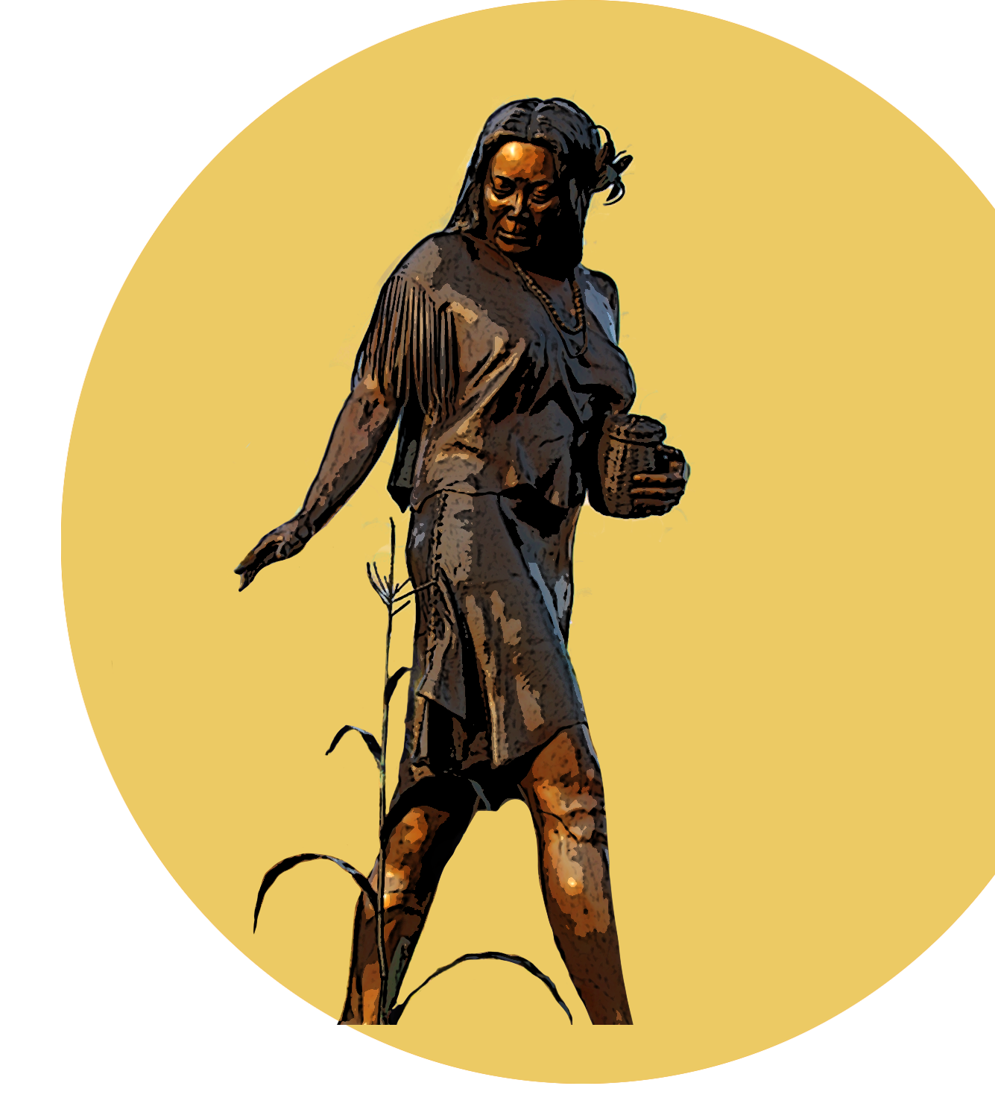


The Genetics of Selu
Selu illustration: B. Bramhall / NPS from photo by J. Metz
Notes:
Dialogic question: When you think about the term “genetics” what comes to mind?
Genetics is the study of the inheritance of traits from parents to offspring. This is a phenomenon in humans as well as all other forms of life.
Selu (pronounced shay-loo) is the Cherokee word for corn as well as a “corn mother” who was the original woman in Cherokee creation stories.
The Eastern Band of Cherokee have been practicing genetics in agriculture for thousands of years, a form of Traditional Ecological Knowledge (TEK), or Indigenous Science. Science is about making observations, and TEK has evolved from generations of experience. Occupying the traditional lands of the Cherokee, the Great Smoky Mountains National Park is working to integrate this knowledge into its education programs and land management practices.
…………………………….
Image: Art B.Bramhall from Jessica Metz photo

Slide 2
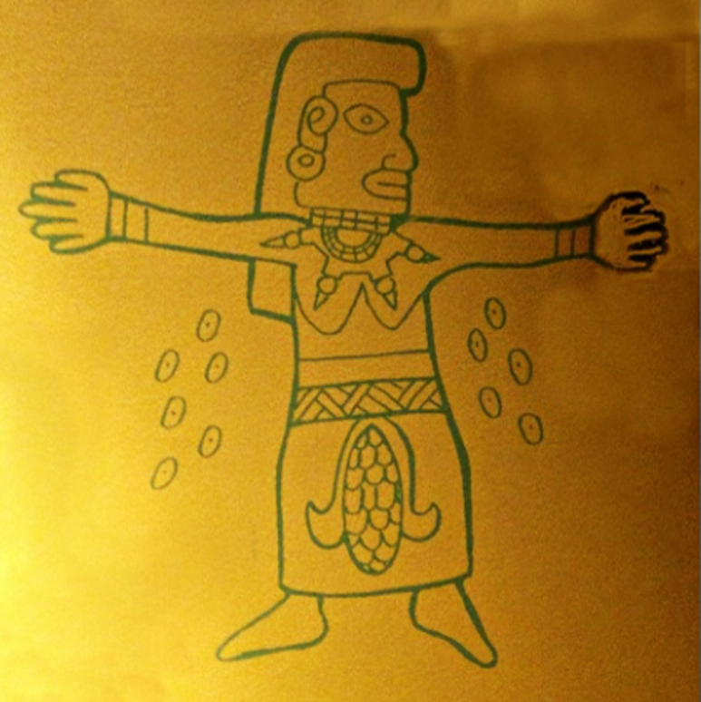
Legend of Selu
Selu illustration: Courtesy of Museum of the Cherokee Indian
Notes:
When you look at this image, what do you think of?
This picture shows an ancient drawing of Selu, exhibited at the Museum of the Cherokee Indian. In this depiction, she is shown with beans coming from her armpits and the corn on her stomach, as told in the Legend.
Selu was also known as the Corn Mother or Corn Woman Spirit, and her story illustrates the importance of corn in Cherokee society. There are many different versions, each with different characters and outcomes.
The common theme is that Selu was from the heavens, would walk the fields and corn would sprout overnight and grow very large, and in a rainbow of colors.
In a locally told version (by Freeman Owle), one year, the corn didn’t grow because “hunger” had kidnapped her and hid her in a cave. Ravens volunteered to help, and being black as night, they were able to hide, attack hunger, and rescue Selu in the darkness. When she walked out into the sunlight, the corn began sprouting up again. Today, when the stalks are waving, it is Selu, walking the fields.
……………………………..
In an older version (outlined by Mooney), Selu, the Corn Goddess, and Kanati, the Hunter, are husband and wife in a creation story of corn. Kanati’s son, with other boys, exploits some of the game that provide eternal nourishment from Kanati’s hunts. In punishment, Kanati sends insects and vermin to punish them. They return home hungry, and Selu goes to her storehouse to retrieve some corn and beans. They secretly follow her there and witness her rubbing her stomach ---- filling her basket with corn as she stands over it. Rubbing her armpits, the basket filled with beans. The legend continues along an epic track, with the boys thinking her a witch and killing her, and an ensuing plot of that explains how corn is grown and hunting occurred thereafter.
-----------------------
If time, longer versions of the story:
One version, by Eastern Band of Cherokee storyteller, Freeman Owle:
Living Stories of the Cherokee - Google Books
20_Story_cardsnew.3 (omsi.edu)
…………..
Image: Photograph of historic image, courtesy of the Museum of the Cherokee Indian

Slide 3
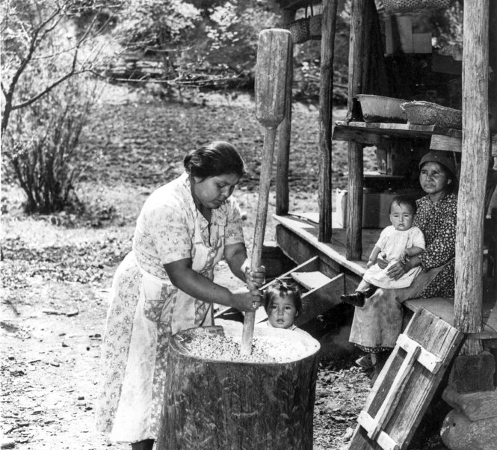
Corn and the Cherokee
Food source
Deer lure
Photo from Museum of the Cherokee Indian: "Lizzie Tooni, Mary Wolfe, Bill Wolfe, and Frances Wolfe"
Notes:
From the earliest times in Cherokee history, the raising of corn was interwoven with the foodways, lifeways, traditional events & spiritual beliefs of the people. Corn has been cultivated in the Southern Appalachians for more than a thousand years. This timeframe corresponds with the beginning of Cherokee culture, as it emerged from the practices of other tribes.
"Corn, or maize, originated in the Americas and was first cultivated in the area of Mexico more than 7,000 years ago and spread throughout North and South America" (http://www.npshistory.com/publications/dewa/spanning-the-gap/v22-1-2.pdf).
Both in ancient times and now, corn had multiple uses and was used in many recipes. Foods include hominy, corn pones, bean bread and cornbread.
During the Mississippian period, about 1,000 years ago (800-1600 CE), stalks around the outside perimeter of a cornfield were often left standing in the winter. One reason may have been to attract deer and allow hunters to stay closer to home in the winter months.
It is a producer plant, a green plant that synthesizes food through photosynthesis, the process of converting sunlight into sugars and complex carbohydrates. This quality of corn made the daily use of corn beneficial for nutritional value for the Cherokee people.
…………………………..
Photo from Museum of the Cherokee Indian: "Lizzie Tooni, Mary Wolfe, Bill Wolfe, and Frances Wolfe"

Slide 4
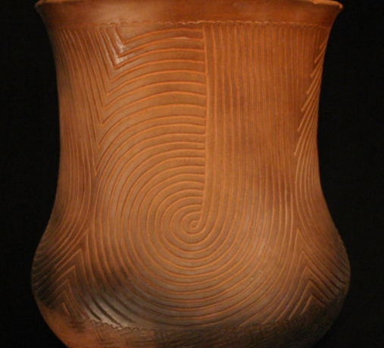
Corn and the Cherokee
Pottery –
  Fired with pot for dark coloration
  Less porous, more waterproof
Image: Pot courtesy of Jane Osti 2006. Cherokee Heritage Press.
Notes:
Corn has also been used in the process of firing pottery, both in ancient and modern times, producing the signature “blackened” effect of Cherokee pottery, and also resulting in pots that are less porous and more waterproof.
…………………………
Image: Pot courtesy of Jane Osti 2006. Cherokee Heritage Press.

Slide 5
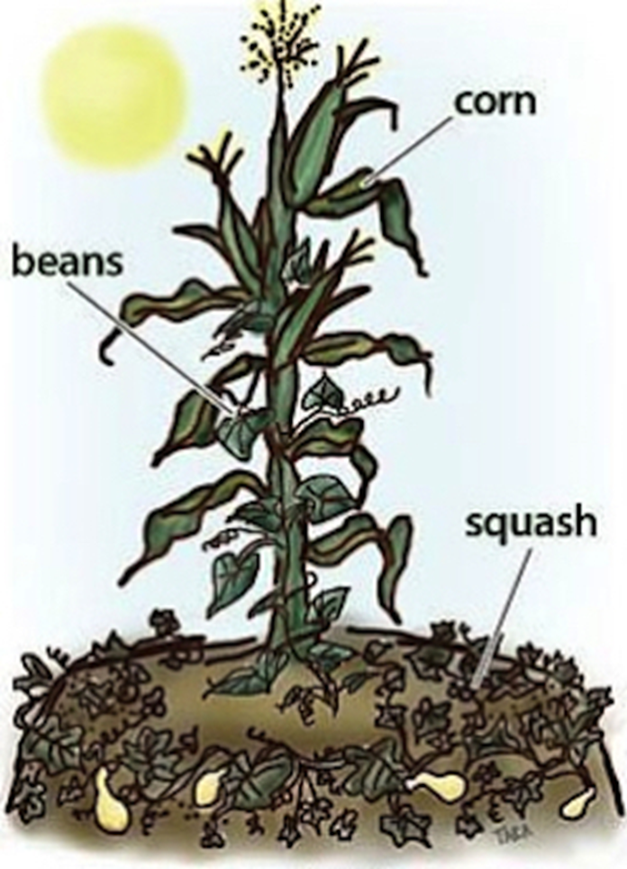
The "Three Sisters"
Image: UCANR.org (University of CA Agriculture and Natural Resources)
Notes:
What have you heard of the agricultural practice known as ”three sisters”?
Corn, beans, and squash, together, are known as the “3 Sisters” to many Eastern tribes. They are planted together for several reasons.
The corn stalk provides structure for the climbing vines of the bean plants;
The bean plants have nitrogen-fixing bacteria living in the roots, add beneficial fertilizer to the soil;
The large-leaved, low-growing squash plants provide both shade & ground cover that keeps away weeds and preserves the soil moisture.
Though corn had been grown in its first forms for more than a thousand years, in the Mississippian Period, a new variety with more kernels emerged called Eastern Flint. These more productive crops provided the means by which people were able to increase their population and leisure time.
----------------
Image: UCANR.org (University of CA Agriculture and Natural Resources)

Slide 6
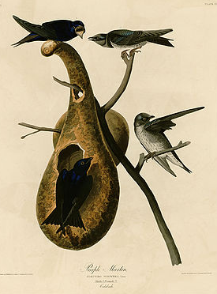
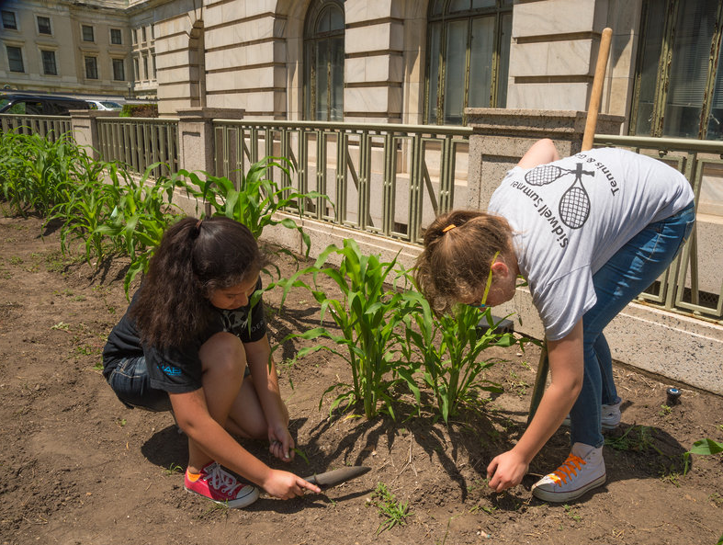
Corn and the Cherokee
Images: Hilling corn- http://www.publicdomainfiles.com/show_file.php?id=14025562811677 , Audobon: Purple Martins
Notes:
In time, the Cherokee refined their planting, cultivating, and harvesting techniques. They used a method called “hilling,” piling dirt around the base of the cornstalk to provide drainage. Cherokees also had an ingenious method of pest control. They hung gourds around their garden to attract purple martins. Nesting in the gourds, these birds, known to consume large quantities of insects, would aggressively defend their territory against crows and blackbirds, both of which could destroy newly planted corn.
----------------------------
Images: Hilling corn- http://www.publicdomainfiles.com/show_file.php?id=14025562811677 , Audobon: Purple Martins

Slide 7
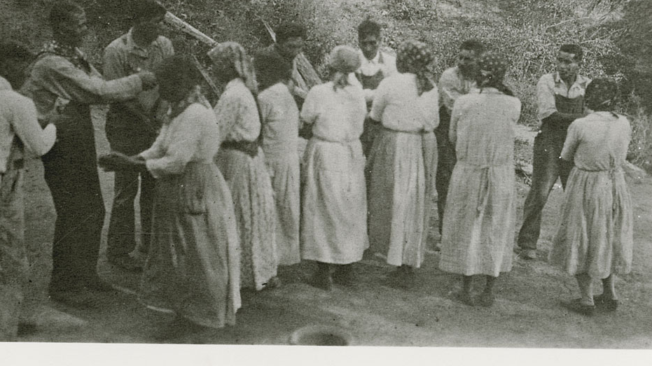
Green Corn Ceremony
“Green Corn Dance” 1932. Photo courtesy of the Smithsonian Institution
Notes:
Corn continues to play an important role in the societies of Cherokee and many other indigenous peoples. More than simply food, corn is important to the cultural and religious practices of the Eastern Band of Cherokee community. Every year, a Green Corn Ceremony is held to celebrate the ripening of the year’s crop, accompanied by games, competitions, art, music and a community fair.

Slide 8
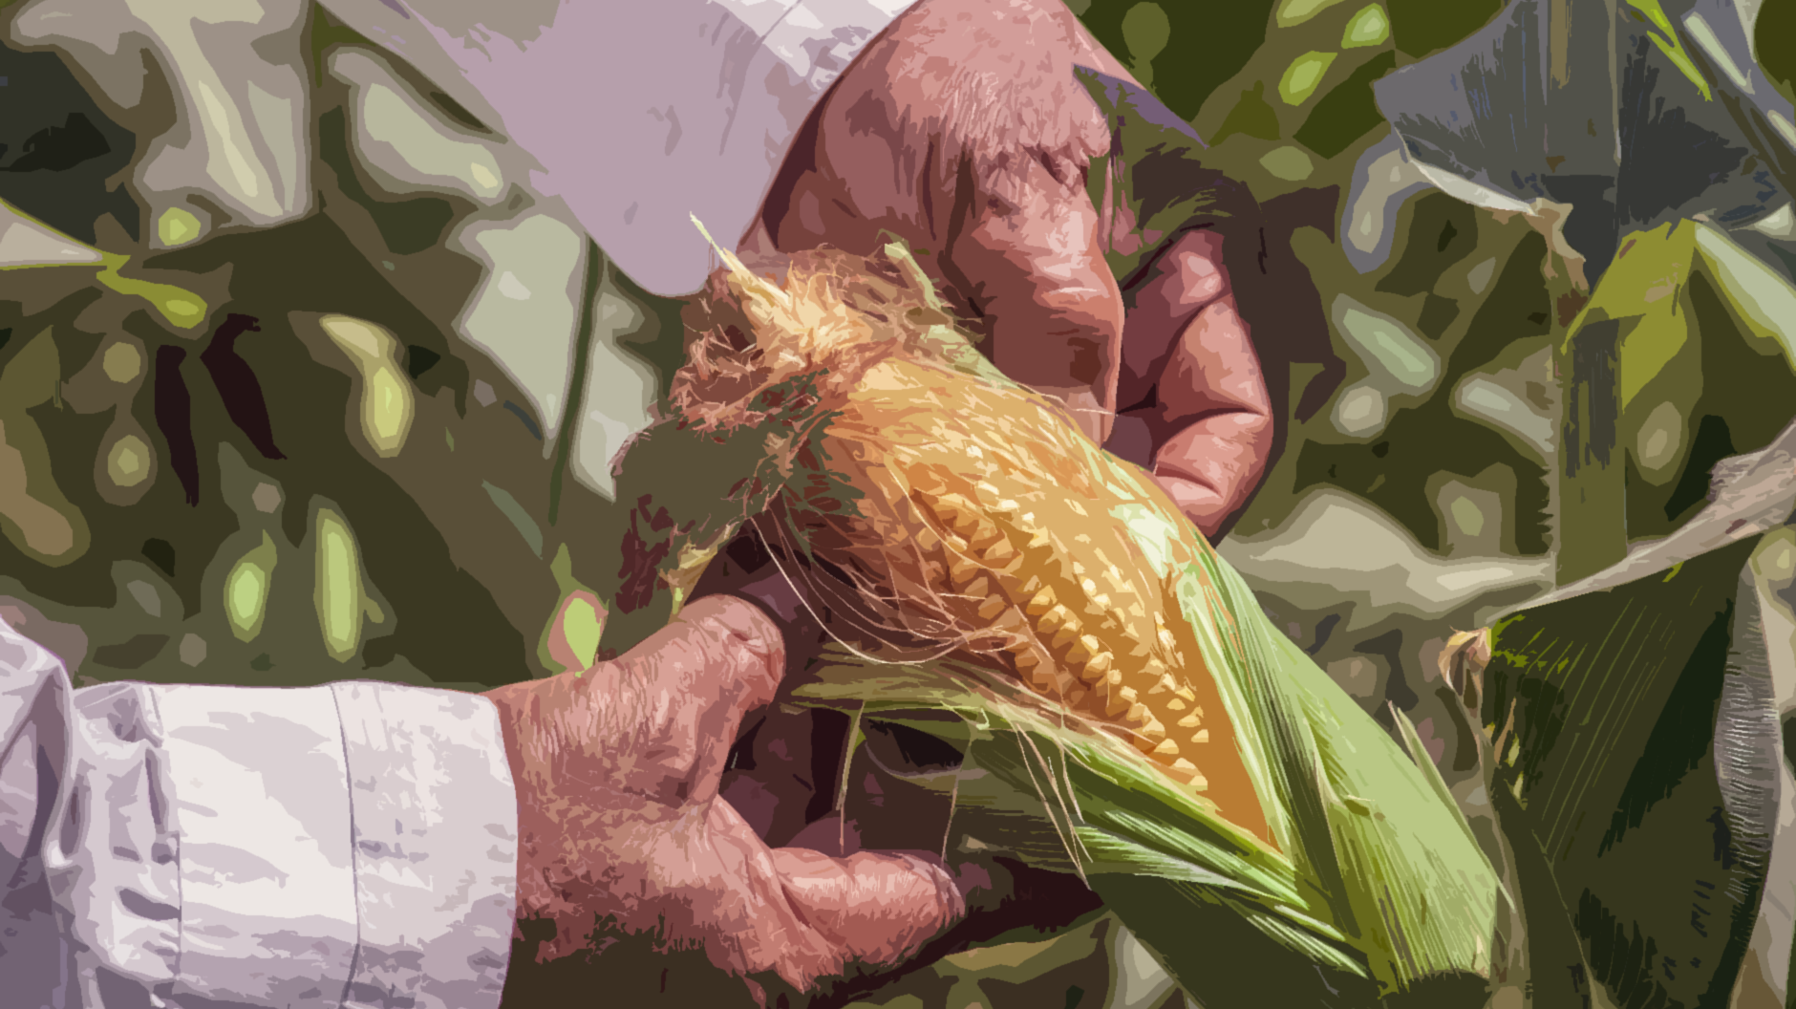
How do we use corn?
Notes:
What are some ways in which corn is used in your daily lives?
Corn is also very important in many aspects of the culture and products of the United States today.
Think beyond simply food and discuss with your classmates.
Image: USDA

Slide 9
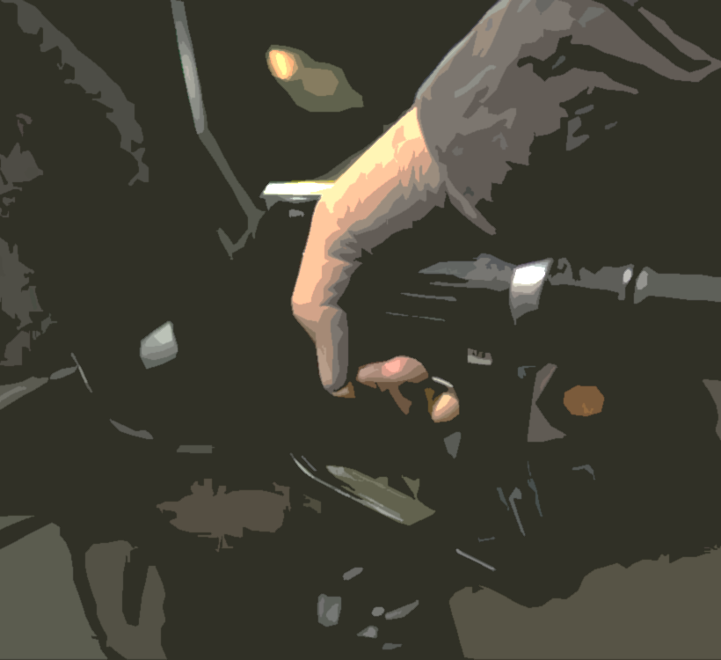
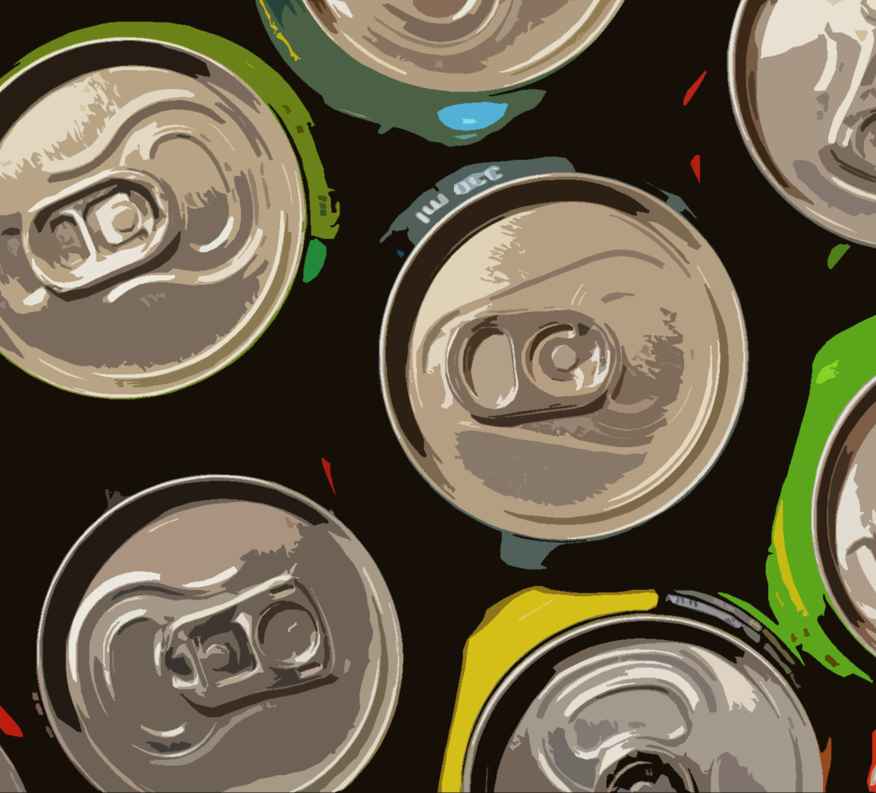
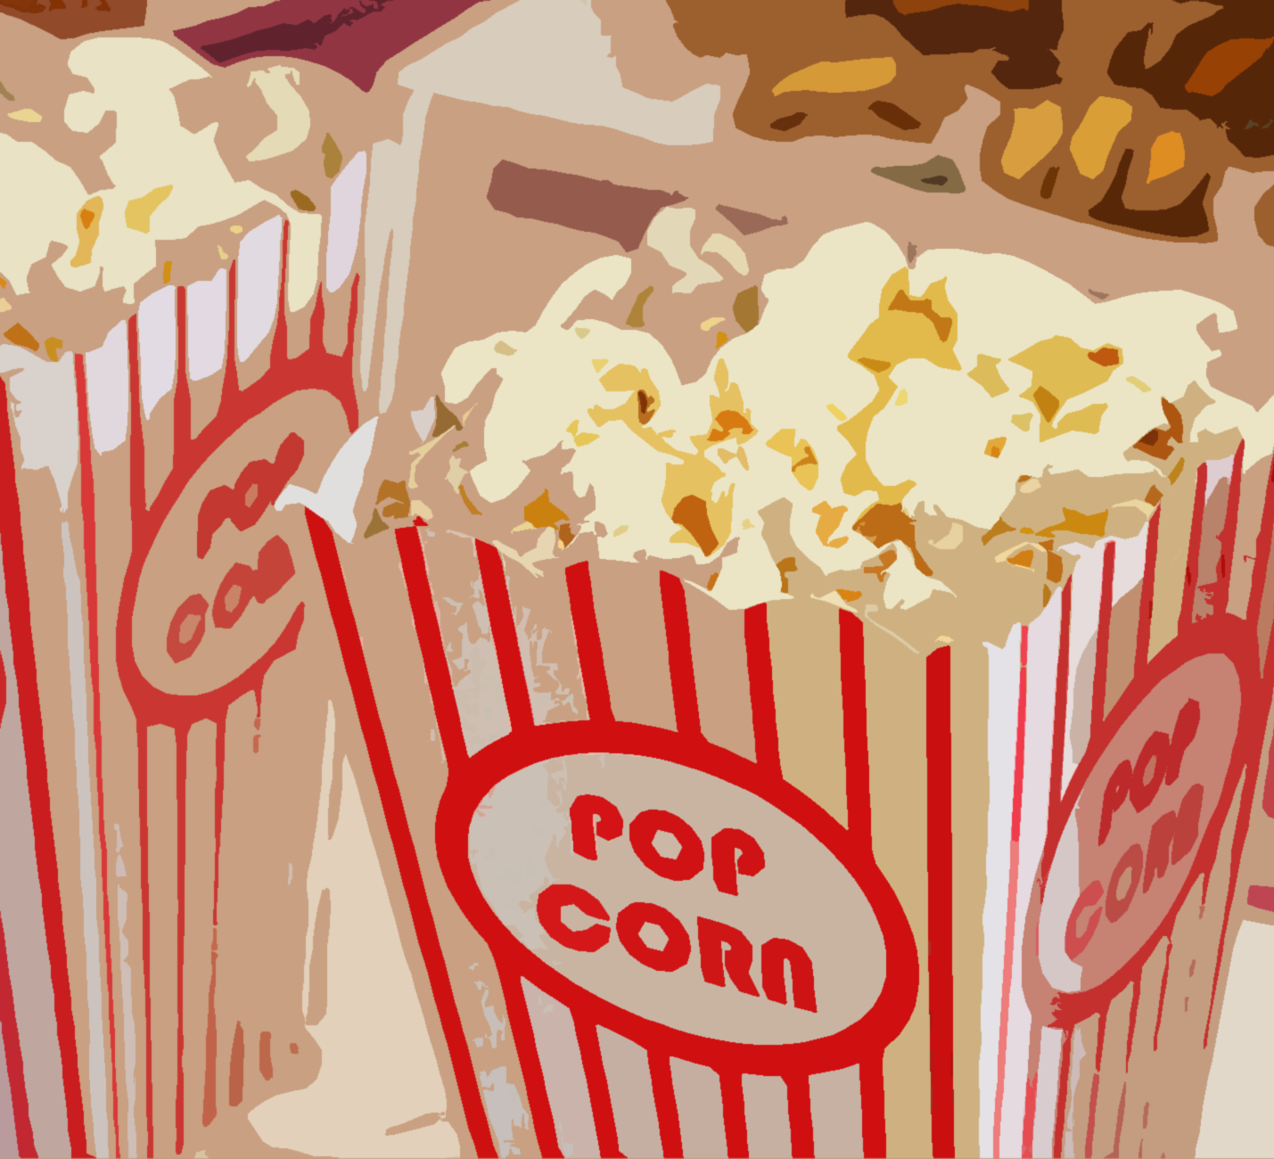
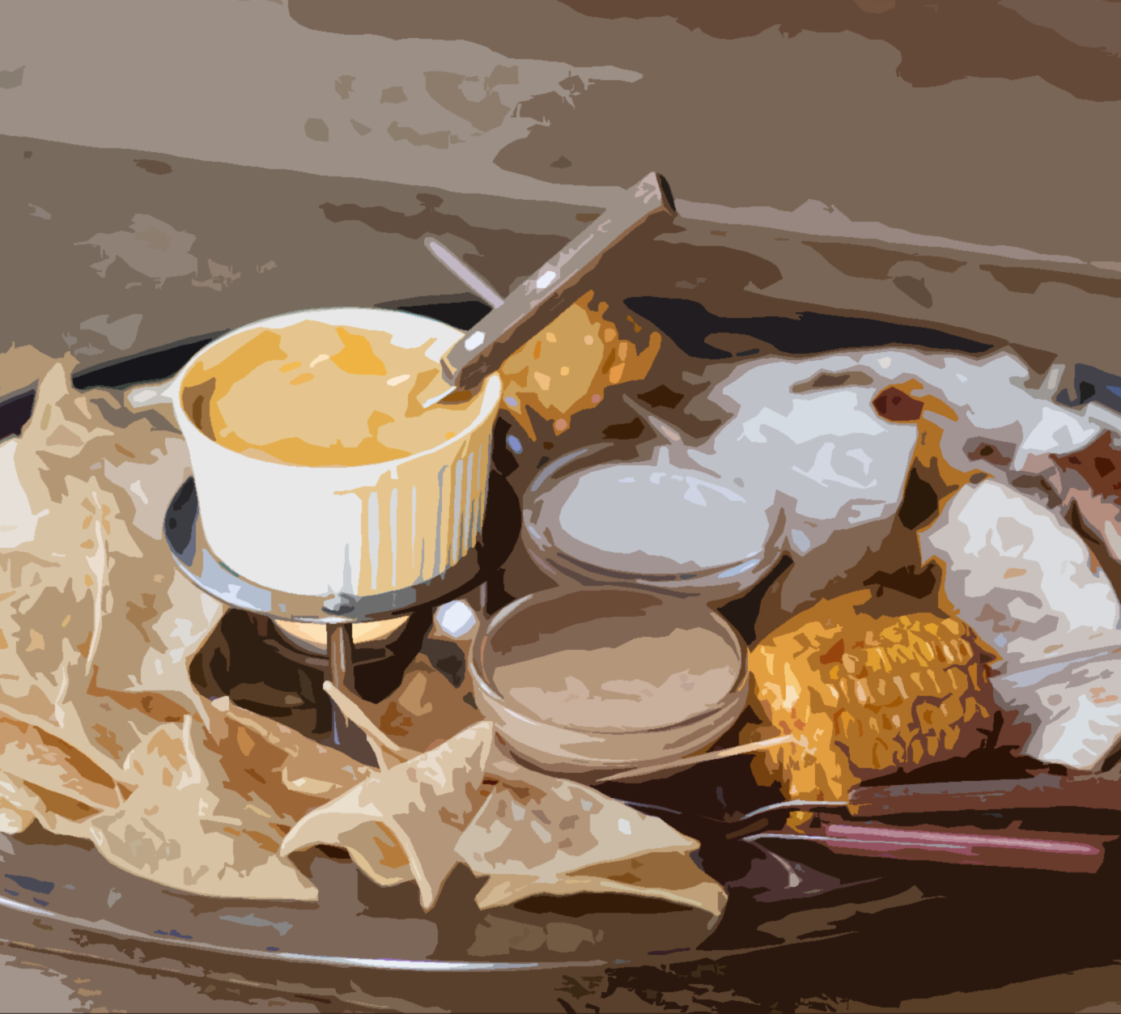
How do we use corn?
Notes:
Examples: corn syrup is in soda and many other processed foods. Tortilla chips and popcorn are some popular snacks made from corn. Much of our gasoline that is used to power our vehicles is cut with “ethanol”, a product of corn. Corn can also be used in explosives, cosmetics, fibers, cooking oil, alcohol, paint, antibiotics, corn meal and flour, grits, hominy, cornstarch, feed for animals, bio-fuels, bio-plastics, baby diapers (absorbent acrylic acid…), corn-based pellets for woodstoves, medications and vitamins use cornstarch, carpets and textiles, and even crayons.

Slide 10
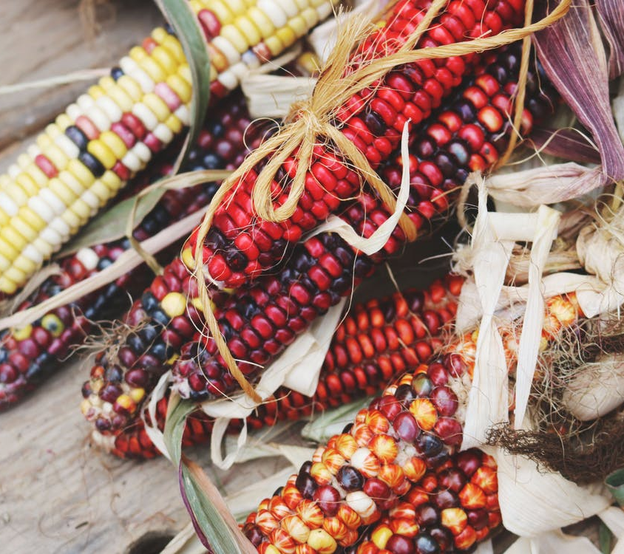
Why does some corn look different?
Colors
Textures
Size
Taste
Photo: Taken by Don Graham: Free Cultural Works/Share license: https://www.flickr.com/photos/23155134@N06/15518408005/
Notes:
You’ve likely seen corn that is yellow, white, and possibly a variety of colors.
Why do you think some corn is red, purple, or multicolored?
When we shop at the grocery store, the corn we buy in the produce section or in a can is usually yellow and/or white. But the corn you see in this photo, and at the Annual Cherokee Indian Fair, and in produce stands everywhere in the fall can be many, many different colors. But how does one ear of this multicolored flint corn form kernels of so many different colors? Today we are going to talk about how farmers use their knowledge of genetics to produce corn that has the colors they want to see. In other words, we will learn how they use their knowledge of genotype to produce the desired phenotype…and win a ribbon at the fair!
Photo: Taken by Don Graham: Free Cultural Works/Share license: https://www.flickr.com/photos/23155134@N06/15518408005/

Slide 11
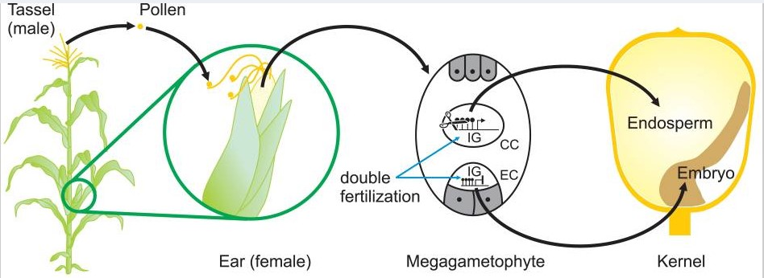
Corn Reproduction
Image: Creative Commons attribution license: Finnegan, Whitelaw, PLOS Genetics. 2008. Retrieved from Figure - PMC (nih.gov)
Notes:
As we mentioned, Corn is a flowering plant. It reproduces like other flowering plants, by passing pollen from the male to the female part of the plant. Under the husks, each of these kernels is attached to one of the “silk” threads you see protruding from the top of the ear. The tassels on the top of the plant are the male part of the plant. When pollen from the tassels land on the silk, they fertilize the seed. Because each silk is only attached to one kernel, then each kernel has the possibility of inheriting a different genotype.
……………………………….
Image: Finnegan, Whitelaw, PLOS Genetics. 2008. Retrieved from Figure - PMC (nih.gov)
This is an open-access article distributed under the terms of the Creative Commons Attribution License, which permits unrestricted use, distribution, and reproduction in any medium, provided the original author and source are properly credited.

Slide 12
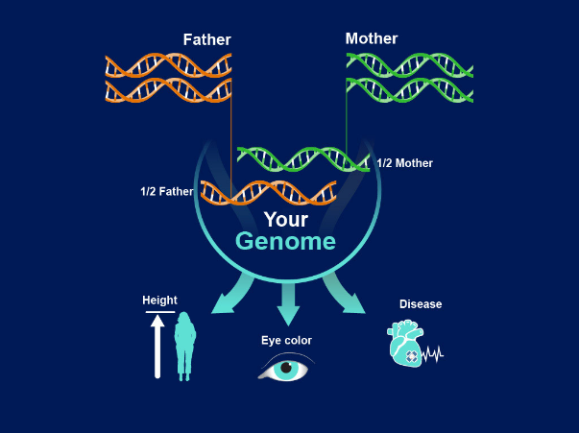
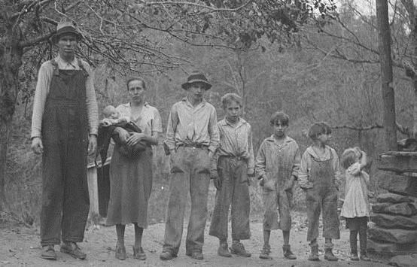
Genetics
Family Resemblance
Information encoded in DNA
Heritability
Image: National Human Genome Research Institute, NIH.
Gilbert Family, 1937. TVA / NARA. PD.
Notes:
As mentioned earlier, genetics is the study of how genes are inherited and expressed in one generation to the next. It is the reason that we share qualities with and look like mixtures of our parents and siblings.
Ultimately, most differences in the appearance and qualities of corn – and humans as well as all life – come down to a simple molecule known as DNA.
How would you define “DNA”?
…………..
Image: Gilbert Family, NARA from a TVA image. 1937, Murphy, NC. PD.
Your Genome: NIH National Human Genome Research Institute

Slide 13
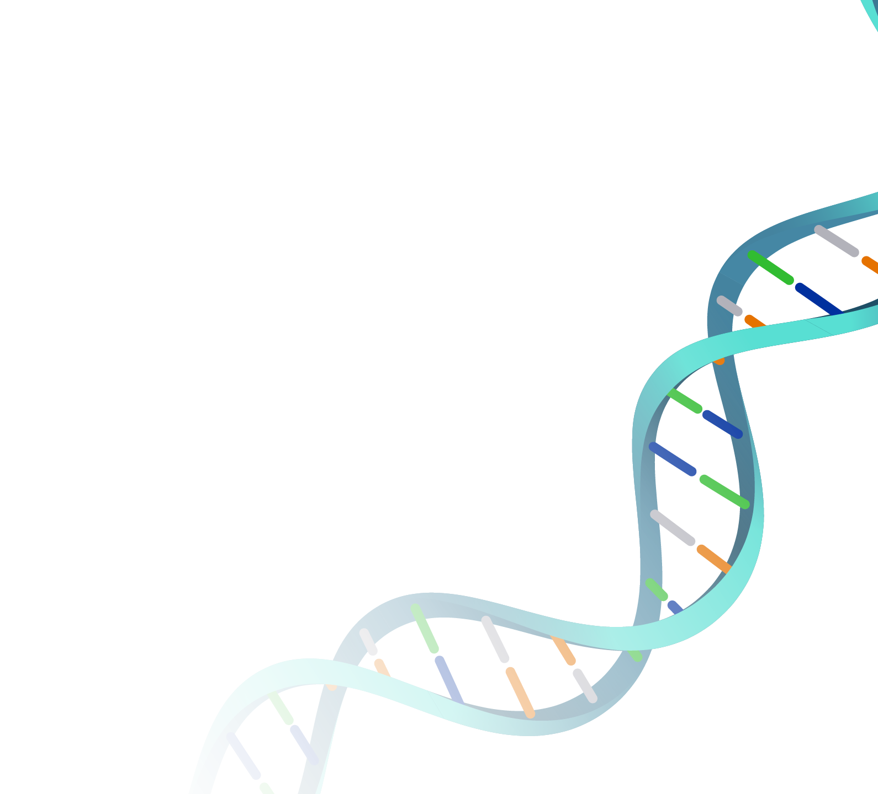
DNA
Deoxyribonucleic Acid (DNA)
Molecule found in every cell
The code for who you are
Click Here: TED Talk DNA Animation Link
Image: Double Helix, National Human Genome Research Institute, NIH.
Notes:
DNA is like an instruction book that tells your body how to grow and express itself.
DNA stands for Deoxyribonucleic Acid. (Try to pronounce that!)
DNA is passed down from one generation to the next, from parents to offspring.
This transfer of DNA, of your genetic instruction book, is known as heritability. This explains why we have similar attributes with our parents, brothers, sisters, and other family relatives.
TED Talk DNA Animation Link: (~9 min.) https://www.ted.com/talks/drew_berry_animations_of_unseeable_biology

Slide 14
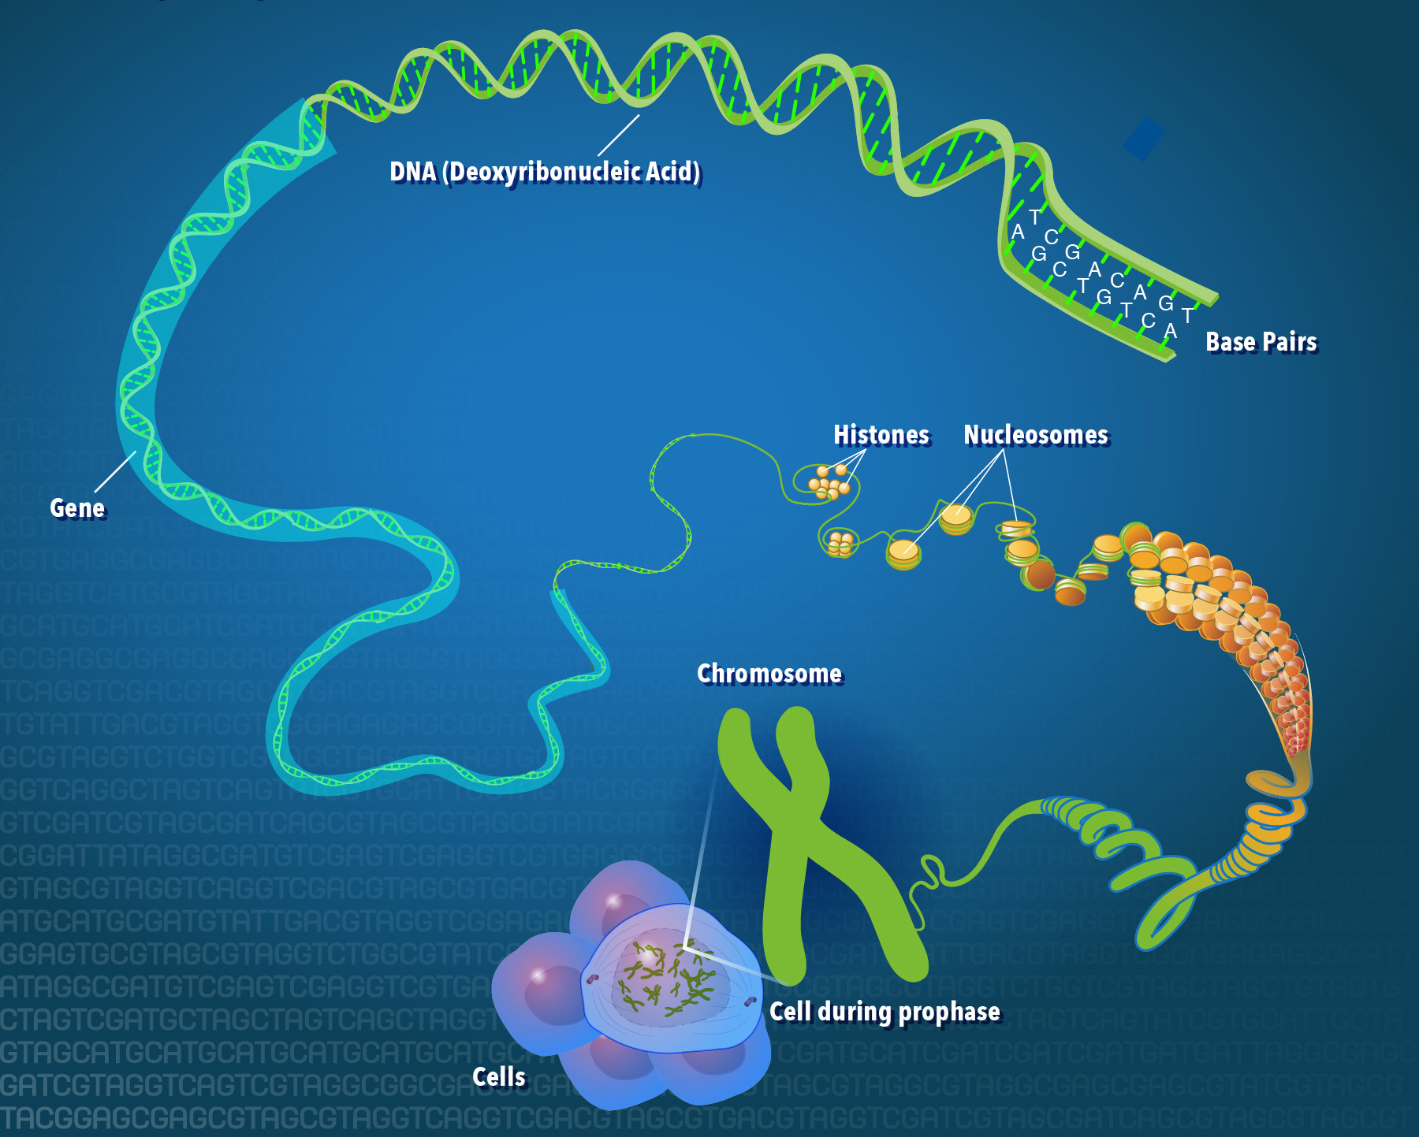
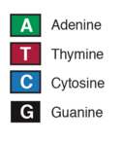
DNA
Nucleotides:
Chemical Building Blocks
Image: National Human Genome Research Institute, NIH.
Notes:
Similar traits (your father’s eyes, your mother’s nose) are transferred from one generation to the next through DNA. This information is encoded in DNA by four chemical building blocks known as nucleotides.
The four nucleotides are adenine, thymine, cytosine and guanine (A,T,C, and G for short). Every A fits perfectly with a T on the other strand of the double helix and every C fits perfectly with a G. In this way the strands are complimentary. These building blocks are found lined up one after the other on a DNA strand. Your body reads these chemical cues in order and makes your body accordingly.

Slide 15
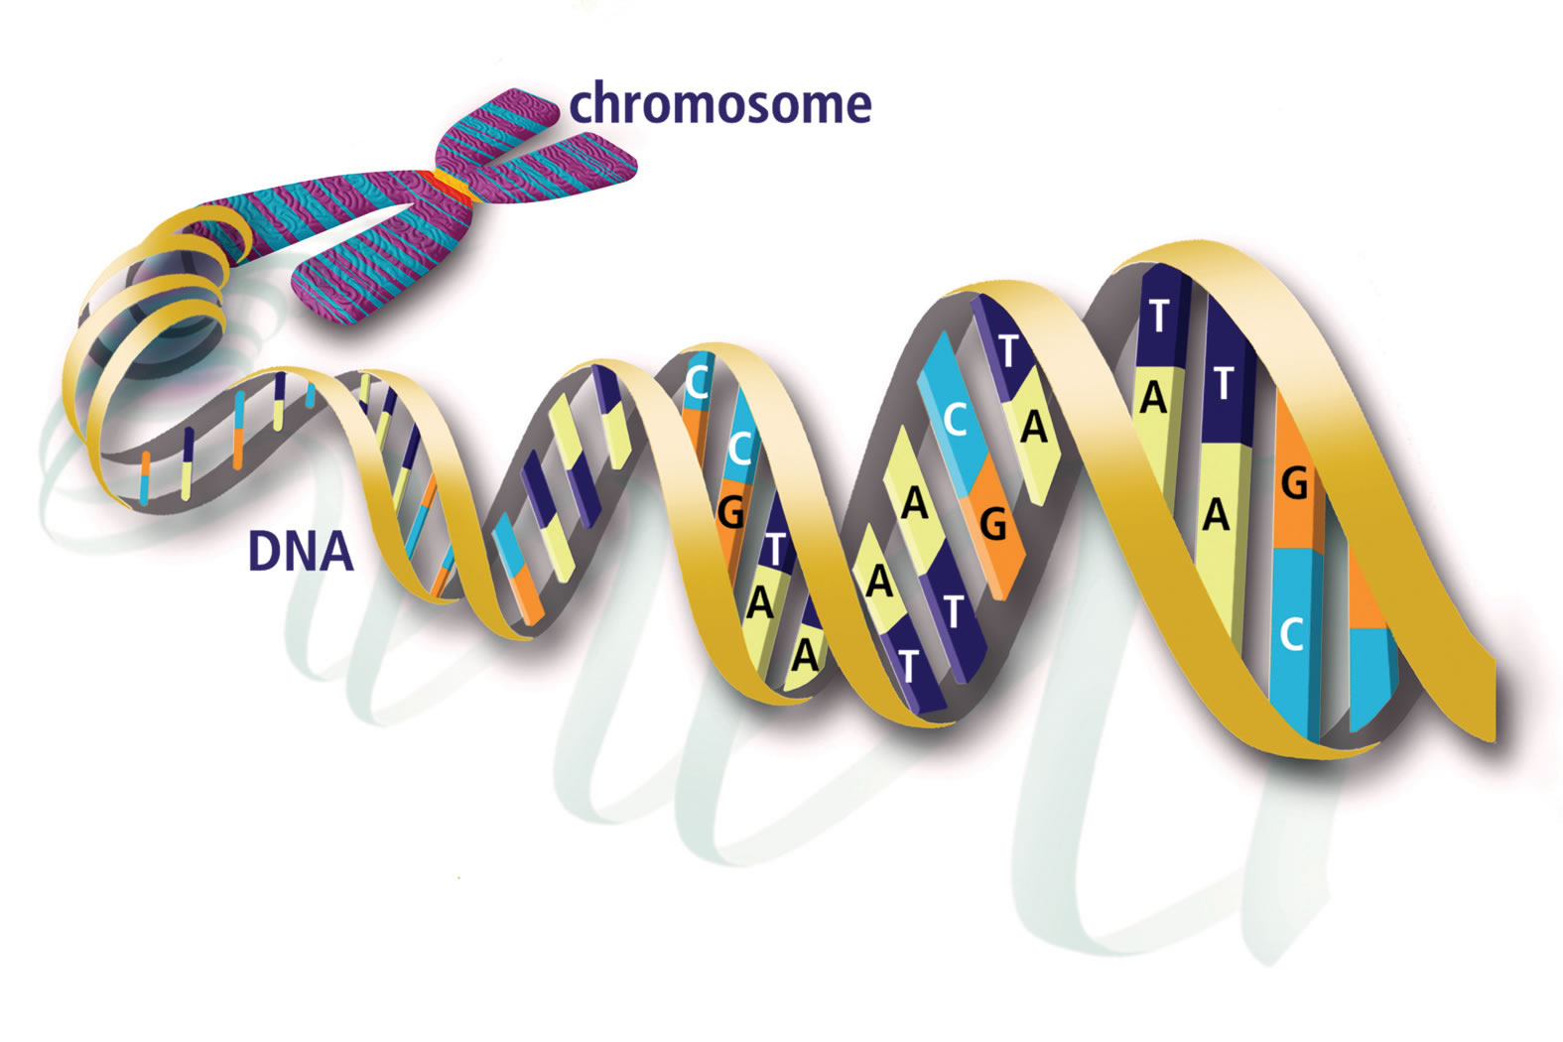
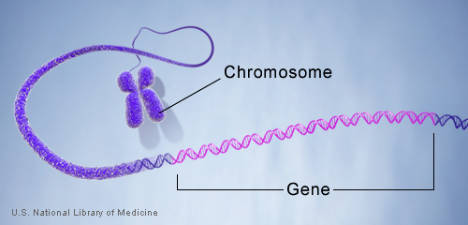
Genes – sections of DNA
Notes:
In every human cell there are about 3 billion of these pairs of letters. All of this DNA is organized into special bodies known as chromosomes.
Each person (usually) has 23 pairs of chromosomes in each cell. With about 3.7 trillion cells in each of our bodies, that’s a lot of information! However, a lot of our DNA does absolutely nothing – in fact only 1.2% is known to have a specific purpose in coding for physical traits. Sections of our DNA that code for specific traits are known as genes.
As we will see on the next slide, small variations in these genes (the code), can have major implications for how we present.

Slide 16
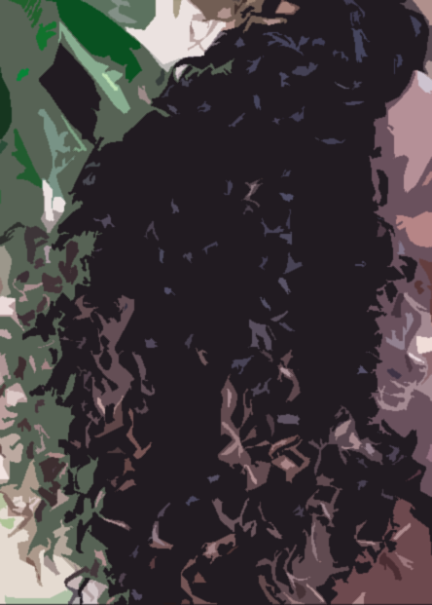
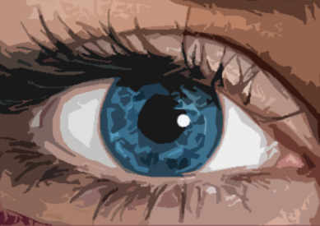

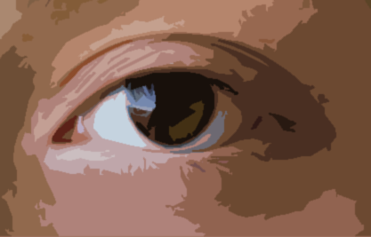
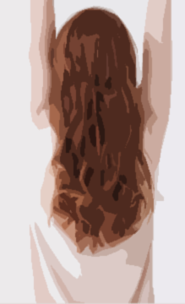



Genes – DNA sections translating codes into traits
Nucleotides
Nucleotides
A =
T =
Notes:
What color are your eyes? (brown/blue/green/hazel)
While we all have a gene for eye color, slight changes in the order of the letters of our code can have major effects on the way our eyes look.
In this graphic, each color bar represents a different pair of nucleotides (A,T,C, or G).
Can you identify any differences in the code between the brown eye and the blue eye? (the differing base-pairs are highlighted)
Next perform the same task with the red and black hair colors.
These variations in code account for the vast diversity of appearances in people and all life on the planet.
Each gene codes for a specific protein. The proteins are the true workhorses of our cells. Proteins are responsible for every aspect of our lives – they dictate how we look (for example a protein determines our eye color), they allow our nerves to function so we can read and understand this text, they allow us to digest our food, etc.. Almost all critical functions of cells, and therefore multicellular organisms such as corn plants, are controlled by proteins that are coded for by DNA.
Each gene has multiple versions or alleles. Some genes have only two alleles, for example eye color is partially controlled by a gene with two versions – the brown-eye allele and the blue-eye allele. Some genes have many alleles, like blood type.
*Note: these are not actual gene sequences. These are very simplified to illustrate the impact of genes on appearance (phenotype).*

Slide 17
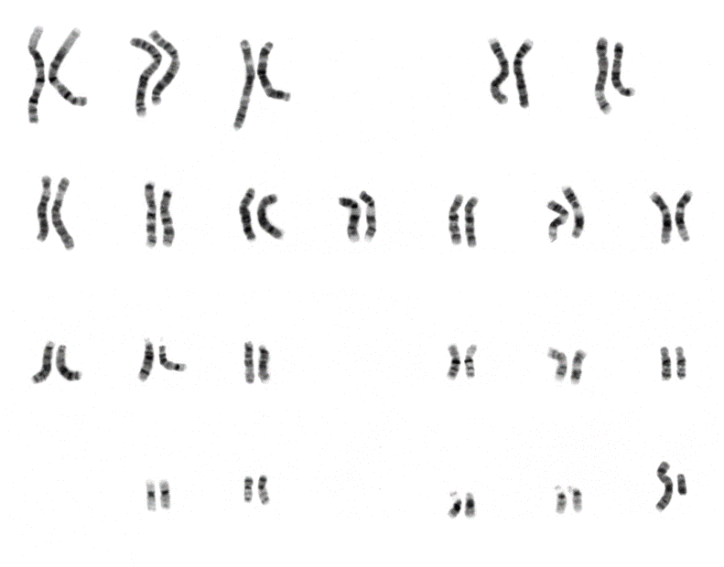
Chromosomes
Genes are stored on chromosomes
Two copies of each gene – alleles
Notes:
As we mentioned earlier genes are found on DNA and DNA is all bound up in large bodies called chromosomes. Some of you may remember that humans (usually) have 23 pairs of chromosomes – giving us a total of 46 chromosomes in each cell.
We inherit 23 chromosomes from our mother and the other 23 from our father. The chromosomes from each of our parents have different versions of the same genes making us a mixture of their genetic material.
When you have two versions of the same gene, those genes are known as alleles. To get a better grasp of alleles, let’s take a look at the next slide.
Image: NIH

Slide 18







Homozygous
Heterozygous
Mom Dad
Recessive
Allele 1
Dominant
Allele 2
Notes:
When we have the same allele from our mother and our father – the same gene on the same chromosome – we are said to be homozygous (home-uh-zy-gus) for that allele. (homo=same, zygous=specific genetic material)
From the example on the left we see that this individual is homozygous for the blue eye gene – they have two copies of the same gene, one from their mother and one from their father.
Now, let’s take a look at this individual with brown eyes. As we can see they have one blue eye gene and one brown eye gene.
They have two different alleles of the same gene. Because the alleles are different, they are said to be heterozygous for this allele. (hetero=different)
Now some of you might be wondering why, if this person has a blue eye gene and a brown eye gene, they have brown eyes. For instance, why isn’t it a mixture or why isn’t one eye blue or one eye brown?
The reason, in this case, is that some genes are dominant, and some genes are recessive. Because you have two copies for virtually every one of your genes, which one is expressed has to do with genetic factors of dominance and recessiveness. A dominant allele will be expressed over a recessive allele. So, our brown-eyed individual here is heterozygous for the eye color gene, one blue eyed allele and one brown eyed allele. Based on their appearance (brown eyes) which of these alleles is the dominant one? (brown).
Individual one has blue eyes because they are homozygous for this recessive allele. Nothing is going to outcompete this gene for expression in individual one. However, as we see in individual two, even though there is only one brown eyed allele, it is dominant over the blue-eyed allele and so it is likely expressed.

Slide 19
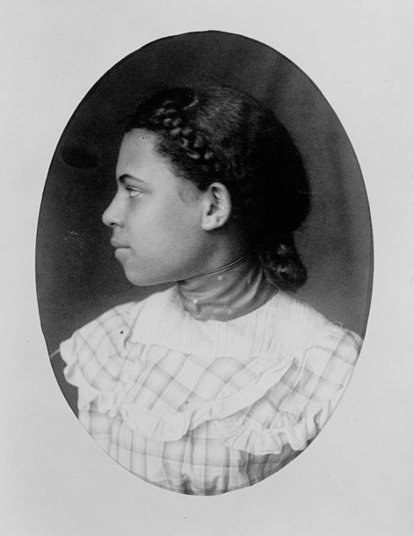
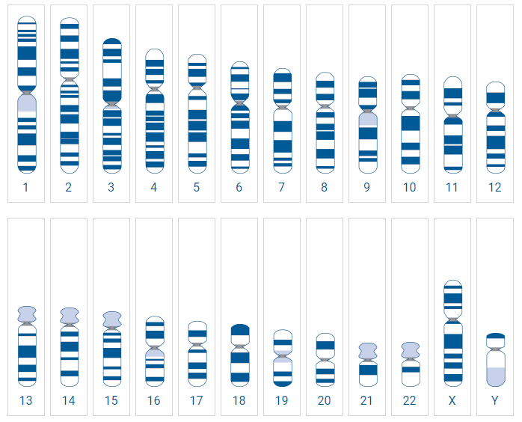
Genotype
Phenotype
Image: LOC, Daniel Murray Collection, 1900. From Paris Exposition. PD
.
Notes:
Our genes – referred to collectively as our genotype – inform our physical appearance – what is known as our phenotype.
From what we have learned about genetics it is also apparent that how we look – our phenotype – is not the end of the story. Many of us carry recessive genes that are not expressed but may become expressed in our offspring. There is more to each-and-every one of us than is readily apparent from the way we look.
Image: LOC, Daniel Murray Collection, 1900. From Paris Exposition. PD

Slide 20
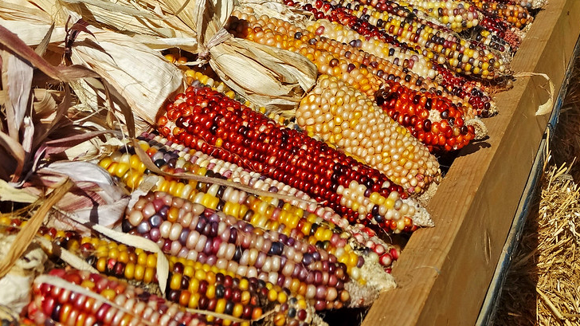
Corn Reproduction
Notes:
Now that we have spent some time understanding human genetics let’s shift back to corn. All life uses the same molecule, DNA, to transmit this heritable information between generations. Corn inherits copies of genes from its parents in the same way that we do. Some of those genes are more dominant than others, and how their phenotype is subject to the same rules that ours is.
Each kernel on an ear of corn is a distinct, separate breeding event. If it is helpful for you, you can think of each kernel as a child and the whole ear of corn is covered in its brothers and sisters.
So how can we predict what our corn is going to look like from one generation to the next?

Slide 21
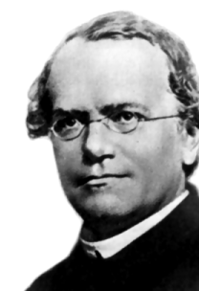
Gregor Mendel
Principles of Inheritance
  Law of segregation
  Law of dominance
  Law of independent assortment
Punnett Squares
 | a | a
A | Aa | Aa
A | Aa | Aa
Gregor Mendel, PD. courtesy of National Institute of Health
Notes:
The genotype of our parent corn can predict its phenotype by using probability and a special tool called the Punnett square. The man who is credited with discovering the basic laws of inheritance is a 19th century monk named Gregor Mendel. Mendel experimented on pea plants, observing how traits would pass from one generation of peas to the next. Through years of experimentation, he was able to describe the basic principles of inheritance that we still use today.
……………………………..
These laws are:
Law of Segregation: the alleles for each gene are not blended.
Law of Dominance: the alleles of each gene are dominant or recessive to each other. The dominant allele is expressed in individuals with one or two dominant alleles. The recessive allele is expressed only in individuals with two recessive alleles.
Law of Independent Assortment: genes for different traits are unaffected by one another, therefore, the presence or absence of one trait in offspring is not affected by the presence or absence of another trait.
……………
Image: Gregor Mendel, Public Domain. NIH.

Slide 22
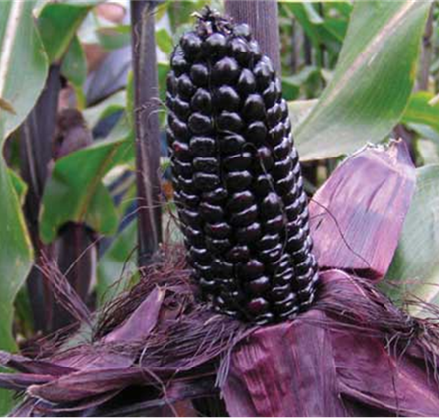
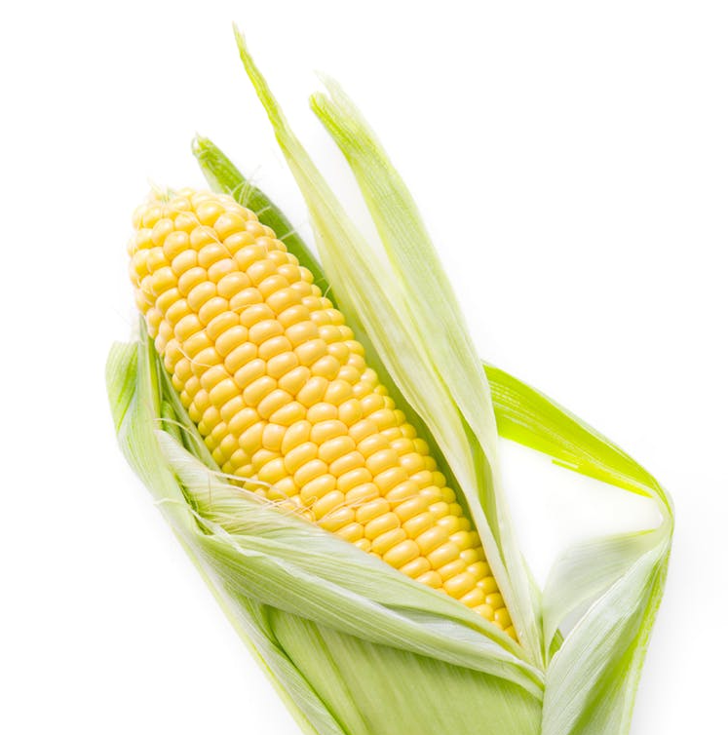
Generation F₀ (Parent Plants)
AA x aa (“A” for Allele)
AA = homozygous dominant
aa = homozygous recessive
Notes:
*Pass out worksheet – do worksheet along with powerpoint*
We will investigate phenotypes of corn that are expressed in the seed. You will be given ears of corn (or images) for your investigation. Each seed on an ear of corn results from a separate fertilization event and thus represents an offspring.
Generation F0 stands for the parent generation of this study. One parent plant produces purple ears of corn, the dominant color.
We’ll use a capital A, meaning that it is a dominant allele (purple).
We’ll use the lower case “a” for recessive color allele (yellow).The other parent plant produces yellow ears of corn, the recessive color due to a lack of pigment.
This is standard notation for genetics. We are using the letter "A" because it stands for “allele” and is easy to tell the upper and lower case apart.

Slide 23
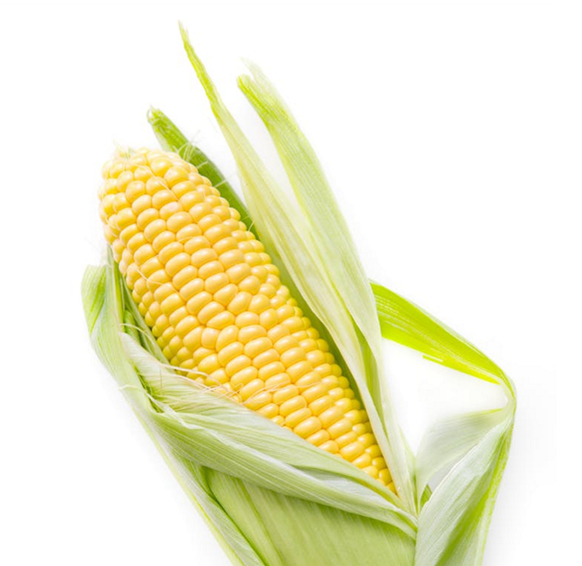

STEP 1: F₁ First Generation Selu
 | a | a
A
A
aa x AA
Notes:
*Ask them to complete Step 1 of the worksheet, drawing Punnett square or work through it together in the next five slides.*
With a Punnett square we are able to predict what the ratio of our offspring’s genotype and phenotype will be.
For instance, will we have all 50% heterozygous and 50% homozygous dominant offspring? Will they all be yellow? Will they all be purple? Will it be 50/50, or more like 75/25? The Punnett square can help us predict with great accuracy the patterns of inheritance.
To start:
Under STEP 1:
Label your square in the light gray area with lowercase “a, a” in the top row, and uppercase “A, A” vertically on the left side.
We’ll go through the resulting combinations together in the next slides.

Slide 24



F₁ First Generation Selu
a a
A
Notes:
For the first generation, you will take the uppercase “A” from the y-axis, and combine it with the lowercase “a” from the x-axis. The first result will be Aa.

Slide 25
F₁ First Generation Selu
a a
A
A
Notes:
Continue filling in the Punnett Square. The next quarter should be “Aa”.

Slide 26

F₁ First Generation Selu
a a
A
A
Notes:
Keep going. Yes, another “Aa”. (uppercase, lowercase)

Slide 27
F₁ First Generation Selu
a a
A
A
Notes:
Punnett square work towards predicting the outcome of a generation.
Alleles on the outside of the box are combined with their complimentary allele on the other side of the box to fill out all of the boxes. Each box represents 25% of the offspring (corn kernels). If we multiply each 25% by 4, we have 100%.
Worksheet: Step 1, question 1.
1. What is the genotype of F1? (heterozygous or homozygous - circle one)
Answer: We should see that the offspring are a 100% heterozygous genotype.
(click next slide to go to Question 2. – Phenotypes)

Slide 28

F₁ First Generation Selu
Aa = heterozygous
a a
A
A
Notes:
Step 1, Question 2.
2. Based on what you know about recessive and dominant genes, what will be the likely phenotype of this heterozygous corn? (what will it look like?)
(Click to next slide for answer)

Slide 29
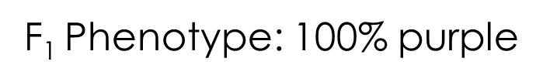
F₁ First Generation Selu
Aa = heterozygous
a a
A
A
Notes:
Our F1 phenotype is likely PURPLE. Good job!
(Why? Because all four squares representing the allele combinations contain the dominant PURPLE color, or capital “A”. It will likely “win out” in each of the gene combinations.)
Let’s move to Step 2 on the next page of your worksheet.

Slide 30
STEP 2: F₂ Second Generation Selu
?
Aa x Aa =
A a
A
a
Notes:
Now we are going to cross two of the offspring corn plants (purple) from the F1 generation to make our F2 second generation. Remember, they are heterozygous, or “Aa” genotypes. You will fill out the squares with “Aa” on the x and y axes on the outside, then combine them in the inner squares to come up with a result. (Example: the top left square will combine the two top left letters, “A & A” for “AA” combined.)
*Have students complete Step 2 with their teams. After they do this come back to slideshow to check their answers on the next two slides.

Slide 31

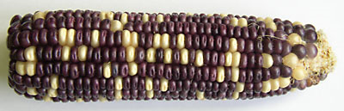
F₂ Second Generation Selu
Aa x Aa =
A a
AA
A
25% homozygous
dominant
a
Aa
aa
25% heterozygous
25% homozygous
recessive
Notes:
*Worksheet Step 2 question 1 answer
Hopefully you should have something like this.
Question 2: What will be the resulting genotypes?
(click to go over in next slide)

Slide 32
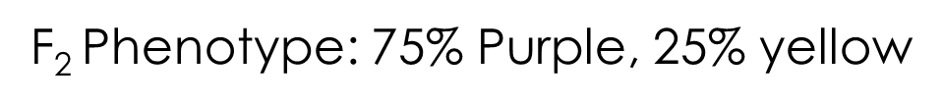
F₂ Second Generation Selu
Aa x Aa =
A a
AA
A
25% homozygous
dominant
a
Aa
aa
25% heterozygous
25% homozygous
recessive
Notes:
*Worksheet Step 2 question 2 answer
What are the genotypes of the F2 Second Generation?
25 % Homozygous Dominant (AA)
50 % Heterozygous (Aa)
25___ % Homozygous Recessive (aa)

Slide 33
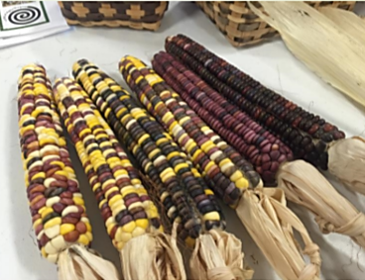
Step 3:
Make Your Hypothesis!
Notes:
*Worksheet Step 3: Make a Hypothesis
Look at Step 3 on the Worksheet. You will now create a hypothesis for the phenotypes, or color ratios, of the offspring. How do you think the F2 corn kernel colors will be affected?
Will there be all purple? All yellow? A mixture with equal amounts? Or a mixture with more purple, or yellow? Can you predict the ratios or percentages?
Write your guess on the outcome, or your hypothesis, in the space. Don’t worry about being “right”, this is going to be the basis of our study.

Slide 34
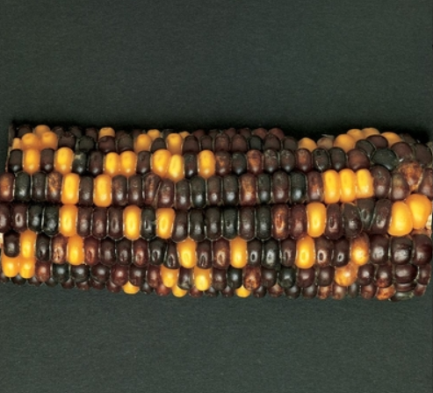
Step 4:
Test Your Hypothesis!
2 Rows
Read colors across row aloud: “purple, purple, yellow, etc.)
Notes:
Step 4: Test your Hypothesis
You will get an ear of corn (or an image) representing the cross that we diagramed in step two. We will see if this ratio of phenotype, or yellow and purple, will play out in real life. Punnett squares provide a prediction. We are going to see if our hypothesis (75% purple, 25% yellow) is true or not.
To do this each team will count two rows of corn from these F2 ears of corn (passed out).
One student should note the color of each kernel aloud (Ex: “purple, yellow, yellow…”),
Their partner(s) makes a tally mark on the chart under each color. (in fives: four slashes and a cross slash)
Total your counts in worksheet table under each color. (Ex: Purple: 50 / Yellow: 50)
Then add together all the kernels (both colors) counted from the purple and yellow totals.
Finally, you can determine the percentage or ratio by dividing each number of each color, by the total number counted. (Ex: 60 purple divided by 100 total = .60). Do this for both purple and yellow.
**Note: The decimal numbers you get in step 4 can be changed into percentages (Ex: .60 = 60% of the corn kernels were purple.) While we didn’t count every single kernel on our corn cobs, we did collect a sample – data on 100 kernels from that corn cob – due to the nature of genetic ratios we can infer that the percentage we got from our sampled data is very close to the percentage we’d get by counting all the kernels.

Slide 35
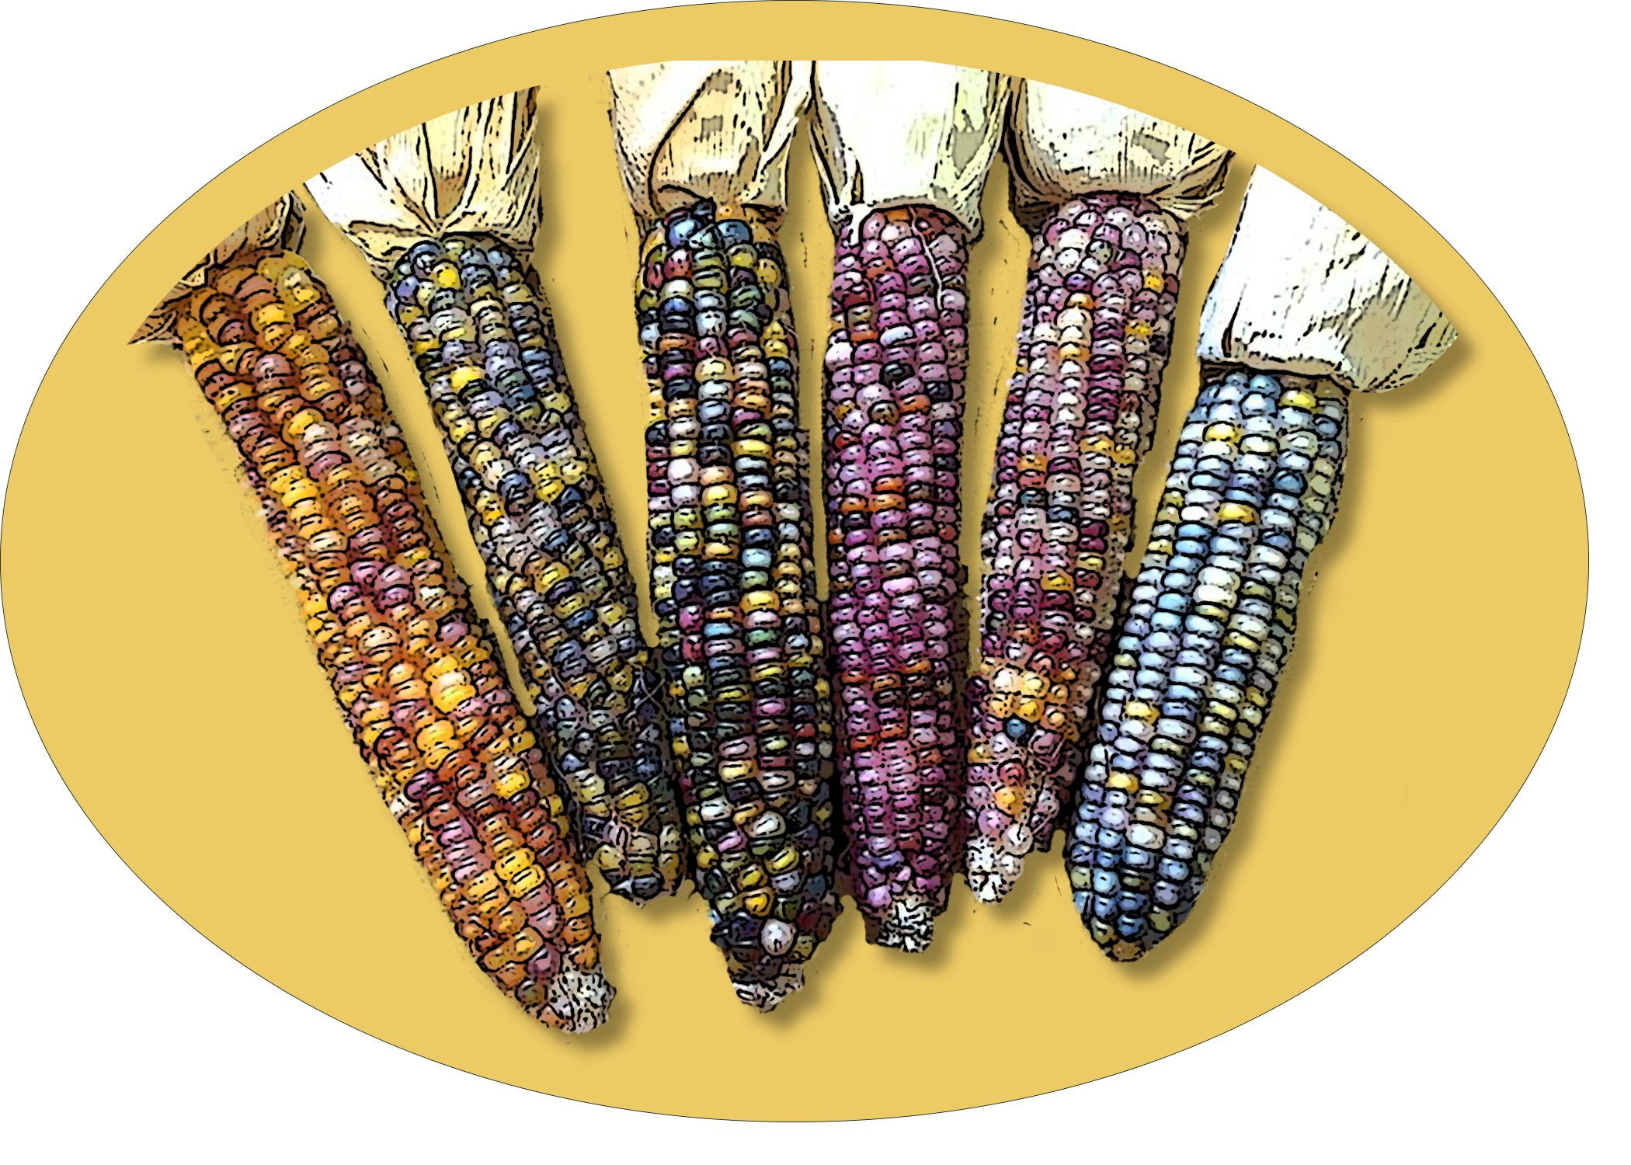
Step 5:
Class Totals
Notes:
Step 5: Class Totals to confirm our hypotheses.
Once all teams are done, we will collect totals from each team— and record them on the board. You can then write these numbers in Table 2 for class results. By making an average of all the team’s counts, we will have more data to either prove or disprove our different hypotheses.

Slide 36
Step 5: Class Totals
Table 2: Class F2 Counts for Purple and Yellow Seeds
Phenotype | Purple | Yellow
1. Class Counts
2. Class Color Totals | Purple Total: | Yellow Total:
3. Total number of all kernels counted (combine total of purple and yellow above):
4. Percentages: Divide number of Purple Kernels by Total Number of Kernels: Divide number of Yellow Kernels by Total Number of Kernels:
Notes:
Class counts: each team should give their total counts for each color. (Ex: purple – 60, yellow – 40)
Once all are shared, each color, or phenotype, should be totaled.
Then, those two boxes should be totaled, for a “total number of all kernels counted” for the whole class.
Finally, once again, find the percentages or ratios by dividing each color “total” by the total number of kernels.
Example:
Total class count: ~ 1600
Phenotype: Purple - Expected count: (About 1200 or 75%)
Phenotype: Yellow - Expected count: (About 400 or 25%)

Slide 37
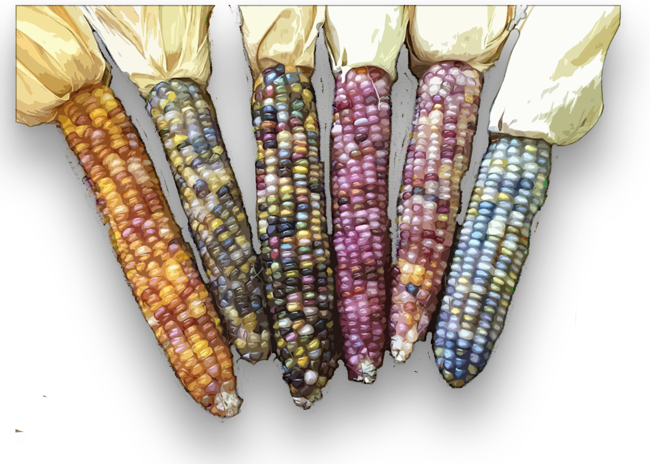
Step 6: Analysis
Notes:
Step 6: Analysis
What was your guess in Step 3? (majority of kernels will be purple?)
Compare your expected counts / ratios from Step 3 with the actual counts from Step 5: Table 2. Are the actual counts different from the expected counts?
Expected ratio of purple to yellow: ? (get their guesses)
Actual ratio of purple to yellow: should be about 75% purple to 25% yellow
Explain why: In Step 2, we determined that the genotypes of F2 generation are comprised of:
25% homozygous dominant (AA)
50% heterozygous (Aa)
Which likely results in mostly purple, because purple is dominant, and adds to 75% of the genotype.

Slide 38
Step 6: Analysis
STEP 6: ANALYSIS
Compare your expected counts / ratios from Step 3 with the actual counts from Step 5: Table 2. Are the actual counts different from the expected counts?
Expected ratio of purple to yellow: _______________________________
Actual ratio of purple to yellow: __________________________________
Explain why:
Notes:
Step 6: Analysis
What was your guess in Step 3? (majority of kernels will be purple?)
Compare your expected counts / ratios from Step 3 with the actual counts from Step 5: Table 2. Are the actual counts different from the expected counts?
Expected ratio of purple to yellow: ? (get their guesses)
Actual ratio of purple to yellow: should be about 75% purple to 25% yellow
Explain why: In Step 2, we determined that the genotypes of F2 generation are comprised of:
25% homozygous dominant (AA)
50% heterozygous (Aa)
Which likely results in mostly purple, because purple is dominant, and adds to 75% of the genotype.

Slide 39
Step 6: Analysis
In Step 2, we determined that the genotypes of F2 generation are comprised of:
  25% homozygous dominant (AA)
  50% heterozygous (Aa)
  This totals 75% leaning towards the dominant purple color, as opposed to 25% leaning yellow.
Notes:
Why? Actual ratio of purple to yellow: about 75% purple to 25% yellow
In Step 2, we determined that the genotypes of F2 generation are comprised of:
25% homozygous dominant (AA)
50% heterozygous (Aa)
Which likely results in mostly purple, because purple is dominant, and adds to 75% of the genotype.
Is this surprising? Or is it what you had expected? This is why certain traits can be non-existent in one generation but reappear in later generations.

Slide 40
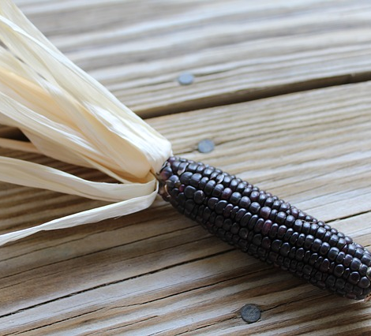
Why does this matter?
Purple corn with combinations of chemicals fight:
  Diabetes
  Obesity
  Inflammation
  They also can be used as alternative food colorants.
    No more scary dyes!
Image: USDA / NIFA
.
Notes:
Why should we care about genetics and our food?
Scientists are studying varieties of corn and grains for their health. Some from the University of Illinois have found that hybrids of purple corn contain different combinations of chemicals that fight obesity, inflammation and diabetes. Phenols in Purple Corn Fight Diabetes and Obesity in Mouse Cells | National Institute of Food and Agriculture (usda.gov)
…….
Image: USDA/NIFA from above linked article

Slide 41
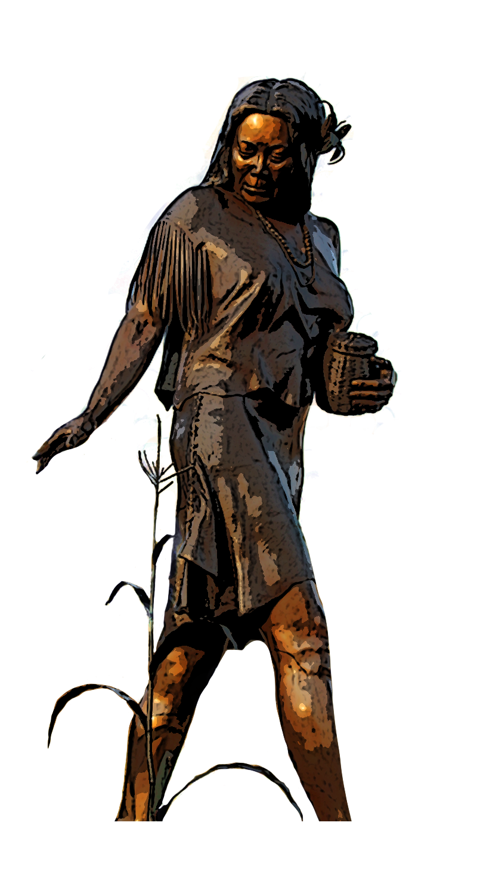
Selu’s footsteps
Notes:
Many people are continuing in Selu’s footsteps, collecting and curating seeds to keep the ancient heirloom varieties available. Varieties such as the Cherokee White Flour Corn can trace their roots back to the Harinoso de Ocho, originally domesticated in the low elevations of Mexico. Today, Cherokee farmers are continuing to plant old varieties and are breeding new beautiful varieties. A knowledge of genetics allows both for preservation and innovation.
(Source: Races of Maize in Mexico: their Origins, Characteristics and Distribution. E.J. Wellhausen, L.M. Roberts and E. Hernandez X., with P. Mangelsdorf. Bussey Institution of Harvard University.1952.)

Slide 42

What questions do you have?

Slide 43
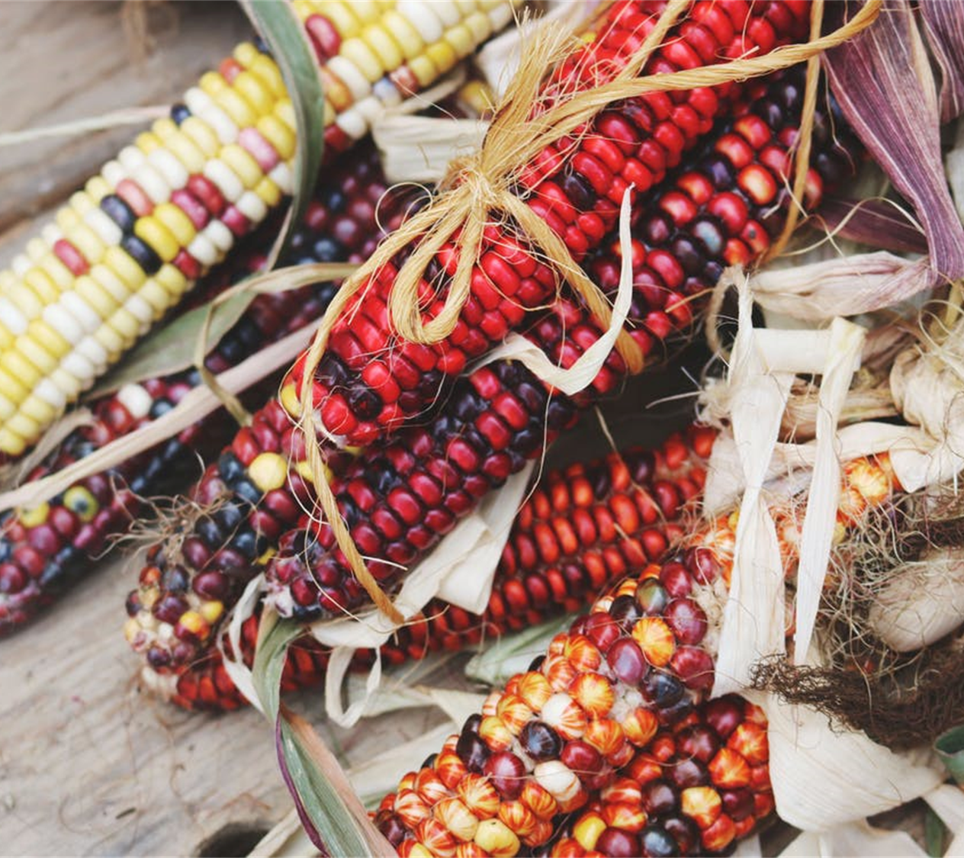
Additional Activity: Historic Photos
Notes:
Historic Photos Activity
The Historic Photos activity allows students to see the people, places, buildings, methods, and tools in the cultivation of corn. All images are from the Great Smoky Mountains area, mostly from the Cherokee, NC area.
Procedure:
• Pass out the historic photos and ask students:
o What do these photos have in common?
o What do you notice? What do you wonder about? What do they remind you of?
o Put them in order any way that might represent how corn is processed or used.
o Justify and discuss the answers.
o What is different about how corn was managed and processed in the past with how it might be today?
• Text on photos can help support answers.

Slide 44
Historic Photos Activity
The Historic Photos activity allows students to see the people, places, buildings, methods, and tools in the cultivation of corn. All images are from the Great Smoky Mountains area, mostly from the Cherokee, NC area.
Procedure:
• Pass out the historic photos and ask students:
  What do these photos have in common?
  What do you notice? What do you wonder about? What do they remind you of?
  Put them in order any way that might represent how corn is processed or used.
  Justify and discuss the answers.
  What is different about how corn was managed and processed in the past with how it might be today?
• Text on photos can help support answers.
Notes:
Step 6: Analysis
What was your guess in Step 3? (majority of kernels will be purple?)
Compare your expected counts / ratios from Step 3 with the actual counts from Step 5: Table 2. Are the actual counts different from the expected counts?
Expected ratio of purple to yellow: ? (get their guesses)
Actual ratio of purple to yellow: should be about 75% purple to 25% yellow
Explain why: In Step 2, we determined that the genotypes of F2 generation are comprised of:
25% homozygous dominant (AA)
50% heterozygous (Aa)
Which likely results in mostly purple, because purple is dominant, and adds to 75% of the genotype.

Slide 45
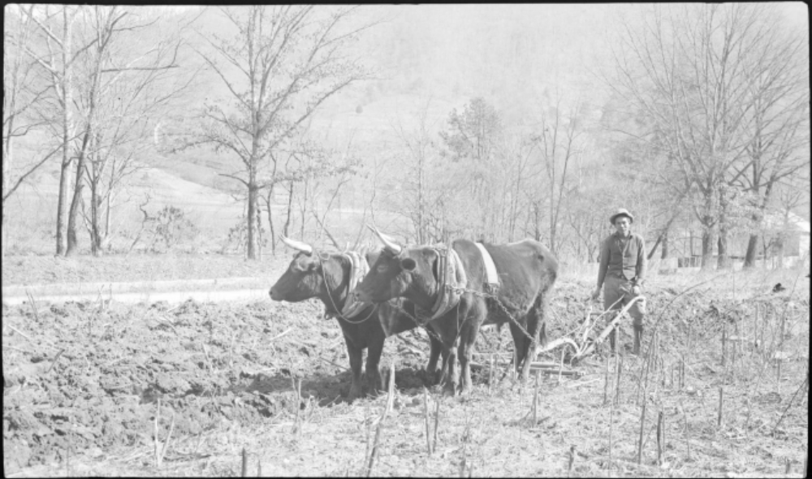
1936 Cherokee Man Plowing Cornfield
(GSMNP Collections)

Slide 46
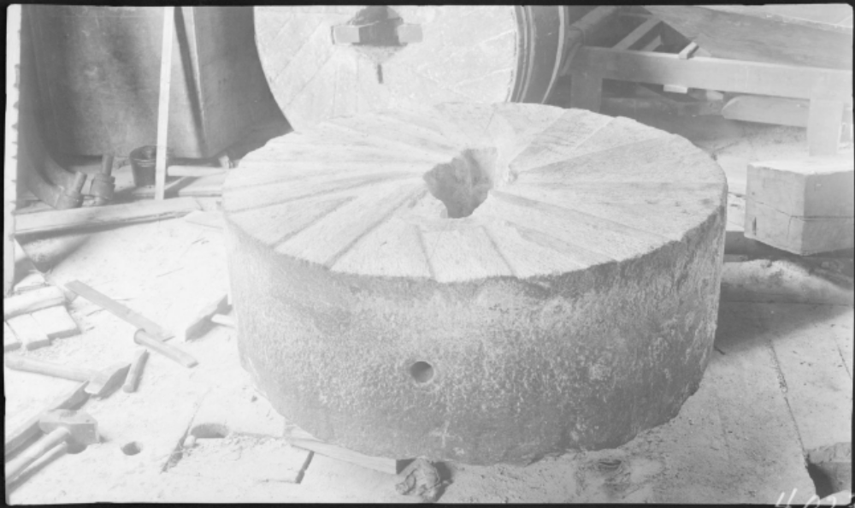
1937 Mingus Mill – Mill Stone
(GSMNP Collections)

Slide 47
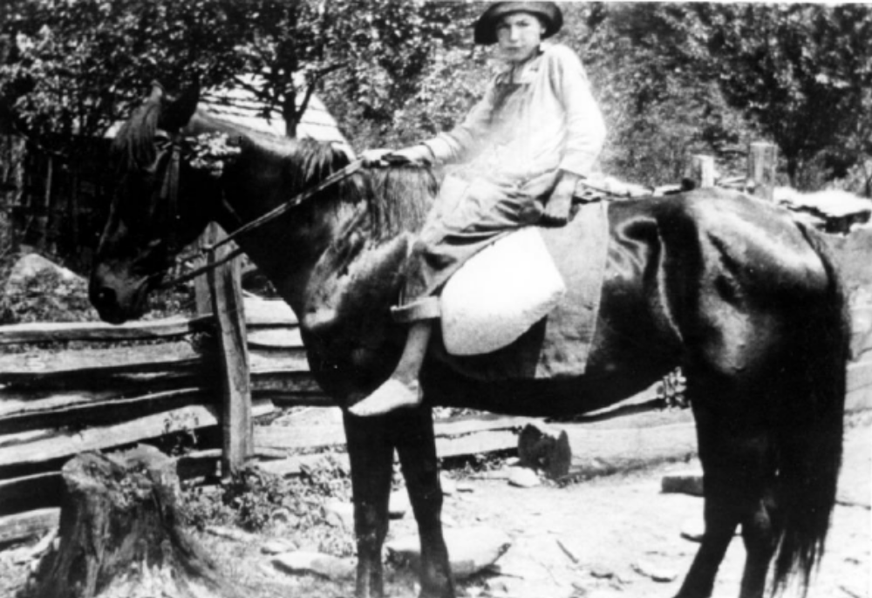
1920 Boy taking corn to the mill (Cades Cove)
(GSMNP Collections)

Slide 48
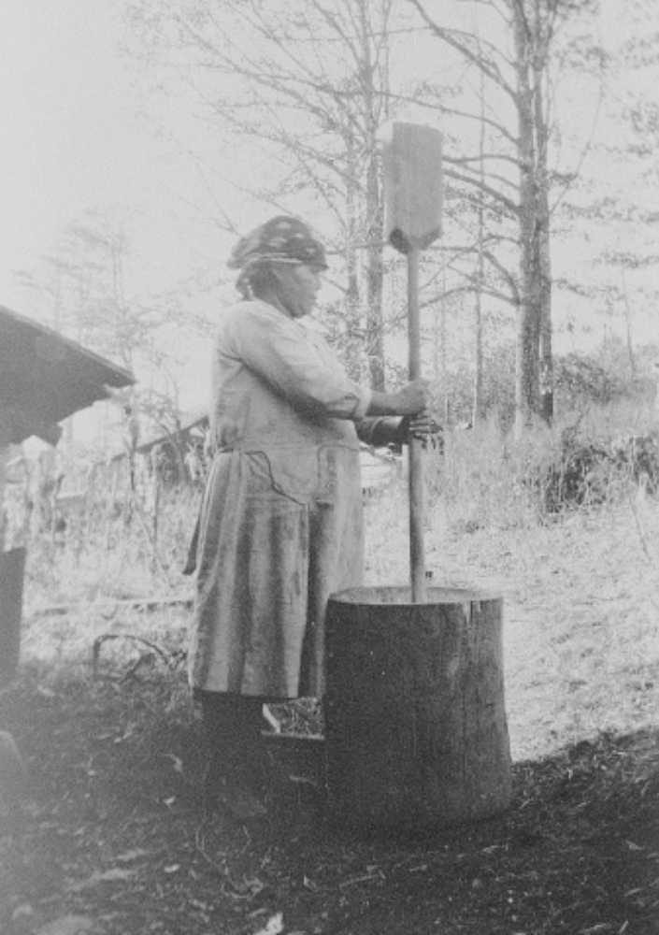
Mollie Running Wolf pounding corn (date unknown)
(GSMNP Collections)

Slide 49
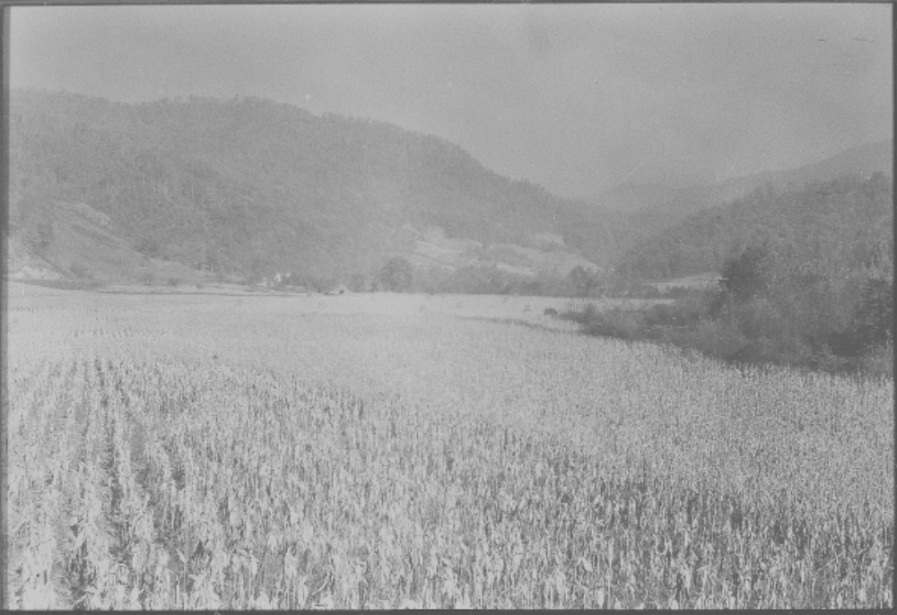
Oconaluftee (Cherokee, NC) Cornfield – Pre-1940
(GSMNP Collections)

Slide 50
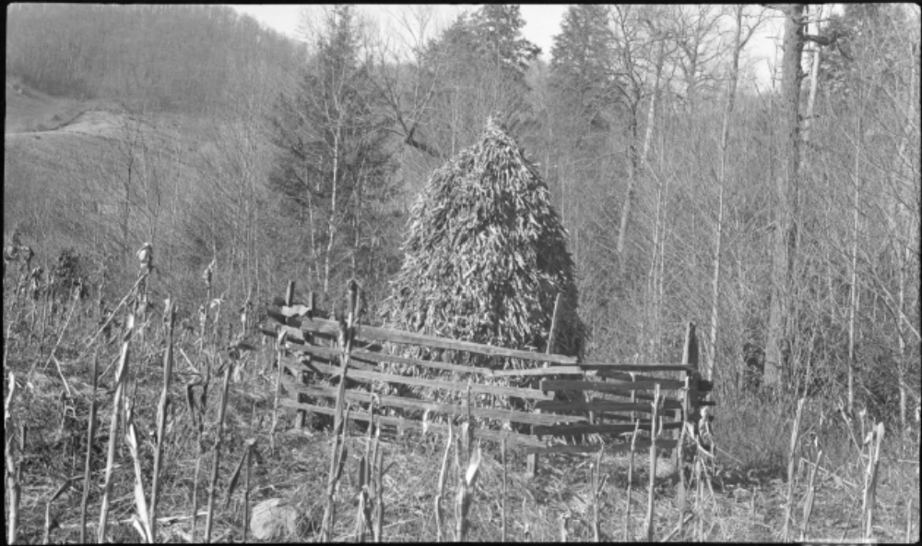
1937 Rob Brown place, corn “topped” and stacked, stalks left for grazing cattle.
(GSMNP Collections)

Slide 51

1930s - Ayunini’s House – pounding corn (Mooney photo).
(GSMNP Collections)

Slide 52

Woman making hominy Oconaluftee Indian Village
(GSMNP Collections)

Slide 53

1937 Corn Crib for storage – Upper Joe Queen Place, Cherokee, NC
(GSMNP Collections)

