Slide 1
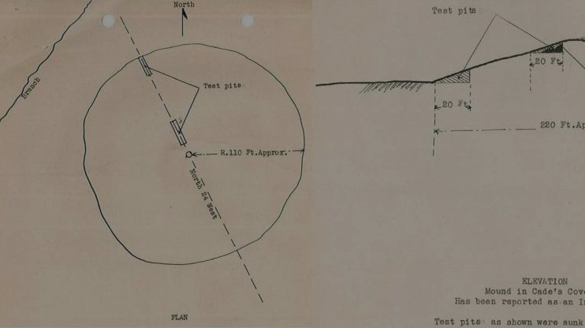


Cherokee Physics:
Technology in Motion
Notes:
What is physics?
Physics is the science that deals with matter, motion, energy, and interactions.
Technology is any invention or innovation that allows us to accomplish a task or goal more efficiently.
As people evolved in these mountains, they adapted to their surroundings using local resources, and developed tools that allowed them to hunt, harvest crops, and live within their villages in these valleys. Some tools were developed locally, others were adopted and then enhanced with local innovations.

Slide 2
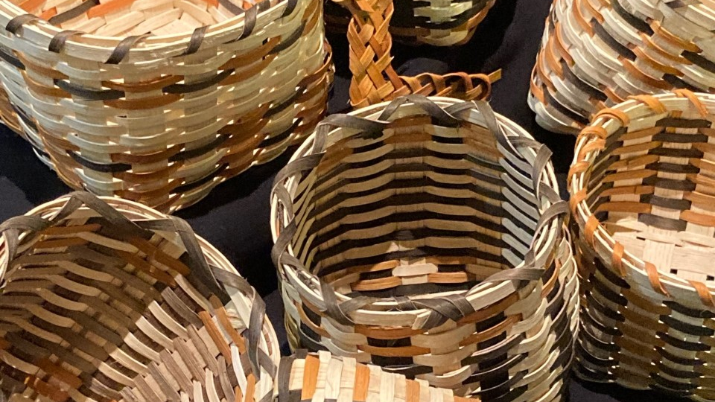
How long have people been in these mountains?
Notes:
Before we begin: How long have people been in the Mountains?
……………….
NPS image: B. Bramhall

Slide 3
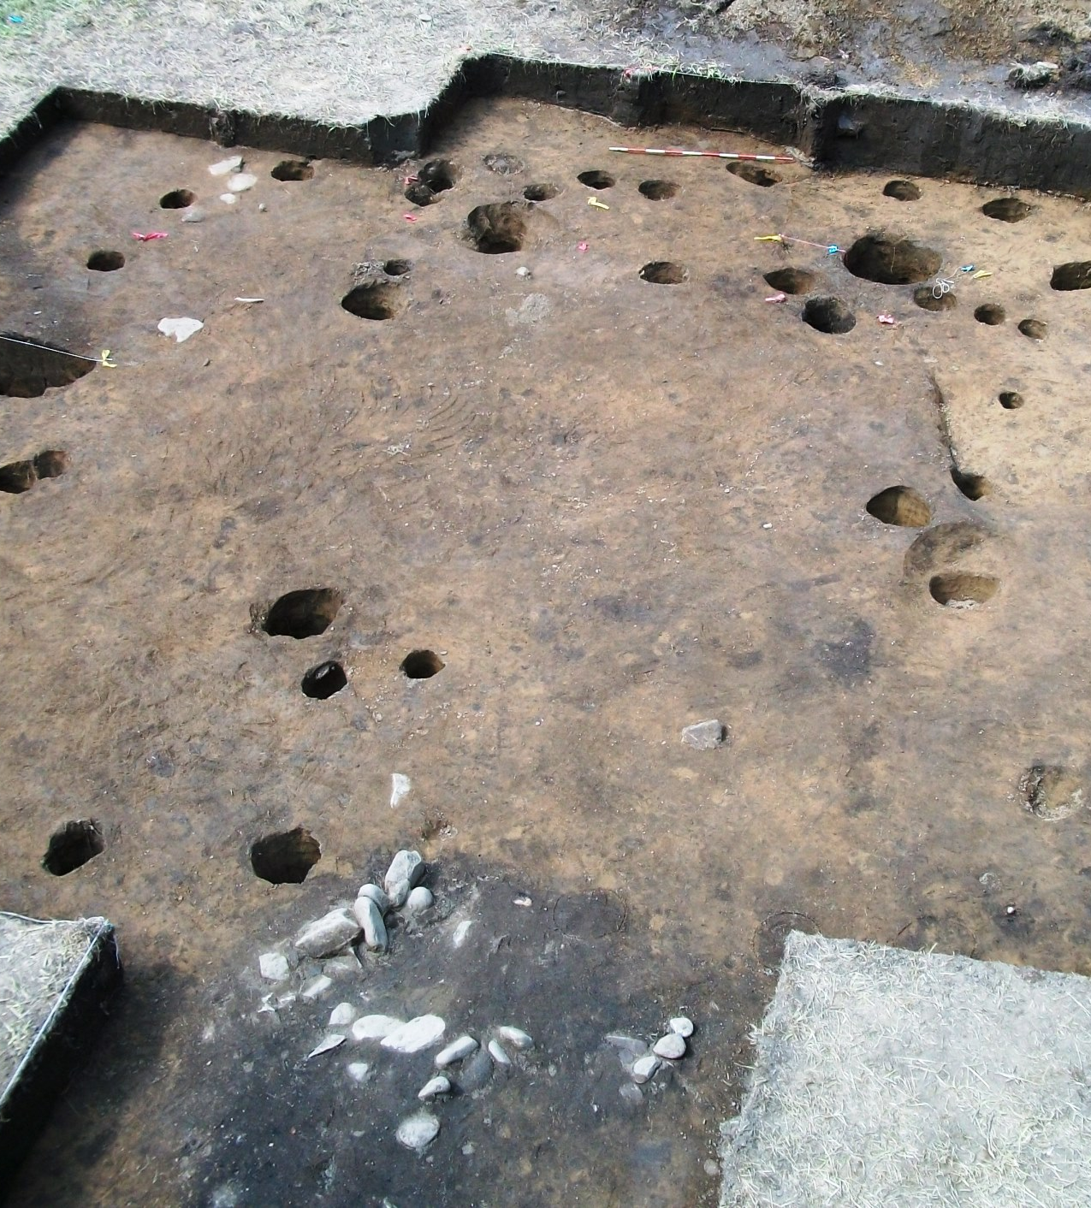
Evidence of the past
Presence going back 14,000 years!
Recent studies conducted near the Park in both Cherokee, NC (Ravensford 2004-2006 & Yellowhill, 2016) and in Townsend, TN.
Cherokee: We have always been here
(Photo: 18th century Cherokee winter house. EBCI/Utennessee/NPS)
Notes:
Through archeological studies, there is evidence that suggests people have been here for at least 14,000 years. Think about that for a minute.
However, origin stories of the Cherokee tell us that they are the principal people of this area and have always been here.
………………….
Image: 18th century Cherokee winter house. EBCI/Utennessee/NPS
Archaeology in the Great Smoky Mountains National Park – Tennessee Council for Professional Archaeology (wordpress.com)

Slide 4
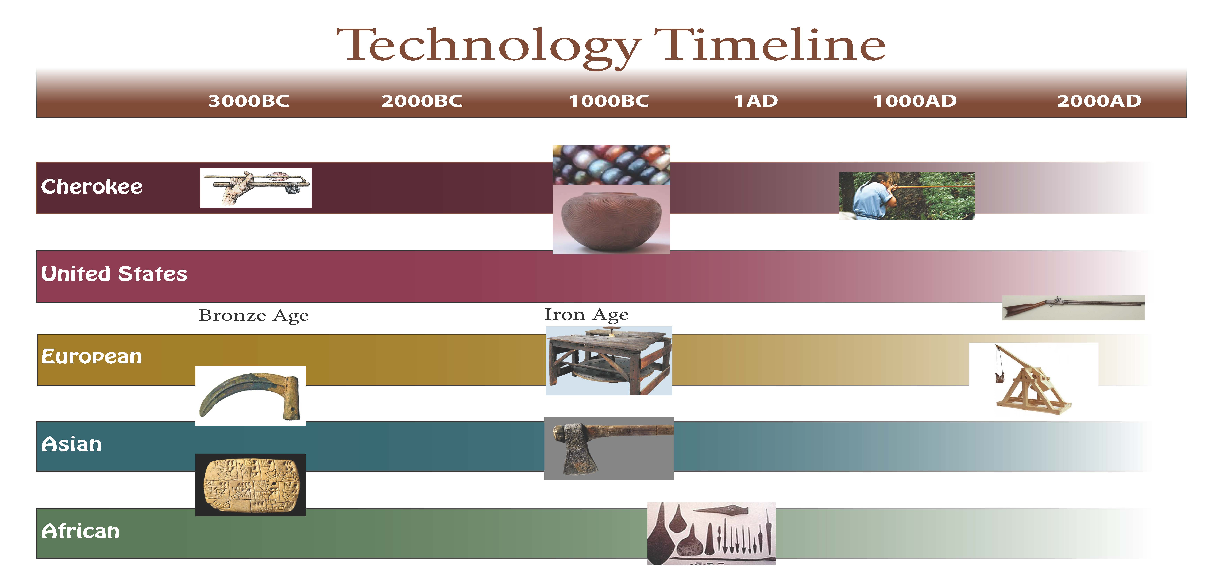
Let’s go back in time…
Notes:
If we were to go back in time and compare some of the Cherokee technologies with other areas of the world, we would find that their development aligned similarly with some of the major technological innovations. For example, while Europeans and Asians were using minerals to be turned into metals, Cherokee and other native cultures were developing their own tools to survive using local minerals also transformed through fire.
……………….
NPS image/ B.Bramhall

Slide 5
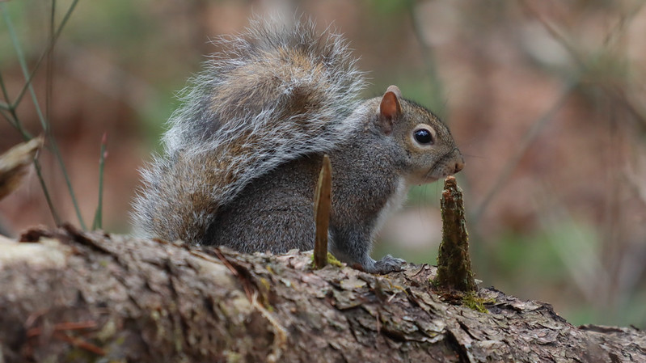
Technology to solve problems
What was invented to hunt with more stealth, accuracy, range, and ease?
Notes:
What if you needed to catch small game animals like squirrels, rabbits and turkeys with stealth and ease?
What type of technology was invented to solve this dilemma?
…………………..
Image: NPS/W. Bielenberg

Slide 6
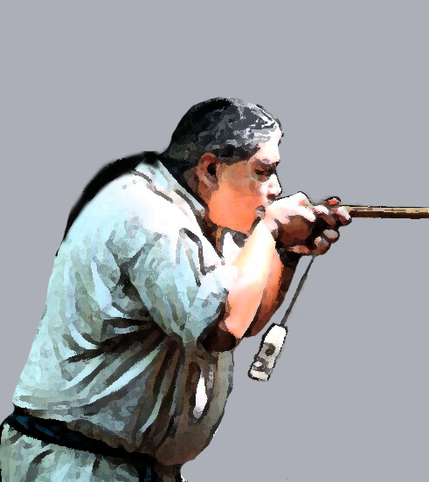
Blowguns
“tu-gwe-sdi”
Ancient ingenuity in physics
Notes:
Blowguns have been used for at least 2,000 years by peoples throughout the world and are still used today by some, both for hunting and in shooting competitions.
They are also used to this day by wildlife specialists to tranquilize animals for research or medical purposes.
……………………
Artwork (NPS/B.Bramhall) derived from photo from Oconoluftee Indian Village: https://www.blueridgeheritage.com/destinations/oconaluftee-indian-village/

Slide 7
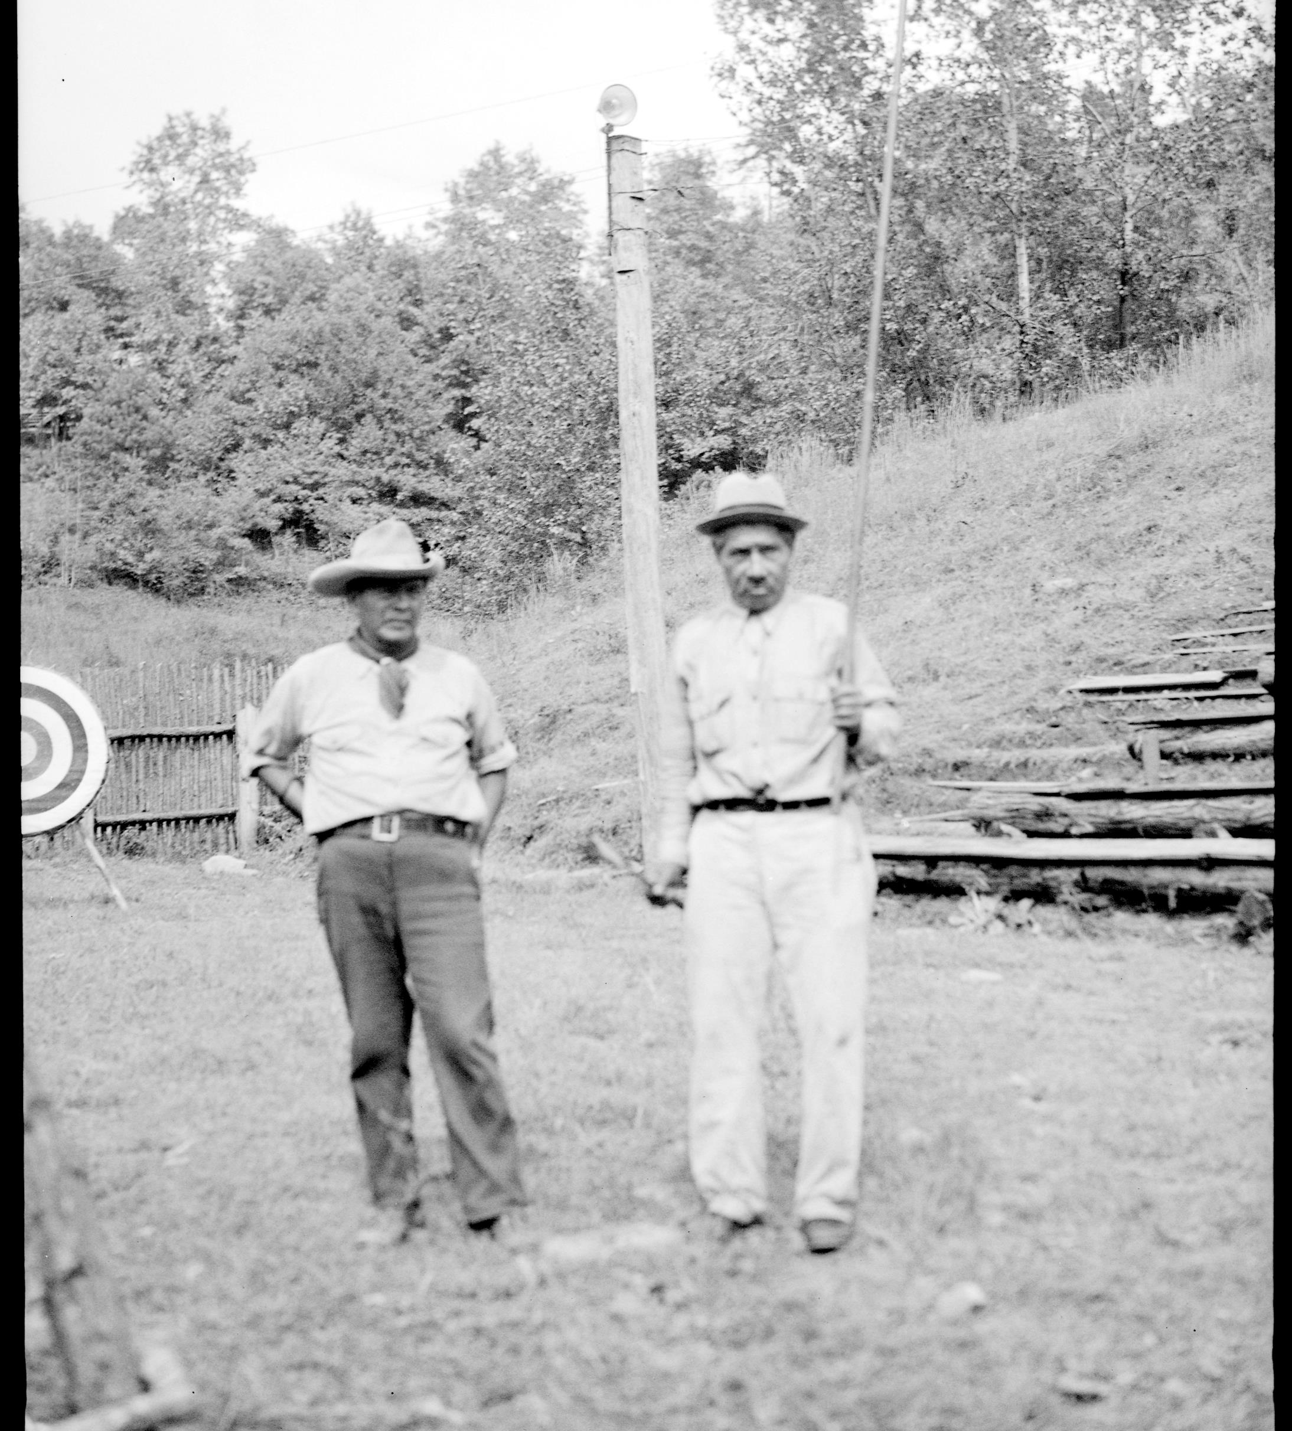
What is a blowgun?
A blowgun is a long, narrow tube used to propel light projectiles (darts).
Through the hunter’s forced exhalation (breath) they propel the dart with desired speed and force.
(Photo: 18th century Cherokee winter house. EBCI/Utennessee/NPS)
Notes:
A blowgun is a long, narrow tube used to propel light projectiles (darts). Through the hunter’s forced exhalation (breath) they propel the dart with desired speed and force.
…………………………..
Image: Chief Standing Deer and Samuel Walsh_1936 (GRSM/NPS collection)

Slide 8

How are blowguns made?
Notes:
Blowguns are made from hollowed out rivercane, an American species of bamboo in the grass family that can grow over 12 feet tall. The cane is allowed to dry out over several months, then heated over hot coals to straighten. It is then hollowed out by dropping embers inside and allowing them to burn the joints out. It is finally smoothed inside with another wooden stick
Link for video: https://www.youtube.com/watch?v=-WewedPqi_k
Making darts: https://www.youtube.com/watch?v=3PBU4pfOZmE
…………………….
Image: Artwork B.Bramhall / NPS

Slide 9
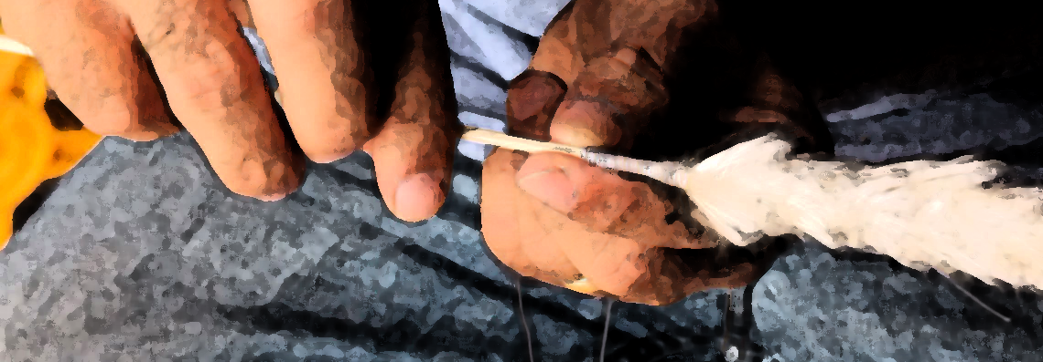
The Darts
Notes:
The Darts are made from a hardwood, often locust, with some seeking trees that have been hit by lightning. The wood is carved down to a long sharp point.
Scottish thistle is then rolled onto the dart with string, in a twirling motion. (See the video)
Let’s see how a craftsman still uses old techniques to make darts. Watch this video with Davy Arch: https://www.youtube.com/watch?v=3PBU4pfOZmE
See Cherokee Nation (OK) video: Cherokee Traditional Games: Blowguns – YouTube
……………..
Image: Thistle Dart (B.Bramhall artwork/NPS adapted from Exarc image)
Video: Davy Arch

Slide 10
How do you use it?
Notes:
To use the blowgun, the Cherokee style is to hold the cane with both hands near the mouth, with one forming a seal between the mouth and opening.
It was used to hunt squirrels, rabbits, and birds, and likely never was used for anything larger than a turkey.
It is interesting that many tribes around the world have developed blowguns, but each had individual styles of both blowguns, darts, and hunting technique. While some used poisoned darts, Cherokee hunting with blowguns relied on accuracy and impact.
See Cherokee Nation (OK) video: Cherokee Traditional Games: Blowguns – YouTube
…………………………….
Artwork: (NPS/B.Bramhall) derived from photo from Oconoluftee Indian Village: https://www.blueridgeheritage.com/destinations/oconaluftee-indian-village/

Slide 11
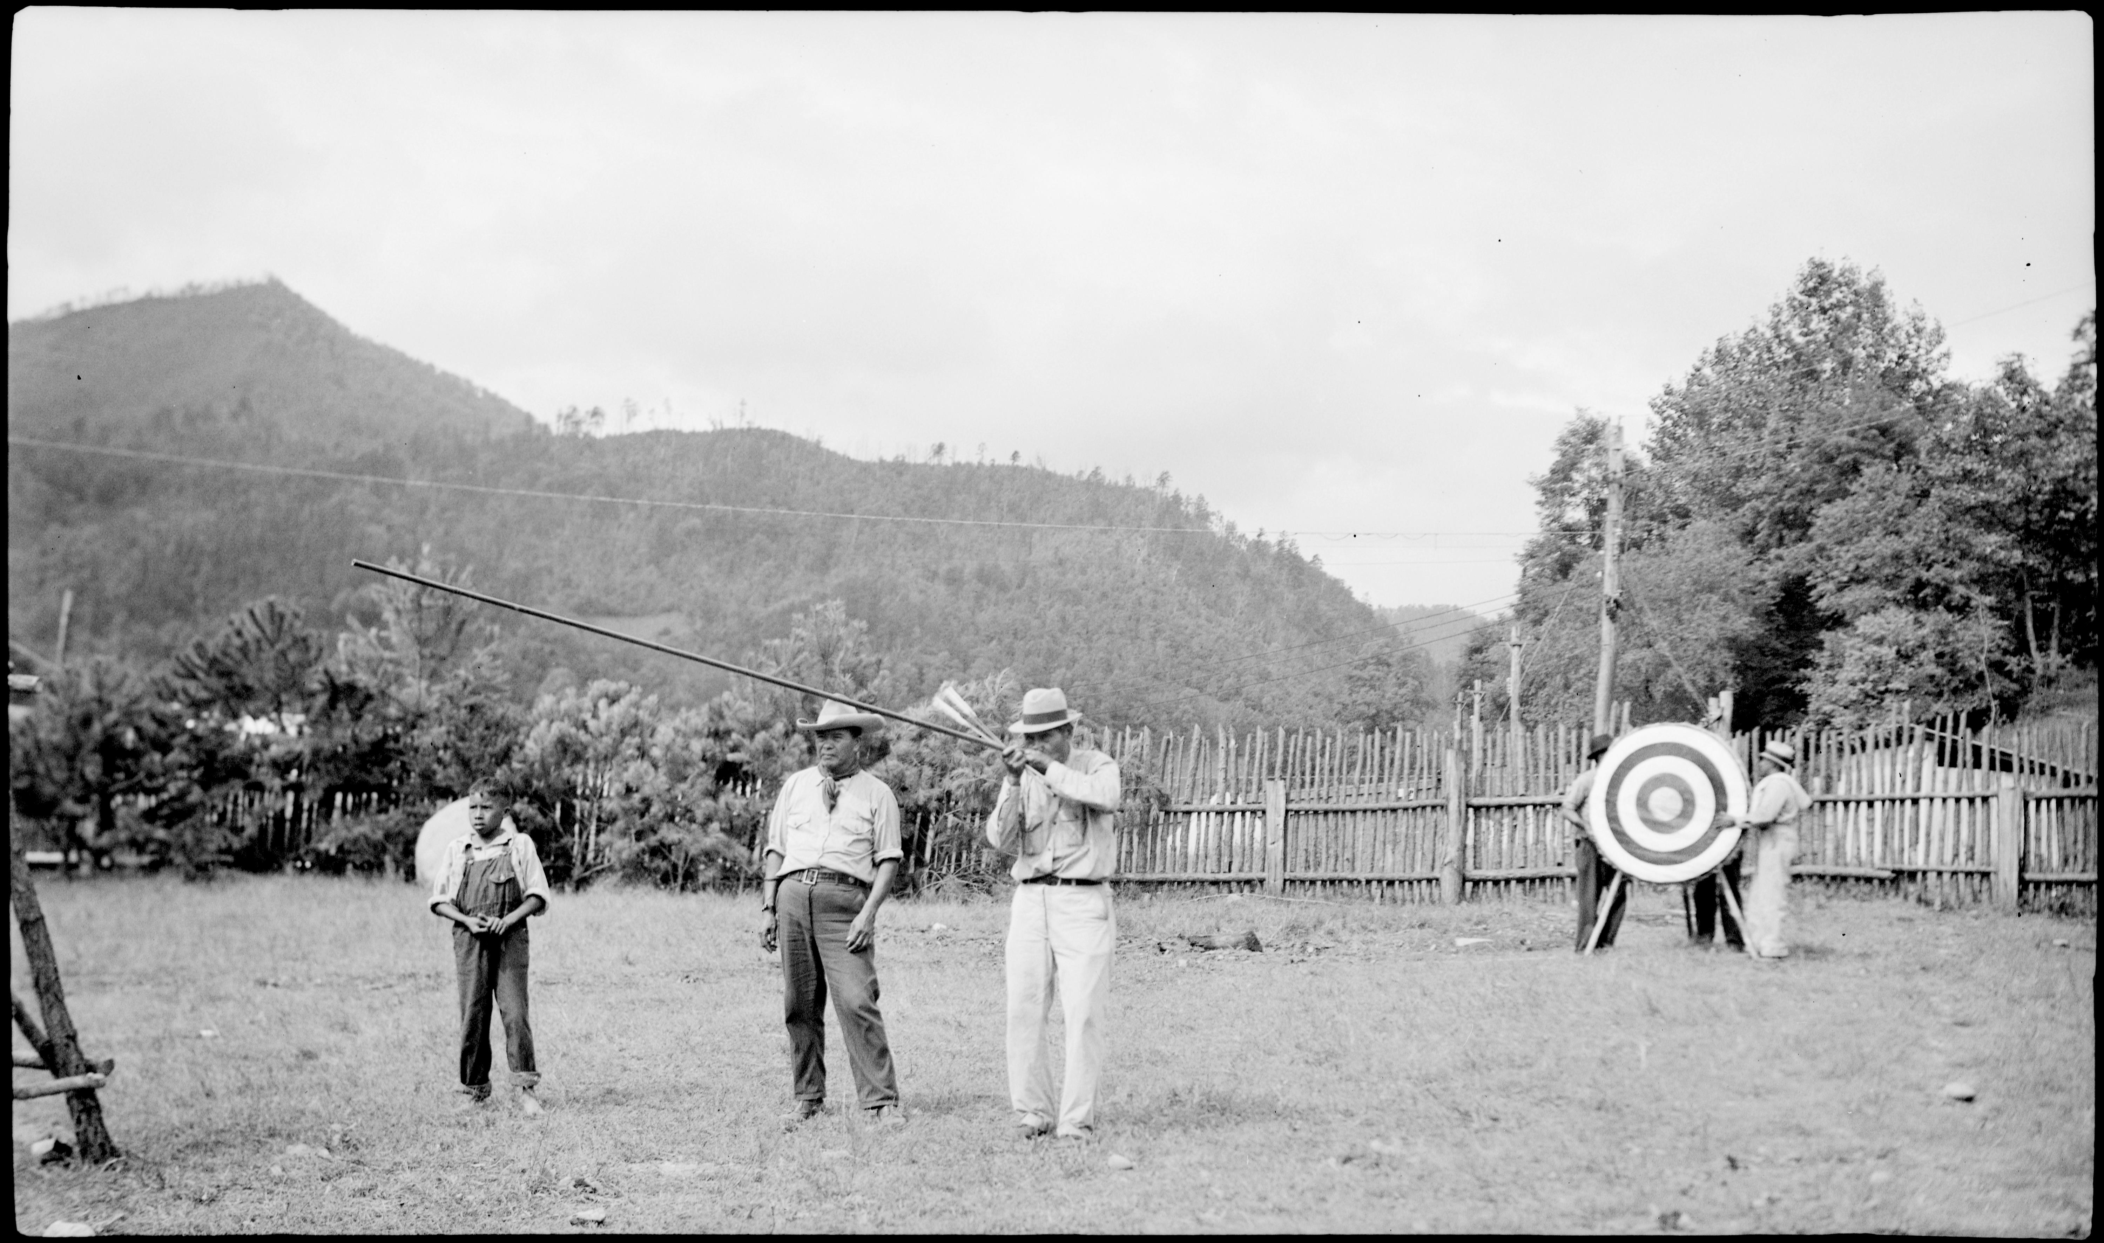
How old is the technology?
Notes:
How old do you think this technology is?
No one really knows the exact origin or first year of use. It may have been independently invented in this region, or it may have migrated from the Southwest, South America, or Mexico.
The earliest documented use of blowguns in the Smokies was in the 1700s by Henry Timberlake, but archeologists estimate it was already in use for many centuries prior, likely dating to at least 500 CE (Common Era) if not much much earlier.
Why do you think it is challenging to determine the earliest use? Unlike spears or bows and arrows, blowguns and darts are made entirely of organic materials that easily decompose, making it challenging to find early artifacts.
………………….
Image: Samuel Walsh with Chief Standing Deer. 1936. NPS / GRSM Collection

Slide 12

How does it work?
Notes:
If you were able to watch the video of Mr. Davy Arch, he mentioned the down of a blowgun dart catching the breath of the blower in an airlock that then propels the dart through the blowgun shaft toward its target.
This means, blowgun users are harnessing 3 basic principles of modern physics in their craft!
See Cherokee Nation (OK) video: Cherokee Traditional Games: Blowguns – YouTube
…………………….
Image: Courtesy of Oconaluftee Indian Village

Slide 13
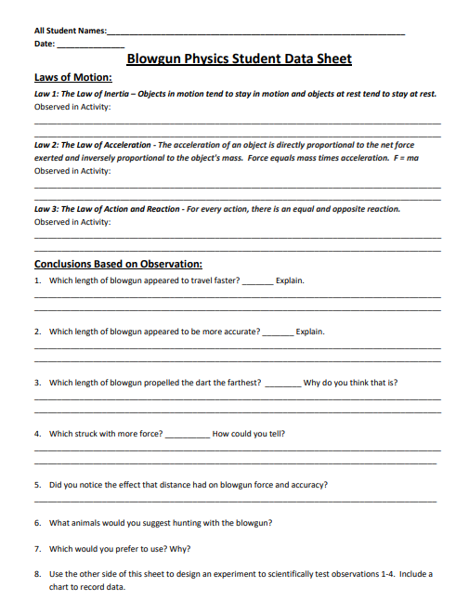

Blowgun Experiment
Set up a safe blowgun course & go over rules
Pass out Data Sheets
Conduct experiments with different lengths of blowguns
Observe accuracy, distance, and speed
Go over answers together
Notes:
(COVID or disease transmission safety: do not use shared blowguns, but perhaps just demonstrate or have one student demonstrate.)
If experimenting during safe times, be sure to follow protocols:
Clean end of blowgun between each use with alcohol swabs
Have students make two fists, arrange them in line with one another to simulate a blowgun and practice blowing on the fist nearest their mouth, and using the other to encircle and “seal” with the blowgun (essentially creating a mouthpiece with their hands.)
Sanitize again!
If you have a blowgun and darts, now is a good time to try it out and conduct experiments on how effective it is. If you have multiple sizes of blowguns, experiment with accuracy, distance and speed.
Set up a safe blowgun course and go over the rules.
Pass out copies of the Blowgun Physics Student Data Sheet and pencils.

Slide 14
Newton’s Laws of Motion
Law of Inertia: Objects at rest remain at rest and objects in motion remain in motion unless acted upon by a force.
Law of Acceleration: Force equals mass times acceleration. F = ma
Law of Action and Reaction: For every action there is an equal and opposite reaction.
Notes:
The three laws of physics that blowguns utilize are:
Law of Inertia: Objects at rest remain at rest and objects in motion remain in motion unless acted upon by a force.
Law of Acceleration: Force equals mass times acceleration. F = ma
Law of Action and Reaction: For every action there is an equal and opposite reaction.
Can you take a moment and discuss how it utilizes each of these three principles?

Slide 15
Newton’s Laws of Motion
Law 1 - Law of Inertia:
Objects at rest remain at rest and objects in motion remain in motion unless acted upon by a force.
The dart will remain at rest inside the blowgun until acted on by the force of blowing, which causes the dart to project out of the blowgun when it overcomes the force of friction.
The dart will continue on its path until it hits another object or the force of gravity pulls it to the ground.
Notes:
Newton’s Law #1 - Law of Inertia: Objects at rest remain at rest and objects in motion remain in motion unless acted upon by a force.
The dart will remain at rest inside the blowgun until acted on by the force of blowing, which causes the dart to project out of the blowgun when it overcomes the force of friction.
The dart will continue on its path until it hits another object or the force of gravity pulls it to the ground.

Slide 16
Newton’s Laws of Motion
Law 2: The Law of Acceleration –
The acceleration of an object is directly proportional to the net force exerted and inversely proportional to the object's mass.
Force equals mass times acceleration. F = ma
The force of the dart is equal to the mass of the dart multiplied by its acceleration or change in velocity.
Notes:
Newton’s Law # 2: The Law of Acceleration - The acceleration of an object is directly proportional to the net force exerted and inversely proportional to the object's mass. Force equals mass times acceleration. F = ma
Observed in Activity: The force of the dart is equal to the mass of the dart multiplied by its acceleration, or change in velocity

Slide 17
Newton’s Laws of Motion
Law 3: The Law of Action and Reaction
For every action, there is an equal and opposite reaction.
The force of blowing on the dart in the blowgun must be equal and opposite to the force of friction holding it in place.
Notes:
Law 3: The Law of Action and Reaction
For every action, there is an equal and opposite reaction.
The force of blowing on the dart in the blowgun must be equal and opposite to the force of friction holding it in place.

Slide 18
Blowgun Experiment
What else did you observe?
Which length appeared to make the dart:
travel faster?
more accurate?
go the furthest?
strike with the most force?
Which would YOU use?
Notes:
What did you learn from your experiments?
Did the length of the blowgun appear to affect the dart’s ability to travel faster, further, or with more force or accuracy?
Which one would you likely use to hunt? Why?

Slide 19
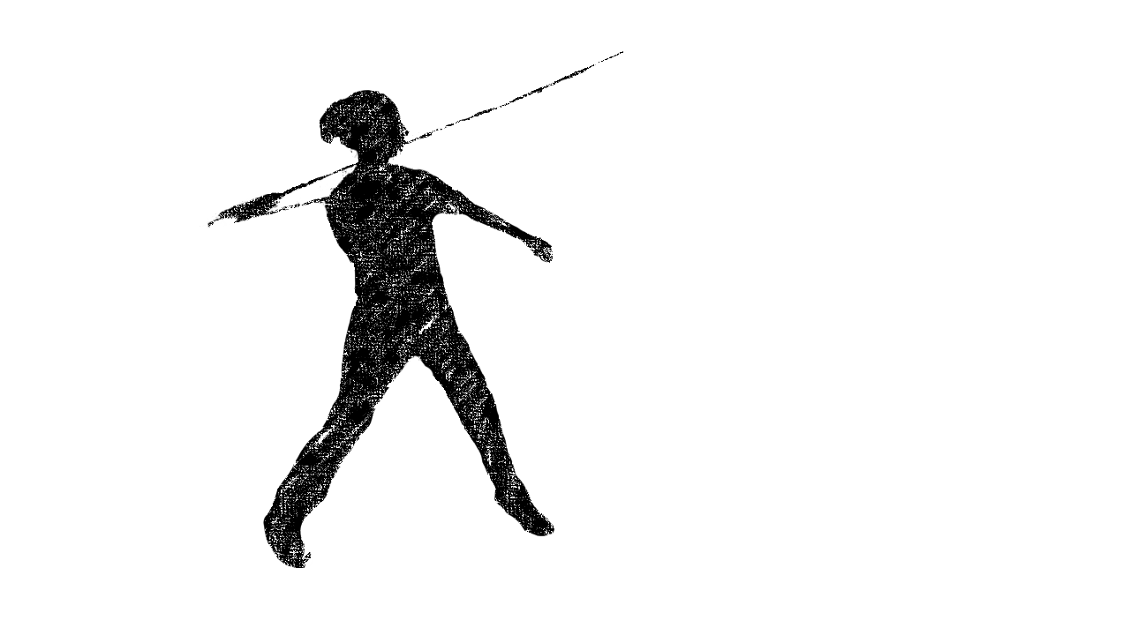
Atlatls
Ancient ingenuity in physics
Notes:
Let’s check out another example of Cherokee Physics….
How do you pronounce it?
At-lattle.
Or
Ott-lottle.
The word comes from the Aztec language.
Image: B. Bramhall / NPS

Slide 20
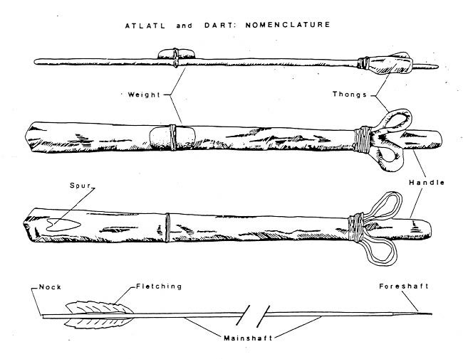
What is an atlatl?
A wooden rod with a hook at one end and a handle on the other end.
The hook fits the dimpled opening on a rivercane dart.
As the atlatl is thrust forward, it launches the dart towards the target.
Variations in design found throughout the US.
Stone weights were affixed to the atlatl to improve performance….
Notes:
What is an atlatl?
A wooden rod with a hook at one end and a handle on the other end.
The hook fits the dimpled hollow opening at the end of a rivercane dart.
As the atlatl is thrust forward, it launches the dart towards the target.
Variations in design are found throughout the US and into South America.
Stone weights were affixed to the atlatl to improve performance…. We’ll talk about that later.
Image: Courtesy of Raymond, A., 1986, Experiments in the Function and Performance of the Weighted Atlatl World Archaeology Vol. 18, No. 2, Weaponry and Warfare (Oct., 1986), pp. 153-177 Published by: Taylor & Francis, Ltd.

Slide 21
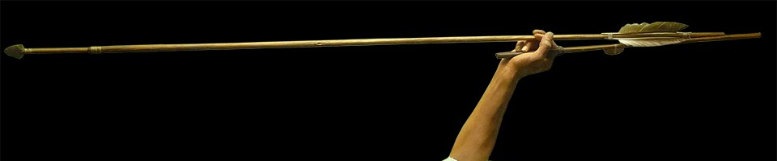
What is a dart?
Design of the dart is key to system.
Southeastern darts often made of rivercane. (Cherokee)
Long and flexible, with feather “fletching” on rear section.
Tip affixed with dart point – stone or bone.
Notes:
The dart is a long, flexible rivercane spear, tipped with a stone or bone point. There would be a “fletching” on the rear section to help guide the dart straight to the target. As the atlatl is swung forward, the dart flexes and then launches forward.
………………….
Image: Mesa Verde Artifact / NPS

Slide 22
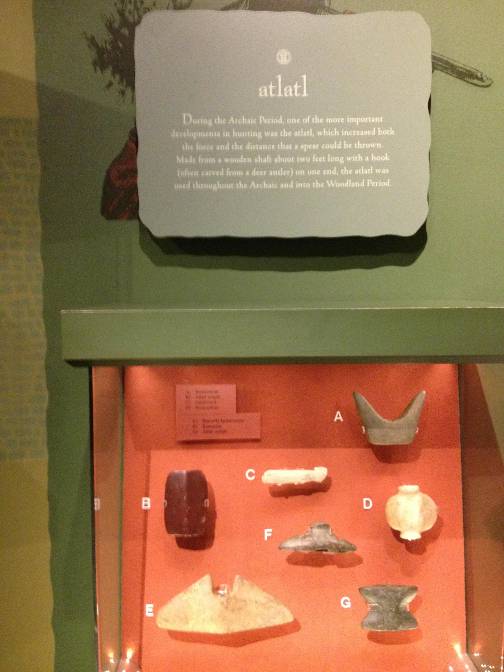
History of atlatls
Locally, atlatl artifacts have been found dating back about 5,000 years.
They have been found around the world going back more than 10,000 years.
Used in Paleo era but refined locally.
Replaced with other weapons, such as bow and arrow (CE 1000) and rifle.
Continued use even in historic era: increased penetration than bow.
Notes:
Atlatl stones have been found in the area dating back about 5,000 years! That would be about 3,000 BCE.
Worldwide, atlatls date back to more than 10,000 years. The word “Atlatl” comes from the Aztec language.
While other technologies were invented after the atlatl, such as the bow and arrow, Cherokee continued to use it even in the historic era after the 1500s. It is likely that it was used as a weapon of war, due to the increased penetration of armor over the lighter bow and arrow. The men of de Soto’s expedition in the 1500s were terrified of the “darts” after one of their comrades was killed.
……………………
Image: B. Bramhall from the Museum of the Cherokee Indian / NPS

Slide 23
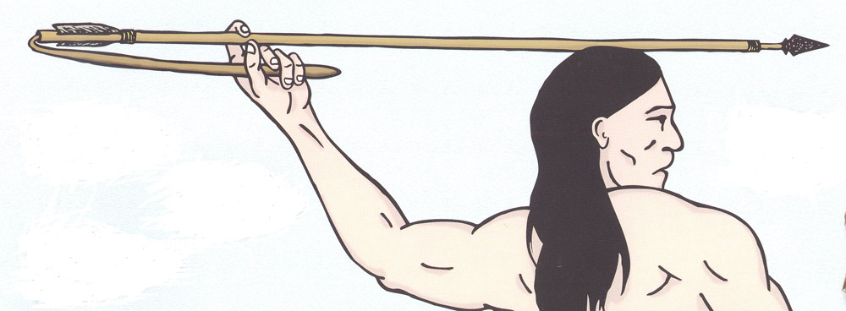
Things to think about:
If you were hunting, what factors are important?
What alterations help you to “hunt more successfully”?
Notes:
If you were hunting, what factors are important? (to be able to sneak up, to be stealth, accuracy, speed, velocity…)
What alterations help you to “hunt more successfully”?
………………….
Image: ND.gov – State Historical Society: People living on the land: Lesson 2. Retrieved from Section 1: Hunting | North Dakota Studies (ndstudies.gov)

Slide 24
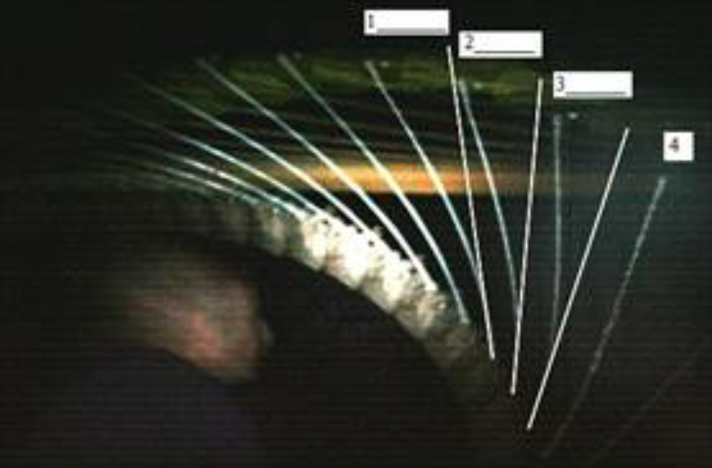
Let’s experiment with physics!
Why does it launch the dart further and with more force?
What alterations could improve its performance?
Notes:
Let’s answer some questions about how it works with some questions:
Why does it launch the dart further and with more force?
What improves its performance?
………………….
Image: Courtesy of Richard Baugh, Atlatl Dynamics. Lithic Technology. 1998.

Slide 25
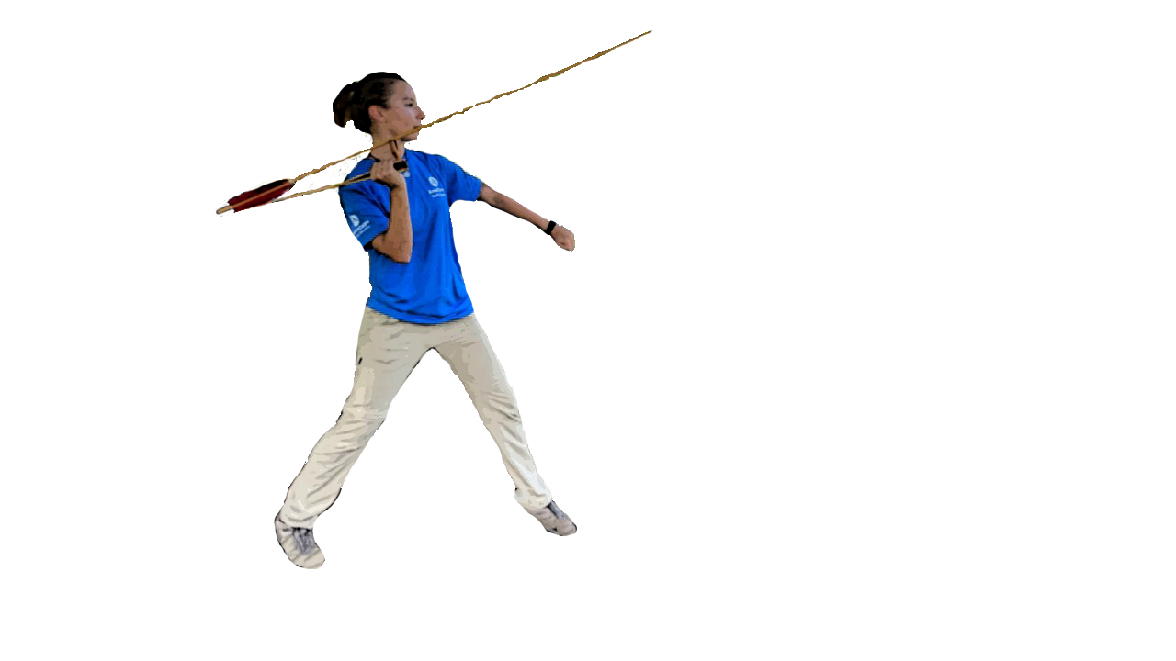
Safety first!
Set up a safe field: no visitors, large target at least 10 yards away.
Students in line. No one down range when throwing.
Hold atlatl and balance the dart with tip forward, shaft resting on “v” fork.
Throw overhand, still holding onto atlatl, with a smooth motion.
Once all darts are thrown in each round – designate one person to retrieve safely.
Notes:
If you have an atlatl or blowgun set to try, it is very important to set up a safe field to experiment.
Set up a safe field: no visitors or others walking through,
Set up a large target at least 10 yards away.
Students in line. Mark where they need to stand behind.
No one down range when throwing.
Hold atlatl and balance the dart with tip forward, shaft resting on “v” fork.
Throw overhand, still holding onto atlatl, with a smooth motion.
Determine one person to retrieve darts: Only retrieve once all the darts have been thrown to prevent accidental throws during retrieval.
Image: B. Bramhall (Sarah Dickinson demonstrating) / NPS.

Slide 26
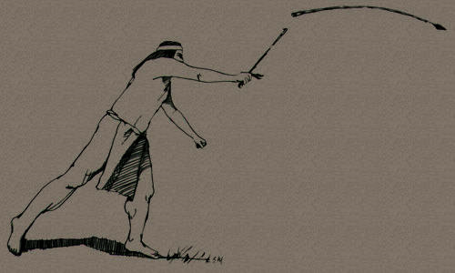
The task:
Experiment with the tools and provided data sheets to measure distance, speed and accuracy.
OR
Design your own experiment!
  Create a data collection sheet, decide what data will support your argument and how you will conduct a study to support your claim “honestly”.
Can you figure out which law of physics your experiment might support?
Notes:
For these experiments, you can start by using the provided data sheets.
Then, as you experiment – you might start to ask new questions.
Experiment with the tools to measure distance, speed and accuracy.
OR
2. Design your own experiment!
Create a data collection sheet, decide what data will support your argument and how you will conduct a study to support your claim “honestly”.
3. Analyze the results
Can you figure out which law of physics your experiment might support?

Slide 27
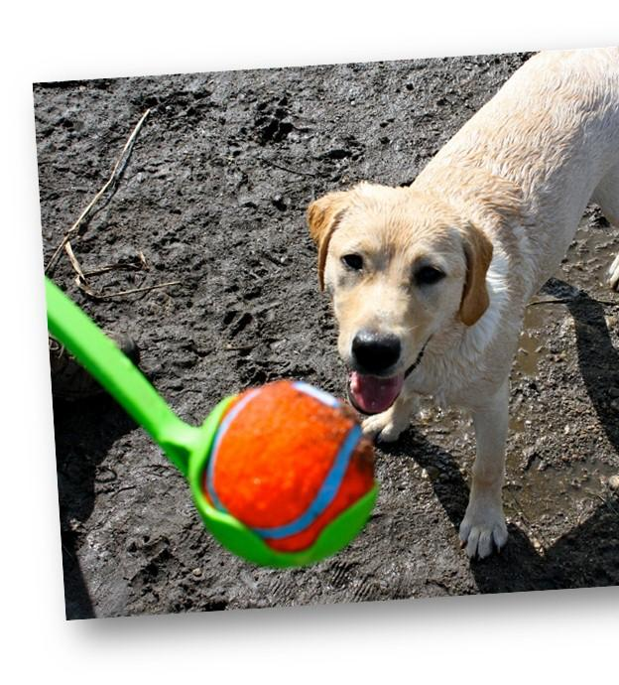
Tools
Atlatl and dart (for demo)
Dog chuckits (3 sizes)
Worksheets
Pads of paper and pencils
Measuring tape (30 meter)
Range finder (if available)
Stopwatch
Flags
Others????
Notes:
For the atlatl experiment, we can use Chuck-its.
Why do you think this is?
It’s virtually the same technology, except there isn’t the same launching power as the darts.
Image: Chuckit

Slide 28
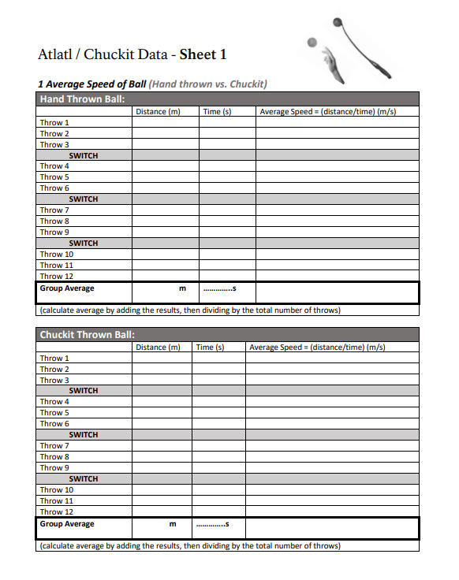
Methods
Break into groups
Assign Tasks (switch between rounds)
  Thrower
  Timer
  Measurers
  Recorder
Experiment with hand thrown, and with the launchers.
For each round, record time in air and distance that balls travel.
At the end, calculate group averages by totaling the sums and dividing by numbers of throws.
Notes:
Break into groups
Assign Tasks (switch between rounds)
Thrower
Timer
Measurers
Recorder
Experiment with hand thrown, and with the launchers.
For each round, record time in air and distance that balls travel.
At the end, calculate group averages by totaling the sums and dividing by numbers of throws.

Slide 29
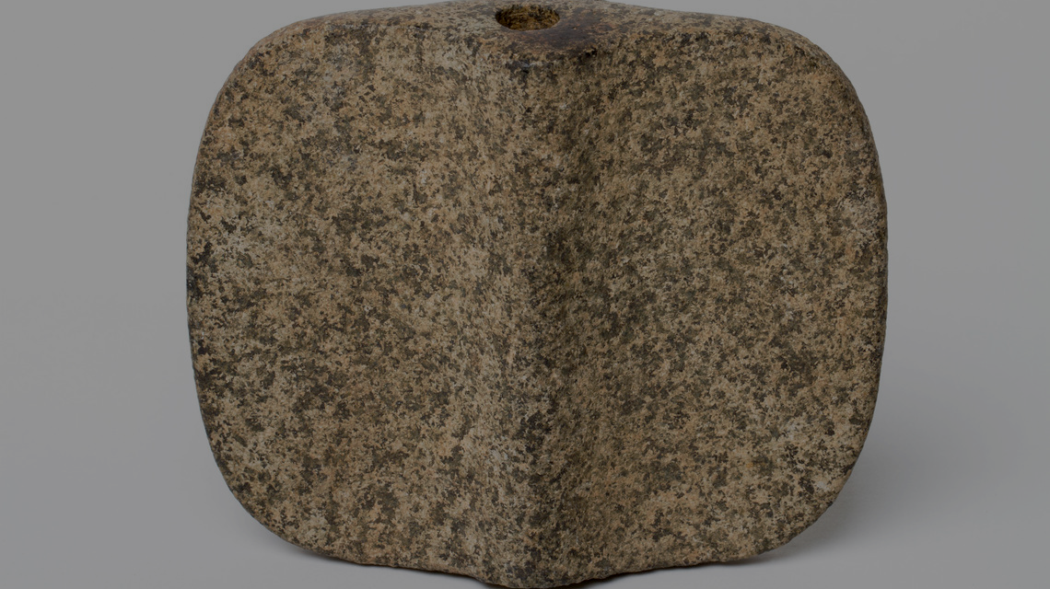
How did it go?
Notes:
Each group can report back
Did the launcher have an effect on distance or accuracy? Did the length of the launcher have any effect?
What aspect of the atlatl’s technological abilities did you investigate? (distance, accuracy, speed, other?)
Did you modify anything along the way?
Can you link your results to one of the principles of physics? (velocity, acceleration, inertia, kinetic energy, etc.)
What seemed to have the biggest impact to your investigation?
Image: Bannerstones: Courtesy of Anna Blume of the Fashion Institute of New York “Archaic Bannerstone” Project. FIT Library. Retrieved from Browse Items · FIT Archaic Bannerstone Project (fitnyc.edu)
All images on the ABP (Archaic Bannerstone Project) under the Bannerstone Tab may be freely downloaded, shared, and reused for non-commercial purposes with proper attribution

Slide 30
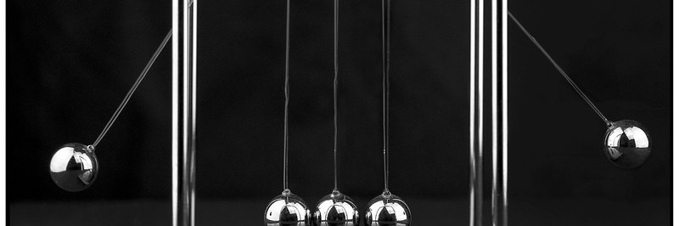
Which Newton’s Law of Motion?
1st Law: an object at rest will stay at rest, and an object in motion will stay in motion at constant velocity, unless acted upon by an unbalanced force.
2nd Law: Force equals mass times acceleration.
3rd Law: For every action there is an equal and opposite reaction.
Notes:
Let’s think again about Newton’s Law of Motion.
Once again,
Law of Inertia: Objects at rest remain at rest and objects in motion remain in motion unless acted upon by a force.
Law of Acceleration: Force equals mass times acceleration. F = ma
Law of Action and Reaction: For every action there is an equal and opposite reaction.
Can you take a moment and discuss how it utilizes each of these three principles?
…………………….
Image: Newton’s Cradle, Sheila Sund, Attribution License: File:Newton's Cradle (15221366308).jpg - Wikimedia Commons

Slide 31

Newton’s Law in Action
Atlatls are levers –
A force or effort and force arm (atlatl)
A resistance or load and resistance arm (dart)
A pivot point or fulcrum (elbow/wrist)
Types of Levers Systems
3rd Class – Pivot-Force-Resistance
Like a catapult!
Notes:
Atlatls (and dog Chuckits) are essentially third-class levers.
The handle is the fulcrum, where the hand meets the handle.
The input force is the the rotation of the wrist by the thrower.
The output force created pushes the dart (or tennis ball) nestled on the tip. It essentially is “the snap” created by the tension.
Speed is increased by atlatl. Speed = change in distance / change in time. The speed is increased, as are the distance, velocity, acceleration and force.
Work=force applied x distance over which you apply that force
(How did the experiment support this theory?)
For more about levers: TEDEd Talk: The mighty mathematics of the lever - Andy Peterson and Zack Patterson - YouTube

Slide 32
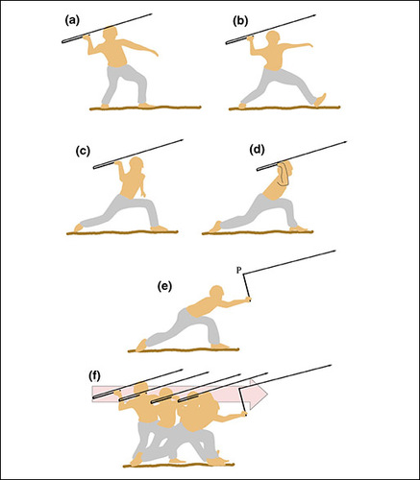
Here’s how the scientists explain it…
Flexibility of the dart and atlatl act as a spring --- having a bigger effect than just the lever alone.
How would adding a weight affect the performance?
Notes:
The mechanics of the atlatl involve the flexibility of the rivercane dart. It stores energy like a spring. If you think through the launch in slow-motion, sometime during the swing, the atlatl is no longer accelerating to cause further compression in the dart, and then the dart needs to launch itself with the stored energy.
If both the atlatl and the dart are flexible, they function as a relationship, like that of a diver on a diving board. They both are bending and pushing off of one another. Would there be the same energy if the diving board was stiff?
The length and flexibility of either atlatl or dart can change the parameters of its effectiveness. The longer the dart, the greater the spring force needed.
The mass and weight of the projectile point (the spearhead) can also have a great effect on the system. Scientists have found many had a similar design and mass, so their density was often consistent.
………………………….
Image: Courtesy of American Association of Physics: Atlatl Internal Ballistics, Mark Denny. 2019.

Slide 33
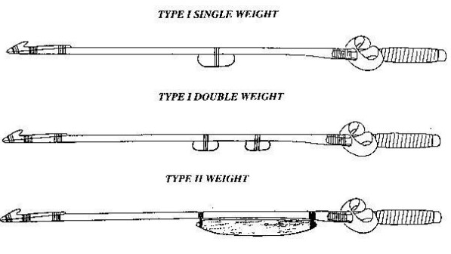
Adding weight to the situation
How would adding a weight affect the performance?
Notes:
Newton’s Second Law: relationships between mass, force and acceleration.
So, the kicker is, though the distance is not that much better with the weight, the stone weight insures a stronger, smoother and more controlled launch.
What would this help with? Accuracy and power. That’s what you would need to take down the big game.
Three main types:
Type I – single point weight or multiple point weights in center with mass of about 65 g in total. (Multiples allowed a smoother response.)
Type II – a mass of about 65 g, but long and narrow, distributed along the back half of the shaft.
Type III – the stealth weight, or Banner Stone. This was found in Eastern United States… in KY, where atlatls are generally smaller and shorter in length. It has a unique “c” shape that has the effect of silencing the noise of the swing, or at least changing it from a high frequency “zing” to a lower sounding “woof”.
……………………
Image: Courtesy of William “Bob” Perkins, Atlatl Weights: Function and Classification. 1993.

Slide 34
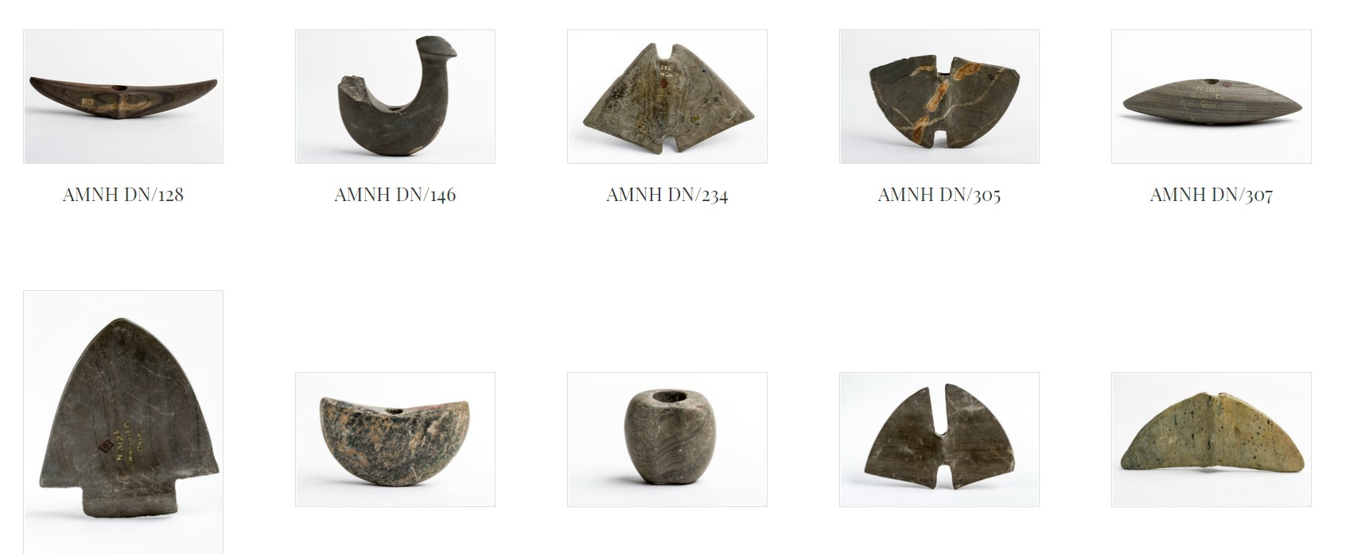
What’s with all the shapes?
Is there a function in the form?
Notes:
Archaeologists struggle with classifying atlatl weights, as they had different shapes, sizes and materials. Some were smooth, some grooved, holed or shaped. All of this has an influence on the operation.
……………………
Image: Courtesy of the Fashion Institute of New York “Archaic Bannerstone” Project. FIT Library. Retrieved from Browse Items · FIT Archaic Bannerstone Project (fitnyc.edu)

Slide 35
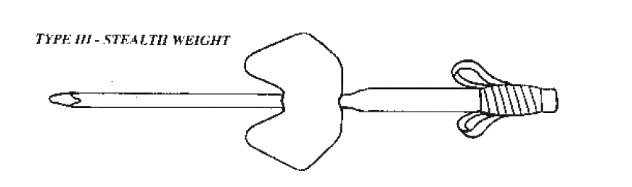
Wait… there’s more?
Whaaaaatt?
Bannerstones and sound!
Notes:
There are some scientists working on discovering how shapes affect not only performance, but SOUND!
This is the Type III – the stealth weight, or Banner Stone. This was found in Eastern United States… in KY, where atlatls are generally smaller and shorter in length
How might this shape affect the sound?
………………….
Image: Courtesy of William “Bob” Perkins, Atlatl Weights: Function and Classification. 1993.

Slide 36
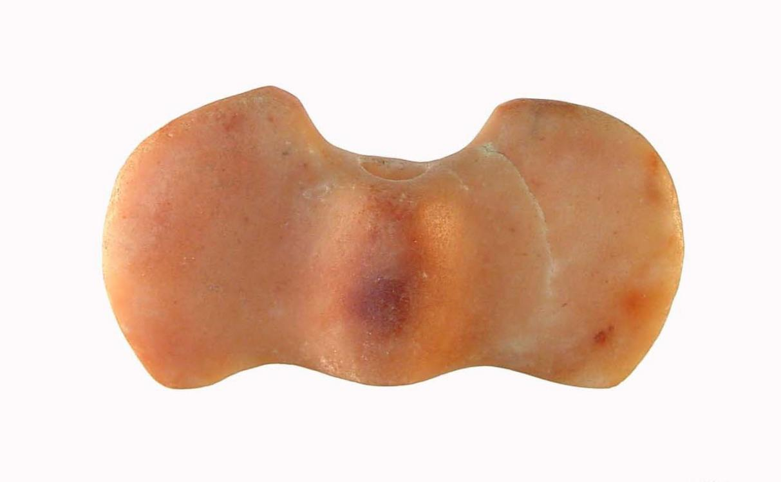
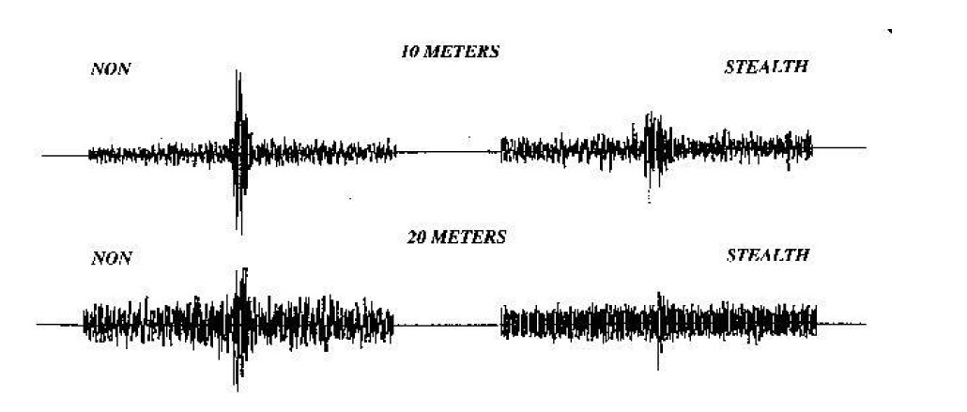
Silence of the stone
Shape = quieter?
Notes:
Some Bannerstones have a unique “c” shape that has the effect of silencing the noise of the swing, or at least changing it from a high frequency “zing” to a lower sounding “woof”. This is called the “superposition of sound waves”.
In experiments, atlatl guru “Atlatl” Bob Perkins found that the Type III “stealth” stones produced lower sound levels when recorded, as you can see in the soundwave image, from left (no shape) to right (shaped stone). These types of studies are called “experimental archaeology”.
Interestingly, the maximum sound reduction occurred to be around 20-25 meters, right in the sweet spot of hunting.
………………
Images:
Bannerstones: Courtesy of Anna Blume of the Fashion Institute of New York “Archaic Bannerstone” Project. FIT Library. Retrieved from Browse Items · FIT Archaic Bannerstone Project (fitnyc.edu)
All images on the ABP (Archaic Bannerstone Project) under the Bannerstone Tab may be freely downloaded, shared, and reused for non-commercial purposes with proper attribution
Soundwave: Courtesy of William “Bob” Perkins, Atlatl Weights: Function and Classification. 1993. Atlatls & Primitive Technology (onagocag.com)

Slide 37
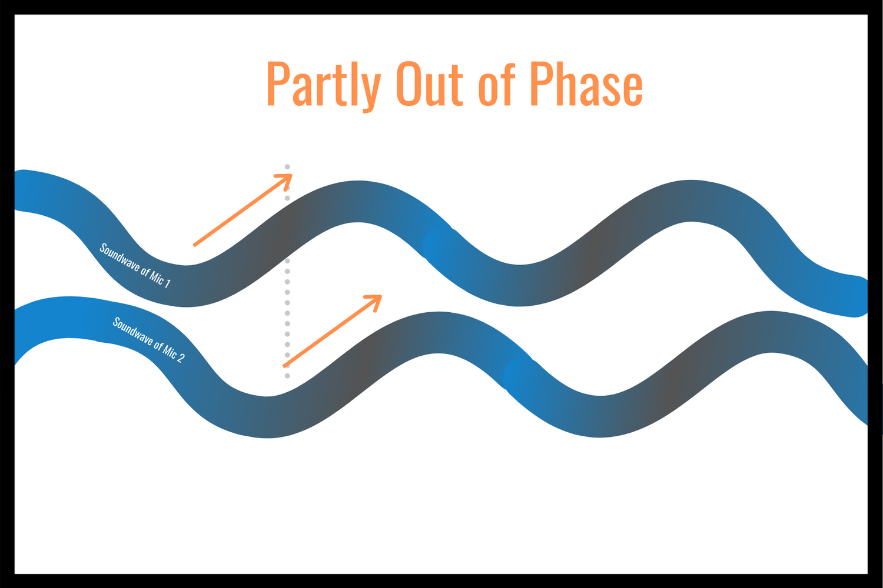

Sound waves
Out of phase: Distortion!
Notes:
Why?
Imagine sound waves traveling invisibly through the air, like giant jump-ropes that you’re waving up and down. They can be in sync, or out of sync, and the results are dramatic.
How many of you have been to a concert with really bad feedback or distortion?
What about someone whose microphone sounded muffled?
These are examples of when sound waves are out of phase.
………………
Image: Phase Cancellation and Distortion: Toughtones. Retrieved from Phase Cancellation – The Easy Approach (No BS or Technical Jargon) (toughtones.com)

Slide 38
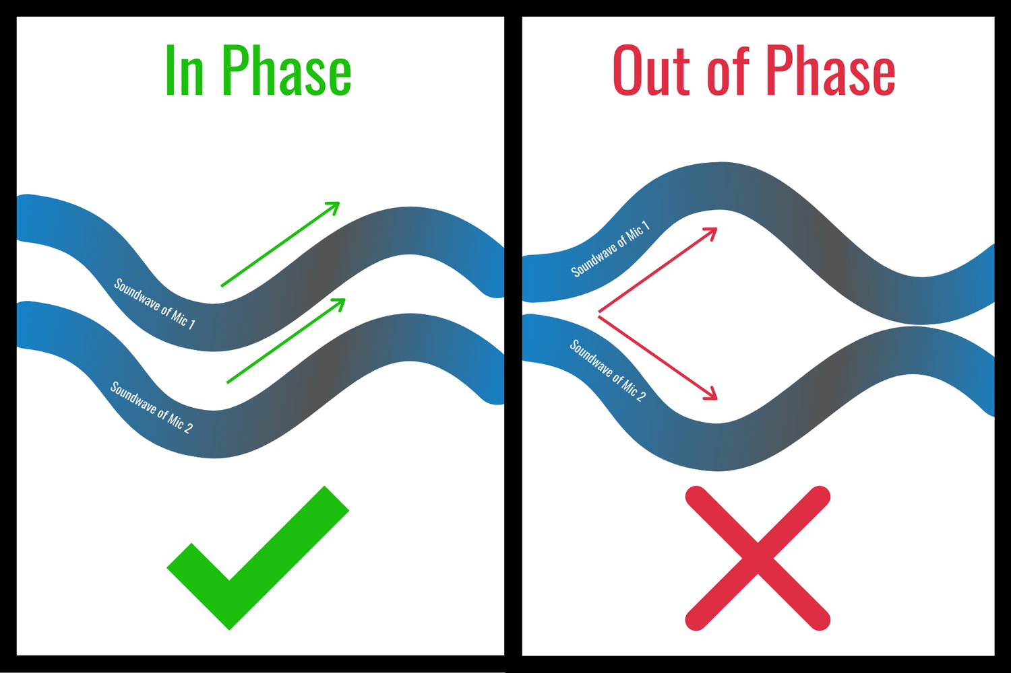
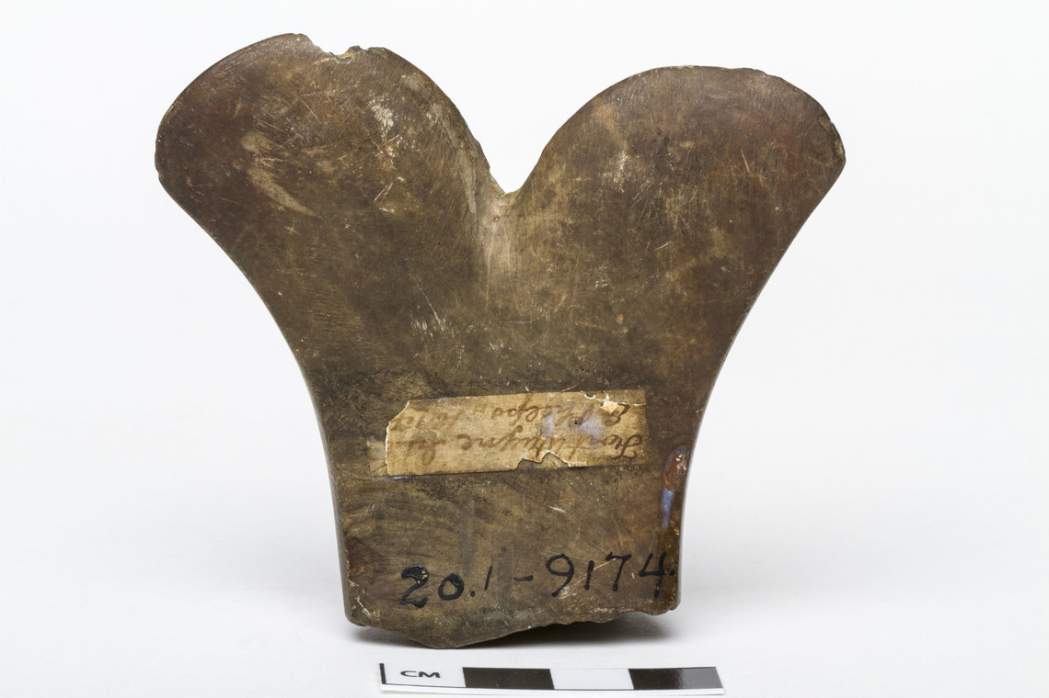
Silence of the stone
Out of Phase = Phase Cancellation – superposition of sound waves.
Notes:
Essentially, the stone’s shape creates two sound waves simultaneously, that offset one another, resulting in a decrease in volume. (Phase cancellation--- out of phase).
The dual edge of the stone creates two waves, they cancel each other out. Could this be deliberate?
Superposition of Sound Waves - Wolfram Demonstrations Project
…………………….
Images:
Phase Cancellation and Distortion: Toughtones. Retrieved from Phase Cancellation – The Easy Approach (No BS or Technical Jargon) (toughtones.com)
Bannerstone: Courtesy of Anna Blume of the Fashion Institute of New York “Archaic Bannerstone” Project. FIT Library. Retrieved from Browse Items · FIT Archaic Bannerstone Project (fitnyc.edu) https://bannerstone.fitnyc.edu/
All images on the ABP (Archaic Bannerstone Project) under the Bannerstone Tab may be freely downloaded, shared, and reused for non-commercial purposes with proper attribution

Slide 39
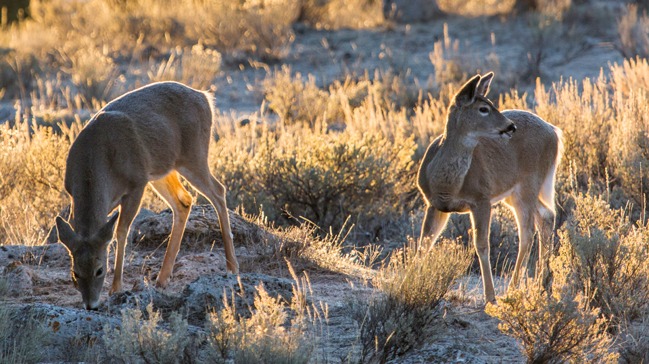
How could this help a hunter?
Stalking prey closer?
Notes:
With shorter atlatls in the east, perhaps this shaped stone was invented to allow hunters to stalk there prey closer.
……………
Image: NPS

Slide 40
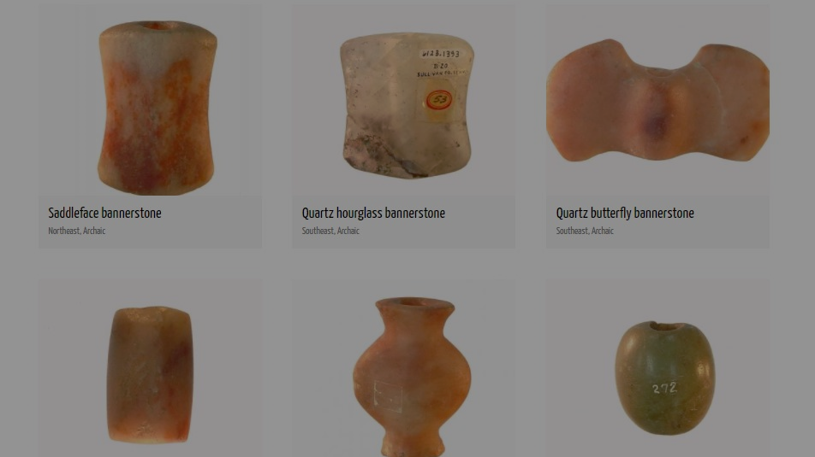
How could we demonstrate theories of why stones have different shapes?
Notes:
How might we demonstrate these theories? Could you design an experiment?
……………….
Image: Bannerstones: Courtesy of Anna Blume of the Fashion Institute of New York “Archaic Bannerstone” Project. FIT Library. Retrieved from Browse Items · FIT Archaic Bannerstone Project (fitnyc.edu)
All images on the ABP (Archaic Bannerstone Project) under the Bannerstone Tab may be freely downloaded, shared, and reused for non-commercial purposes with proper attribution

Slide 41
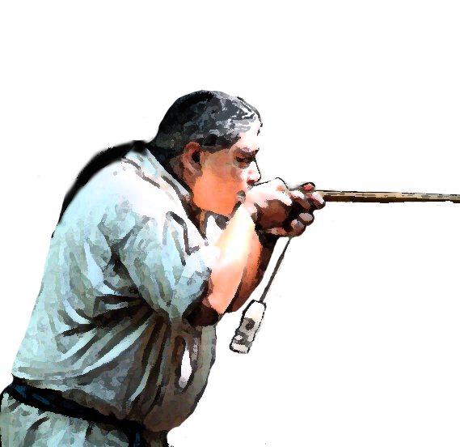

Traditional Ecological Knowledge: TEK
    Accumulation of knowledge, practice and beliefs.
    Relationships between humans, plants, animals, landscapes, seasons.
    Passed down generations.
Can you think of other examples of TEK?
Notes:
Traditional Ecological Knowledge is known as “TEK” for short.
It is the ongoing accumulation of knowledge, practice and belief about relationships between living beings in a specific ecosystem. It is passed down generations and goes back hundreds of thousands of years. It includes relationships between humans, plants, animals, landscapes and seasons.
Many of these old practices are being proven today through methodical scientific studies.
Isn’t science just purposeful observation through testing of theories?
Can you think of other examples of TEK?

